Slide 1
Units
Paper 1
Question 1 – The challenge of natural hazards
Question 2 – The living world (Hot Deserts)
Question 3 – Physical landscapes in the UK - Coastal landscapes in the UK
Question 4 – Physical landscapes in the UK – River landscapes in the UK
Paper 2
Question 1 – Urban issues and challenges
Question 2 – The changing economic world
Question 3 – The challenge of resource management
Question 6 – Energy
Paper 3
Question 1, 2 and 3 – Issue evaluation
Question 4 – Unseen Fieldwork
Question 5 - Fieldwork

Slide 2


Acronyms
PEE
Point – What are you going to talk about?
Evidence – Prove your point. Use facts from a case study/example, or the resource.
Explain – How does this evidence prove your point?
PED
Point – What are you going to talk about?
Evidence – Prove your point. Use facts from a case study/example, or resource.
Describe – Give more detail about your point and evidence.

Slide 3
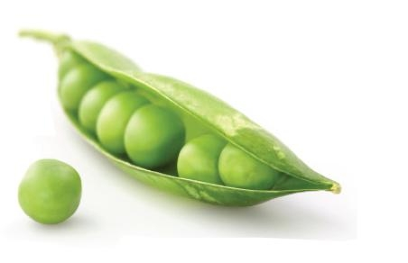




PEA
Point - What are you going to talk about?
Evidence – Prove your point. Use facts from a case study/example, or the resource.
Analyse – Make a judgement by examining all of the facts. Remember to include original thoughts.
TMT
This means that……
Use this sentence to expand on your answer and help improve your analysis.
TMT
SEE(P)
Social, Economic, Environmental, (Political)
BUG
B – Box the command word
U – Underline the key words
G – Glance back at the question
TEA
Trend – State/Describe the pattern
Evidence – Prove your pattern with evidence from the resource
Anomaly – State and prove anything that doesn’t fit the pattern identified.

Slide 4

Command Words
Analyse – Break down the content of a topic, or issue.
Annotate – Add to a diagram, image etc, a description/explanation of the feature.
Assess – Consider several options or arguments.
Calculate – Work out the value of something.
Define – State the meaning of the word/idea.
Describe – Say what something is like.
Discuss – Set out both sides of an argument and
draw a conclusion.

Slide 5
Evaluate – Consider several options and come a conclusion.
Examine – Consider carefully and provide a detailed account.
Explain – Give reasons why something happens.
Justify – Give reasons why you support a particular decision or opinion.
Outline – Provide a brief account.
To what extent – Show how far you agree or disagree with a statement.

Slide 6
Level Marking
Any question worth more than 3 marks will be marked using a level.
4 mark questions
Level | Description
1 - Basic | Limited or no reasoning. Simple description/explanation. Answer is mostly general and without detail. Few key terms are used and limited if any specific facts.
2 – Clear | Some reasoning. Clear description/explanation. Answer has some detail but this may vary. Some key terms are used, with some specific facts.

Slide 7
6 and 9 mark questions
Level | Description
1 - Basic | Limited or no reasoning. Simple description/explanation. Answer is mostly general and without detail. Few key terms are used and limited if any specific facts.
2 – Clear | Some reasoning. Clear description/explanation. Answer has some detail but this may vary. Some key terms are used, with some specific facts.
3 - Detailed | Very clear reasoning. Description/explanation is detailed. Points are developed throughout. Key terms are present and there is use of a range of specific facts.

Slide 8

Question Structure
6 mark questions
2 Paragraphs, that show different points.
Explanation questions should follow the PEE structure
Description questions should follow the PED structure
If the question asks you to; assess, to what extent, evaluate, discuss etc. Then the 2 paragraphs should contradict each other and follow the PEA structure.
If you are asked to use a figure and your own knowledge, then the 1st paragraph should be based on the figure and the 2nd on your case study/example.

Slide 9

9 mark questions
2 Paragraphs, that contradict each other,
and a conclusion.
They should follow the PEA structure.
You must include at least 3 specific pieces of information linked to a case study/example.
If you are asked to use a figure and your own knowledge, then the 1st paragraph should be based on the figure and the 2nd on your case study/example.
Your conclusion must give your opinion and answer the question. E.g. To a large extent I believe……

Slide 10
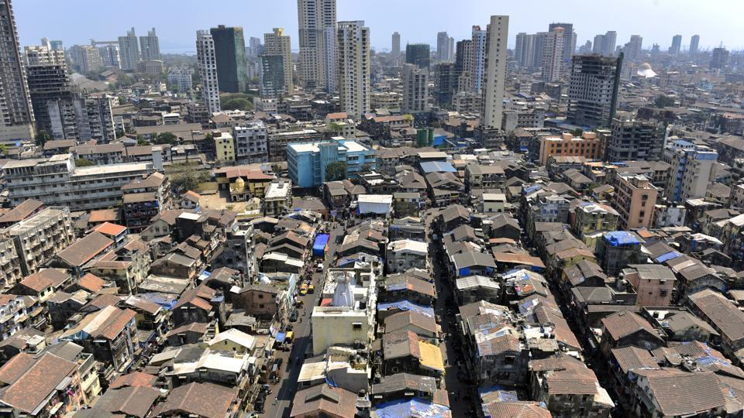
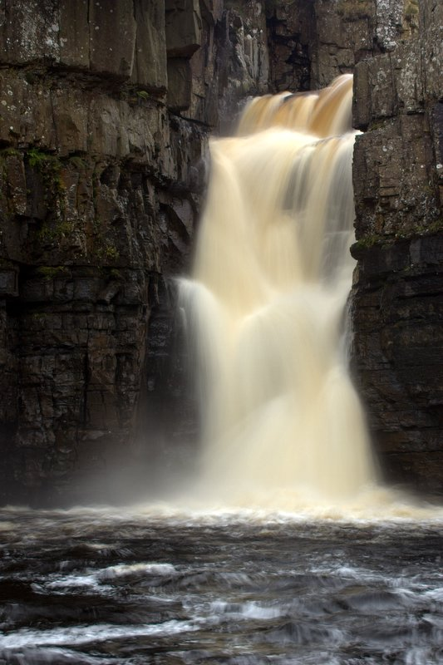
Case Study Vs Example
Case Studies – These are broader in context and require
a greater spread and depth of knowledge.
You are required to know lots of information about one location.
Our Case Studies – Paper 1
Q3 - The Choco Rainforest and The Qatar Desert
Our Case Studies – Paper 2
Q1 – Mumbai and Birmingham
Q2 – Malaysia
Examples – These are more focused on a specific event or situation. They are smaller in scale and require less knowledge.
Our Examples – Paper 1
Nepal, Tohoku, Typhoon Haiyan, UK Winter Storm,
Nap Wood, Holderness, River Tees, Boscastle
Our Examples – Paper 2
Mumbai, Birmingham, Tanzania, Teesside, Gannet
Oilfield, Melela

Slide 11
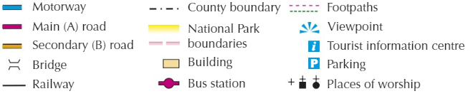
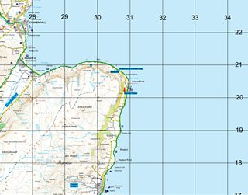
Map Skills
Ordnance Survey Maps (OS Maps)
Knowing your symbols:
4 Figure Grid References
Find the bottom left corner of
the grid square.
2. Follow the line up/down to find
the first 2 digits e.g. 29
3. Go back to the corner and follow
the line left/right to find the next
to digits e.g. 20
4. Put the numbers together to get
your reference e.g. 2920

Slide 12
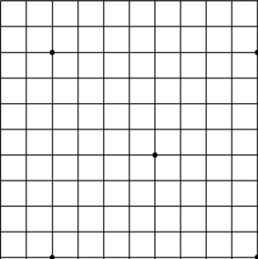
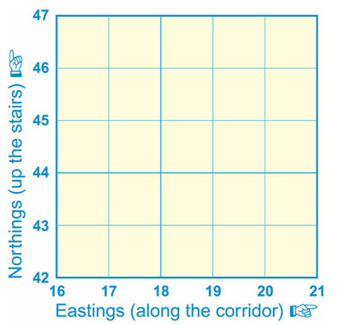
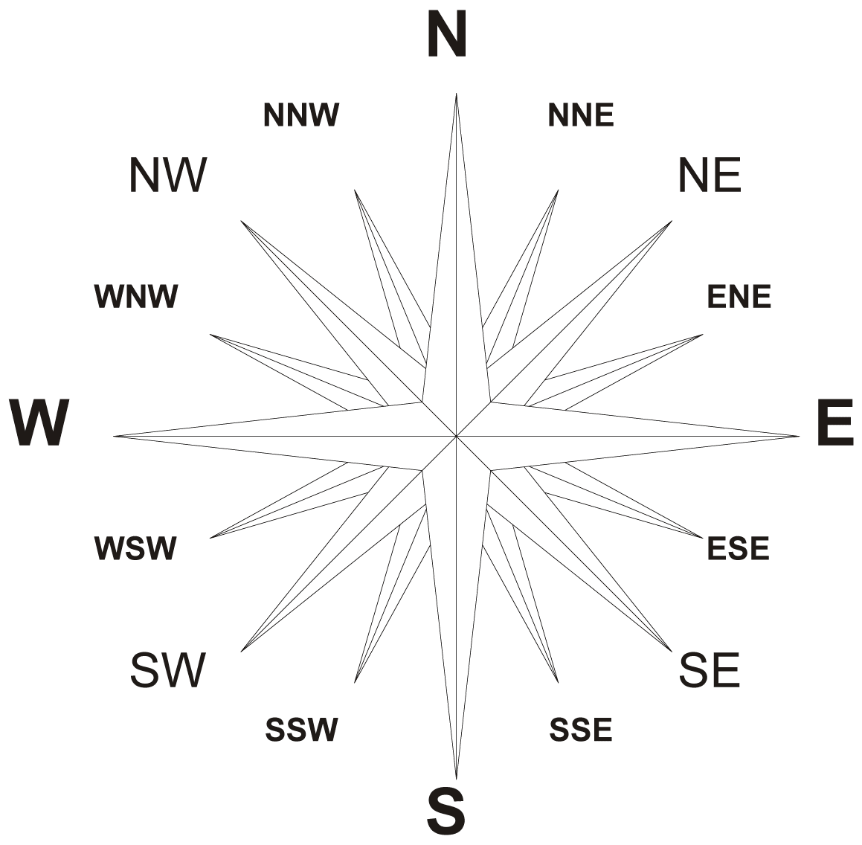
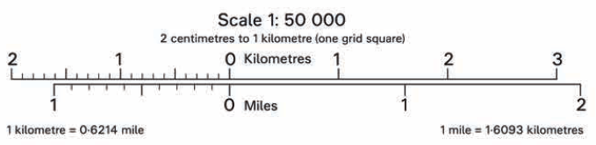
6 Figure Grid References
Work out the 4 figure grid
reference but leave a space
after each reading e.g. 29_20_
2. Divide the square up into 10
across and 10 down.
3. Find the middle of the object
and read up the new lines and
and place next to the first
2 digits e.g. 294
4. Repeat but this time go right and place at the end of the 4 figure reference e.g. 205
5. Your reading is now complete e.g. 294205
Compass points
Distance/Scale
To work out the distance between 2 places on a map, use a ruler to measure the distance in cm then compare it to the scale to find the distance in km.

Slide 13
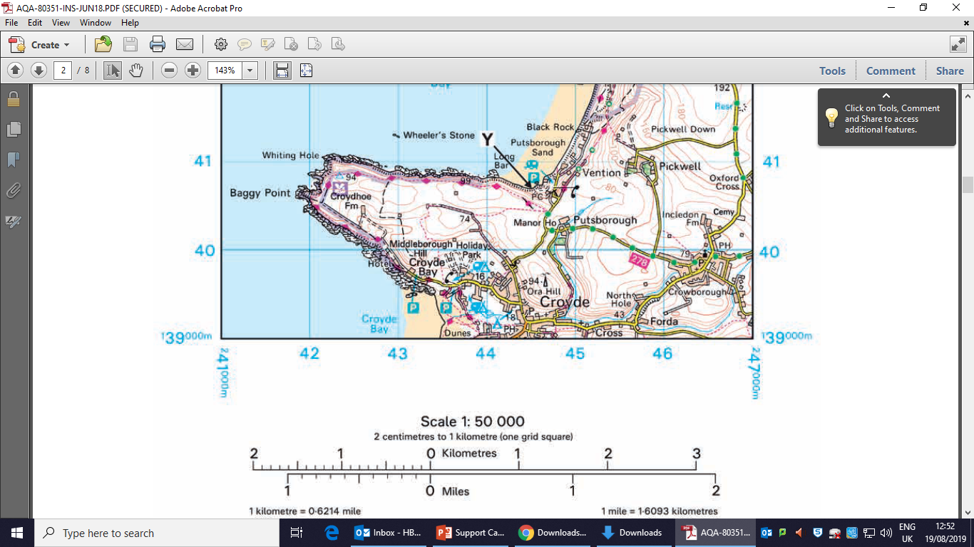
Relief
Contour lines are the brown/orange lines on a map. They join points of equal height. They help tell you the relief of the land e.g. if it is steep or flat etc.
The numbers on the map tell you the height of the land.
If the lines are close together this means it is steeper.
If the lines are far apart then the land is flatter.
This means the land
is 80m high

Slide 14
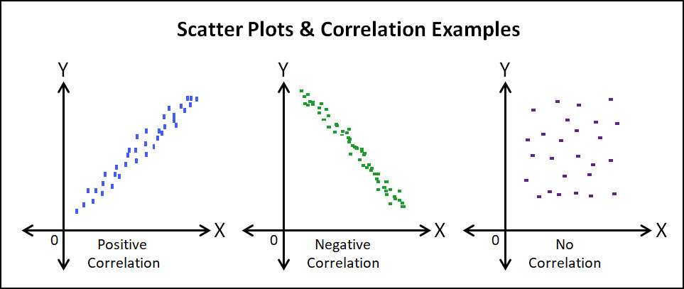
Maths Skills
Scatter Graphs
Scatter graphs tell you the relationship between 2 values. We use the term correlation to describe the relationship.
Range
The range is the difference between the highest and lowest values in a data set.

Slide 15

Central Tendency
Mean – Add all of the data together and divide by the number of values.
E.g. 12,11,10,9,8,15,16,7,14,14 = 116. There are 10 values. So the mean is 116/10 = 11.6
Mode – The most common values.
E.g. There are 2 number 14’s therefore the mode is 14.
Median – Place the data in numerical order, and calculate the middle value. If you have an even number, the median is the mean of the two middle values.
E.g. 7,8,9,10,11,12,14,14,15,16 Median = 11.5
Percentage
Calculating Percentage – Divide the value by the total, then multiply the answer by 100.
E.g. The amount of students at RBA is 660, 81 of them are in year 10. What is the percentage of students in year 10?
(81/660)*100 = 12.27%
Percentage Change – Calculate the change in value. Divide the change by the original value. Then multiply this value by 100.
E.g. Last year the amount of students at RBA was 660, this year the number of students is 684. In percent how much has the student population changed by.
684-660 = 24
24/660 = 0.036
0.036*100 = 3.6%
If this value ends up being negative, this means that there was a percentage decrease.

