Slide 1
Temperate coniferous forest | Also known as the taiga, this biome is a northern coniferous (evergreen) forest. It is a cold woodland found north of temperate deciduous forests. It is the largest biome - covering about 17% of the Earth's land area and can be found in Canada, Europe, Asia, and the United States
Temperate deciduous forest | This biome has few extremes of climate and can be found in the eastern half of North America, and the west of Europe. It can also be found in Asia. The forest has four distinct seasons, spring, summer, autumn, and winter. In the autumn the leaves change colour. During the winter months the trees lose their leaves.
Tundra | This biome covers one-fifth of the land on earth – there is little precipitation, a short growing season; and poor nutrients. It is below freezing at night year round and the meaning of its name comes from Lappish language (Lapland) which means “land with no trees”.
Temperate Grassland | A large biome with rolling terrains of grasses, flowers and herbs. It is a region where the average annual precipitation is great enough to support grasses, and in some areas a few trees. The precipitation is so unpredictable that drought and fire prevent large forests from growing.
Tropical Rainforest | This is a very hot and wet biome located on or around the equator. It has the greatest biodiversity (number of plants and animals) found anywhere on earth.
Desert | This biome is very hot and also very, very dry. As a result of this very little grows – only very hardy plants such as cactus which can survive drought.
Mediterranean | This is a biome that is found in small areas on of most of the continents - the west coast of the United States, the west coast of South America, the Cape Town area of South Africa, the western tip of Australia and the coastal areas of the Mediterranean. This biome has flat plains, rocky hills and mountain slopes. It is very hot and dry - the winter is very mild (usually about 10 °C), the summer is so hot and dry at 40 °C that fires and droughts are very common.
Tropical Savannah | A dry and hot area composed of mainly grassland and scattered shrubs and isolated trees, which can be found between a tropical rainforest and desert biome in Africa, Arabia and even Australia

Slide 2
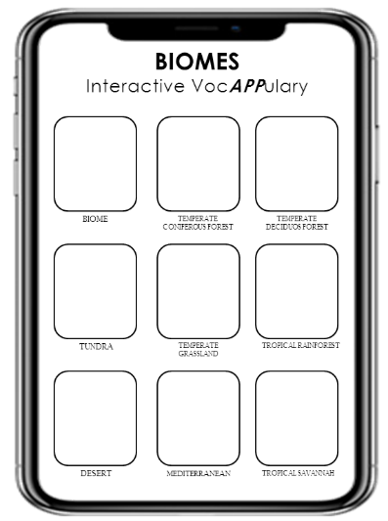
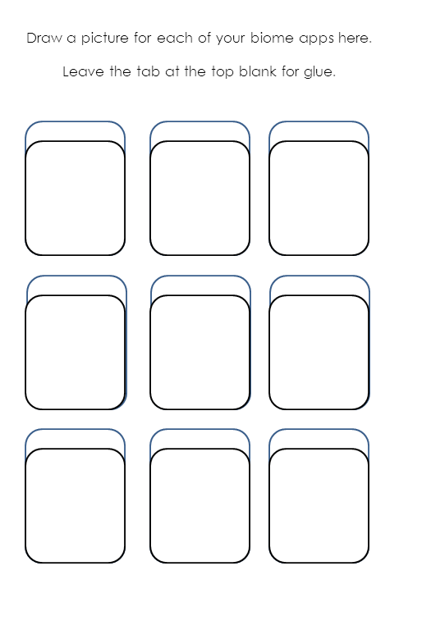
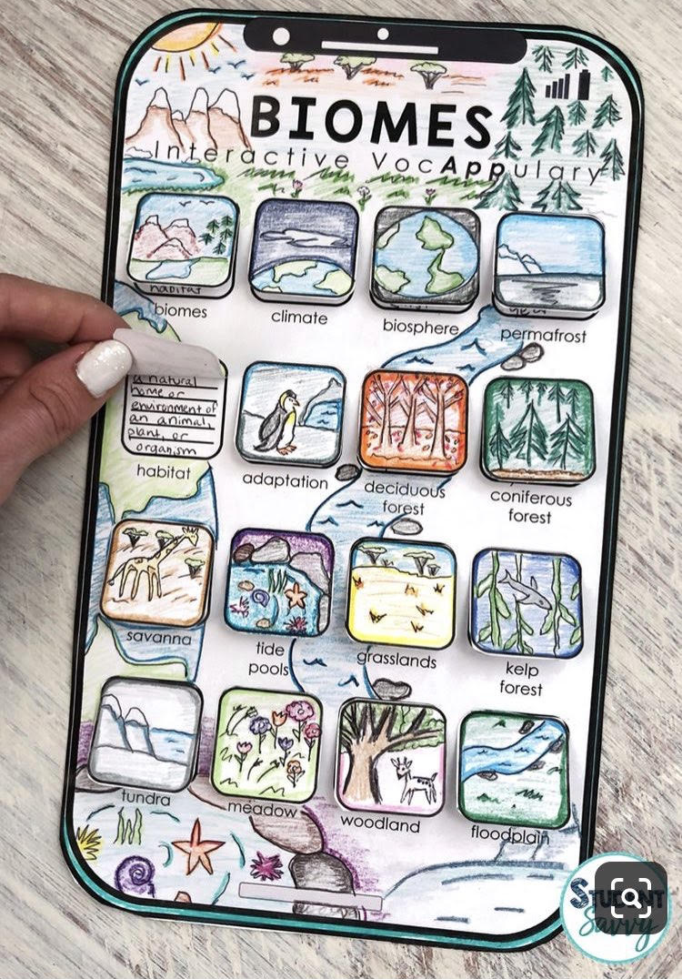
On the phone template sum up the description of each biome in your own words in the relevant box using your information table.
Cut the boxes out of the other template (do not cut off the tab at the top).
Draw a picture on each of the blank boxes for each biome
Stick the boxes over the information summary using the blank tabs

Slide 3

BIOMES
Interactive VocAPPulary
BIOME
TEMPERATE CONIFEROUS FOREST
TEMPERATE DECIDUOS FOREST
TUNDRA
TEMPERATE GRASSLAND
TROPICAL RAINFOREST
DESERT
MEDITERRANEAN
TROPICAL SAVANNAH

Slide 4
Draw a picture for each of your apps here
Leave the tab at the top blank for glue

