Slide 1

Deconstruct
the Question

Slide 2
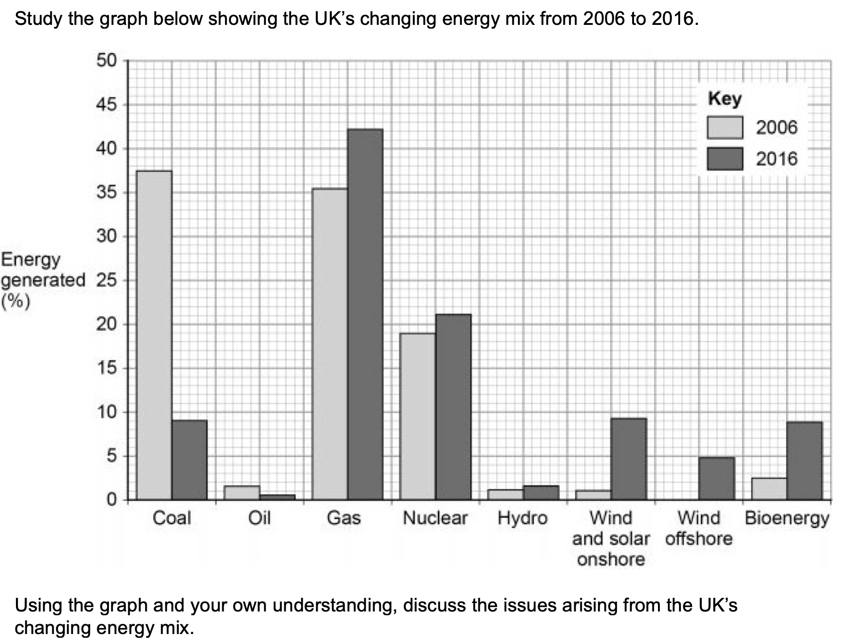

Slide 6
Coal releases 50%
More CO2 than gas
UK importing
more gas
UK has CO2 targets

Slide 7
Coal releases 50%
More CO2 than gas
UK importing
more gas
UK has CO2 targets
social, economic, political and environmental
Opportunities
Challenges

Slide 8
Decline in coal mining and
deindustrialisation increases
unemployment e.g. North East.
Increased reliance on other
countries for gas supplies.
Greater risk of waste with increased use of nuclear.
Decline in coal mining and the
use of coal reduces CO2
emissions.
Increased use of gas reduces
CO2 emissions (50% less
released compared to coal).
Coal releases 50%
More CO2 than gas
UK importing
more gas
UK has CO2 targets
social, economic, political and environmental
Opportunities
Challenges

Slide 9
Decline in coal mining and
deindustrialisation increases
unemployment e.g. North East.
Meeting demand surges with
renewable energy such as wind.
Increased reliance on other
countries for gas supplies.
Environmental impact of
constructing renewable energy resources on ecosystems.
Greater risk of waste with increased use of nuclear.
New industries in renewables; increased employment in some areas as a result e.g. Humber estuary.
Decline in coal mining and the
use of coal reduces CO2
emissions.
Increased use of gas reduces
CO2 emissions (50% less
released compared to coal).
Reduced air pollution and climate change risk.
Coal releases 50%
More CO2 than gas
UK importing
more gas
UK has CO2 targets
social, economic, political and environmental
Opportunities
Challenges

