Slide 1
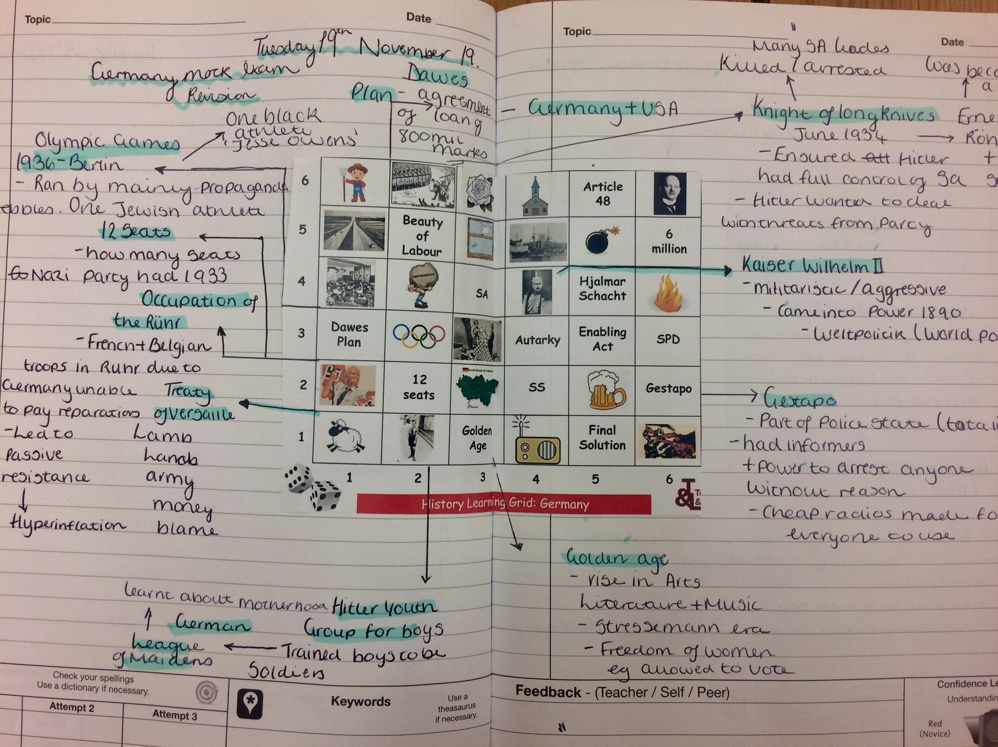
Geography Learning Grid: Living World
Stick sheet into middle of a double page
Get into team of 4.
Roll the dice twice to find a grid square (along the corridor, up the stairs).
Discuss in your group how this links to Living world.
Draw a neat line from the square and write the notes.
Repeat until complete!
Extension
Colour code each square into the 3 main specification areas
Ecosystems overview
Tropical rainforests
Hot deserts

