Slide 1
River Fieldwork Enquiry

Slide 2
Fieldwork Investigation
THE JOURNEY
Selecting, measuring and recording data
Describing, analysing and explaining data
Evaluation
Enquiry question and risk assessment
Data presentation and processing
Reaching conclusions

Slide 3
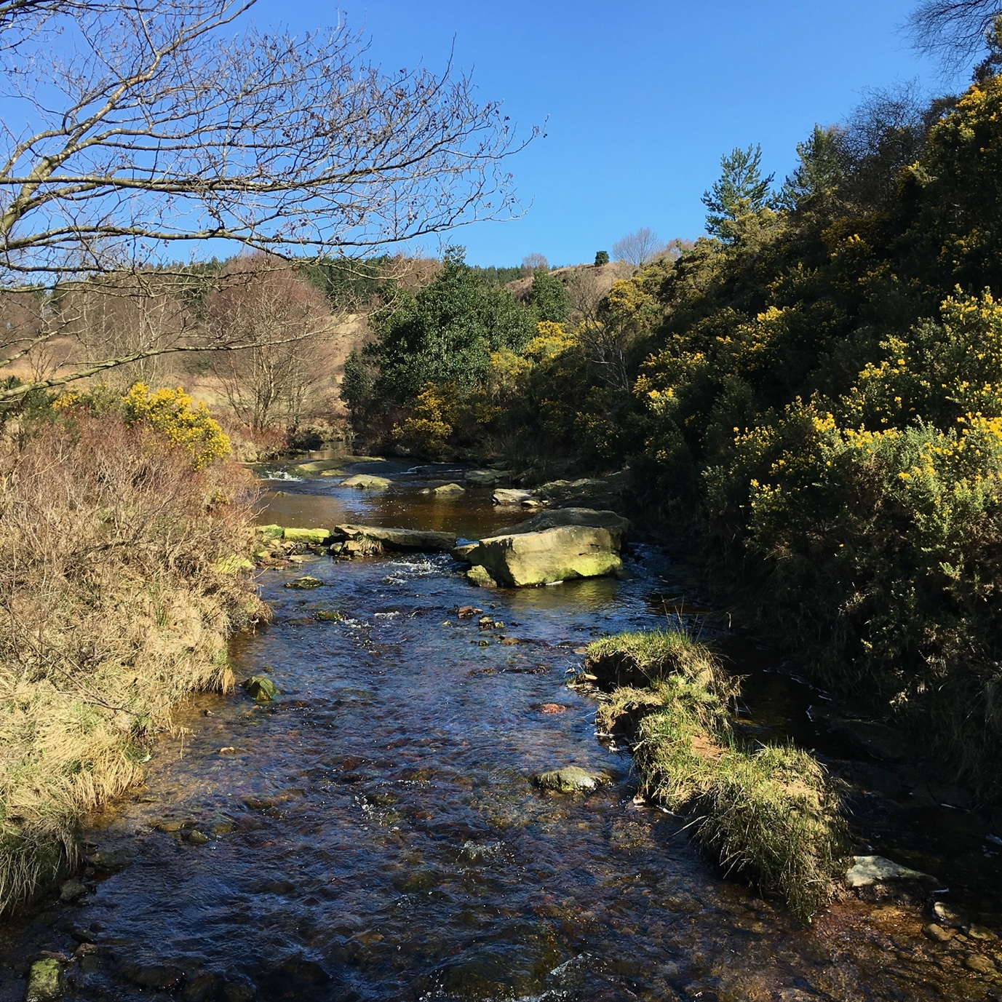
Fieldwork Investigation
ENQUIRY QUESTIONS
Based on the unit we are studying, what enquiry questions/hypothesis could we investigate in this area?
?

Slide 4
Fieldwork Investigation
ENQUIRY QUESTIONS
How does channel shape change along the course of the river?
How does erosion and deposition change along the course of the river?
How does discharge change along the course of the river?
How does the gradient of the river change along the course?
How does velocity change along the course of a river?
What is the impact of flooding along the river?
How does the shape and size of bedload change along the river?
How effective has flood management been along the river?
How does erosion and deposition change along the course of the river?
Hypothesis:
Velocity and discharge increase along the long profile of a river.
How does the long profile of the river change?
The geographical theory/concept underpinning the enquiry:
The Bradshaw Model suggests that both discharge and average velocity increases along the course of a river.
What is the impact of mass movement along the course of the river?
How does the cross profile of a river change?

Slide 5
Fieldwork Investigation
RISK ASSESSMENTS AND MANAGEMENT
What are the risks associated with this environment and how can they be managed?

Slide 6
Fieldwork Investigation
RISK ASSESSMENTS AND MANAGEMENT
Risk: Deep water
Management: Check local weather forecast and live river depth data. Observe river depth at each location. Check depth using metre ruler before entering.
Risk: Landslips
Management: Check valley sides and river for evidence of recent mass movement.
Risk: Water pollution / Weil’s disease
Mitigation: Antibiotic hand gel to be used after completing fieldwork at each location. Hands washed before eating.
Risk: Fast flowing water
Management: Observe speed of river at each location. Check flow with flow meter ensuring the river is safe to enter.
Risk: Slippery surfaces
Management: Wear appropriate footwear, long trousers, rucksack and helmet to protect from falls. Avoid rocks covered in algae
Risk: Cold water
Mitigation: Appropriate warm clothing to be worn (including thick socks and wellies). Spare set of clothing.
Risk: Bad weather
Mitigation: Check weather forecast immediately before your visit. Check local conditions are safe before entering the river.
Risk: Uneven surfaces
Management: Wear appropriate footwear, long trousers, rucksack and helmet to protect from falls.
Risk: Meeting strangers
Management: Stay within group at all time. Be polite to strangers. Do not provide personal details or go anywhere with a stranger.

Slide 7
Fieldwork Investigation
SELECTING, MEASURING AND RECORDING DATA
What quantitative techniques would you use?
What qualitative techniques techniques would you use?
Sample size?
Sample technique?

Slide 8
Fieldwork Investigation
DATE PRESENTATION AND PROCESSING TECHNIQUES
Presentation techniques
Processing techniques

Slide 9
Fieldwork Investigation
DESCRIBING, ANALYSING and EXPLAINING THE DATA
Patterns and trends
Links between data sets
Anomalies
Reasons for patterns

Slide 10
Fieldwork Investigation
CONCLUSIONS
Link to original hypothesis/enquiry question
Link evidence from the data you collected to support your conclusion

Slide 11
Fieldwork Investigation
EVALUATION
• Problems with data collection
• Limitations of the data collected
• What other data could have been collected?
• How reliable are your conclusions?

Slide 12
Slide on techniques
Link to new page in plus area
Promote new resources
Finish guide
Do as an example including data etc.
Online quiz to check learning > rivers fieldwork > multiple choice

