Slide 1

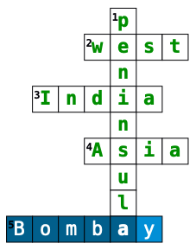
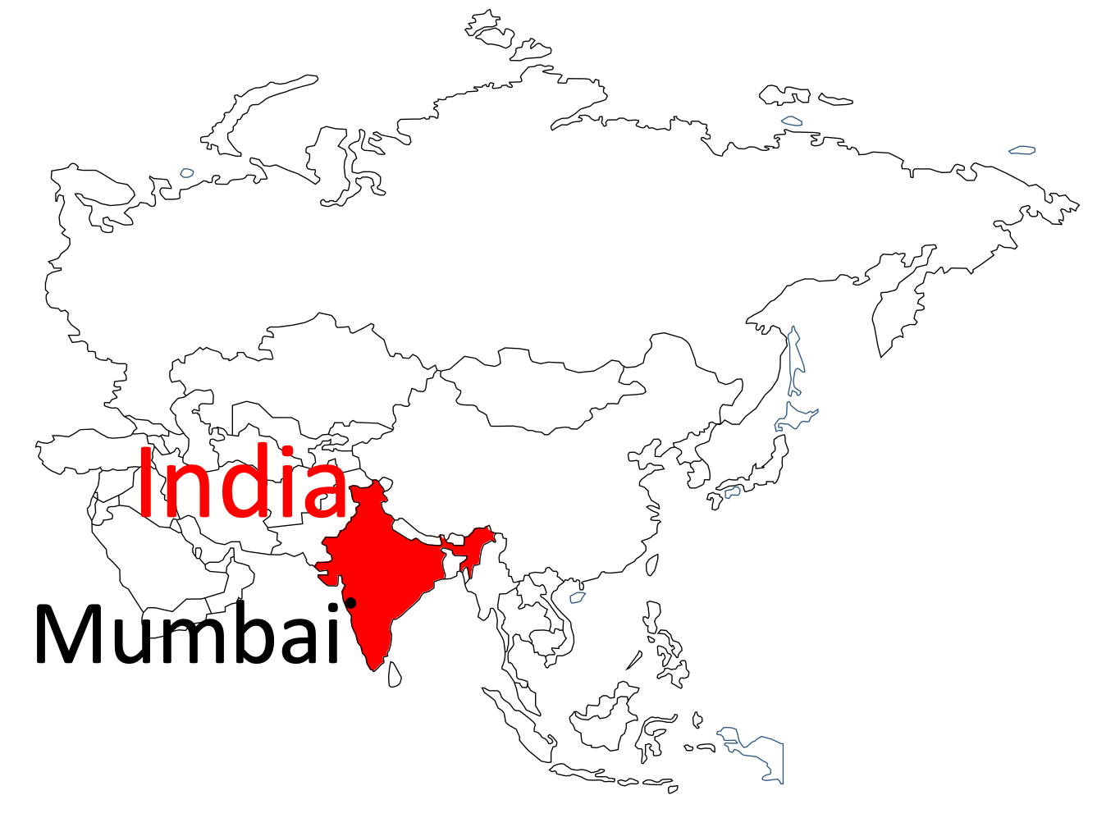
Recap – Urban Growth in Mumbai 1
Across
2. The coast on which
Mumbai is located.
3. The country
where Mumbai is
located.
4. The continent where
India is located.
5. The former name for
Mumbai.
Down
1. The landform that Mumbai is located on.
Where is India and Mumbai located?
Shade India and locate Mumbai on the map below.
What is Mumbai like?
Fill in the missing words below.
Mumbai is located on the western coast of ________________ state in __________ India, bordering the __________ Sea. The city is on a narrow _______________ (a piece of land that is almost entirely surrounded by water but is connected to the mainland on one side) on the southwest of Salsette Island, which lies between the Arabian Sea to the west, Thane Creek to the east and Vasai Creek to the ____________.
With an estimated population of around 20 ____________ people, Mumbai is India’s biggest city and the _________ largest in the world. Mumbai is an ‘_______’ city as due to its economic importance.
Arabian alpha Maharashtra western peninsula north million fourth
Maharashtra
western
Arabian
peninsula
north
million
fourth
alpha
The regional, national and international importance of Lagos
1 | In the past, which colonial country ruled India?
○ | A | France
○ | B | Spain
○ | C | Germany
○ | D | Britain
 | Regional | National | International
Three million people commute from surrounding areas to Mumbai for work. The population of Mumbai is constantly growing, taking the young workforce from neighbouring cities. | x
Nationally, Mumbai contributes 33% of all income tax and 60% of all customs duty from trade. |  | x
Mumbai is a transport hub with links to all major industrial cities India. |  | x
The city contributes 40% of total income to the whole state of Maharashtra. | x
Mumbai’s tourism industry is booming with thousands flocking to the area from all over the globe. |  |  | x
Mumbai is one of India’s dominant urban centres and is one of the world’s largest and most densely populated cities. |  | x
Receives the largest amount of foreign investment of any other city in India. The city the largest number of international companies in Asia. The Bank of America, Volkswagen, Walt Disney and many more international companies have their headquarters in Mumbai. |  |  | x
Mumbai is India’s commercial and financial capital, contributing around US $310 bn to its economy. It is responsible for 70 per cent of India’s maritime trade and is responsible for 25 per cent of its industrial output. |  | x
The Hi-tech industry is growing call centres, online banking and software development. | x
2 | True or false? Mumbai is a megacity
○ | A | True
○ | B | False
3 | What is the approximate population of Lagos?
○ | A | 5 million
○ | B | 15 million
○ | C | 20 million
4 | Which of the following describe the regional importance of Lagos?
○ | A | It is important in its provision of schools, universities and hospitals.
○ | B | India’s major chemical, petrochemical and pharmaceutical industries have located within the city.
○ | C | Most large transnational corporations (TNCs) are located here.
○ | D | The city is a transport hub.
5 | Which of the following describe the national importance of Mumbai?
○ | A | Mumbai is one of India’s dominant urban centres and is one of the world’s largest and most densely populated cities.
○ | B | Nationally, Mumbai contributes 33% of all income tax and 60% of all customs duty from trade.
6 | Where is Mumbai located within India?
○ | A | North
○ | B | West
○ | C | East

