Slide 1

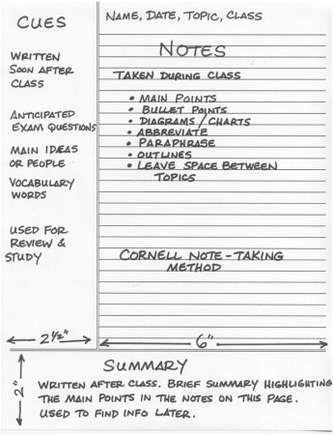
Cornell Notes
Figure: _______________
Page: _______________
Cues
Questions you have about the information
Vocabulary and definitions
Anticipated
exam questions
Notes
Main points
Bullet points
Diagrams/charts
Abbreviate
Paraphrase
Outline
Leave space between sections
Summary
Brief summary highlighting the main points in the notes on this page.

Slide 2
Cornell Notes
Figure: _______________
Page: _______________

