Slide 1

Lesson Purpose
To discover how the secrets of the Earth’s past environment are locked up in ancient ice

Slide 2
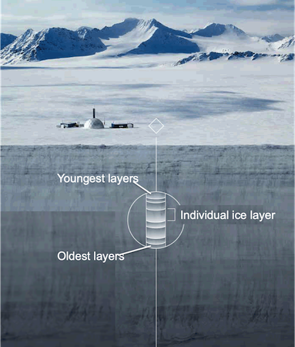
Key idea: in cold environments, each year of snowfall won’t melt. Therefore, every new year lands on top of the old year, creating layers of compact ice over time.

Slide 3
“The secrets of the Earth’s history is locked away in the ice”
By looking at ancient ice locked away deep in Antarctic ice sheets, we can work out what the climate and environment was like long before humans existed.

Slide 4
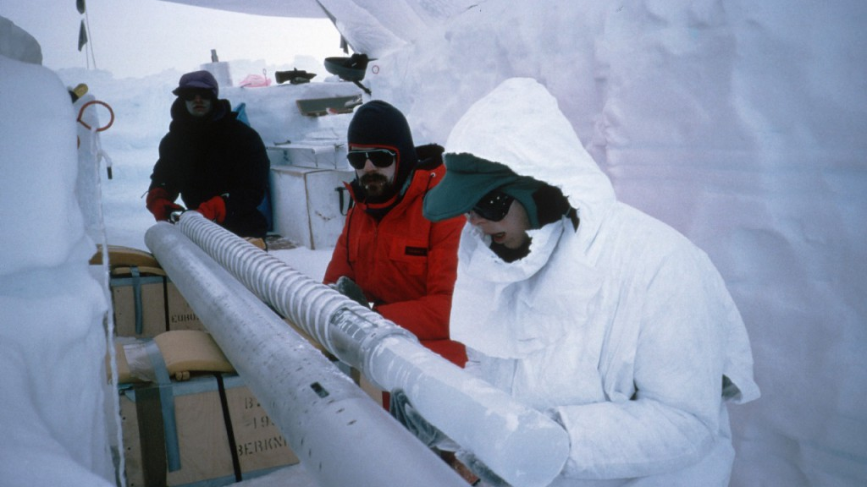

Slide 5
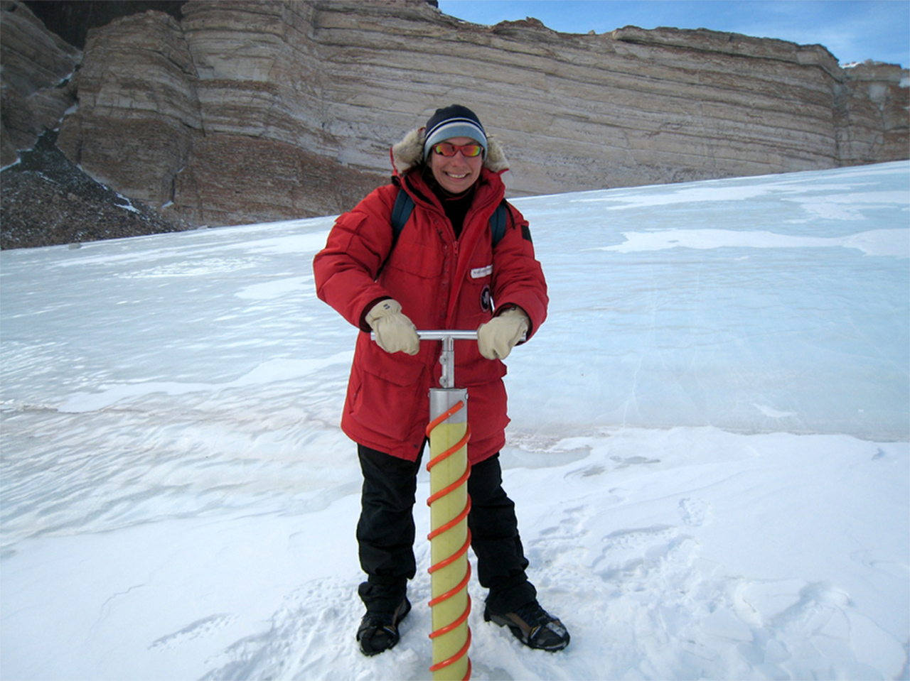
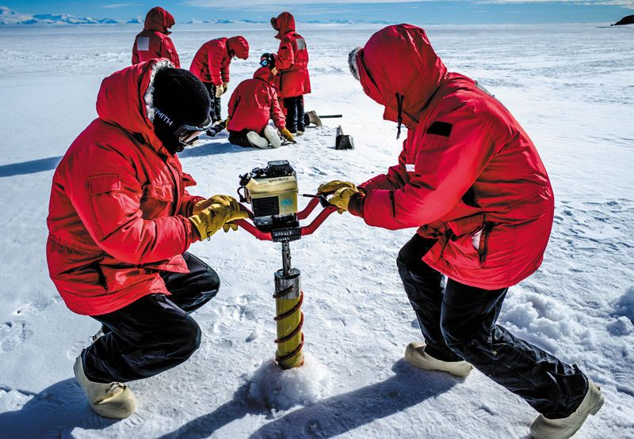
How are ice cores extracted?

Slide 6
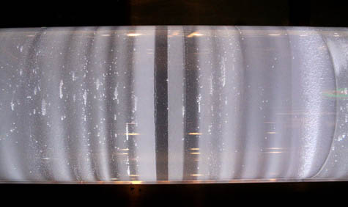
What we find in each layer of ice can tell us roughly what was happening in that year.
For example, what could this darker layer represent?

Slide 7
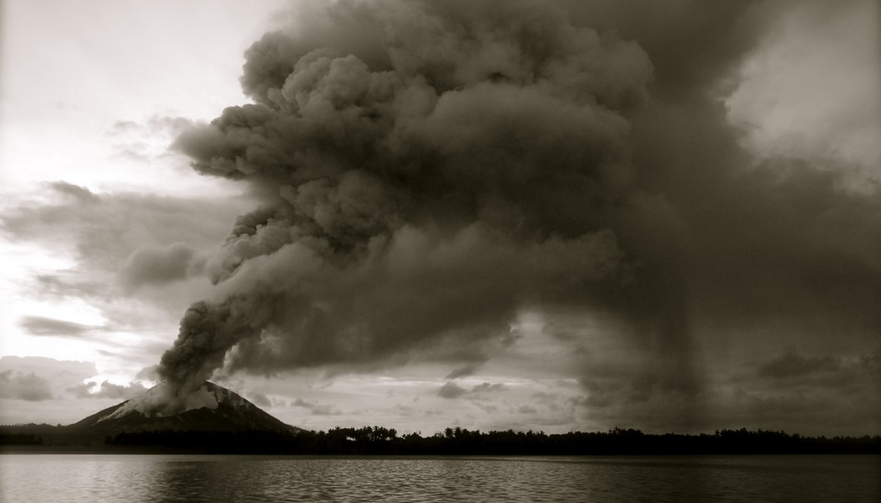

Slide 8
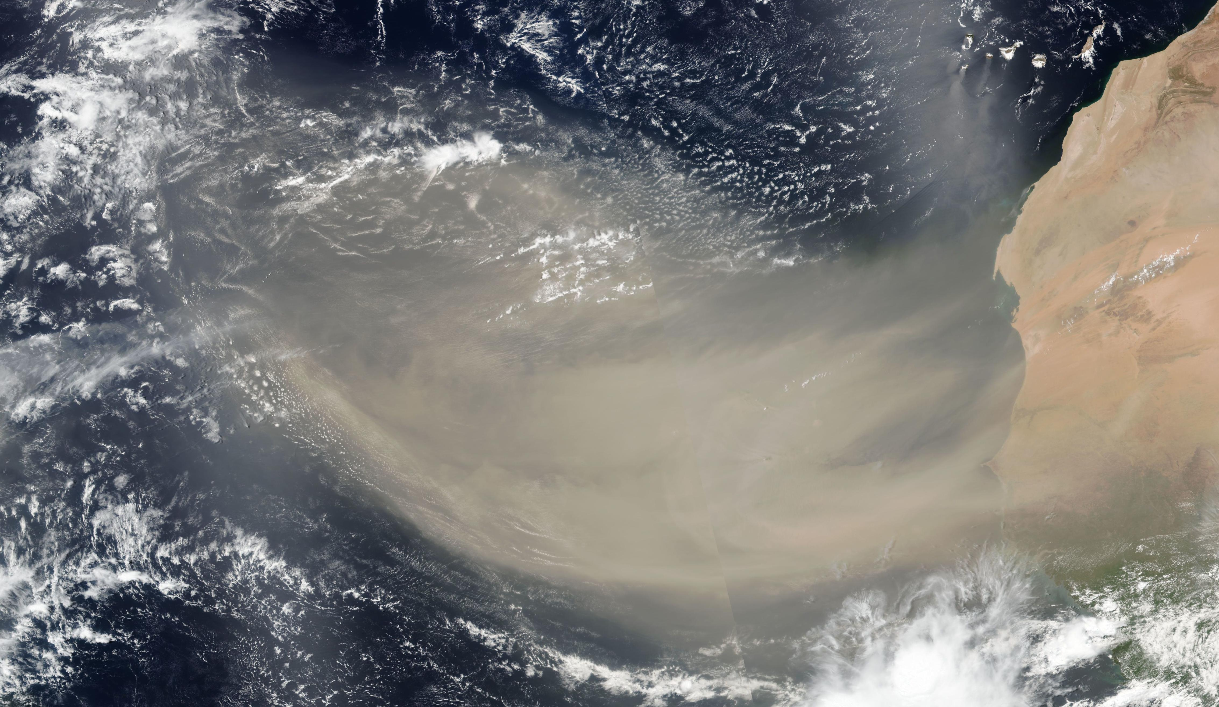

Slide 9
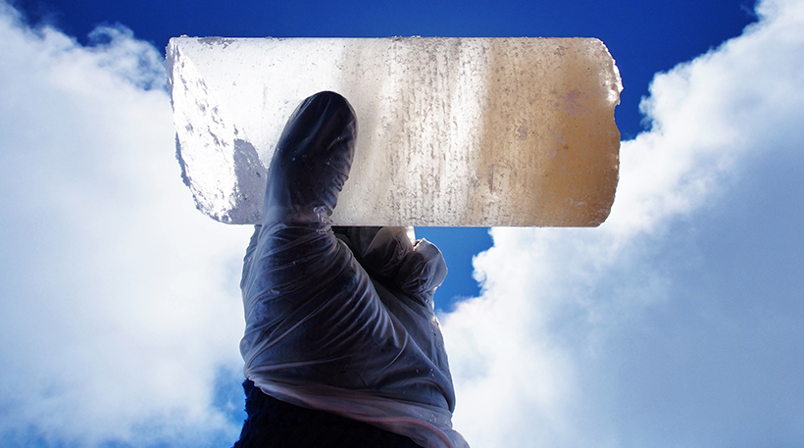

Slide 10
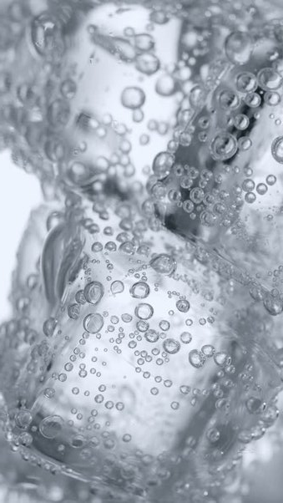
Ice traps air bubbles from the year that it freezes.
The air bubbles will represent what the air and atmosphere was like during the year that it freezes.
If we dig deep and find ice that is 100,000 years old, we can melt a small sample of it and analyse the contents of the air bubble. You will essentially be breathing air that has been trapped for 100,000 years!

Slide 11
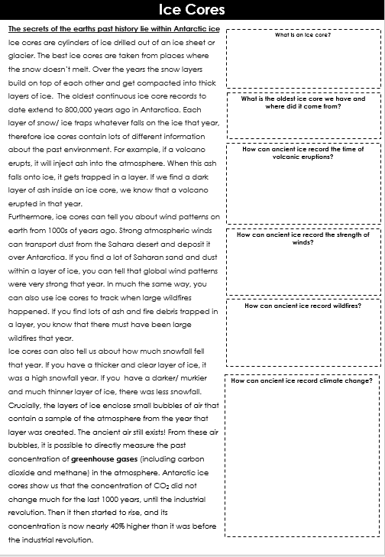
Guided Reading

Slide 12
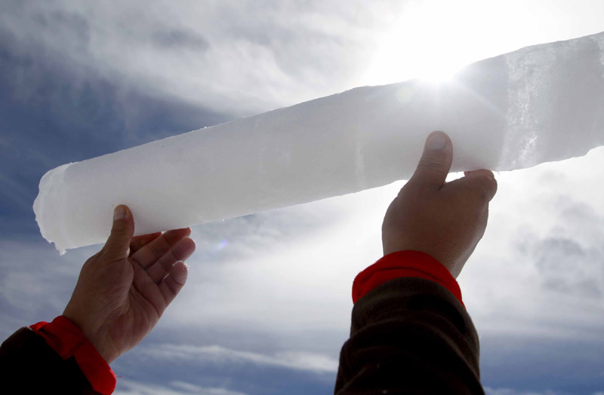
Studying Antarctic Ice Cores

Slide 13
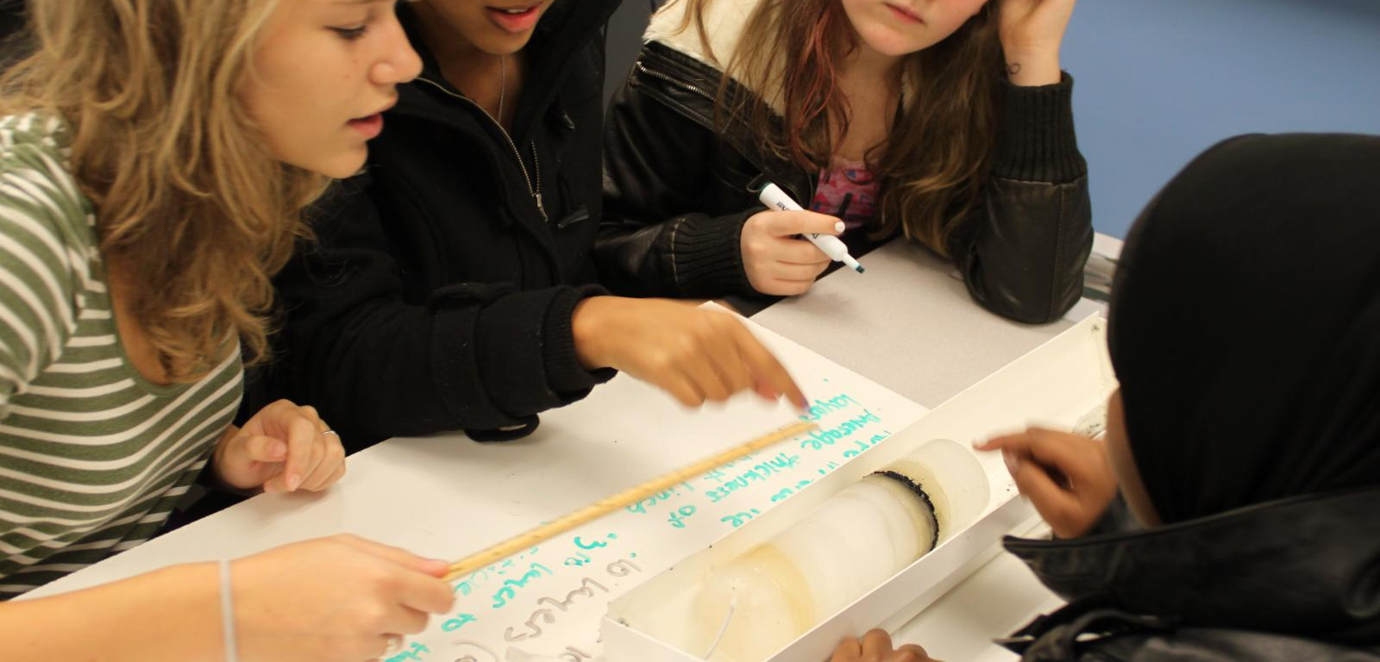
Task 1: Study your ice core
Have a look at the different layers
Generate some ideas in your head: what could these layers tell you about the environment during that year?

Slide 14
Task 2: Create a sketch of your ice core
Ensure your sketch clearly shows each layer

Slide 15
Task 3: Annotate your sketch
Make observations about what each layer could be telling us about how the environment has changed over time

Slide 16
Task 4: Write a story
Write a paragraph describing how the environment around this ice core has changed in this time period

Slide 17
What could future geographers find in the 2022 layer in an ice core?
Think – Pair – Share

Slide 18
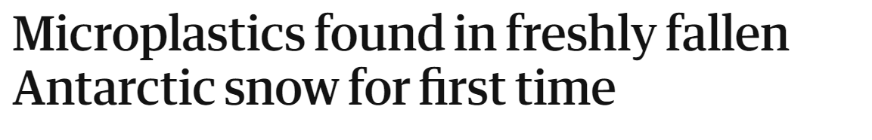
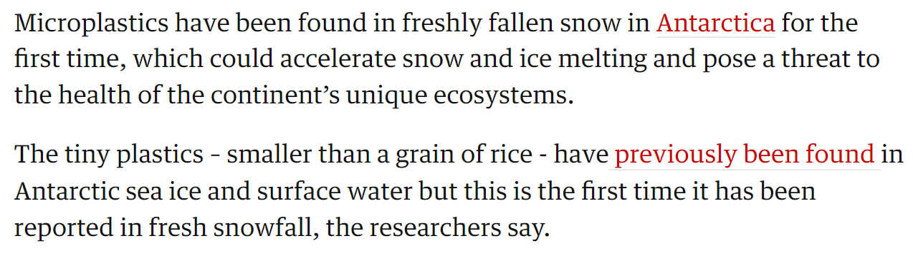
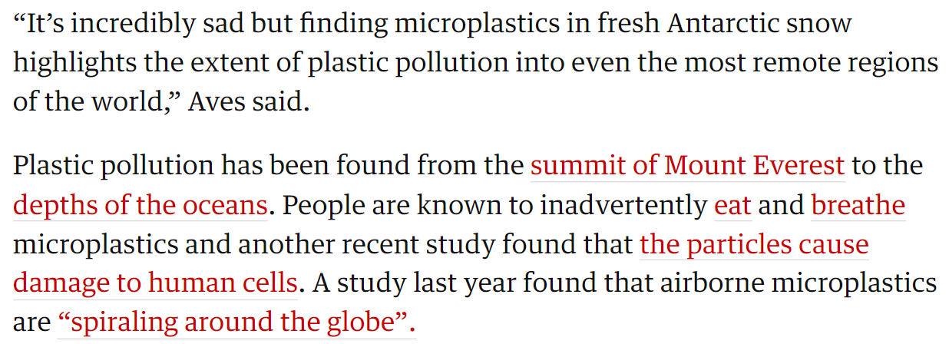
What could future geographers find in the 2022 layer in an ice core?

Slide 19
References + Lesson Inspiration
Initial lesson inspiration – Ohio State University online: https://byrd.osu.edu/create-classroom-ice-cores
Additional inspiration and help from: https://sciencelessonsthatrock.com/teaching-climate-change-with-ice-cores-html/
https://www.smithsonianmag.com/smart-news/in-a-first-microplastics-are-found-in-fresh-antarctic-snow-180980264/#:~:text=Scientists%20have%20found%20microplastics%E2%80%94small,their%20findings%20in%20The%20Cryosphere
https://www.bbc.co.uk/news/science-environment-61739159
Main information and picture source: https://climate.nasa.gov/news/2616/core-questions-an-introduction-to-ice-cores

