Slide 1

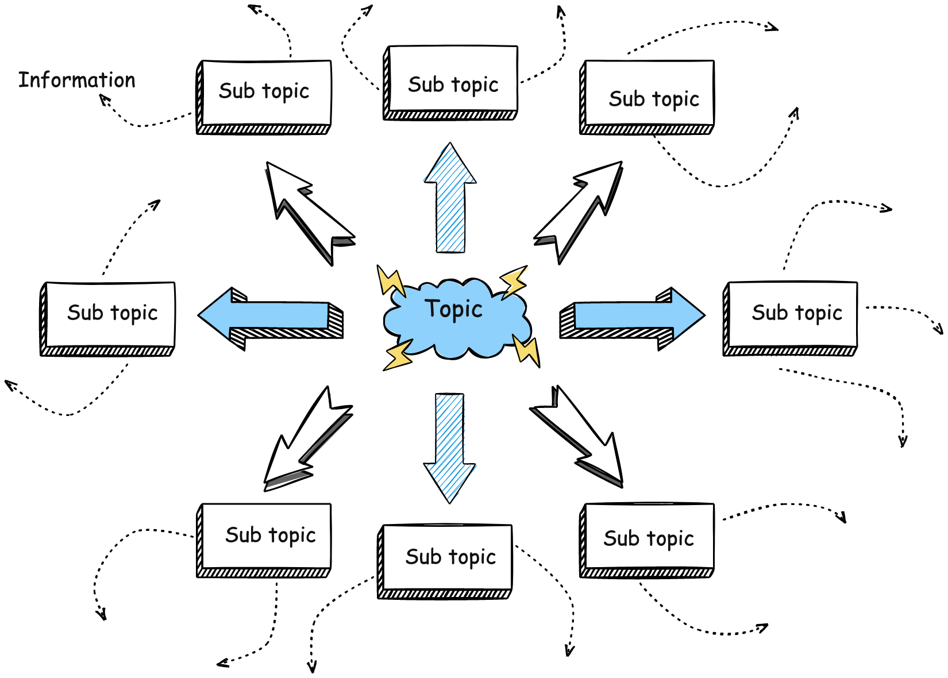
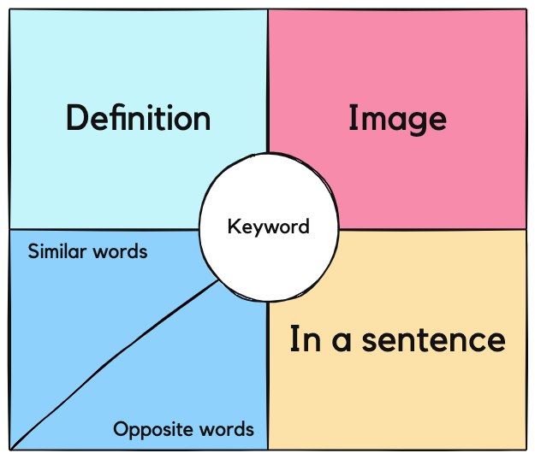
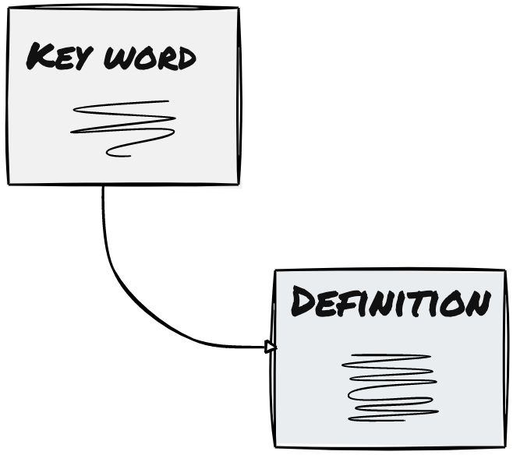

Global Atmospheric Circulation
Strategies for addressing gaps in knowledge
Mind map
Need to know:
The features of global atmospheric circulation
Pressure belts (convection cells) and their role in global atmospheric circulation.
The surface winds and their role in global atmospheric circulation.
Freya model
Flash cards
Class feedback from learning review:
Strengths:
INSERT HERE
Areas for development:
INSERT HERE

