Slide 1









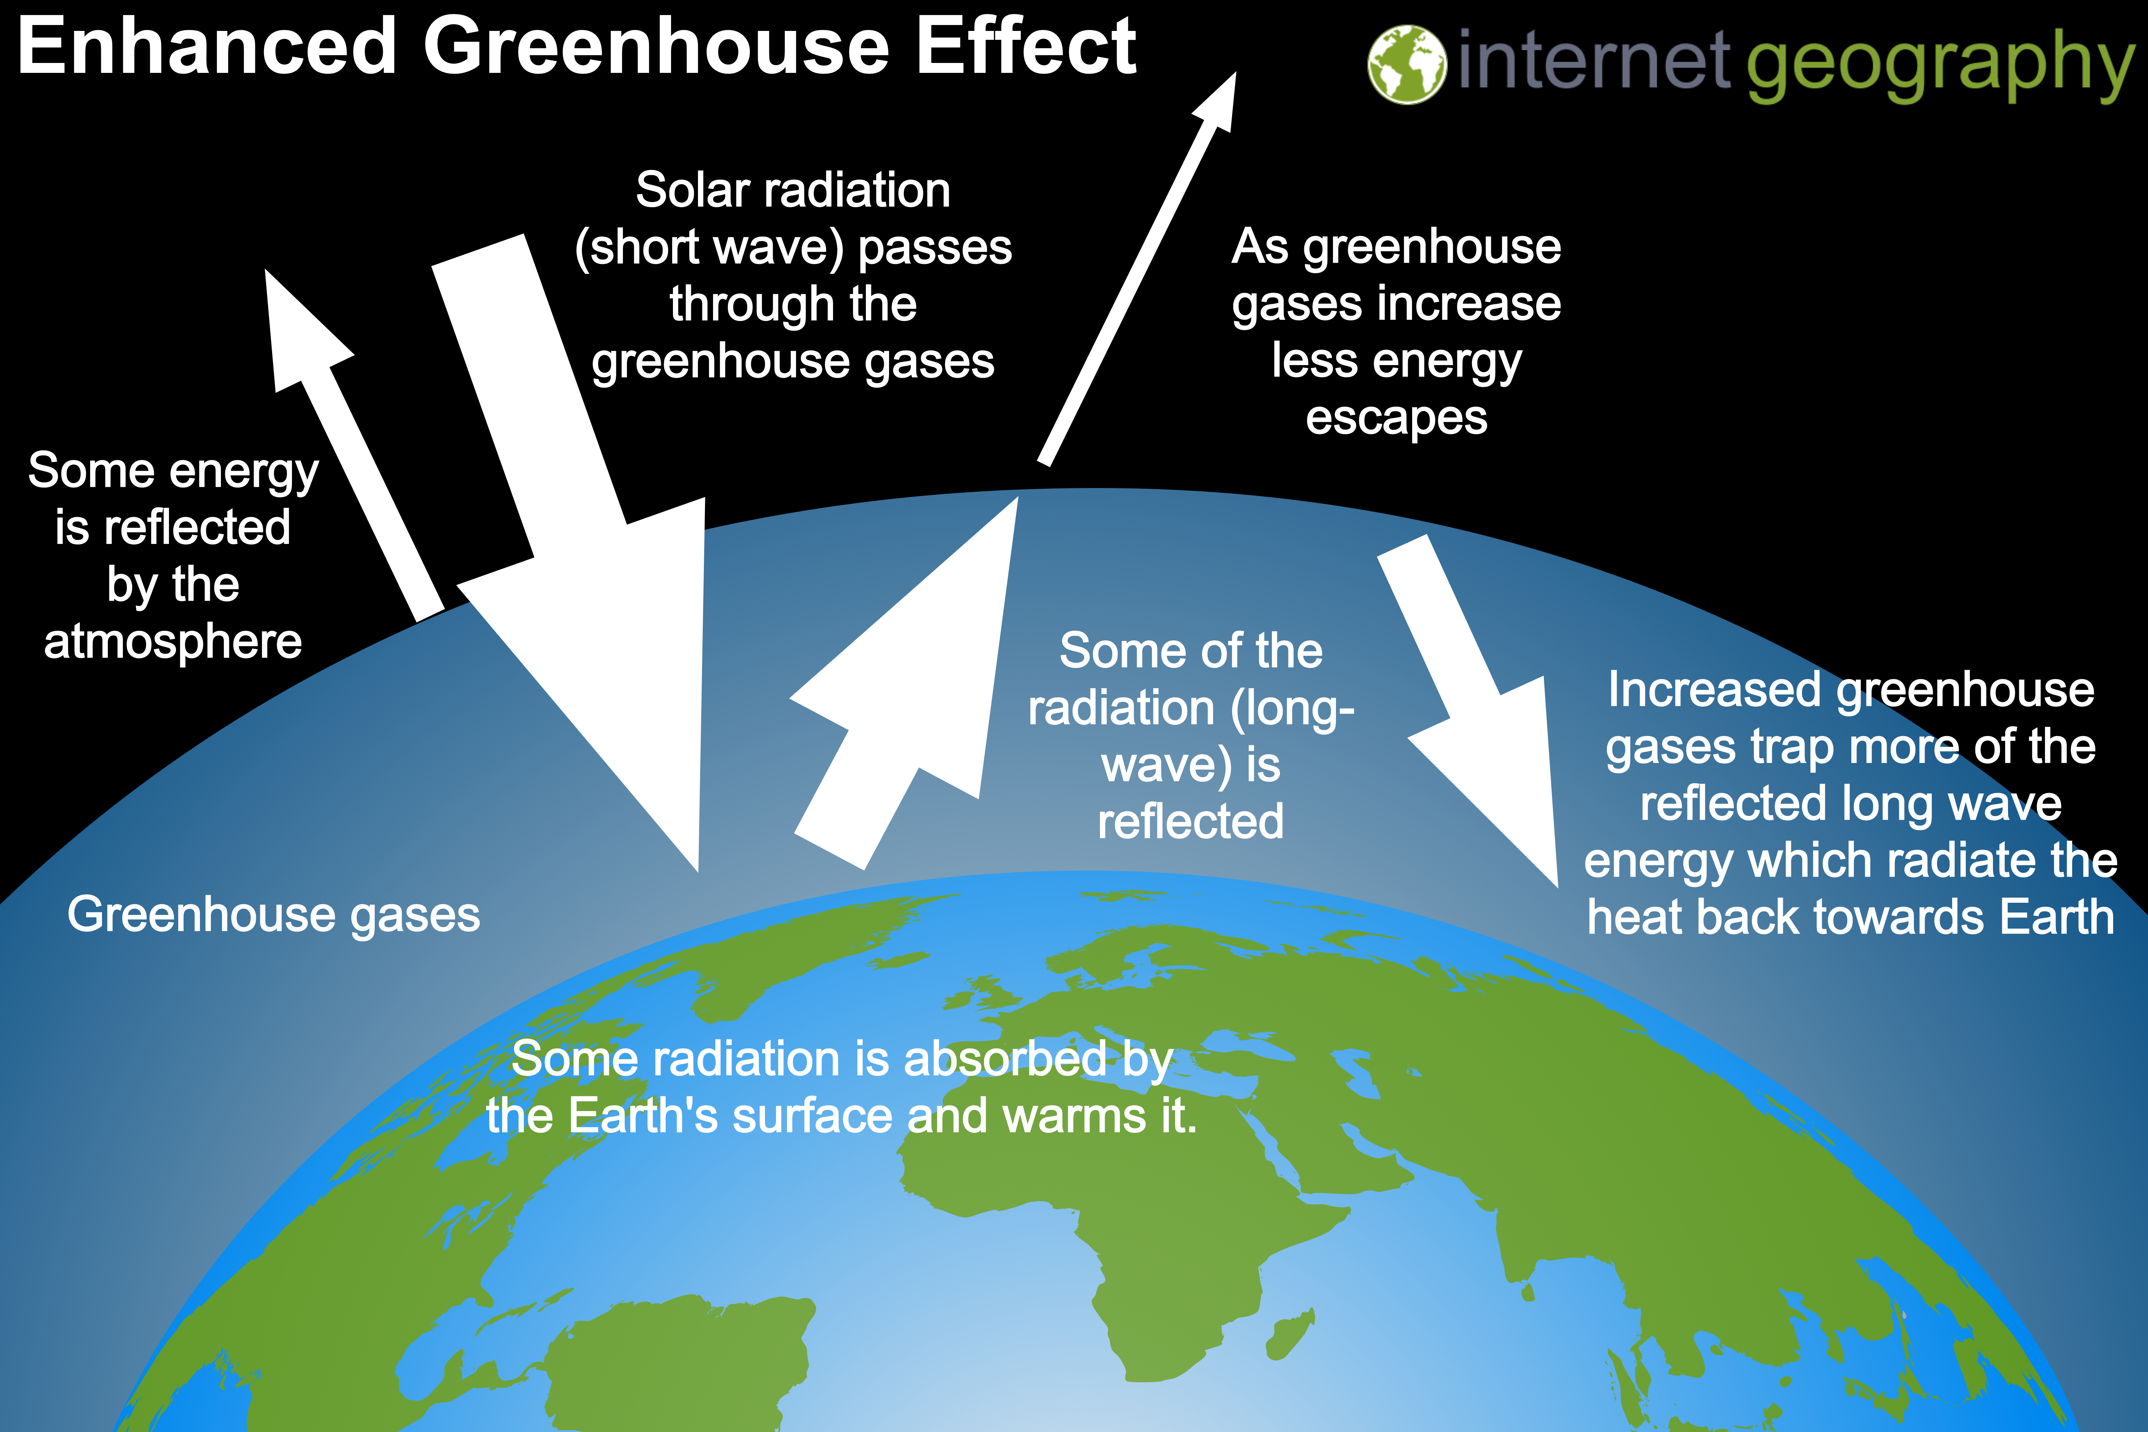
Natural Hazards
The Enhanced
Greenhouse Effect
read
quiz
The Big Picture
Enhanced
natural hazards
tectonic hazards
The Greenhouse effect is a naturally occurring phenomenon that keeps the Earth warm enough for life to exist. It is estimated that the Earth would be 33° colder without the greenhouse effect.
Like a greenhouse, the atmosphere allows most of the heat from the Sun to pass through it to warm the Earth’s surface. Gasses then trap some reflected energy as glass does in a greenhouse.
The enhanced greenhouse effect involves human activity increasing the layer of greenhouse gases which naturally exists. Activities that generate greenhouse gases include burning fossil fuels, transport, agriculture and deforestation. Less heat escapes the from the Earth’s atmosphere and more is trapped by the thicker layer of greenhouse gases, leading to higher temperatures.
Natural Hazards
weather hazards
climate change*
Key Terms
Enhanced Greenhouse effect – The warming of the Earth’s atmosphere due to human activity increasing the layer of greenhouse gases.
Greenhouse gases – gases in the Earth's atmosphere that trap heat.
Long-wave radiation – Energy that is radiated outward by the Earth (land and sea)
Short-wave solar radiation – Solar energy that enters our atmosphere in the form of ultraviolet rays and visible light.

