Slide 1

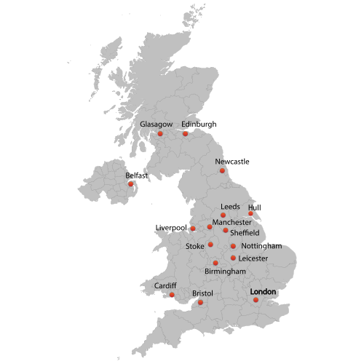
Urban Issues and Challenges – Urban growth in the UK
City studied: _________________________________________
Keywords
UK population distribution and cities
Location and importance of ______________________________
Term | Definition
Brownfield site
Dereliction
Economic opportunities
Greenfield site
Inequalities
Integrated transport systems
Pollution
Rural-urban fringe
Social deprivation
Social opportunities
Sustainable urban living
Trade
Traffic congestion
Urban greening
Urban regeneration
Urban sprawl
Waste recycling
Population
Cities
Location
Importance of the city within the UK
Importance of the city to the wider world
Urban change in ________________________________
Impacts of migration on the growth and character of the city
National migration
International migration
Impact on character

Slide 2
Urban Issues and Challenges – Opportunities and challenges in a LIC/NEE city
Opportunities created by urban change
Opportunities created by urban change
Cultural mix
Recreation and entertainment
Employment
Integrated transport
Urban greening
Urban deprivation
Inequality in housing
Inequality in education
Inequality in health
Employment
Dereliction
Building on born and greenfield
Waste disposal
Urban sprawl

Slide 3
Urban Issues and Challenges – Urban sustainability
Urban regeneration project
The features of sustainable urban living
Sustainable urban transport strategies
Example
Why did the area need regeneration?
What are the main features?
What was the impact of the regeneration project?
Water conservation
Energy conservation
Waste recycling
Creating green space
Issues with traffic congestion
Strategy 1:
Strategy 2:
Strategy 3:

