Slide 1


Paper 3 Pre-release 2023
AQA GCSE Geography
Work Booklet 2

Slide 2

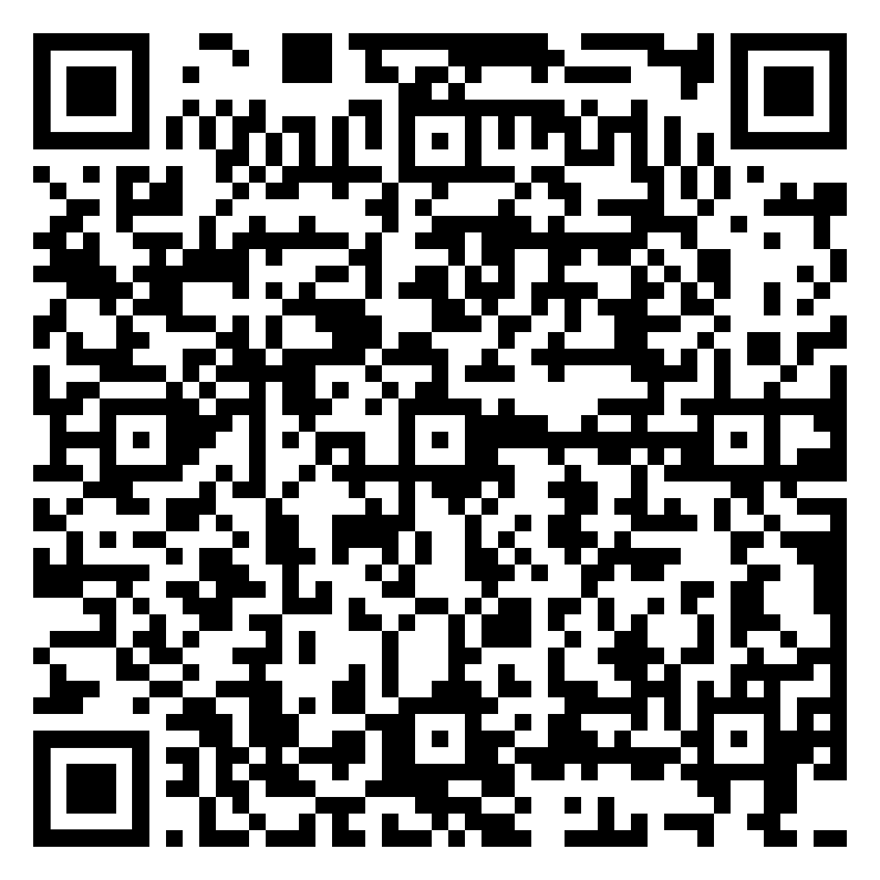
Figure 2 – Key Terms
Below are the key terms used in figure 2. You need to
know what each term means and be able to use it in sentence.
Architecture | Ashore
Berthing facilities | Cargo port
Cayman Islands | Coral reef
Cruise ship terminal | Cruise traffic
Culture | Economic opportunities
Environment | Nature
Pedestrianised shopping | Pier
Port | Reclaimed land
Redevelopment project | Social opportunities
Stay-over visitors | Tourism

Slide 3



Figure 2 Cruise Terminal and Port
investigate
Describe the location of the Cayman Islands.
Identify the issues associated with the current Cayman Islands port.
apply
skills
Complete the graph below to show the Cayman Islands imports.
Calculate the percentage
increase in imports for the
Calculate the percentage
increase in cruise passengers
Cayman Islands between 1998 and 2018.
visiting the Cayman Islands between 1998 and 2018.

Slide 4
Figure 2 Cruise Terminal and Port
investigate
Suggest reasons for the increase in imports in the Cayman Islands.
apply
skills
Complete the questions below, based on the proposed port development.
When was the development of a new cruise terminal and port proposed?
Identify the location of the proposed development.
How are cruise ship passengers currently transported to shore? Why?
Why is the lack of docking facilities for cruise liners and passengers an issue?
Identify the groups against the proposed development.
Give reasons why the groups you identified above are against the developments.
Highlight the diagram at the bottom of page 4 of the pre-release to identify the positive and negative economic and environmental effects of the proposed port development.

Slide 5
Figure 2 Cruise Terminal and Port
investigate
Complete the table below to show the economic and environmental effects of the proposed port development
apply
 | Advantages | Disadvantages
Economic
Environmental
skills
Complete the questions below, based on the proposed port development.
Produce a pie chart to show the source of cruise arrivals in the Caribbean.
Key
Highlight the diagram at the bottom of page 4 of the pre-release to identify the positive and negative economic and environmental effects of the proposed port development.
USA
Western Europe
China
Australia
Others
Explain the source of cruise arrivals in the Caribbean.

Slide 6
Figure 2 Cruise Terminal and Port
investigate
Complete the questions below, based on tourism arrivals in the Caribbean.
apply
What has happened to the number of visitors to the Caribbean over the last 30 years?
What has happened to visitor spending in the Caribbean over the last 30 years?
Identify an issue associated with calculating tourism arrivals in the Caribbean.
Identify why long-stay tourists are preferred to cruise passengers.
skills
Complete the questions below, based on the proposed port development.
Identify the human and natural features that attract tourists to the Cayman Islands.
Human | Natural
Highlight the diagram at the bottom of page 4 of the pre-release to identify the positive and negative economic and environmental effects of the proposed port development.

Slide 7
Figure 2 Cruise Terminal and Port
investigate
Study the climate graph for the Cayman Islands. Complete the table below.
apply
 | Hours of sunshine | Average temperature
Mean
Median
Mode
Range
skills
Complete the questions below, based on the proposed port development.
Highlight the diagram at the bottom of page 4 of the pre-release to identify the positive and negative economic and environmental effects of the proposed port development.

Slide 8
Glossary
investigate
Architecture
The art or practice of designing and constructing buildings.
Ashore
To or on the shore or land from the direction of the sea.
Berthing facilities
A designated location in a port or harbour used for mooring vessels when they are not at sea.
Cargo port
A maritime facility comprising one or more loading areas, where ships load and discharge cargo and passengers.
Cayman Islands
A British overseas territory, formed from three coral islands in the Caribbean Sea northwest of Jamaica.
Coral reef
An underwater ecosystem characterized by reef-building corals. It is one of the most important ecosystems in the world, and have been called 'the rainforests of the sea' owing to the diverse range of plants and animals that they support.
Cruise ship terminal
A structure in a port which services passengers boarding and leaving water vessels such as ferries, cruise ships and ocean liners.
Cruise traffic
The movement or volume of cruise ships within a particular area or along specific routes.
Culture
The traditions, way of life and beliefs of a specific group of people.
Economic opportunities
Economic opportunities refer to the various ways in which a region or area can develop and prosper economically.
Environment
The natural and human-influenced surroundings in which living organisms, including humans, interact and exist.
apply
skills

Slide 9
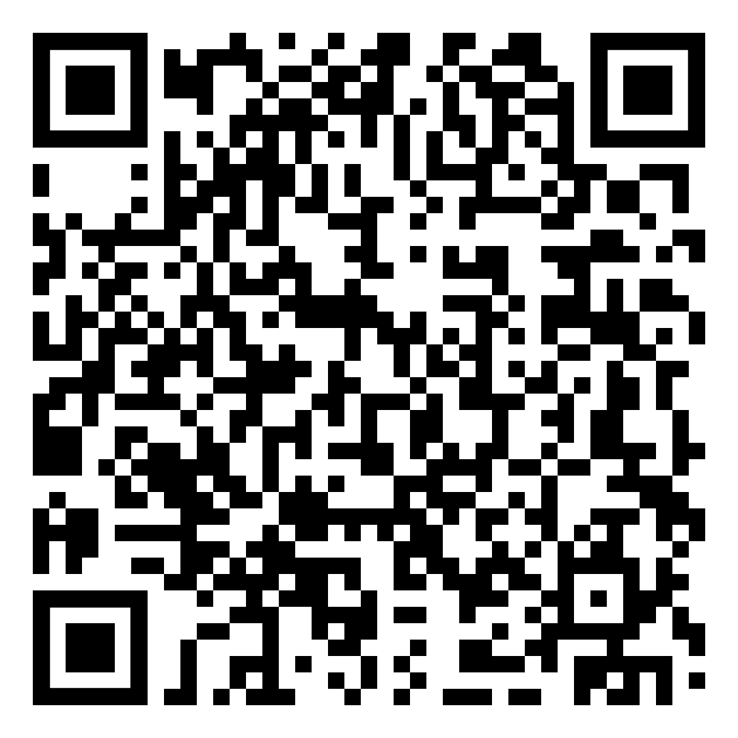
Glossary
investigate
Nature
All the plants, animals and things that exist in the universe that are not made by people.
Pedestrianised shopping
An area of a city or town containing shops that is reserved for pedestrian-only use.
Pier
A structure built out into the water for use as a landing place or walk or to protect or form a harbour.
Port
A place where ships may take shelter. It is also used for loading and unloading cargo and passengers.
Reclaimed land
New land created from the sea by filling the area with large amounts of heavy rock and/or cement, then filling with clay and soil until the desired height is reached.
Redevelopment project
Demolition and reconstruction or substantial renovation of existing buildings or infrastructure within an area.
Social opportunities
Chances for people to improve their quality of life, for instance, access to healthcare and education.
Stay-over visitors
A tourist that stays in a country or island for more than 24 hours.
Tourism
The movement of people to countries or places outside their usual environment for personal or business/professional purposes.
apply
skills
Quizzes
https://tinyurl.com/2023prereleaserevision

