Slide 1
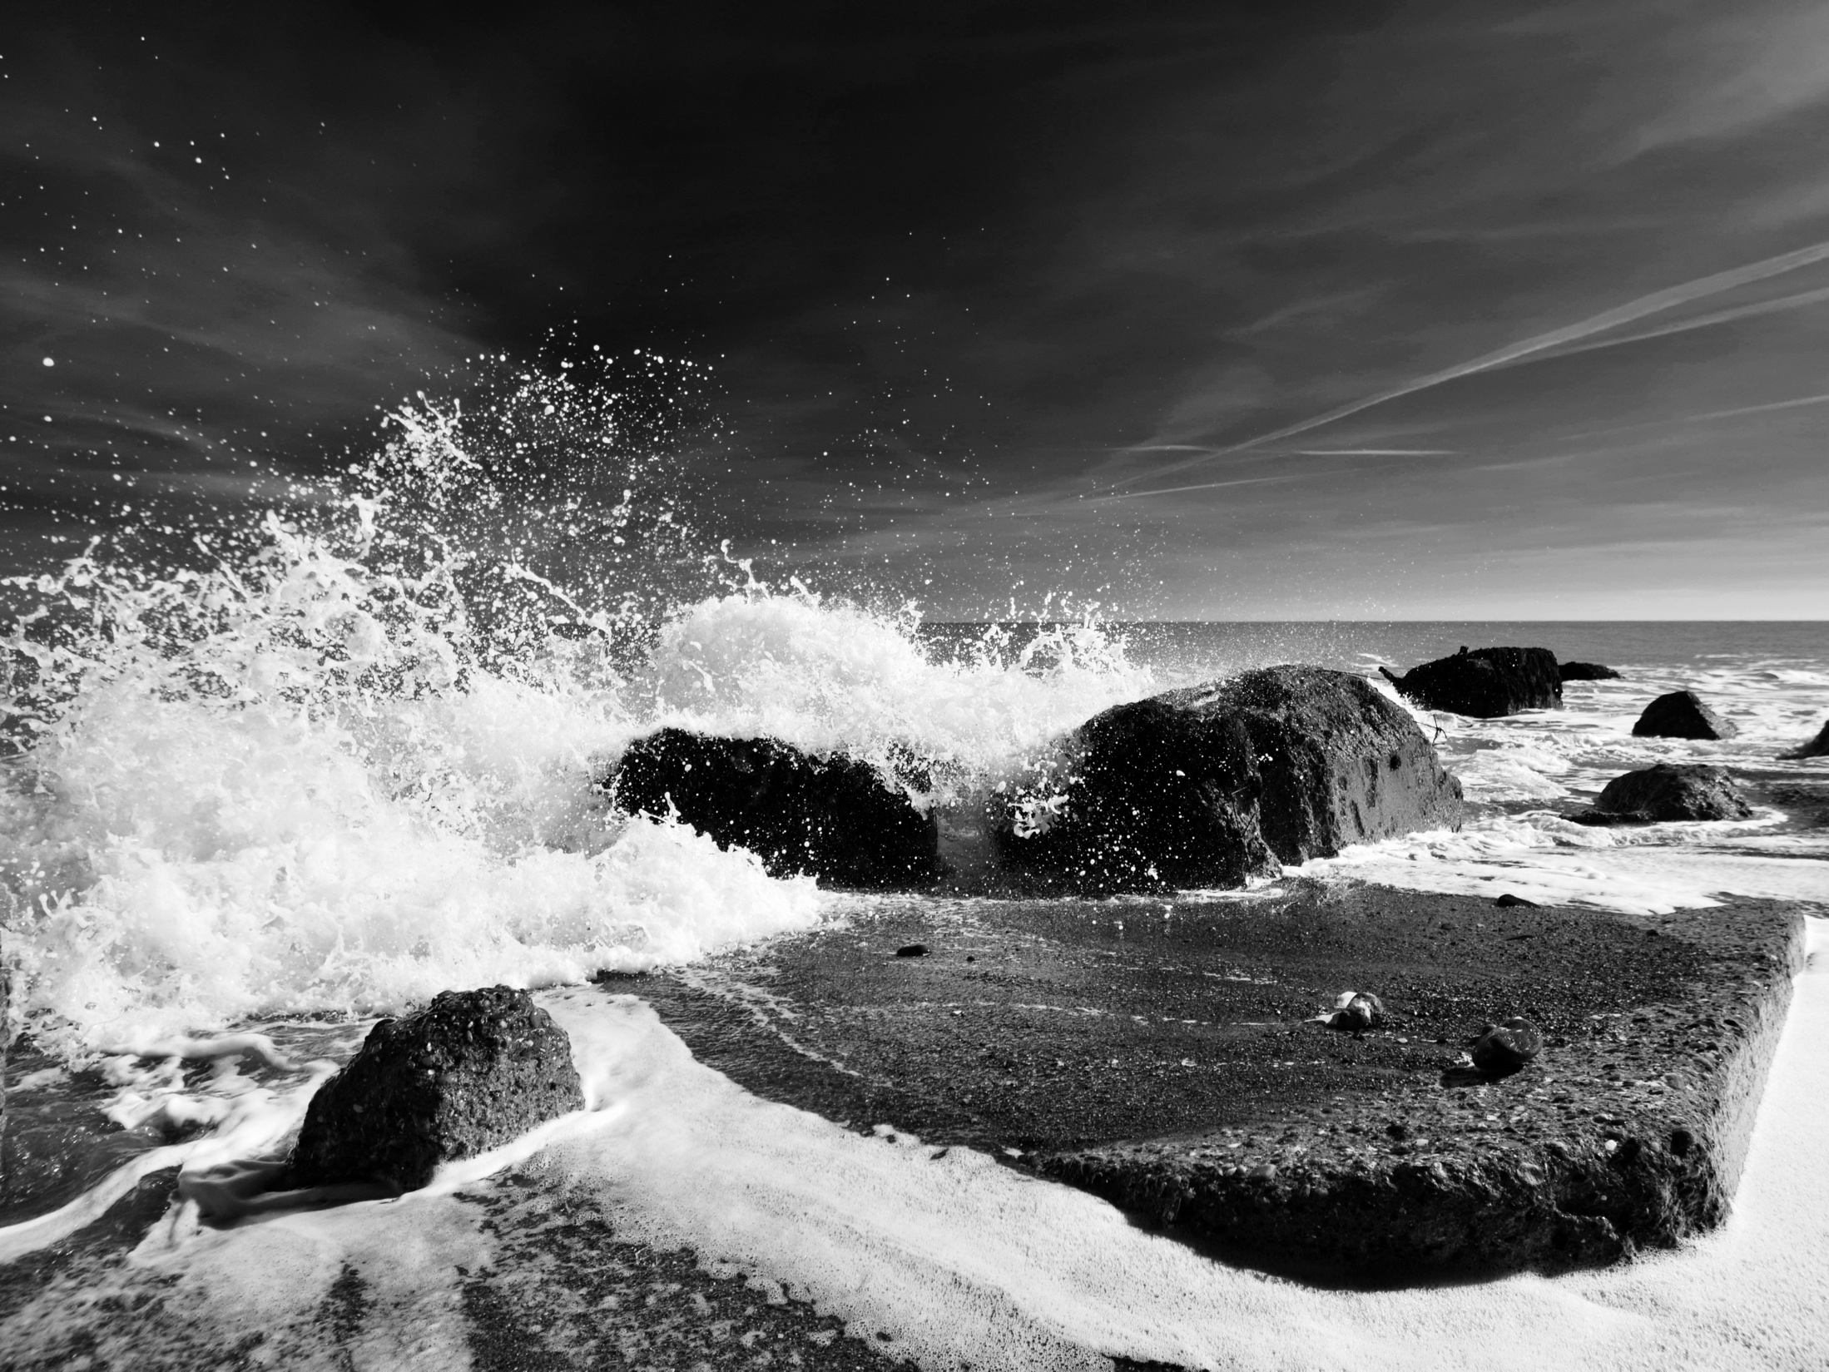
What do you know about waves?

Slide 2
How do waves form and what are their characteristics?
Need to know…
How waves are formed
The factors affecting wave size
The characteristics of destructive and constructive waves

Slide 3
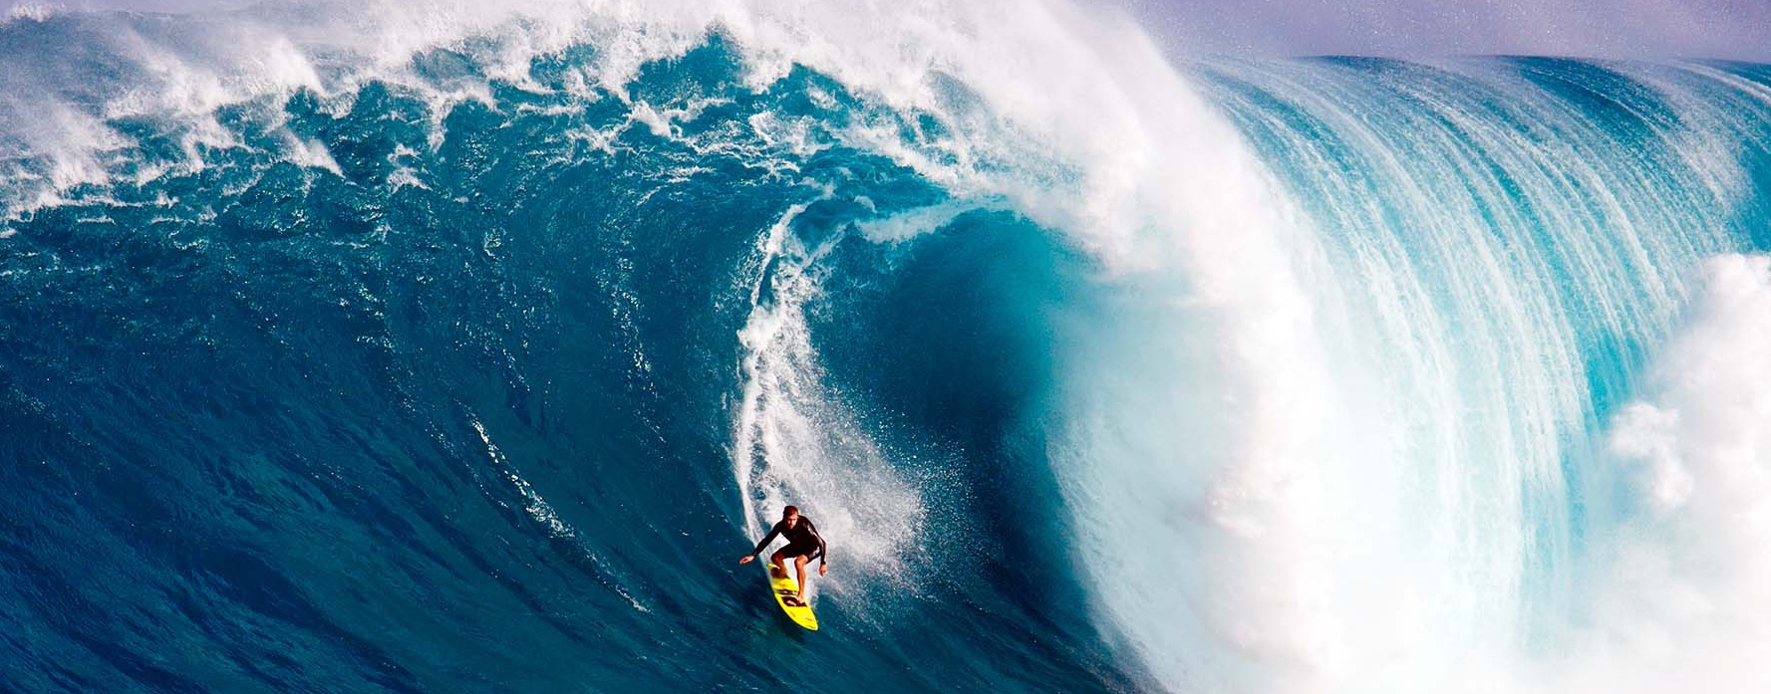
What are waves?
Ripples in the sea caused by the transfer of energy from the wind blowing over the surface.

Slide 4
How to waves form?
1. Ripples form on the surface of the ocean due to friction from the wind.
3. Waves become larger and more organised the further they travel.
2. Fast moving ripples merge with slower ripples. The waves become larger and form sets (straight lines of waves).

Slide 5
What are the characteristics of waves?

Slide 6
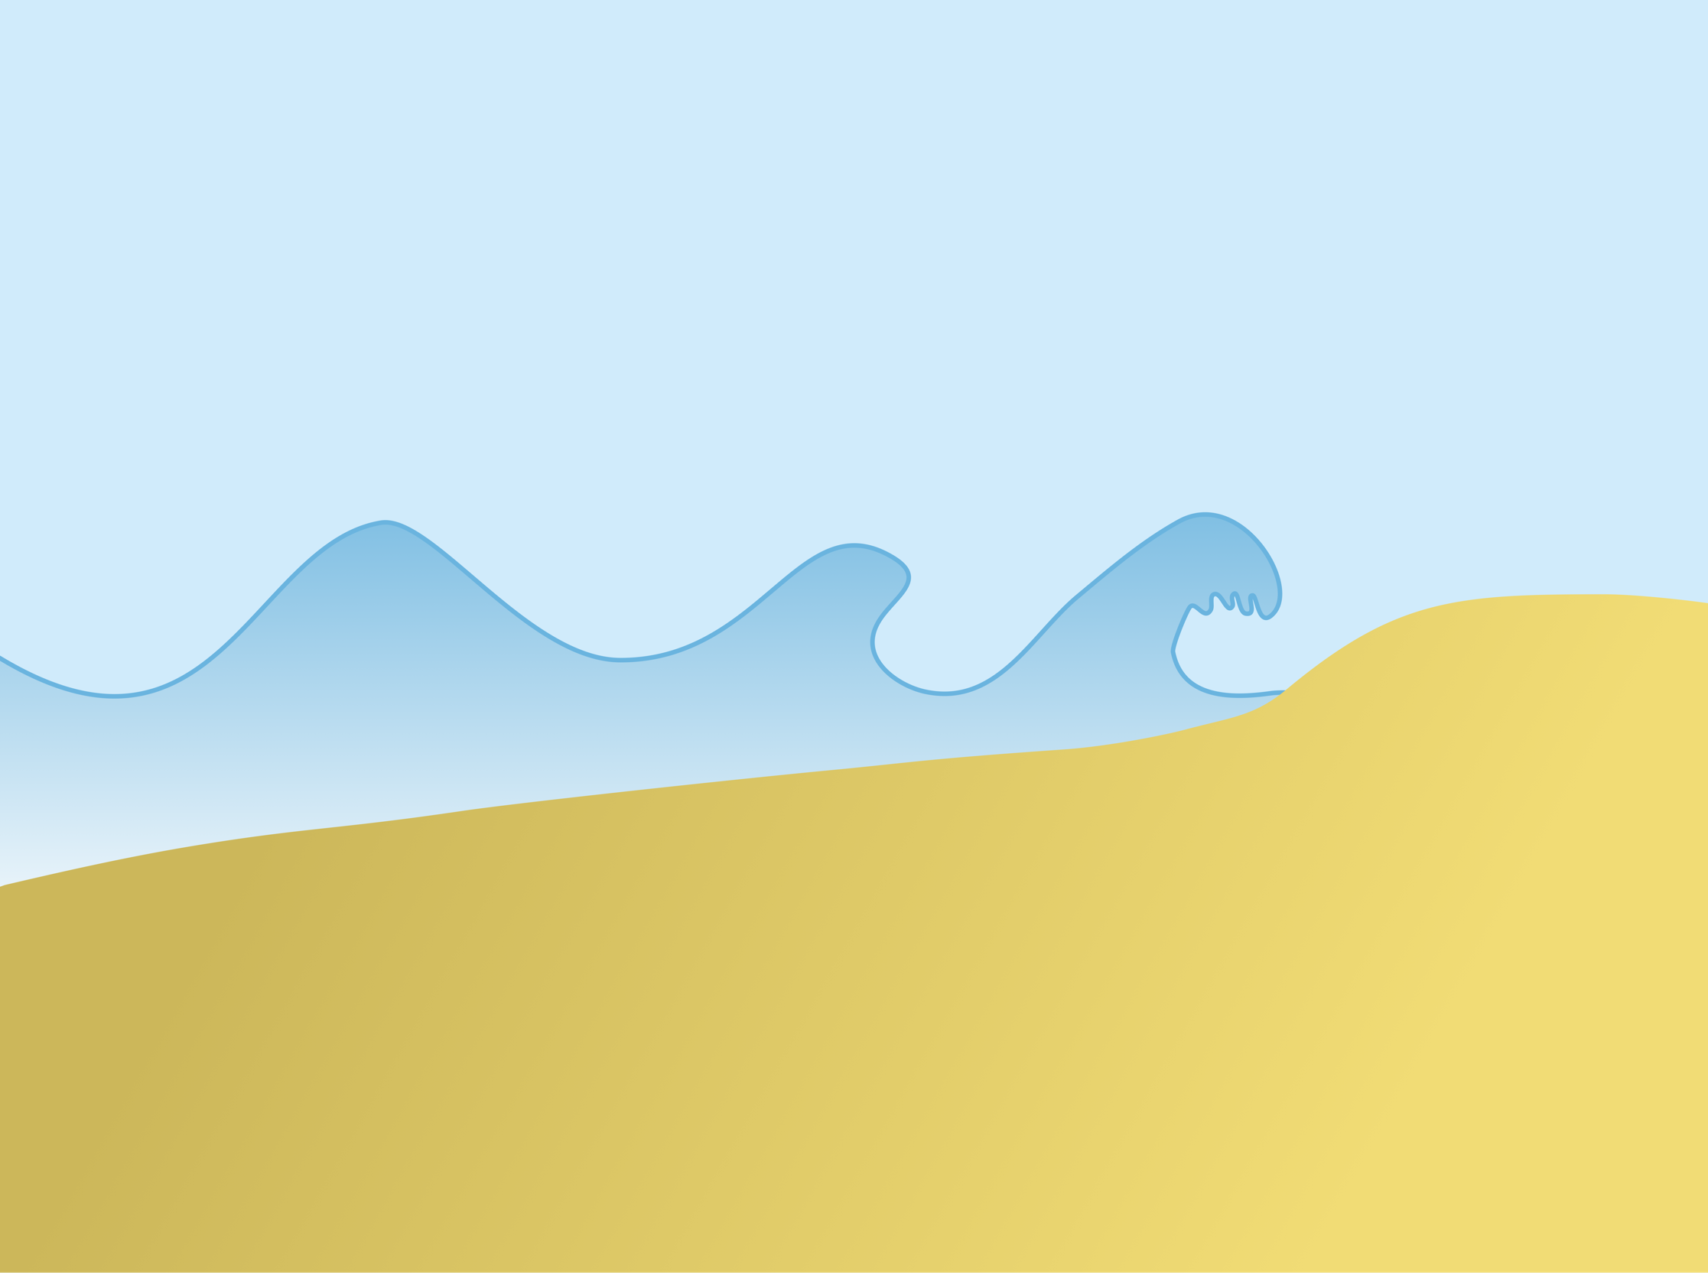
What are the characteristics of waves?
breaking wave gains height
wave crest
base of wave slows
wave length
circular orbit
friction
wave trough
swash
backwash

Slide 7
What affects wave size?

Slide 8
What affects wave size?
Fetch – the distance a wave has travelled.

Slide 9
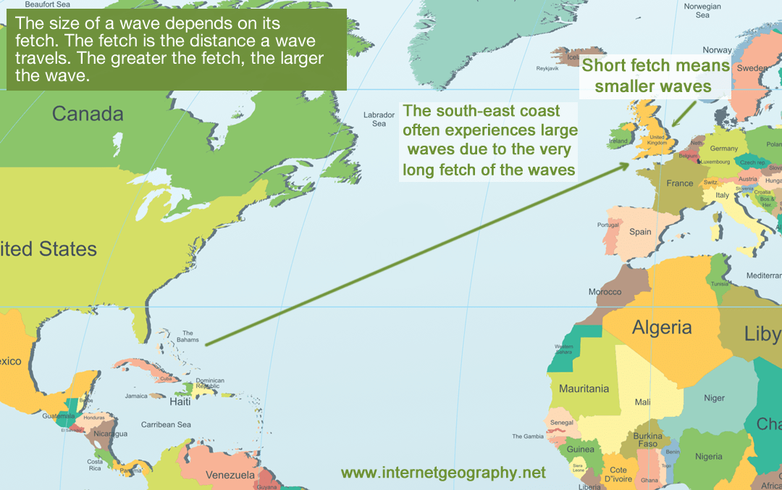
Fetch – the distance a wave has travelled.

Slide 10
What affects wave size?
Fetch – the distance a wave has travelled.
Wind speed – the strength of the wind.
Wind duration – how long the wind has blown over the sea.

Slide 11
How do constructive and destructive waves compare?
Consider:
wave length
wave height
frequency
swash
backwash
constructive wave
destructive wave

Slide 12
What are the characteristics of constructive waves?
breaking wave gains little height and spills onto the beach (spilling waves)
low wave crest
long wave length so low-frequency (8-10 per minute)
friction
wave trough
strong swash
weak backwash

Slide 13
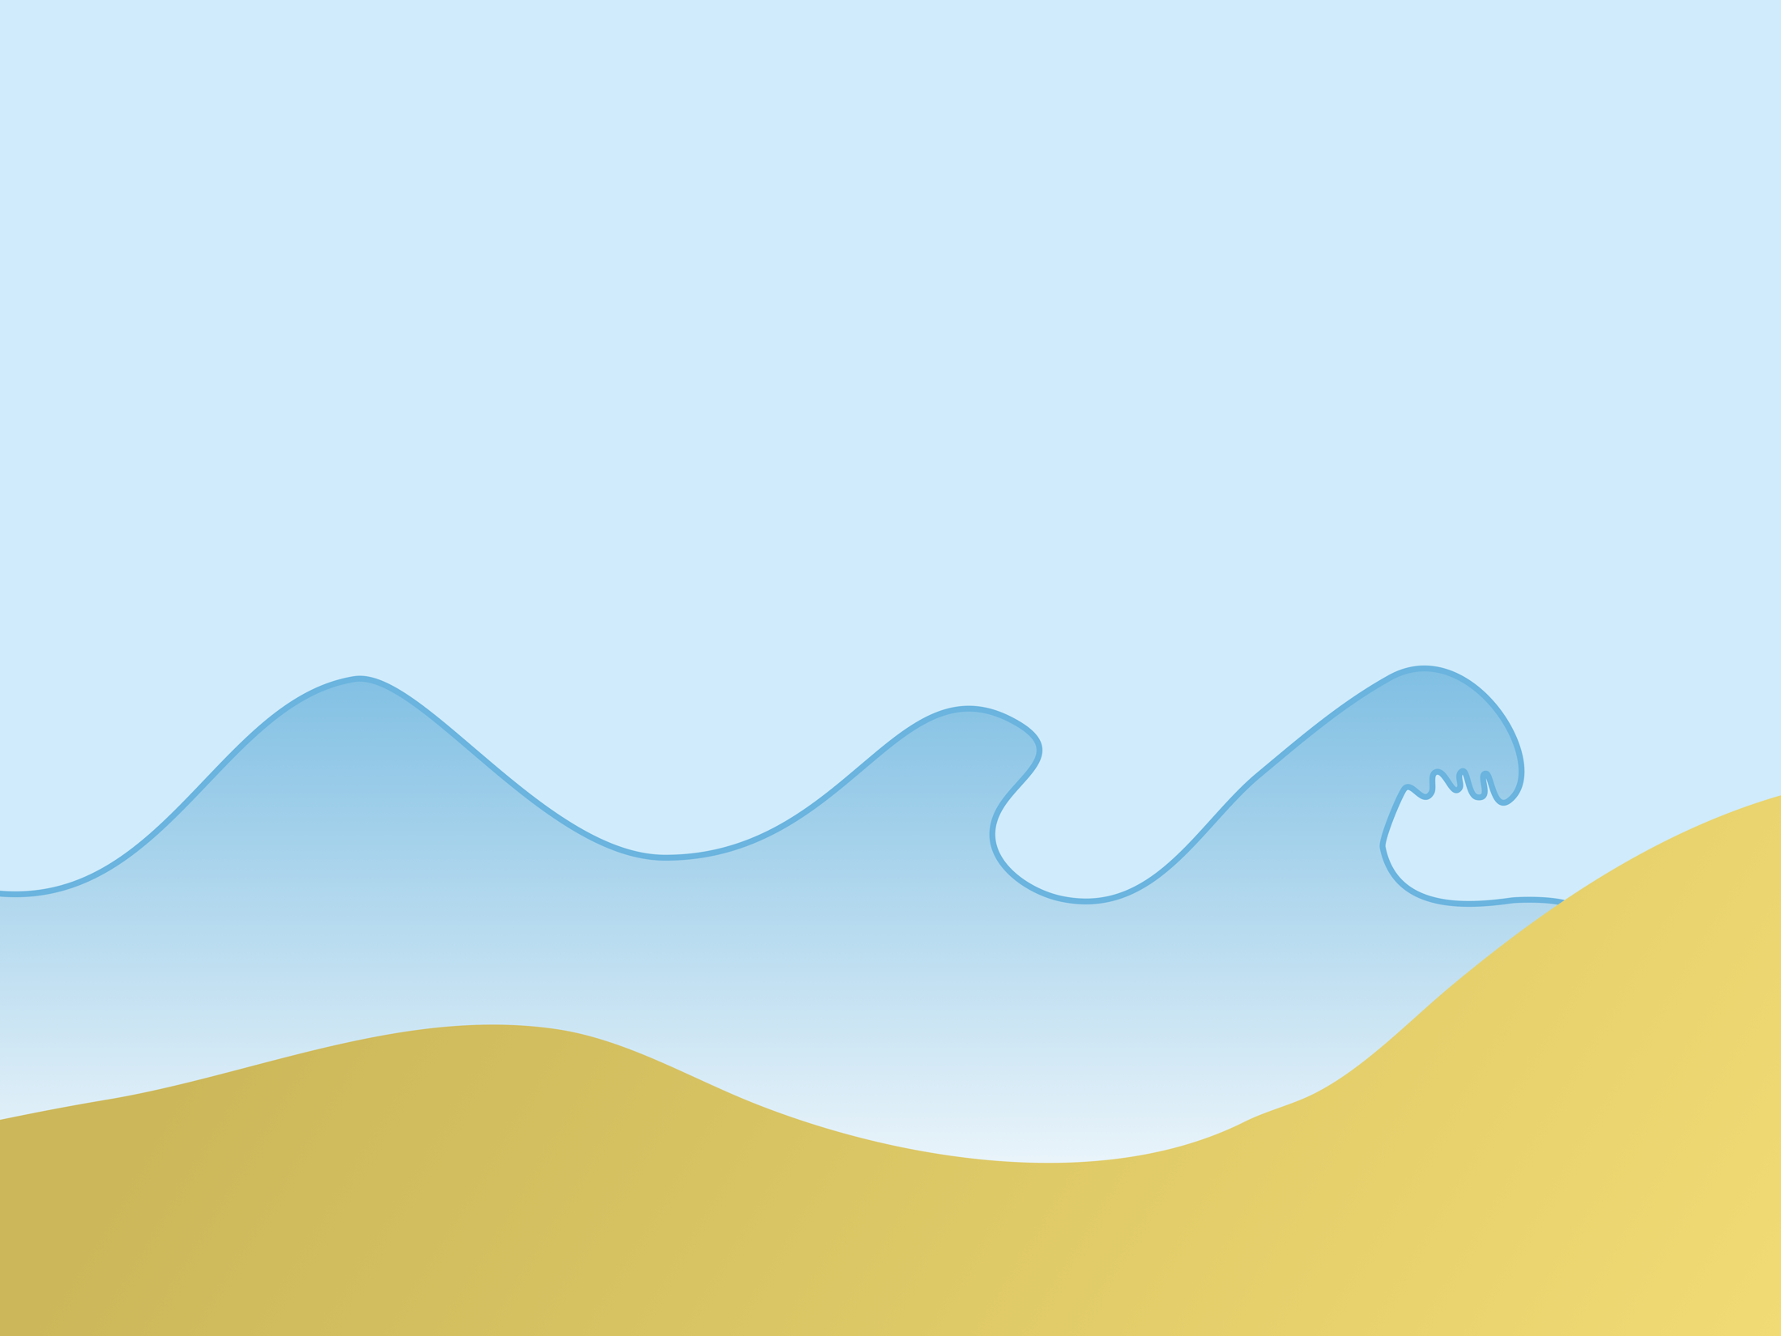
What are the characteristics of destructive waves?
high breaking wave, plunges onto steep beach directing energy downwards (plunging wave)
high wave crest >1m
short wave length high frequency (10-14 per minute)
wave trough
friction
weak swash
strong backwash

Slide 14
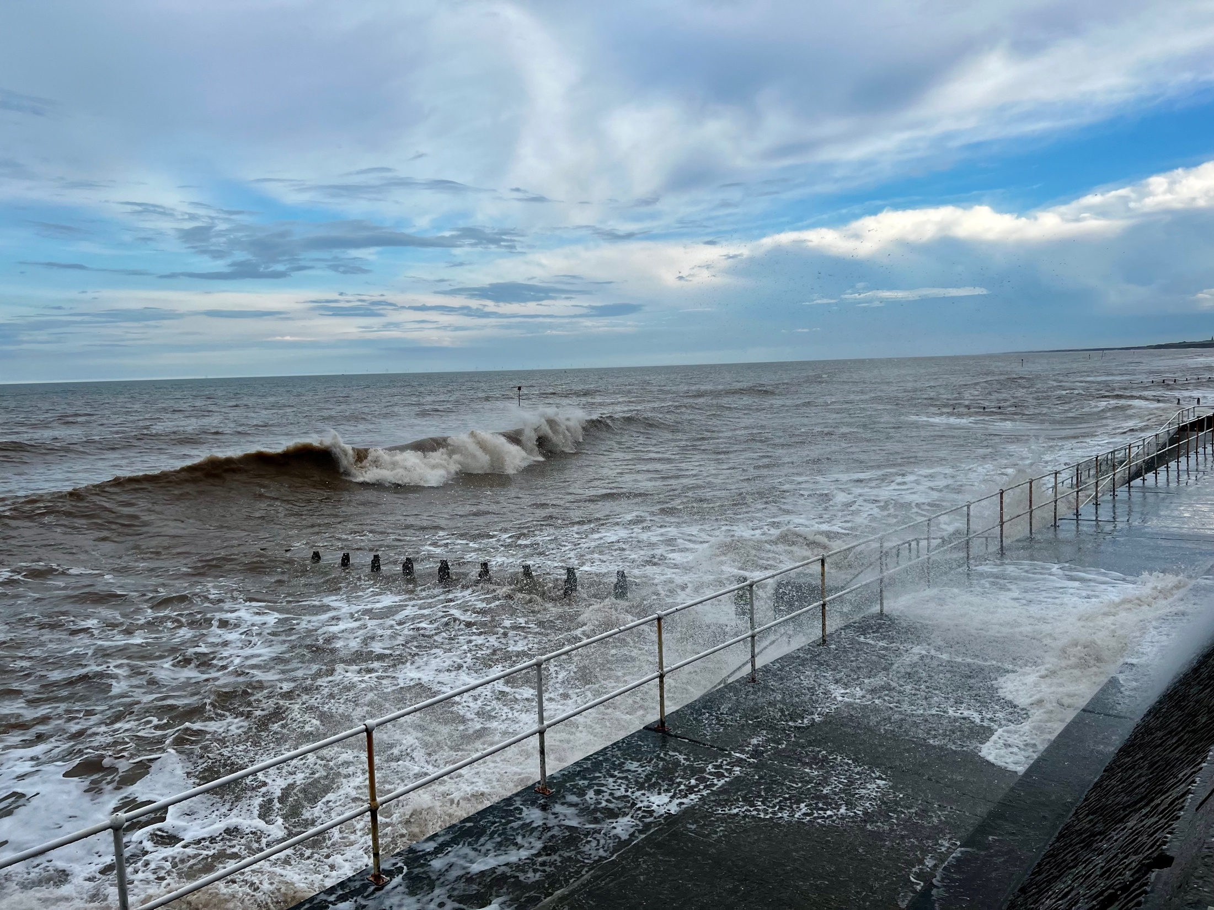
What type of wave? Justify your answer.

Slide 15
What type of wave? Justify your answer.

Slide 16
Additional Resources
Drag and drop these slides to the place in the presentation where you want to use them, or add your own.

Slide 17
Misconceptions
Waves are caused by the tide.
Waves are caused by the wind.
The tide is the rising and falling of the sea caused by the gravitational pull of the Moon and Sun.

Slide 18
Hinge Question
What causes waves?
Tides
The wind
The Sun and Moon

Slide 19
Hinge Question
What causes waves?
Waves are ripples in the sea caused by the transfer of energy from the wind blowing over the surface.

Slide 20
Hinge Question
What is the correct sequence in the formation of a wave?
Fast moving ripples merge with slower ripples. The waves become larger and form sets (straight lines of waves).
Ripples form on the surface of the ocean due to friction from the wind.
Waves become larger and more organised the further they travel.
B > A > C

Slide 21
Hinge Question
Describe the formation of a wave.
Ripples form on the surface of the ocean due to friction from the wind. Fast moving ripples merge with slower ripples. The waves become larger and form sets (straight lines of waves). Waves become larger and more organised the further they travel.

Slide 22
Hinge Question
Which type of wave is most likely to cause erosion?
A destructive wave is more likely to cause erosion than a constructive wave. This is because destructive waves plunge onto the beach so their backwash is stronger than their swash, so beach material is removed. Whereas a constructive wave spills onto a beach and has a stronger swash than backwash, meaning beach material builds up.

Slide 23
True or false?
A wave is a ripple in the sea caused by the transfer of energy from the wind blowing over the surface of the sea.

Slide 24
Interactive Geography
Flashcards
Multiple Choice
Short Answer Qs

Slide 25
definition
diagram
wave
characteristics
a sentence

Slide 26
definition
diagram
constructive wave
characteristics
a sentence

Slide 27
definition
diagram
destructive wave
characteristics
a sentence

Slide 28
Comparing Waves
 | Constructive | Destructive
Wave type
Wave height
Wave length
Energy
Swash
Backwash
Impact on beach

Slide 29
Definitions Flashcards
A ripple in the sea caused by the transfer of energy from the wind blowing over the surface of the sea.
The distance between wave crests.
wave
Wavelength
constructive waves
destructive waves
Low energy, less frequent waves that have a stronger swash than backwash.
High energy, more frequent waves that have a stronger backwash than swash.
This causes a wave to break when it comes into contact with the beach.
The distance a wave has travelled.
friction
fetch

Slide 30
Keyword Flashcards
A ripple in the sea caused by the transfer of energy from the wind blowing over the surface of the sea.
wave
wavelength
The distance between wave crests.
constructive waves
destructive waves
Low energy, less frequent waves that have a stronger swash than backwash.
High energy, more frequent waves that have a stronger backwash than swash.
friction
fetch
This causes a wave to break when it comes into contact with the beach.
The distance a wave has travelled.

Slide 31
Beat the examiner
Figure 1
Using Figure 1, compare two features of destructive and constructive waves. [2 marks]
1 _________________________________________________ ___________________________________________________2 _________________________________________________ ___________________________________________________

Slide 32
Beat the examiner
Figure 1
similarities/differences:
however | whereas | in comparison
Using Figure 1, compare two features of destructive and constructive waves. [2 marks]
1 _________________________________________________ ___________________________________________________2 _________________________________________________ ___________________________________________________

Slide 33
Beat the examiner
Answers should state similarities or differences. Credit 1 mark for two separate statements on the same feature.
Constructive waves are spilling whereas destructive waves are plunging (1)
Destructive wave crests are close together but constructive crests are far apart/destructive waves have a shorter wavelength/Destructive waves are closer together (1)
Constructive waves have strong swash whereas destructive waves have strong backwash (1)
Destructive waves are steeper (1)
Destructive waves are higher (1)
Constructive waves have a lower height (than destructive waves) (1)
Destructive waves have high energy whereas constructive waves have lower energy (1)
Constructive waves help to build up the beach whereas destructive waves remove material (1)
AO4 – 2 marks

Slide 34
Videos
How are waves formed? – Internet Geography
The characteristics of waves – Geography Hawks
Types of waves – Time for Geography

