Slide 1


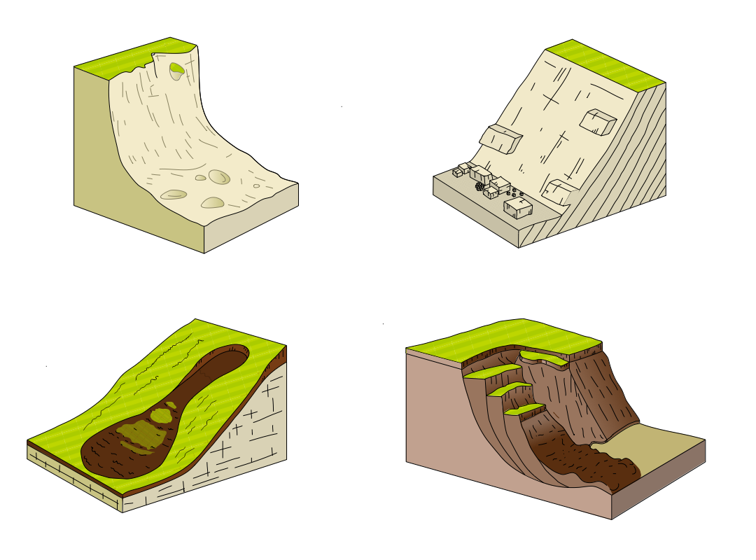
Mass Movement Worksheet
Scan me
https://tinyurl.com/mass-move
Match up the keywords
Identify the influences for each Mass Movement
Mass movement |  | Large blocks of rock slide downhill.
Slumping |  | Saturated soil (soil filled with water) flows down a slope.
Landslide |  | The downhill movement of cliff material along a slip-plane.
Rockfall |  | The downhill movement of cliff material under the influence of gravity.
Mudslide |  | Pieces of rock fall off the cliff face, usually due to freeze-thaw weathering.
 | Rockfalls | Landslides | Mudslides | Slumping
Water
Cold temps
Hot temps
Gravity
Vegetation
Hard geology
Soft geology
Annotate the diagram to explain rockfalls
Annotate the diagram to explain landslides
Annotate the diagram to explain mudslides
Annotate the diagram to explain slumping

Slide 2
Mass Movement Worksheet
Scan me
https://tinyurl.com/mass-move
Match up the keywords
Identify the influences for each Mass Movement
Mass movement |  | Large blocks of rock slide downhill.
Slumping |  | Saturated soil (soil filled with water) flows down a slope.
Landslide |  | The downhill movement of cliff material along a slip-plane.
Rockfall |  | The downhill movement of cliff material under the influence of gravity.
Mudslide |  | Pieces of rock fall off the cliff face, usually due to freeze-thaw weathering.
 | Rockfalls | Landslides | Mudflows | Slumping
Water | x | x | x | x
Cold temps | x | x
Hot temps
Gravity | x | x | x | x
Vegetation | x | x
Hard geology | x | x
Soft geology |  |  | x | x
Annotate the diagram to explain rockfalls
Annotate the diagram to explain landslides
Fragments of rock
break away from
the cliff face due to
weathering e.g.
freeze-thaw
Cliff retreats
Blocks of rock slide downhill
Cliff face
Slide plane
Angular boulder field at the foot of the cliff
Bedding planes
Scree on the beach
Wave-cut platform forms as the cliff retreats
Annotate the diagram to explain mudflows
Annotate the diagram to explain slumping
Large lobe of soil and debris at the bottom of the slope
Soil overlying bedrock
The sea erodes a wave-cut notch, undercutting the cliff
Main scarp
Head
Bedrock
Minor scarp
Saturated soil flows downslope
Saturated soil slumps along a curved slip plane
Toe

