Slide 1

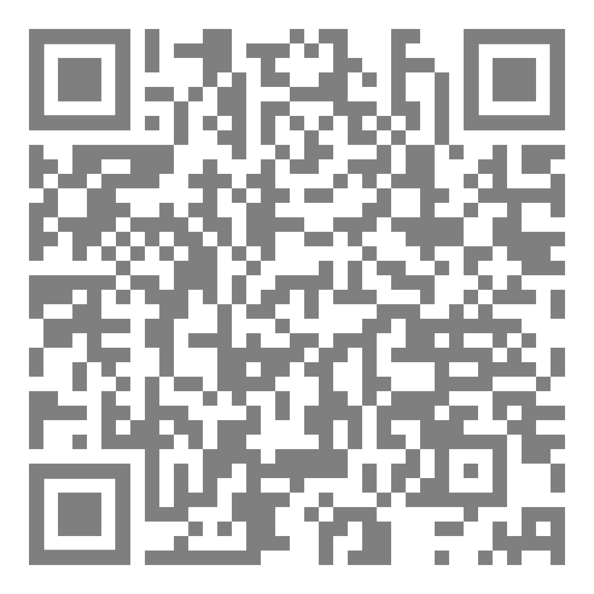

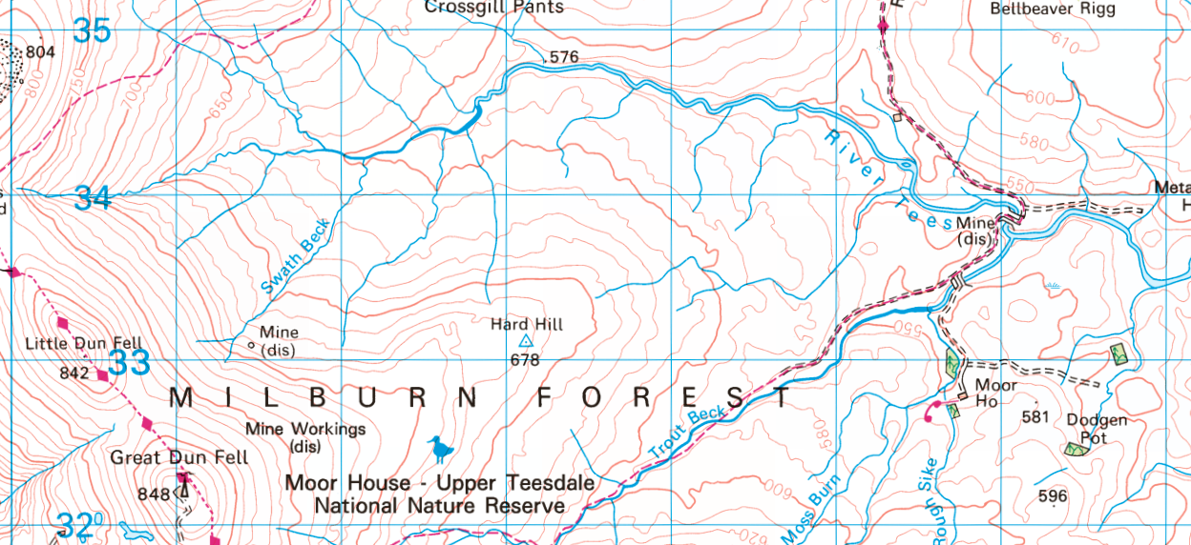
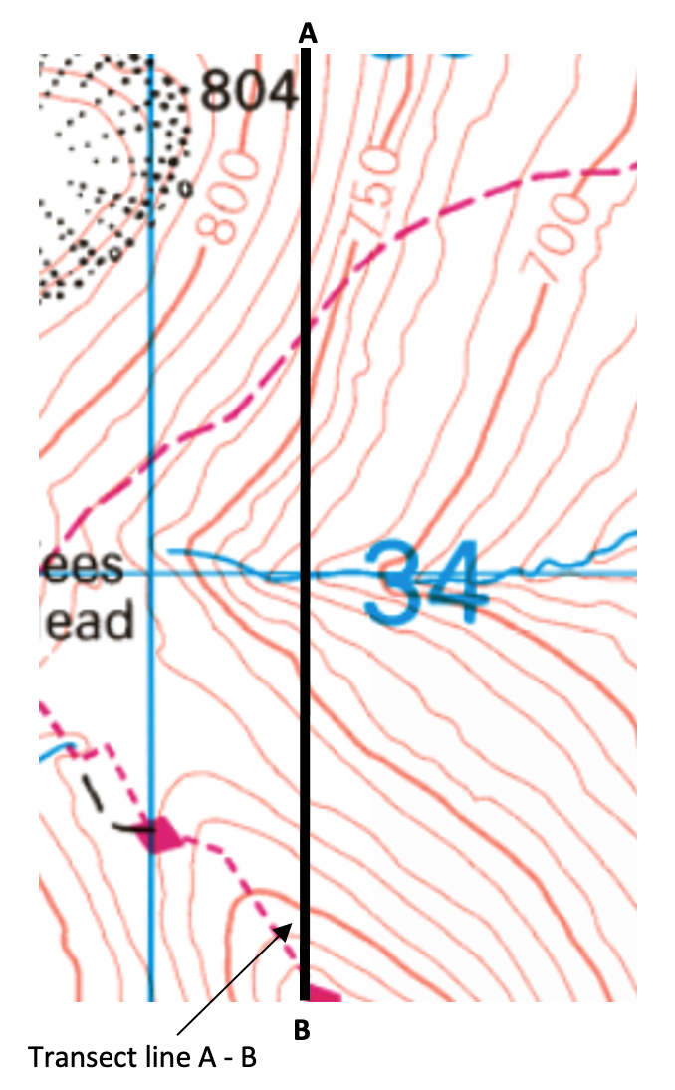
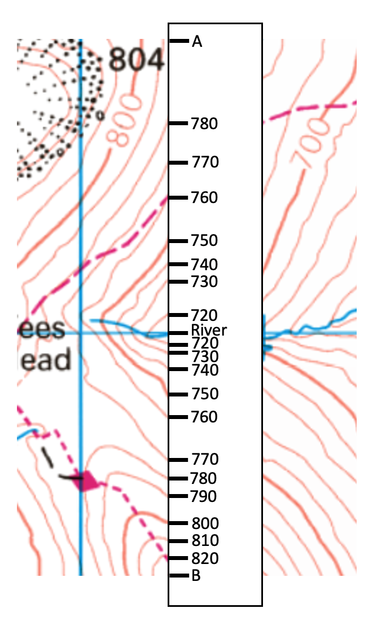
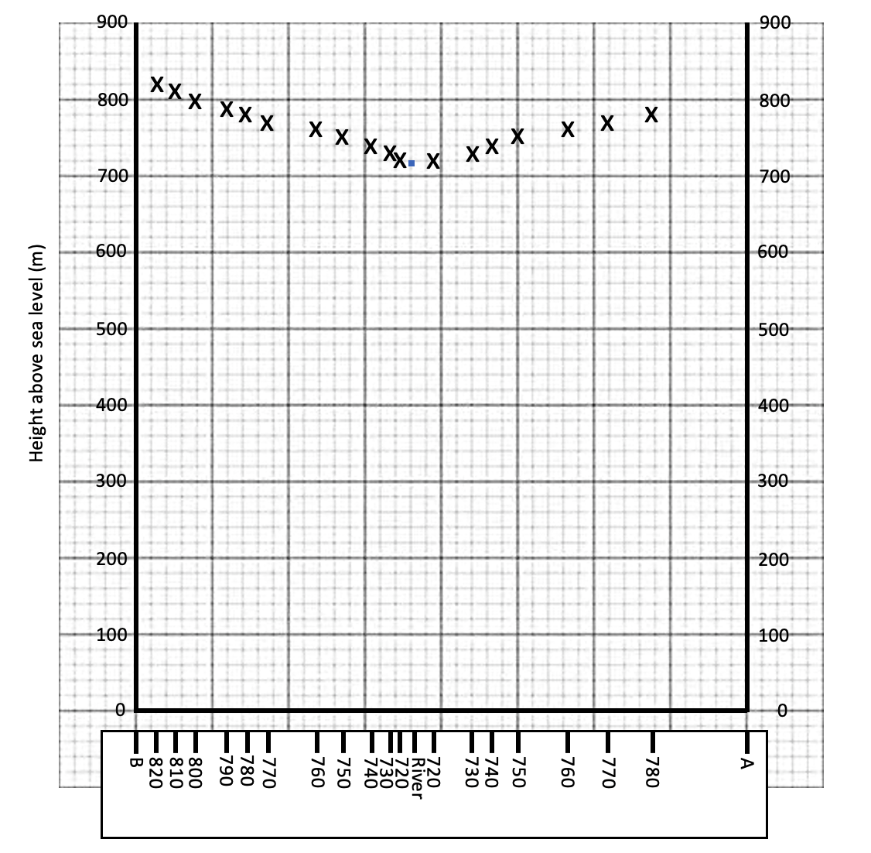
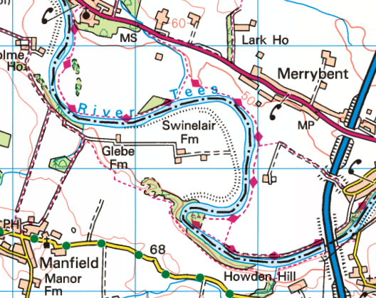
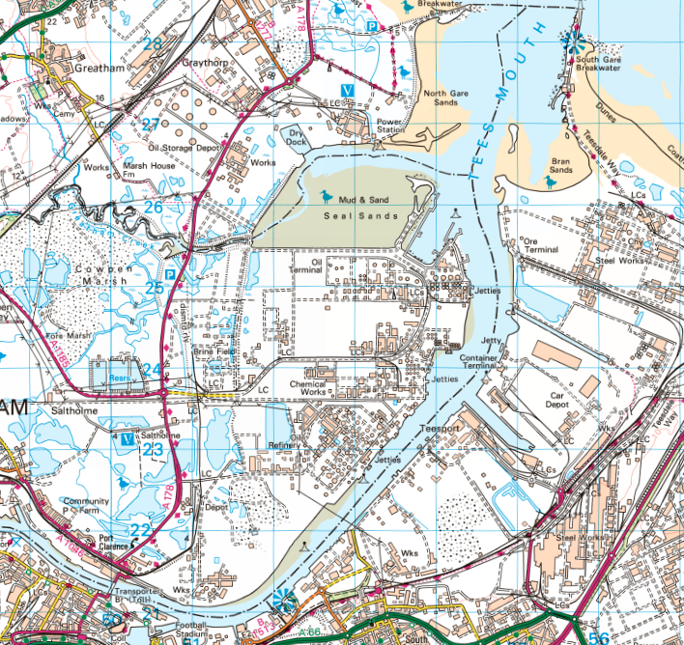
River Features on an OS Map
Identifying River Features
Cross Sections
A cross section shows changes in relief along a chosen line. It is a graph which shows distance along the x-axis (horizontal) and height on the y-axis (vertical).
V-shaped valley
V-shaped contours, point upstream (towards the source). Their proximity shows a steep valley.
Creating a cross section
Place the edge of a piece of paper along the line A-B
Mark the heights of the contour lines where the paper crosses them. Include any spot heights that the line crosses.
On graph paper, draw the horizontal (x ) axis, the same length as the transect, using a pencil and ruler. Check the maximum height of the contours along the cross-section, then create an appropriate Y-axis scale. Label the Y axis. Use your strip of paper to plot the heights as shown.
Use a pencil to draw a smooth line connecting the points you have plotted.
Upper Course
Source
Tributary
Confluence
Lateral erosion
Contour close to meander shows erosion of valley sides
Flood plain
Lack of contours indicates its formation
Flood plain
Extensive areas of flat land indicate wide flood plain
Middle Course
Lower Course
Meanders
Levée
Black line on riverbank.
Meander
Large, looping meander
Mouth
River enters the sea

