Slide 1

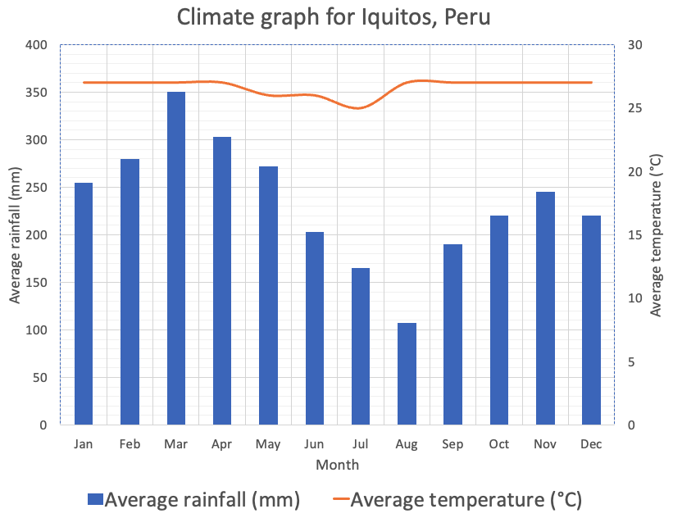
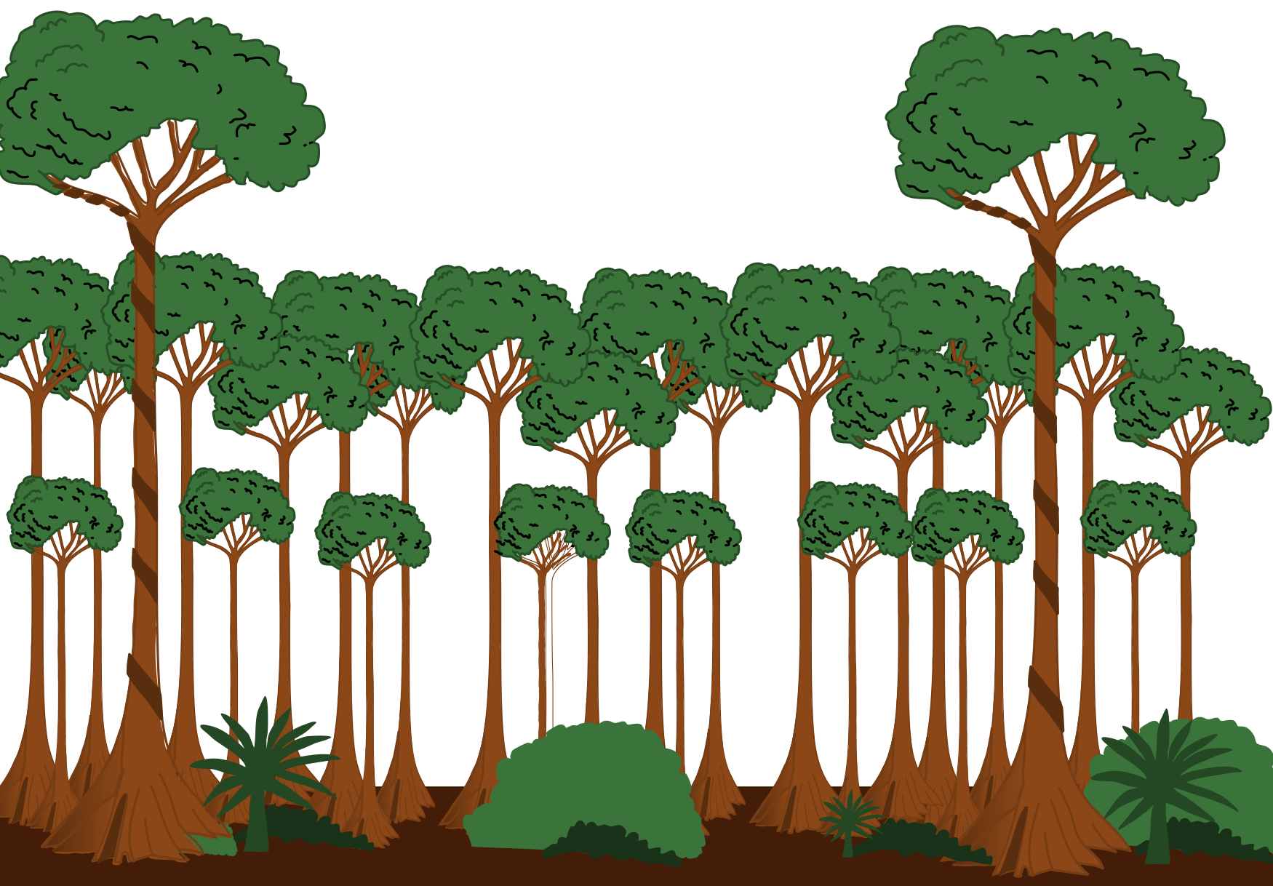
LW4
Learning Review - 4
The physical characteristics of a tropical rainforest
2. Using Figure 1, describe one characteristic of the base of
taller trees.
Study Figure 1, a diagram showing the structure of the tropical rainforest.
/ 1
3. Outline one reason for the distribution of tropical rainforest.
Figure 1
Study Figure 2, a climate graph for one global ecosystem.
40 m
Figure 2
Emergent layer
30 m
Canopy
20 m
/ 2
Under
canopy
10 m
4. Name the continent with the largest area of hot desert.
Understorey
Ground
cover
/ 1
0 m
1. Using Figure 1, which part of the rainforest matches the following
description?
An almost continuous layer of branches and leaves between 20 and
25 metres high.
Emergent layer
Canopy
Under canopy
Understorey
3. Which global ecosystem is most likely to have the temperature and
precipitation pattern shown in Figure 2.
Temperate deciduous forest
Hot desert
Tropical rainforest
Savanna
/ 1
/ 1

Slide 2
LW4
Learning Review - 4
The physical characteristics of a tropical rainforest
Study Figure 3, a diagram showing the rainforest
nutrient cycle
Figure 3
Rainfall
Biomass
Fallout
pathway
4. Calculate the temperature range for the global ecosystem shown in
Figure 2.
Litter
3. Outline one reason for the distribution of tropical rainforest.
°C
/ 1
Biomass store
(tonnes carbon / hectare)
Trunk 120
Branches. 80
Leaves. 10
Roots 30
5. Which one of the following statements describes the climate of a
tropical rainforest?
Mild temperatures (10–18 ºC), rainfall all year (approximately 1000 mm)
High temperatures all year (over 30 ºC), very dry (250 mm of rainfall per year)
High temperatures all year (25–27 ºC), rainfall in every month (1800–2000 mm per year)
Wide range of temperatures (15–30 °C), seasonal rainfall (approximately 750 mm)
Decay
pathway
Uptake
pathway
Runoff
Key
Soil
Nutrient store (circle size proportional amount stored)
Nutrient flow (width proportional to amount of nutrient flow)
Leaching
Weathering
/ 2
/ 1
7. Using Figure 3, what percentage of the biomass is stored in tree
trunks?
30%
40%
50%
60%
4. Name the continent with the largest area of hot desert.
6. Suggest one reason for high biodiversity levels in tropical
rainforests.
/ 1
/ 1
8. Outline one reason why nutrients are rapidly recycled in rainforests.
/ 2
/ 1

Slide 3
LW4
Learning Review - 4
The physical characteristics of a tropical rainforest
12. Suggest one reason for the low nutrient content in rainforest soils.
9. Suggest why biomass is the largest store in the tropical rainforest.
/ 2
/ 2
10. Give one reason why tropical rainforests experience high
temperatures throughout the year.
/ 1
11. Which of the following statements does not describe rainforest soil.
Soils are very high in nutrient content.
Soils are very low in nutrient content.
Soils are typically red in colour due to them being rich in iron.
Nutrients are rapidly washed (leached) out of the soil by heavy rainfall.
/ 1

Slide 4
LW4
Learning Review - 4
The physical characteristics of a tropical rainforest
2. Using Figure 1, describe one characteristic of the base of
taller trees.
Buttressed roots (1)
The base is wider than the rest of the trunk (1)
Wide base (1)
Study Figure 1, a diagram showing the structure of the tropical rainforest.
/ 1
3. Outline one reason for the distribution of tropical rainforest.
Figure 1
Study Figure 2, a climate graph for one global ecosystem.
40 m
Emergent layer
30 m
Canopy
20 m
/ 2
Under
canopy
10 m
4. Name the continent with the largest area of hot desert.
Understorey
Ground
cover
/ 1
0 m
1. Using Figure 1, which part of the rainforest matches the following
description?
An almost continuous layer of branches and leaves between 20 and
25 metres high.
Emergent layer
Canopy
Under canopy
Understorey
3. Which global ecosystem is most likely to have the temperature and
precipitation pattern shown in Figure 2.
Temperate deciduous forest
Hot desert
Tropical rainforest
Savanna
√
/ 1
√
/ 1

Slide 5
LW4
Learning Review - 4
The physical characteristics of a tropical rainforest
Study Figure 3, a diagram showing the structure of the
tropical rainforest.
Figure 3
Rainfall
Biomass
Fallout
pathway
4. Calculate the temperature range for the global ecosystem shown in
Figure 2.
Litter
3. Outline one reason for the distribution of tropical rainforest.
3
°C
/ 1
Biomass store
(tonnes carbon / hectare)
Trunk 120
Branches. 80
Leaves. 10
Roots 30
5. Which one of the following statements describes the climate of a
tropical rainforest?
Mild temperatures (10–18 ºC), rainfall all year (approximately 1000 mm)
High temperatures all year (over 30 ºC), very dry (250 mm of rainfall per year)
High temperatures all year (25–27 ºC), rainfall in every month (1800–2000 mm per year)
Wide range of temperatures (15–30 °C), seasonal rainfall (approximately 750 mm)
Decay
pathway
Uptake
pathway
Runoff
Key
Soil
Nutrient store (circle size proportional amount stored)
Nutrient flow (width proportional to amount of nutrient flow)
Leaching
√
Weathering
/ 2
/ 1
7. Using Figure 3, what percentage of the biomass is stored in tree
trunks?
30%
40%
50%
60%
4. Name the continent with the largest area of hot desert.
6. Suggest one reason for high biodiversity levels in tropical
rainforests.
√
/ 1
1 mark for point, further mark for development (d)
Area X receives very high rainfall (1) which allows many plants to grow (d) (1).
Area X experiences high temperatures and high rainfall (1) which means that plants grow rapidly (d) (1).
Area X receives some rain in every month (1) which means that plants grow throughout the year (d) (1).
There is a hot wet climate (1) which leads to the growth of many plants in a tropical rainforest (d) (1).
/ 1
8. Outline one reason why nutrients are rapidly recycled in rainforests.
The hot, damp conditions allow for the rapid decomposition of dead plant material. (1)
The high temperatures and high rainfall cause rapid cycling of nutrients. (1)
Tall, dense and fast growth of vegetation. (1)
High rainfall (1) | High temperatures (1) Warm conditions (1)
Moist conditions (1) High humidity (1)
There are large numbers of decomposers (on the forest floor)(1)
/ 2
/ 1

Slide 6
LW4
Learning Review - 4
The physical characteristics of a tropical rainforest
9. Suggest why biomass is the largest store in the tropical rainforest.
1 mark for point, further mark for development (d)
The biomass is larger because there are more nutrients stored in the biomass than in the soil or litter (1) This is because plants take up the nutrients rapidly and nutrients in the soil can be lost through leaching (1) (d)
Biomass is the largest store in tropical rainforests due to the rapid growth rates of plants (1). These regions have year-round warm temperatures and high rainfall, which leads to faster photosynthesis and growth (1)(d).
The biodiversity in tropical rainforests contributes to a large biomass store (1). The wide variety of plant species, including tall trees, shrubs, and undergrowth, means there is more living organic matter at any given time (1)(d).
Tropical rainforests have high primary productivity because of the constant availability of sunlight throughout the year.(1) This means that plants can convert more sunlight into biomass via photosynthesis, leading to a larger biomass store. (1)(d)
/ 2
10. Give one reason why tropical rainforests experience high
temperatures throughout the year.
12. Suggest one reason for the low nutrient content in rainforest soils.
The sun’s energy is more concentrated. (1)
Intense sunlight to be consistently distributed over the area all year round close to the equator. (1)
There is little variation in the angle of the sun throughout the seasons. (1)
1 mark for point, further mark for development (d)
Rainforest soils are subject to a process called leaching, where heavy rainfall washes away the soluble nutrients from the soil, leaving it nutrient-poor. (1) Intense and frequent rainstorms mean that nutrients do not have time to accumulate and are quickly removed from the soil. (d) (1)
The warm and moist conditions promote rapid decomposition of organic matter. (1) While this initially releases nutrients, the high rate of decomposition means that these nutrients are quickly consumed by the dense vegetation or washed away by rain. (d) (1)
The soils in rainforests are often very thin due to the underlying rock being close to the surface. (1) This lack of depth limits the amount of organic material that the soil can hold, reducing its capacity to retain nutrients which are essential for plant growth. (d) (1)
/ 1
11. Which of the following statements does not describe rainforest soil.
Soils are very high in nutrient content.
Soils are very low in nutrient content.
Soils are typically red in colour due to them being rich in iron.
Nutrients are rapidly washed (leached) out of the soil by heavy rainfall.
√
/ 2
/ 1

