Slide 1


Paper 3 Pre-release 2024
AQA GCSE Geography
Work Booklet 3

Slide 2

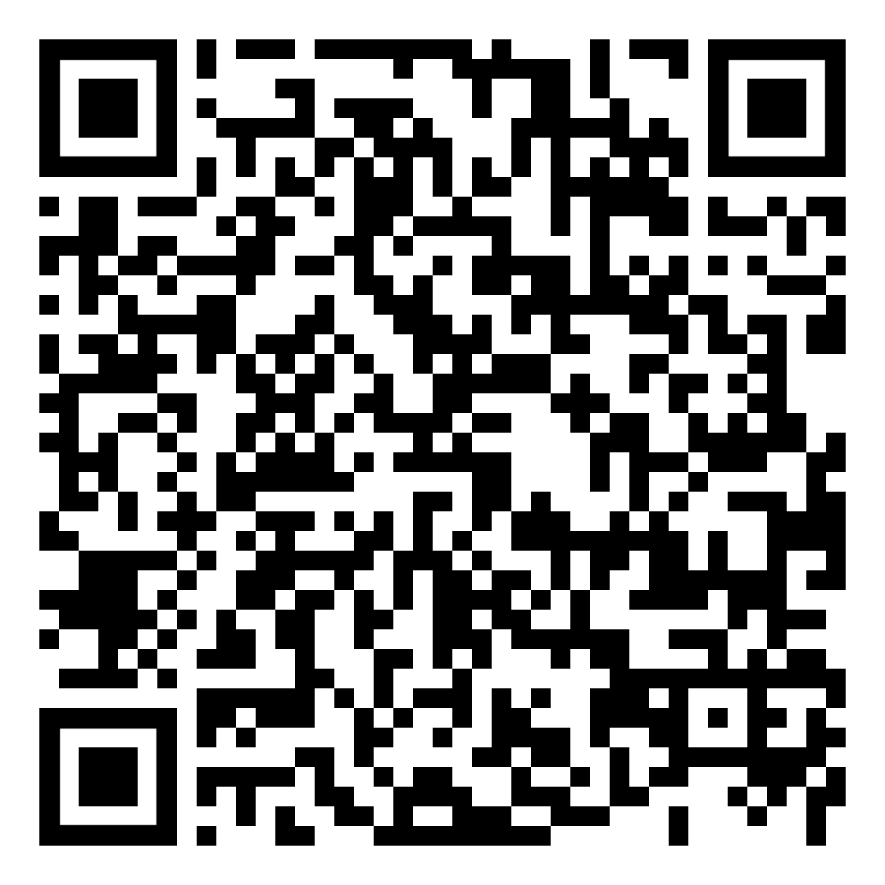
Figure 3 – Key Terms
Below are the key terms used in figure 3. You need to
know what each term means and be able to use it in sentence.
Affordable housing | Renewable energy
Commuter settlement | Solar farm
Congestion | Sustainability
Drainage systems | Sustainable settlement
Flood plain | Sustainable transport
Habitats | Unsustainable
Heritage buildings | Urban sprawl
Infrastructure

Slide 3





Figure 3 Different Perspectives
Investigate
Using page 6 of the resource booklet, complete the questions below to familiarise yourself with the key features of the scheme.
Apply
How is sustainable transport one of the main principles of the proposed village?
How will energy be generated?
What is the plan for local ancient woodland and valuable habitats?
What will be done regarding existing heritage buildings in the proposed areas?
How will housing be developed to meet the needs of a range of people?
Outline the economic opportunities that will be developed as part of the scheme.
Give an overview of the leisure and recreation opportunities included in the scheme.
How will water supply and drainage be managed?
Data presentation
Data skills
Use either page 3 and 4 OR page 5 and 6
Map skills

Slide 4
Figure 3 Different Perspectives
Investigate
Using page 7 of the resource booklet, complete the questions below to familiarise yourself with objections to the scheme.
Apply
What are the characteristics of the land proposed for development? How is the land featured in the proposal currently used?
What issues might occur if the new village were to become a commuter settlement?
What might be the impact of the development be on existing places?
What impacts might the development have on transport infrastructure?
In the short-term, how might the development cause problems in the local area?
Why are additional hard surfaces in the area a concern?
What are the concerns about the existing electricity and sewage infrastructure?
What are the concerns about the impact of the development on local services?
What are the concerns relating to housing?
Data presentation
Data skills
Use either page 3 and 4 OR page 5 and 6
Map skills
Define social, economic, and environmental sustainability.
Give a brief justification for your choice.

Slide 5







Figure 3 Different Perspectives
Investigate
Using page 6, identify the key features of the scheme.
Apply
Housing
Transport
Data presentation
Data skills
Use either page 3 and 4 OR page 5 and 6
Infrastructure
Commercial
Map skills
Leisure and recreation
Heritage
Ecosystems
Define social, economic, and environmental sustainability.
Give a brief justification for your choice.

Slide 6
Figure 3 Different Perspectives
Investigate
Using page 7, identify the key issues with the scheme.
Apply
Housing
Transport
Data presentation
Data skills
Use either page 3 and 4 OR page 5 and 6
Infrastructure
Commercial
Map skills
Leisure and recreation
Heritage
Ecosystems
Define social, economic, and environmental sustainability.
Give a brief justification for your choice.

Slide 7
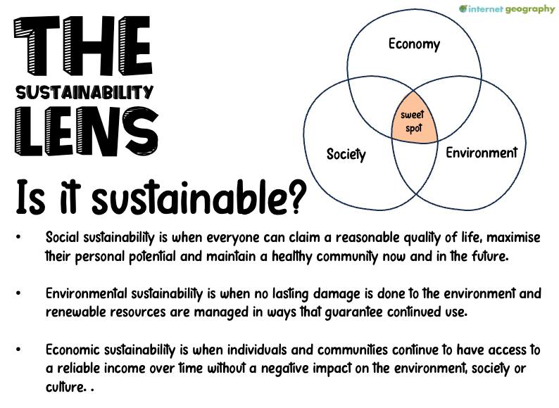


Figure 3 Different Perspectives
Investigate
Based on Figure 3, annotate the diagram below to show the sustainable features of the proposed development. Next, identify the features that are not sustainable. Tip: Read The bullet point list on p7 before doing this.
Apply
Data presentation
Data skills
Map skills
environmental
Review this and the next 3 pages and decide which to use.
economic
social

Slide 8
Figure 3 Different Perspectives
Investigate
Below are some of the key features of the development. Categorise each into social (s), economic (ec) and environmental (env) Some will be a combination. Colour code each to show whether it is sustainable or not.
Apply
Data presentation
Sustainable
Proposed issues with sustainability
Create a pedestrian friendly, walkable community with communities connected through cycle routes and footpaths. | Road networks will be improved and a proposed bypass around Five Oak Green to help manage the increase in transport. | Issues with sustainability as infrastructure and facilities will only be provided when a certain number of houses have been built.
A village green and playing fields will provide recreational space. | Reduced car use will be promoted with footpaths and cycle ways. | Schools and health centre among other community facilities.
New housing will be too expensive for local people and will do little to supply affordable housing | The railway station will be accessible within a ten-minute walk from any location within the village. | Development of new shops will take business away from existing commercial centres and increase traffic in other areas.
The new railway station will provide rail links to London. | Housing will be mixed to suit different family circumstances. | Valuable habitats and ancient woodland will be protected.
A low energy vision is being considered, incorporating district heating and modern waste collection measures. | New buildings will be designed to fit in with existing heritage buildings which will be protected. | Local employment opportunities in shops, services and commercial and office space.
The railway station will not be built until 1900 houses have been built so until then there will be increased traffic. | Concerns that the existing electricity and sewage infrastructure will not cope with the scale of the development. | There will be a bus route to nearby towns , electric vehicle charging and a cycle route to Tonbridge to support sustainable transport.
Increase in areas of hard surfaces will increase flood risk. | Site will take away hedges, woodland and footpaths used regularly by the local community. | Local services have high demand, and this will put further pressure on them.
The floodplain will not be used for development. | The construction of a new electricity substation. | Electric will be generated on a neighbouring solar farm and the development will use renewable energy throughout.
The existing infrastructure for water supply will be used. Upgrades will be made to the drainage systems. | Likely that Tudeley village will become a ‘commuter’ settlement with additional parking and traffic problems, particularly adding to congestion on the B2017. | Congestion already occurs on the B2017 and the development will add to this.
Data skills
Map skills

Slide 9
Figure 3 Different Perspectives
Investigate
Complete the table below to review the proposal against the characteristics of a sustainable settlement.
Apply
 | Characteristic | Included in the plan? | Example
Social | Inclusive community planning
 | Access to affordable housing
 | Quality public services
 | Access to utilities (energy and water)
 | Community and recreational amenities
 | Safety and security
 | Community connectivity
Economic | Local employment opportunities
 | Local economic development
 | Sustainable transport
 | Resource efficiency (efficient use of water, energy and materials)
 | Sustainable waste management
Environmental | Environmental protection (green spaces and biodiversity)
 | Recycling opportunities
 | Energy efficiency
 | Water conservation
 | Pollution reduction
 | Sustainable land use planning
 | Climate change adaptation and mitigation
Data presentation
Data skills
Map skills
This table can be simplified to only include the bullet point list on p7 of the booklet

Slide 10
Figure 3 Different Perspectives
Investigate
Produce a brief summary of the sustainable aspects of the development.
Apply
Socially sustainable | Economically sustainable | Environmentally sustainable
Data presentation
Data skills
Map skills
To what extent do you agree that the proposal is sustainable?
Agree/ disagree? | Completely agree | Strongly agree | Slightly agree | Strongly disagree | Completely disagree
✓
Give a brief justification for your choice.

Slide 11
Figure 3 Different Perspectives
Investigate
To what extent do you believe the proposal should go ahead?
Apply
Agree/ disagree? | Completely agree | Strongly agree | Slightly agree | Strongly disagree | Completely disagree
✓
Data presentation
Give a brief justification for your choice.
Data skills
Map skills

Slide 12
Figure 3 Glossary
investigate
Affordable housing
Homes that people with lower or average incomes can afford to rent or buy, ensuring everyone has a decent place to live without spending too much money.
Commuter settlement
Places where people live and travel from to work in a city, usually by train or car.
Congestion
Too many cars and vehicles on the roads, causing traffic jams and pollution.
Drainage systems
Systems of pipes or channels that carry away rainwater from streets and houses to prevent flooding.
Flood plain
Flat land near rivers that can get flooded when the river water rises.
Habitat
A natural environment where plants and animals live, which provides them with food, water, shelter, and space.
Heritage buildings
Old and important buildings are protected because they are a part of history.
Infrastructure
Basic systems and services a place needs, like roads, bridges, water supply, and electricity.
Renewable energy
Energy from sources that won't run out, like the sun, wind, and water.
Solar farm
A big area with lots of solar panels that use sunlight to make electricity.
Sustainability
Keeping the environment and our resources in good condition so future generations can also use them.
Sustainable settlement
Places where people live are built not to harm the environment, using materials and energy that keep the air and water clean.
Sustainable transport
Ways of getting around that don't harm the environment, like biking, walking, using buses or trains, or cars that don't need petrol or diesel.
apply
skills

Slide 13
Glossary
investigate
Unsustainable
Doing things that can harm the environment or use up resources so they might not be there for people in the future.
Urban sprawl
The spread of urban areas into surrounding rural areas, leading to the development of new housing, roads, and shopping centres, often at the expense of green space and agricultural land.
apply
skills
Quizzes
https://tinyurl.com/2024AQAprerelease

