Slide 1

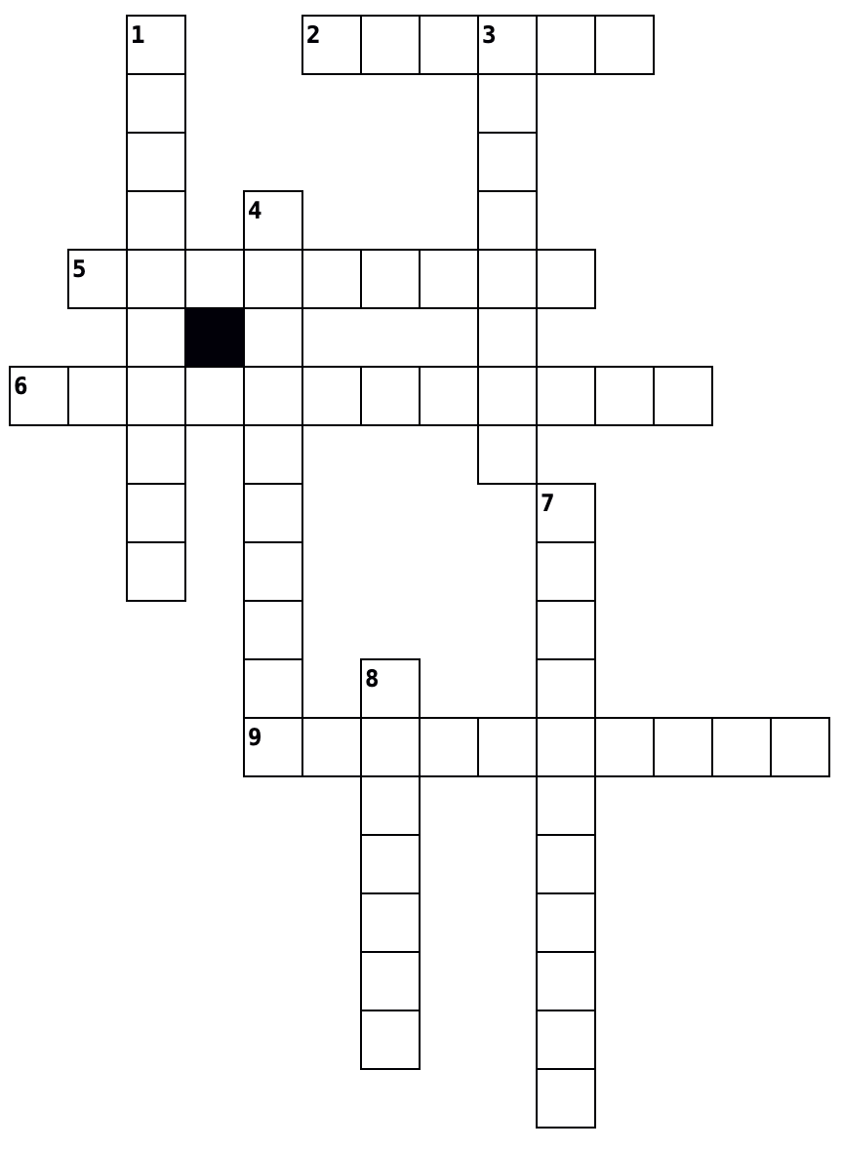
Recap – Paper 3 – Unfamiliar Fieldwork 2
Across
2. A method of sampling where every individual or location has an equal chance of being chosen, minimizing bias and ensuring representativeness.
5. Data that others have collected.
6. Numerical data that can be measured and quantified, allowing for statistical analysis and mathematical calculations.
9. A sampling method that involves dividing a population into smaller groups (strata) based on shared attributes, and then randomly sampling from each stratum to ensure all categories are adequately represented.
Down
1. A sampling method where elements are selected at regular intervals from an ordered list, ensuring each sample is spaced evenly.
3. This data can be counted e.g. the number of pedestrians who pass at a certain time.
4. This data is measured. For example, how quickly a river is flowing or how much noise traffic makes.
7. Data that describes qualities or characteristics, often collected through interviews, observations, or descriptive surveys, and expressed in words.
8. Data you gather yourself directly in the field. This might involve conducting surveys, taking measurements, or observing geographical phenomena first-hand during fieldwork.
Primary or Secondary Data? Human or Physical?
Data | Pri | Sec | Hum | Phy
You record river depth, width, and velocity
Weather data from the Met Office
You complete an environmental quality survey in an urban area
The results of an environmental quality survey from Y11 last year in a river valley on the moors
Traffic counts you conduct for fieldwork
OS map showing an upland area in the UK.
Photographs you take of an area of redevelopment in your local city
Crime statistics for your local town
Health data taken from the Census
An OS map showing the upper stages of a river valley
House price data for your local area
Interviews you conducted in a city centre
Historical photographs of an inner city area in your local area
Types of data
Identify whether the data below is quantitative or qualitative and physical or human.
Sampling Strategies
Read the fieldwork techniques below. Identify the type of sampling being used.
1 | True or false? Primary data is collected by other people, whereas secondary data is data collected you collect.
○ | A | True
○ | B | False
Data | Quan | Qual | Hum | Phy
River depth, width and velocity.
Beach pebble size
Environmental quality survey
Rates of cliff erosion
Traffic counts
Field sketch of coastal landforms
Interviews with people about the impact of regeneration
Photographs showing before and after images of gentrification
Weather data for an urban area
Fieldwork Technique | Random | Systematic | Stratified
Pedestrian counts are completed at points that are equally spaced along a transect of the city centre.
People are interviewed at places that have been chosen using tables of random numbers to generate grid references.
Traffic is counted in streets that have been chosen by putting all street names in a bag and removing 3 without looking which is being taken.
Traffic counts are completed every hour.
Plant species are wind speeds are recorded in a sand dune. 50% of the sampling points are are on slopes facing the sea and the other 50% are taken on slopes that face away from the sea.
Issuing questionnaires to students in your school by allocating the proportion of questionnaire according to how many students are in each year group.
Interviewing the 10th, 20th, 30th person that passes you in the street.
2 | True or false? Opportunistic sampling is useful when data is scarce, so you take the opportunity to collect data whenever you can, e.g. asking a questionnaire of every tourist you can.
○ | A | True
○ | B | False
3 | If a student wants to systematically sample locations along the course of a river, however, a lot of sites are on private land, so they had to sample wherever there was a public footpath, which type of sampling does this become?
○ | A | Opportunistic
○ | B | Stratified
○ | C | Random
Sampling
Match the types of sampling to their definition.
Random
Data is chosen at regular intervals, e.g. every 10th person is interviewed.
4 | Which of the following is a disadvantage of random sampling?
○ | A | Can lead to a poor representation of the overall parent population of an area.
○ | B | It is biased, as not all members or points have an equal chance of being selected.
○ | C | The proportion of subsets must be known and accurate if it is to work properly.
Systematic
Samples are divided into groups, e.g. five people from each age range.
Stratified
Every item has an equal chance of being sampled.

