Slide 1


Coastal Landscapes in the UK

Slide 2


Contents
Knowledge
Contents……………………………………………..
Guide………………………………………………….
Big picture……………………………………………
Waves……………………………………………..….
Wave types…………………………………………..
Weathering…………………………………………..
Mass movement……………………………………
Coastal erosion……………………………….……
Coastal transportation……………………..……
Coastal deposition………………………………..
Landforms of coastal erosion………………….
Landforms of coastal deposition……………..
An example of a UK coastline………………….
Hard engineering coastal management…….
Soft engineering coastal management……..
Managed retreat……………………………………
A UK coastal management scheme………….
Coastal environments and OS maps…….....
Quizzes……………………………………………….
Glossary……………………………………………...
Extra pages…………………………………………..
Revision……………………………………………….
2
3
4
6
11
16
22
28
33
39
43
53
60
67
73
79
86
91
98
99
102
108
2
www.internetgeography.net/booklets/aqacoasts/

Slide 3

Knowledge
Guide
Our school and Internet Geography have partnered to bring you this work booklet covering Coastal Landscapes in the UK for AQA GCSE Geography. The booklet has been designed to maximise your learning to help you achieve the best possible grade in GCSE Geography.
Structure
Each section of the booklet is structured like this:
Knowledge
Activities to help build your knowledge and understanding of coastal landscapes in the UK.
Retrieval
These activities check your knowledge and understanding of the area you have recently studied. It’s an opportunity to identify areas for development. Answers to retrieval activities can be found using the link at the bottom of each page.
Application
These activities are an opportunity to apply your knowledge and understanding, a key skill for GCSE Geography exam success.
Exam Questions
Practicing exam questions, like those you could face in the exam, is a powerful way to prepare yourself for success.
Support
As well as your class resources, such as text books, there are lots of materials on Internet Geography to support you on your GCSE Geography journey. QR codes provide links to online reference notes, videos, and interactive quizzes. The web address at the bottom of each page in this booklet takes you to a dedicated support page on Internet Geography where you will find support resources.
The Big Picture – Mind Map
As you complete each section of this booklet, return to the Big Picture Mind Map and add notes and images. It will become a useful revision resource and will be a really useful reference tool when it comes closer to the exam.
Quiz
When you complete a section in this booklet, have a go at the quiz on Internet Geography. Record your score on page 91.
www.internetgeography.net/booklets/aqacoasts/

Slide 4

Knowledge
Big Picture
Unit Mind Map
Develop this mind map as you progress through the unit.
wave
weathering
types
waves
UK CM
Coastal
Landscapes
in the UK
scheme
managed
retreat
soft
engineering
hard
engineering
UK coastline
depositional
landforms
www.internetgeography.net/booklets/aqacoasts/

Slide 5

mass
movement
Coastal
Landscapes
in the UK
erosion
transportation
deposition
erosional
landforms
www.internetgeography.net/booklets/aqacoasts/

Slide 6
Knowledge
Knowledge
Waves
Waves and their characteristics
What is a wave?
What causes waves?
What factors affect the size and strength of waves?
www.internetgeography.net/booklets/aqacoasts/

Slide 7

Waves and their characteristics
Label the main characteristics of waves on the diagram below.
Explain what happens to waves as they approach the shore.
www.internetgeography.net/booklets/aqacoasts/

Slide 8




Retrieval
Waves
Waves and their characteristics
True or false?
 |  | True | False
1. | A wave is the movement of water from the shore to the deep ocean.
2. | Waves are primarily caused by the gravitational pull of the moon and the sun.
3. | The size of waves is affected by three factors: wind speed, wind duration, and the fetch.
4. | The fetch of a wave refers to the amount of water in a wave.
5. | Backwash is the movement of water up the beach after a wave breaks.
6. | Swash is the water that flows back to the sea after the wave has broken on the shore.
Sketch and Outline
Wave Diagram
Outline the Characteristics of Waves
Find and Fix
Waves are always caused by the gravitational pull of the moon.
The fetch of a wave refers to how high the wave reaches.
Constructive waves erode beaches with their strong backwash and a weak swash.
www.internetgeography.net/booklets/aqacoasts/

Slide 9

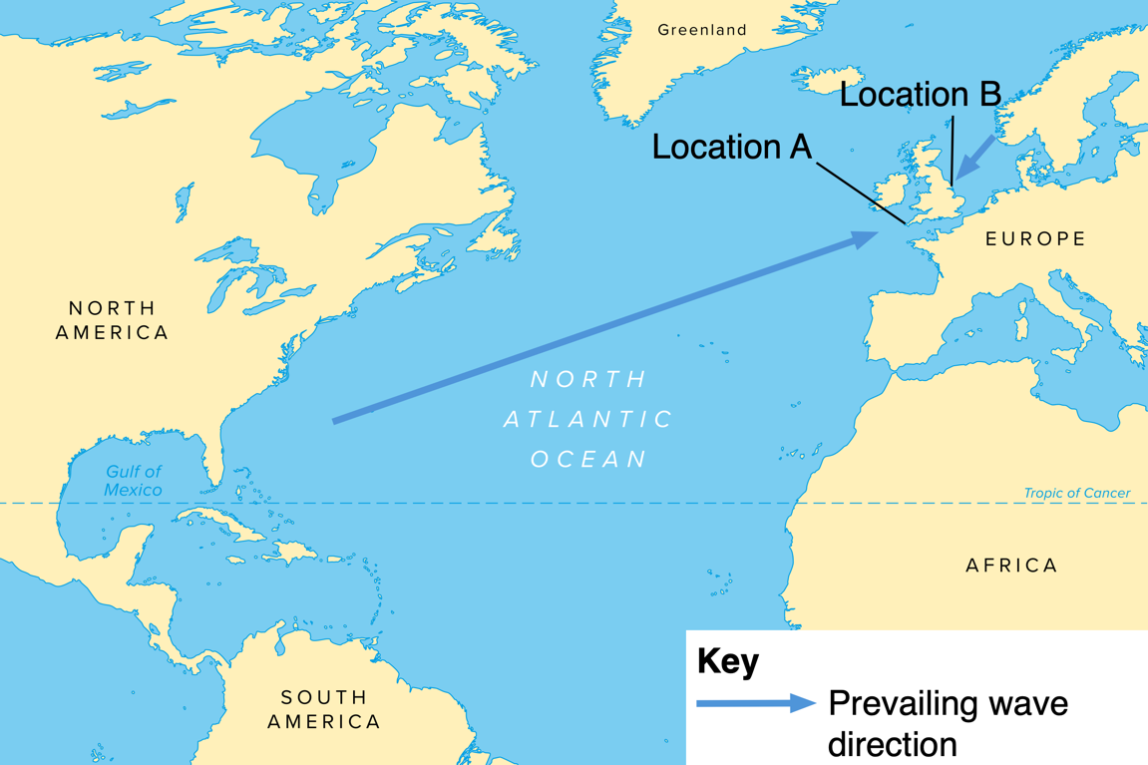
Application
Waves
Waves and their characteristics
Study the map below. Which location is likely to experience larger waves, location A – Southwest England, or location B The Holderness Coast? Justify your answer.
www.internetgeography.net/booklets/aqacoasts/

Slide 10

Exam Questions
Waves
Exam style question(s)
What term is used to describe the distance a wave travels?
Wavelength
Swash
Backwash
Fetch
[1 mark]
2. Outline two factors that affect the characteristics of waves at
the coast
1.
2.
[4 marks]
www.internetgeography.net/booklets/aqacoasts/

Slide 11


Knowledge
Knowledge
Wave Types
Constructive Waves
Label the main characteristics of constructive waves on the diagram below.
Destructive Waves
Label the main characteristics of destructive waves on the diagram below.
www.internetgeography.net/booklets/aqacoasts/

Slide 12


constructive
deconstructive
Constructive and Destructive Wave Characteristics
Complete the table below to summarise the characteristics of constructive and destructive waves.
Characteristics | Constructive Waves | Destructive Waves
Wave frequency
Wave height
Wavelength
Type of wave (plunging or spilling)
Strength of swash
Strength of backwash
Beach sediment – gain or loss?
www.internetgeography.net/booklets/aqacoasts/

Slide 13
Retrieval
Wave Types
Constructive and Destructive Waves
True or false?
 |  | True | False
1. | There are two types of waves: constructive and destructive waves.
2. | Constructive waves are responsible for building beaches.
3. | Constructive waves have a strong swash and a weak backwash.
4. | Destructive waves have a strong swash and weak backwash.
5. | Destructive waves are associated with high energy and storm conditions.
6. | Constructive waves are formed in calm weather conditions with less wind energy.
Sketch and Outline
Destructive Wave Diagram
Outline the Characteristics of Destructive Waves
Find and Fix
Destructive waves build beaches.
Constructive waves are associated with high energy and storm conditions.
Destructive waves have a strong swash and weak backwash.
www.internetgeography.net/booklets/aqacoasts/

Slide 14
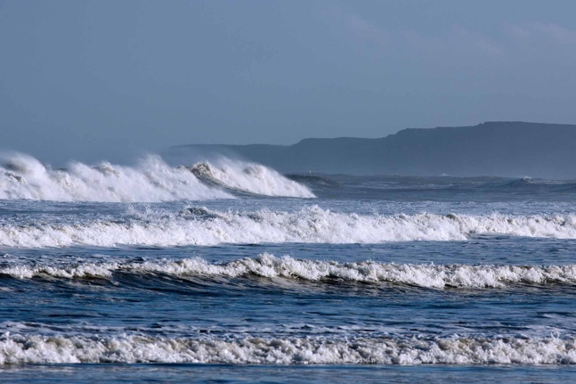
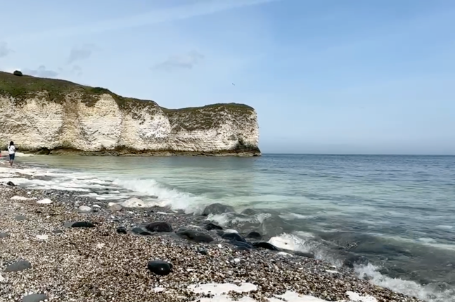
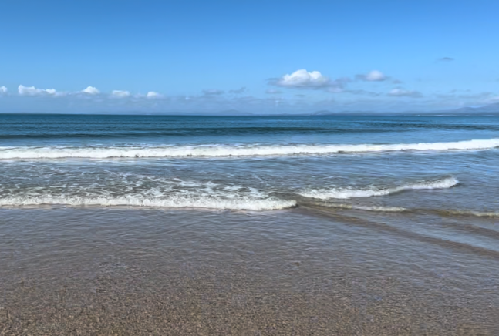
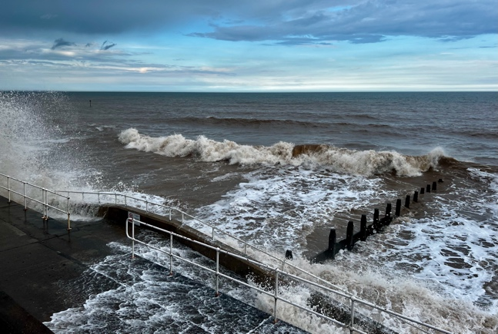
Application
Wave Types
Waves and their characteristics
Study the photographs below. Identify the wave types and explain your choice.
1
2
3
4
www.internetgeography.net/booklets/aqacoasts/

Slide 15


Exam Questions
Wave Types
Exam style question(s)
Which of the following is a characteristic of a destructive wave?
Short wavelength
Strong swash
Weak backwash
Low wave height
[1 mark]
Study Figure 1, diagrams of destructive and constructive waves.
Figure 1
Destructive wave
Constructive wave
2. Using Figure 1, compare two features of destructive and constructive waves.
1.
2.
[2 marks]
www.internetgeography.net/booklets/aqacoasts/

Slide 16
Knowledge
Knowledge
Weathering
What is weathering?
Mechanical weathering
What is mechanical weathering?
Freeze-thaw weathering
Produce an annotated diagram to to show the processes of freeze-thaw weathering.
www.internetgeography.net/booklets/aqacoasts/

Slide 17

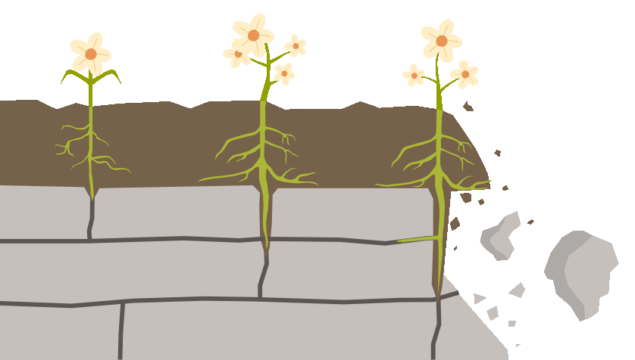
Annotate the diagram below to explain biological weathering
Explain the process of salt weathering.
www.internetgeography.net/booklets/aqacoasts/

Slide 18
Knowledge
Weathering
Chemical weathering
What is chemical weathering?
Types of chemical weathering
Complete the table below by giving an overview of each type of chemical weathering
Processes | Overview
Carbonation
Hydrolysis
Oxidation
www.internetgeography.net/booklets/aqacoasts/

Slide 19

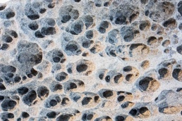
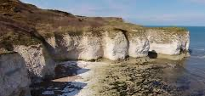
Retrieval
Weathering
Processes of weathering
True or false?
 |  | True | False
1. | Weathering is the process by which rocks are broken down into smaller pieces by physical, chemical, or biological means.
2. | Mechanical weathering involves the chemical alteration of rocks, while chemical weathering involves physical processes.
3. | Freeze-thaw weathering occurs when water seeps into cracks in rocks, freezes, and expands, causing the rock to break apart.
4. | Biological weathering involves the action of plants and animals breaking down rocks.
5. | Salt weathering occurs when salt crystals grow in the pores of rocks, leading to rock disintegration.
6. | Carbonation is a type of chemical weathering where carbon dioxide dissolved in water reacts with minerals, forming weak acids that dissolve the rock.
7. | Hydrolysis involves the reaction of minerals with oxygen, while oxidation involves the reaction of minerals with water.
Find and Fix
Destructive waves build beaches.
Constructive waves are associated with high energy and storm conditions.
Destructive waves have a strong swash and weak backwash.
Image Interpretation
Type of weathering:
Identify the types of weathering likely to
affect this environment:
www.internetgeography.net/booklets/aqacoasts/

Slide 20
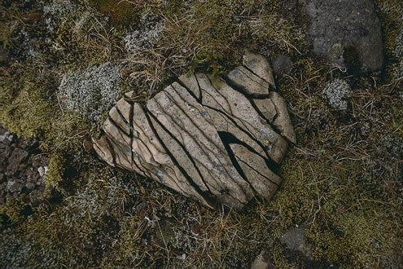
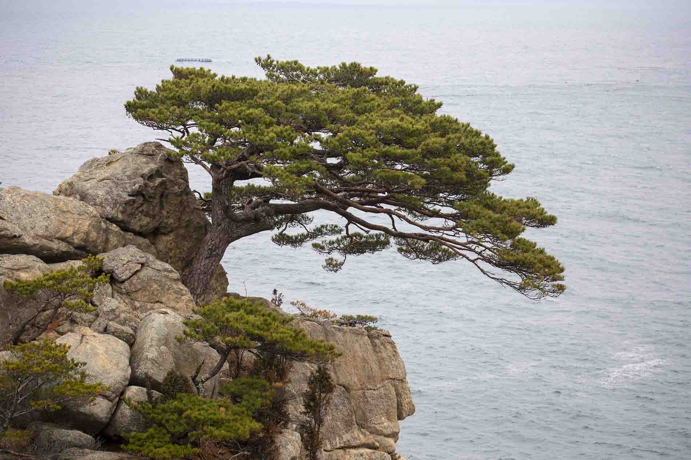

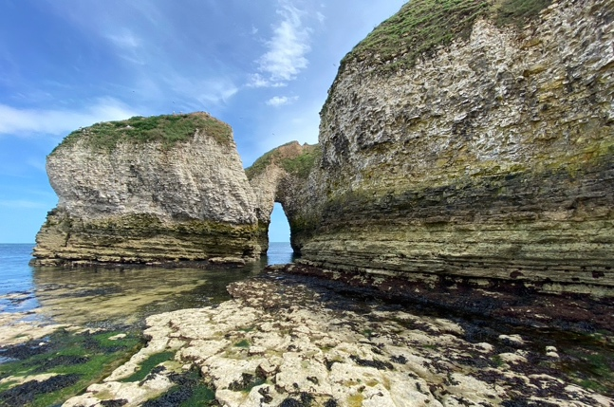
Application
Weathering
Types of weathering
Study the photographs below. Identify types of weathering likely to be occurring and give reasons for your answer.
1
2
3
4
www.internetgeography.net/booklets/aqacoasts/

Slide 21
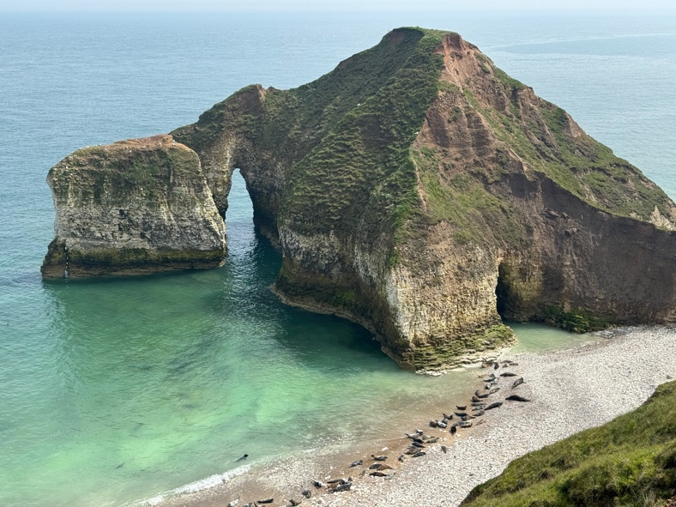
Exam Questions
Weathering
Exam style question(s)
Which of the following is an example of chemical weathering?
Biological weathering
Salt weathering
Freeze-thaw weathering
Carbonation weathering
[1 mark]
Study Figure 1, cliffs at Flamborough on the Holderness Coast.
Figure 1
2. Outline one type of weathering likely to affect the coastal environment shown in Figure 1.
[4 marks]
www.internetgeography.net/booklets/aqacoasts/

Slide 22
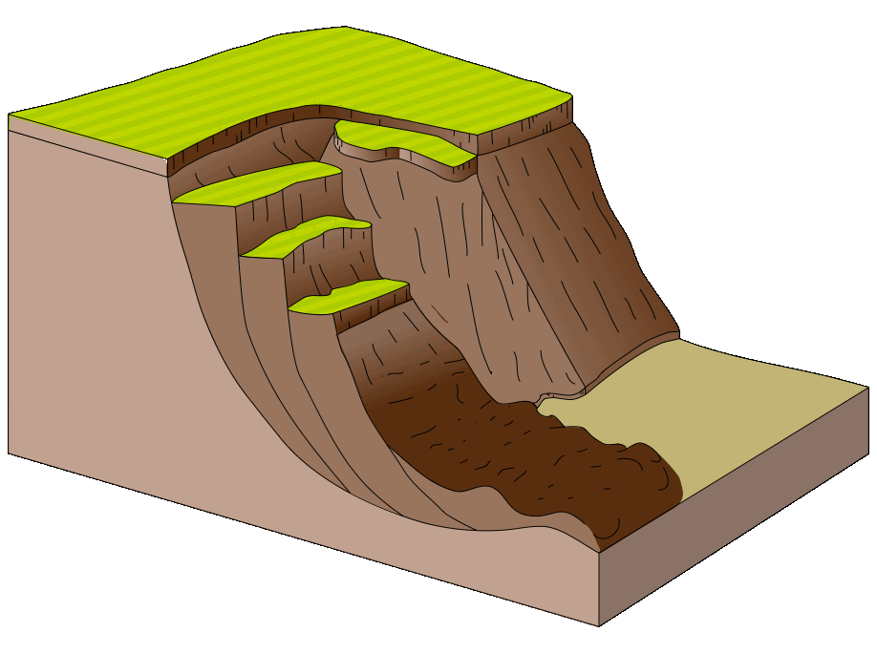
Knowledge
Knowledge
Mass Movement
What is mass movement?
Slumping
What is slumping?
Annotate the diagram below to explain slumping.
www.internetgeography.net/booklets/aqacoasts/

Slide 23

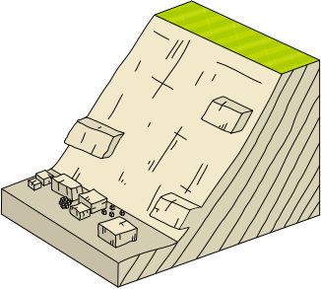
Sliding
What is sliding?
Annotate the diagram below to explain sliding.
Rock falls
What is a rock fall?
www.internetgeography.net/booklets/aqacoasts/

Slide 24
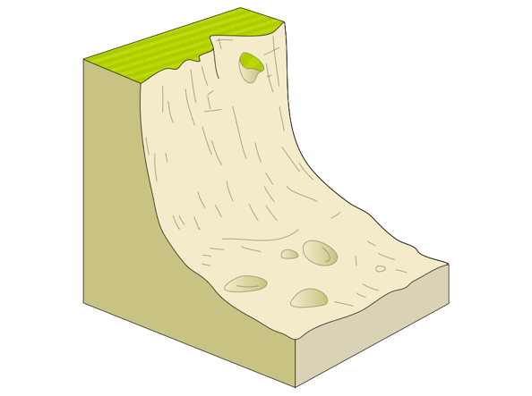
Knowledge
Mass Movement
Annotate the diagram below to explain rock falls.
Mass Movement Sequencing
Outline the sequence of each process of mass movement.
www.internetgeography.net/booklets/aqacoasts/

Slide 25
Retrieval
Mass Movement
Processes of Mass Movement
True or false?
 |  | True | False
1. | Mass movement is the downhill movement of rock and soil due to gravity.
2. | Slumping involves the downward and outward movement of rock and soil along a curved surface.
3. | Sliding refers to the rapid movement of rock and soil down a slope along a flat plane.
4. | A rock fall involves the free fall of rock from a steep cliff or slope.
5. | Sliding can only happen on steep slopes.
6. | Rock falls are typically triggered by weathering processes, such as freeze-thaw cycles or root growth.
Sketch and Outline
Slumping Diagram
Outline the Process of Slumping
Find and Fix
Slumping always occurs on dry, stable slopes.
Sliding requires water to act as a lubricant for the rock and soil to move.
Rock falls only occur in areas with minimal vegetation.
www.internetgeography.net/booklets/aqacoasts/

Slide 26
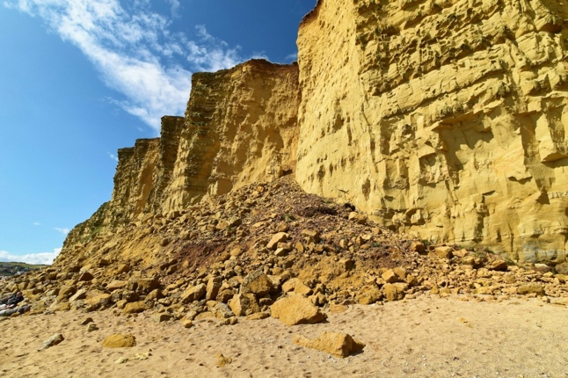
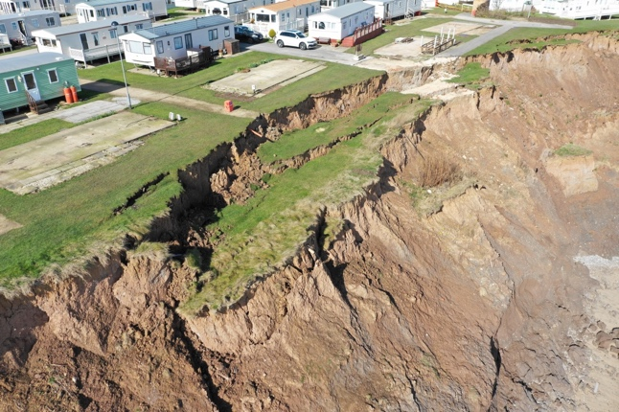
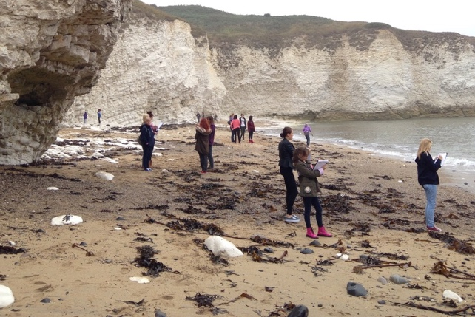
Application
Mass Movement
Types of mass movement
Study the photographs below. Identify the type of mass movement occurring in each and give reasons for your answer.
1
2
3
www.internetgeography.net/booklets/aqacoasts/

Slide 27
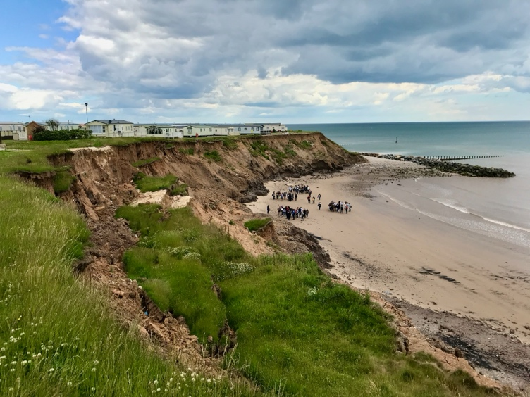
Exam Questions
Mass Movement
Exam style question(s)
Which type of mass movement involves cliff material moving downhill under gravity along a curved slip-plane?
Landslide
Mudslide
Rockfall
Slumping
[1 mark]
Study Figure 1, Hornsea on the Holderness Coast.
Figure 1
2. Suggest one type of mass movement that is affecting these
cliffs.
[1 mark]
3. Outline the effect of geology on the type of mass movement
occurring in the image.
[2 marks]
www.internetgeography.net/booklets/aqacoasts/

Slide 28
Knowledge
Knowledge
Coastal Erosion
What is coastal erosion?
Processes of coastal erosion
What is hydraulic action?
What is abrasion?
What is attrition?
www.internetgeography.net/booklets/aqacoasts/

Slide 29

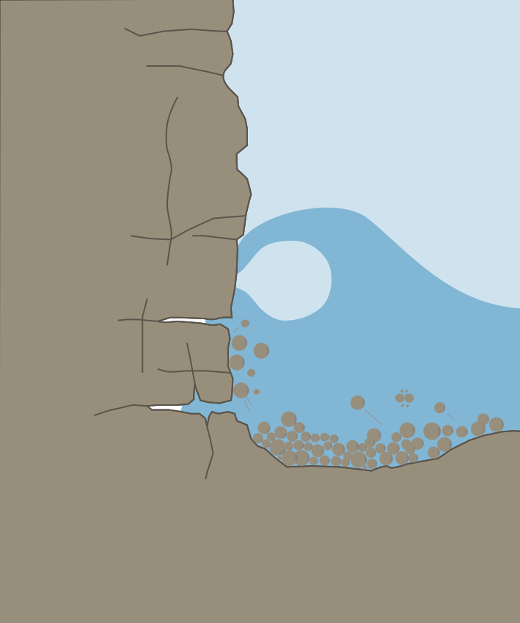
Annotate the diagram below to explain the different processes of coastal erosion.
www.internetgeography.net/booklets/aqacoasts/

Slide 30






Retrieval
Coastal Erosion
Processes of Coastal Erosion
True or false?
 |  | True | False
1. | Coastal erosion is the process by which waves, wind, and tides wear away the land along the coast.
2. | Hydraulic action occurs when waves compress air in cracks in the rock, causing the rock to break apart.
3. | Attrition involves the breaking down of rocks and pebbles by the friction of waves hitting the shore.
4. | Abrasion happens when waves rub sand, pebbles, and larger rocks against the cliff face, wearing it down.
5. | Coastal erosion only occurs during storms and extreme weather conditions.
6. | Hydraulic action is the main form of chemical weathering along coastlines.
Dual Coding
1. ________________
3. ________________
2. ________________
4. ________________
Find and Fix
Coastal erosion is the process by which the land builds up along the coast due to the action of waves, wind, and tides.
Attrition involves the wearing away of the cliff face by sand, pebbles, and larger rocks thrown against it by waves.
Abrasion occurs when air is compressed in cracks in the rock, causing it to break apart.
www.internetgeography.net/booklets/aqacoasts/

Slide 31
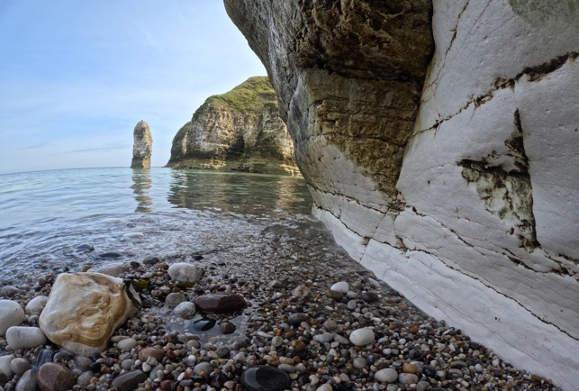
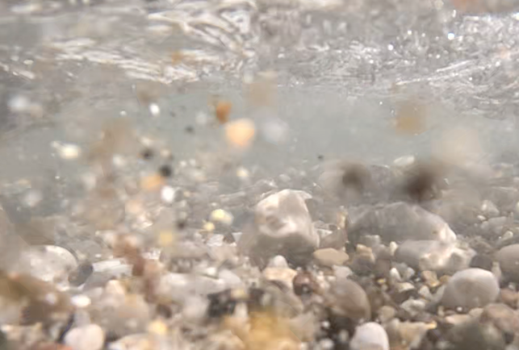
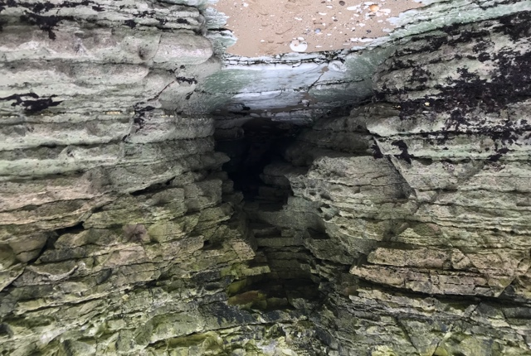
Application
Coastal Erosion
Processes of coastal erosion
Study the photographs below. Identify the type(s) of coastal erosion likely to occur in each environment. Justify your choice.
1
2
3
www.internetgeography.net/booklets/aqacoasts/

Slide 32
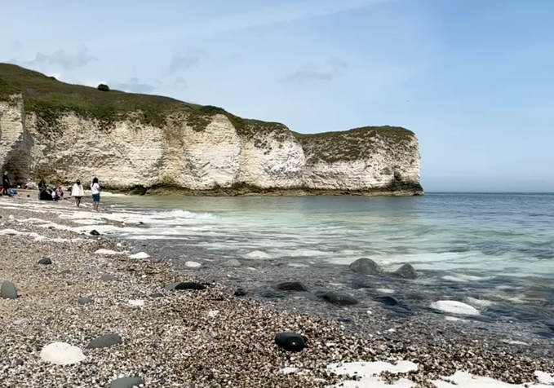
Exam Questions
Coastal Erosion
Exam style question(s)
Which type of coastal erosion involves material being transported by waves wearing away the cliff-face?
Hydraulic action
Attrition
Abrasion
Corrasion
[1 mark]
Study Figure 1, chalk cliffs at Flamborough.
Figure 1
2. Explain the impact of processes of coastal erosion in environments such as the one shown in Figure 1.
[4 marks]
www.internetgeography.net/booklets/aqacoasts/

Slide 33
Knowledge
Knowledge
Coastal Transportation
What is coastal transportation?
Processes of transportation
What is traction?
What is saltation?
What is suspension?
www.internetgeography.net/booklets/aqacoasts/

Slide 34

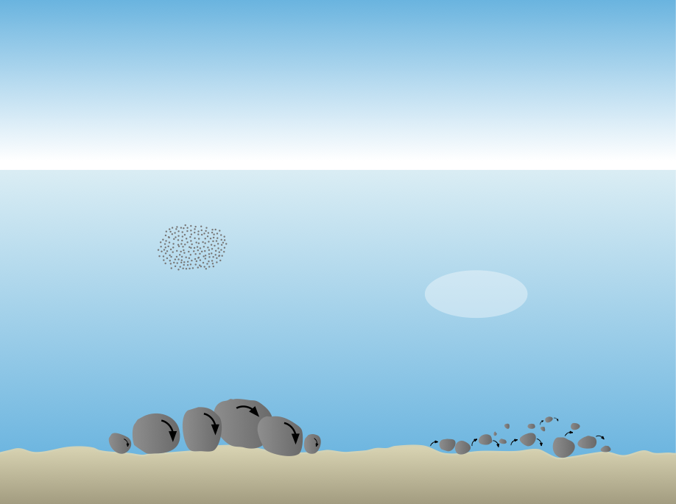
What is solution?
Identify the processes of coastal transportation shown in the diagram below.
www.internetgeography.net/booklets/aqacoasts/

Slide 35
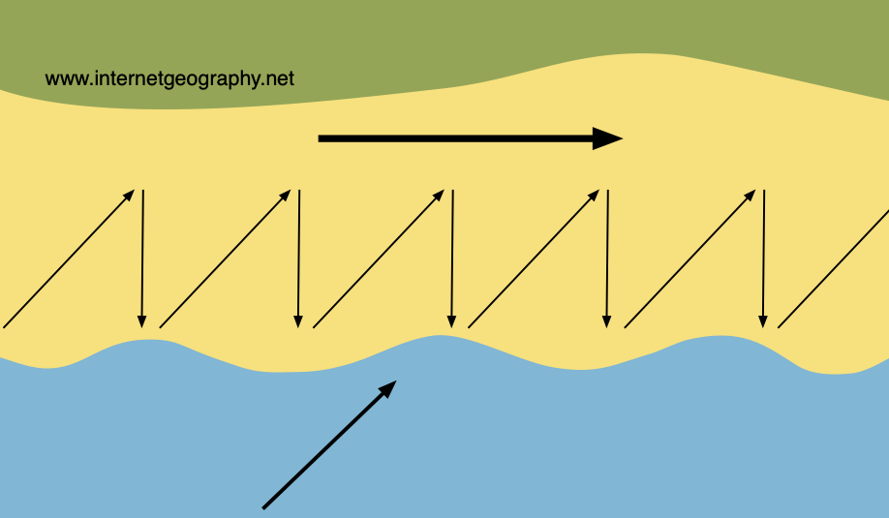
Knowledge
Knowledge
Coastal Transportation
Longshore Drift
What is longshore (littoral) drift?
Annotate the diagram below to explain the process of longshore drift.
www.internetgeography.net/booklets/aqacoasts/

Slide 36
Retrieval
Coastal Transportation
Processes of coastal transportation
True or false?
 |  | True | False
1. | Coastal transportation is the movement of sediment along the coast by wave action.
2. | Traction refers to the process where small particles are bounced along the seabed by water or wind.
3. | Saltation occurs when small pebbles and stones are bounced along the seabed by water or wind.
4. | Suspension refers to particles being carried along in the water without touching the seabed.
5. | Solution involves the dissolving of soluble materials from rocks into the water.
6. | Longshore drift is the movement of sediment down the beach face due to the action of gravity.
Sketch and Outline
Longshore Drift Diagram
Outline the Process of Longshore Drift
Find and Fix
Traction refers to the bouncing of small particles along the seabed by water or wind.
Longshore drift involves the movement of sediment down the beach face due to the action of gravity.
Suspension refers to large rocks being rolled along the seabed by the force of water.
www.internetgeography.net/booklets/aqacoasts/

Slide 37
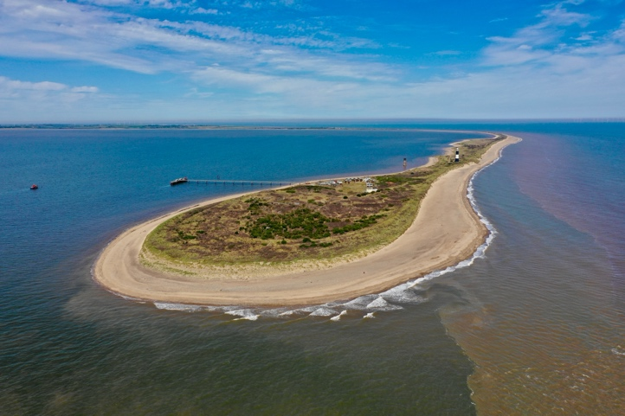
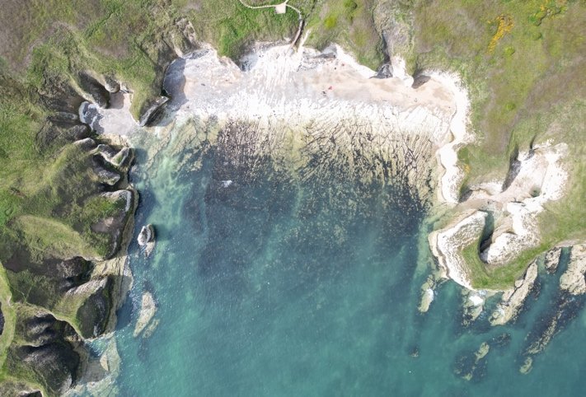
Application
Coastal Transportation
Processes of coastal erosion
Study the photographs below. Identify the type(s) of coastal transportation likely to occur in each environment. Justify your choice(s).
1
2
www.internetgeography.net/booklets/aqacoasts/

Slide 38
Exam Questions
Coastal Transportation
Exam style question(s)
Which of the following is an example of coastal transportation?
Hydraulic action
Attrition
Abrasion
Suspension
[1 mark]
2. Explain the process of longshore drift.
[4 marks]
www.internetgeography.net/booklets/aqacoasts/

Slide 39

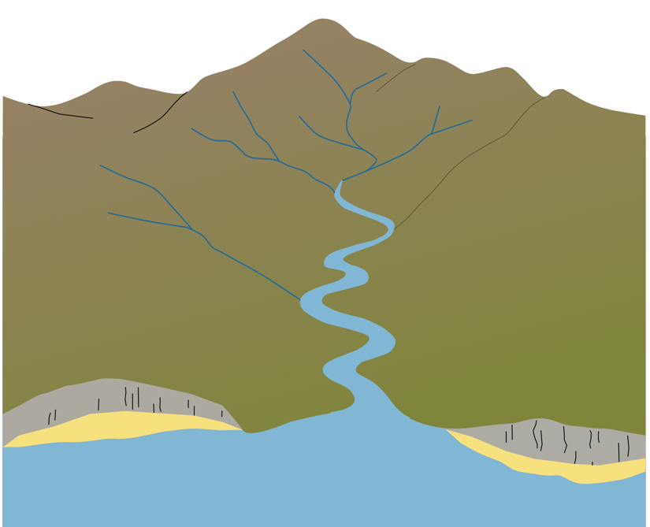
Knowledge
Coastal Deposition
What is coastal deposition?
When does coastal deposition occur?
Where does coastal deposition occur?
Annotate the diagram to explain where coastal deposition occurs.
www.internetgeography.net/booklets/aqacoasts/

Slide 40
Retrieval
Coastal Deposition
Processes of coastal deposition
True or false?
 |  | True | False
1. | Coastal deposition is the process by which sediment is dropped and accumulates along the coast.
2. | Coastal deposition occurs when the energy of the transporting medium, such as water or wind, increases.
3. | Coastal deposition often takes place in sheltered areas such as bays and estuaries.
4. | Deposition can create landforms such as beaches, spits, and bars.
5. | Coastal deposition is more likely to occur in areas where the supply of sediment is low.
6. | Waves with strong backwash contribute to coastal deposition.
Sketch and Outline
Coastal Deposition Diagram
Outline where and why coastal deposition occurs
Find and Fix
Coastal deposition is the process by which sediment is picked up and transported along the coast.
Coastal deposition occurs when the energy of the transporting medium, such as water or wind, increases.
Coastal deposition is unlikely to take place in sheltered areas like bays and estuaries.
www.internetgeography.net/booklets/aqacoasts/

Slide 41
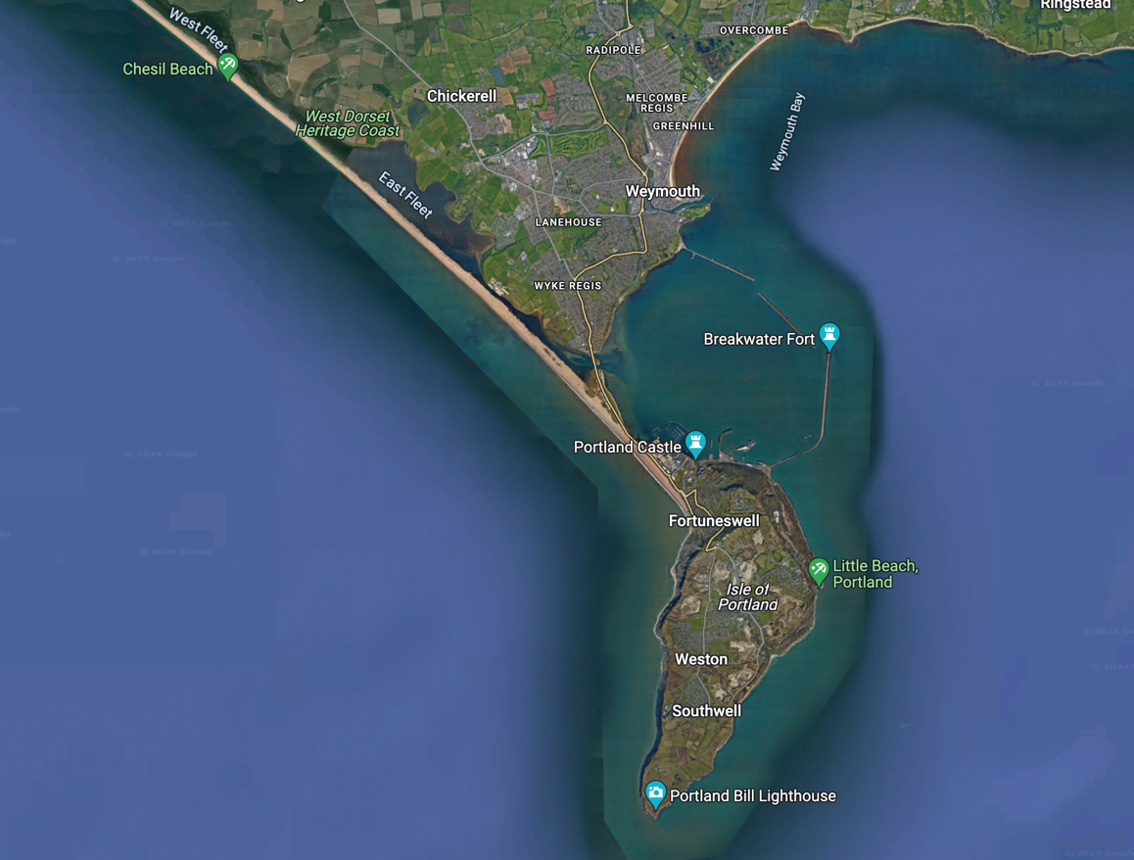
Application
Coastal Deposition
Processes of coastal deposition
Study the map below. Explain why coastal deposition occurs at the locations marked A and B.
B
A
www.internetgeography.net/booklets/aqacoasts/

Slide 42
Exam Questions
Coastal Deposition
Exam style question(s)
Which of the following is not a reason why coastal deposition occurs.
Waves enter an area of shallow water.
Waves enter a sheltered area, e.g. a cove or bay.
A river estuary flows into the sea reducing wave energy.
Destructive waves approach the coastline.
[1 mark]
2. Outline one reason why the sea might deposit sediment.
[2 marks]
3. Describe the characteristics of coastlines where deposition is
common.
[2 marks]
www.internetgeography.net/booklets/aqacoasts/

Slide 43
Knowledge
Knowledge
Landforms of Coastal Erosion
Rock Type and Structure
Give an overview of how geological structure and rock types are important in determining the rate of cliff erosion (retreat).
 | Overview
Geological structure
Rock type
Bays and Headlands
What is a headland?
What is a bay?
www.internetgeography.net/booklets/aqacoasts/

Slide 44

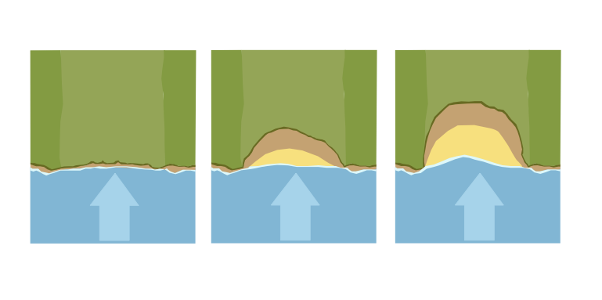
Label the diagram to show the formation of headlands and bays.
Produce a flow diagram to explain the sequence in the formation of bays and headlands. Make sure you include details on the processes of erosion that contribute to their formation.
www.internetgeography.net/booklets/aqacoasts/

Slide 45
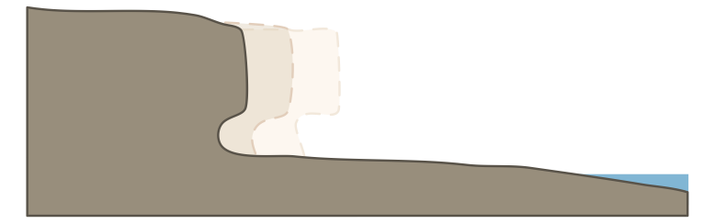
Knowledge
Knowledge
Landforms of Coastal Erosion
Cliffs and Wave Cut Platforms
What is a cliff?
What is a wave cut platform?
Label the diagram to show the formation of a wave cut platform.
www.internetgeography.net/booklets/aqacoasts/

Slide 46

Produce a flow diagram to explain the sequence in the formation of a wave cut platform. Make sure you include details on the processes of erosion that contribute to their formation.
www.internetgeography.net/booklets/aqacoasts/

Slide 47
Knowledge
Knowledge
Landforms of Coastal Erosion
Caves, Arches and Stacks
What is a cave?
What is an arch?
What is a stack?
www.internetgeography.net/booklets/aqacoasts/

Slide 48

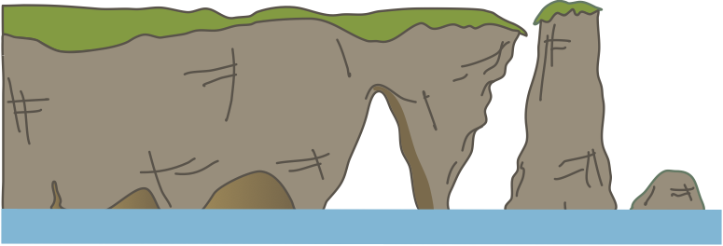
Label the diagram to show the formation of a cave, arch, and stack.
Produce a flow diagram to explain the sequence in the formation of a cave, arch, and stack. Make sure you include details on the processes of erosion and weathering that contribute to their formation.
www.internetgeography.net/booklets/aqacoasts/

Slide 49
Retrieval
Landforms of Coastal Erosion
Landforms of coastal erosion
True or false?
 |  | True | False
1. | Softer rock types, such as granite, erode more slowly than harder rock types, such as clay.
2. | Geological structure, such as the presence of faults and joints, can increase the rate of coastal erosion.
3. | A discordant coastline has alternating layers of hard and soft rock running parallel to the coast.
4. | A concordant coastline has layers of rock running parallel to the coast, often leading to fewer bays and headlands.
5. | A headland is a narrow piece of land that projects into the sea.
6. | A bay is a narrow piece of land that projects into the sea.
7. | Cliffs are steep, high rock faces formed by the erosion of the coast.
8. | A wave-cut platform is a flat area of rock in front of a cliff, created by wave erosion.
9. | A cave is a solid, unbroken area of rock formed by wave action strengthening the rock.
10. | A stack is a large rock pillar formed when the roof of an arch collapses.
Sketch and Outline
Erosion of a headland diagram
Outline the erosion of a headland
www.internetgeography.net/booklets/aqacoasts/

Slide 50
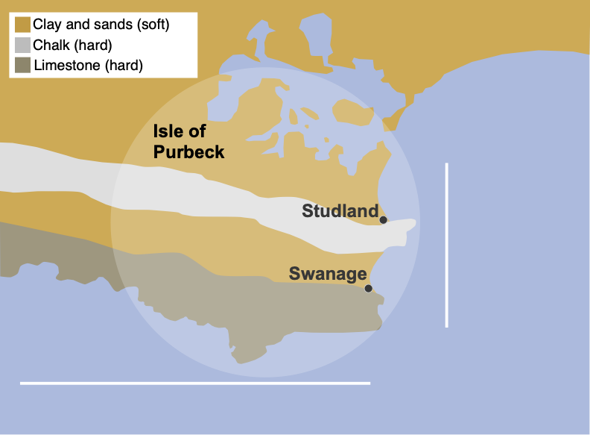
Application
Landforms of Coastal Erosion
Landforms of coastal erosion
Study the map below. Identify the type of coastline labelled A and B and suggest the landforms you would expect to see in each area.
B
A
www.internetgeography.net/booklets/aqacoasts/

Slide 51
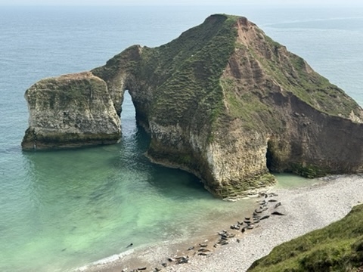
Exam Questions
Landforms of Coastal Erosion
Exam style question(s)
Study Figure 1, a photograph showing a coastal landscape at Flamborough on the Holderness Coast.
Figure 1
1. Explain how different coastal landforms are created by erosion.
Use Figure 1 and your own understanding.
[6 marks]
www.internetgeography.net/booklets/aqacoasts/

Slide 52
Landforms of Coastal Erosion
Exam style question(s)
Extra space
www.internetgeography.net/booklets/aqacoasts/

Slide 53
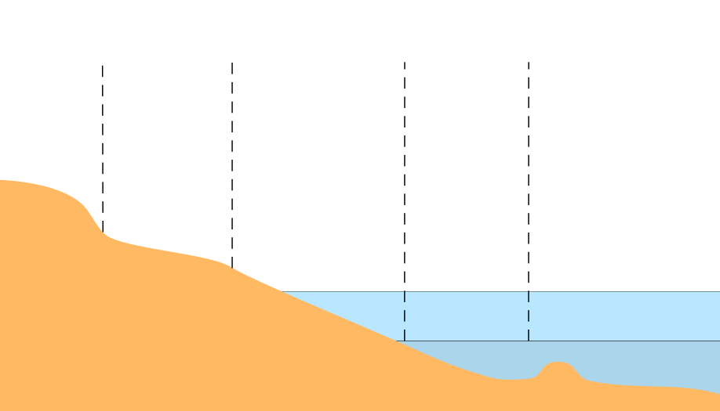
Knowledge
Knowledge
Landforms of Coastal Deposition
Beaches
What is a beach?
Why are beaches different?
Label the diagram below to show characteristics of a beach.
www.internetgeography.net/booklets/aqacoasts/

Slide 54

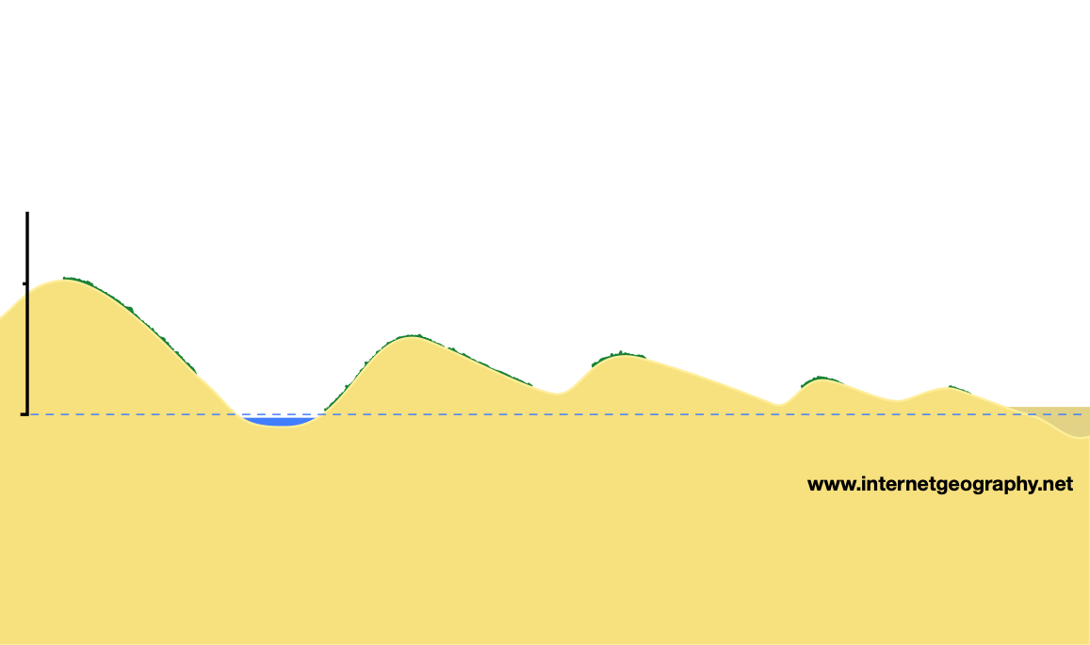
Sand Dunes
What is a sand dune?
Label the diagram below to identify the main characteristics of sand dunes.
Produce a flow diagram to explain the sequence in the formation of a sand dune.
www.internetgeography.net/booklets/aqacoasts/

Slide 55
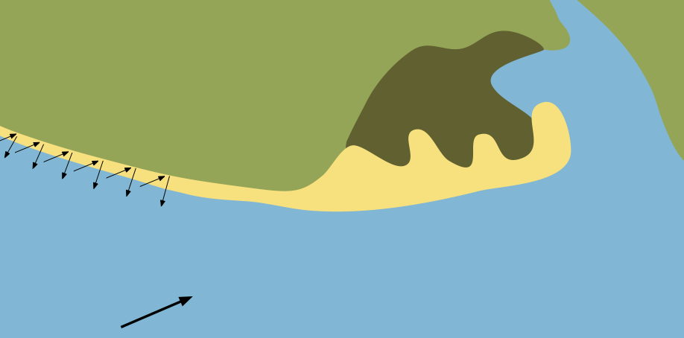
Knowledge
Knowledge
Landforms of Coastal Deposition
Spit
What is a coastal spit?
Label the diagram below to identify the main characteristics of a spit.
Produce a flow diagram to explain the sequence in the formation of a spit.
www.internetgeography.net/booklets/aqacoasts/

Slide 56

Bar
What is a bar?
Label the diagram below to identify the main characteristics of a bar.
Produce a flow diagram to explain the sequence in the formation of a bar.
www.internetgeography.net/booklets/aqacoasts/

Slide 57
Retrieval
Landforms of Coastal Deposition
Landforms of coastal deposition
True or false?
 |  | True | False
1. | A beach is a landform along the coastline composed primarily of sand, pebbles, and other sediments deposited by wave action.
2. | A sand dune is a mound of sand formed by the action of water waves on the beach.
3. | A spit is a narrow stretch of land extending from the coast into the sea, often with a hooked end.
4. | A bar is a ridge of sand or sediment that connects two areas of land with water on both sides.
5. | Sand dunes are most likely to form in areas with high wave energy and frequent storms.
6. | Spits are likely to form where the coastline changes direction and there is significant longshore drift.
Sketch and Outline
Spit diagram
Outline the formation of a spit
Find and Fix
A beach is a mound of sand formed by wind action inland from the coast.
Sand dunes are most likely to form in areas with high wave energy and frequent storms.
A bar is a narrow stretch of land extending from the coast into the sea, often with a hooked end.
www.internetgeography.net/booklets/aqacoasts/

Slide 58
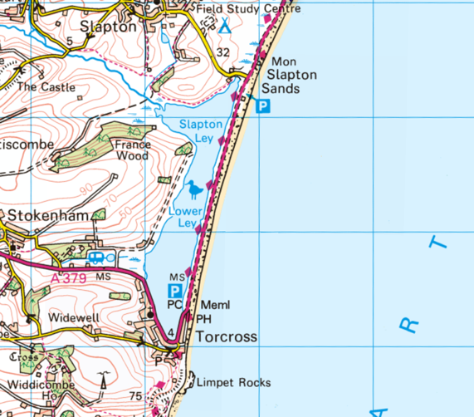
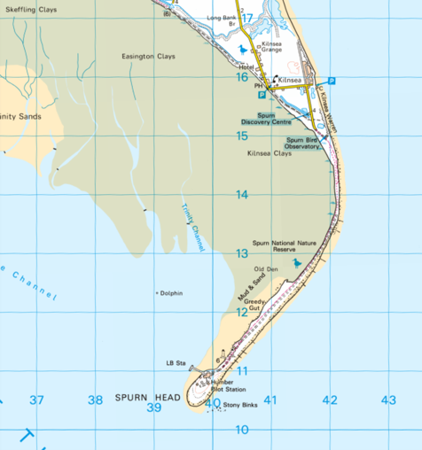
Application
Landforms of Coastal Deposition
Landforms of coastal deposition
Study the maps below. Identify the landforms of coastal deposition and explain why they formed here.
1
2
www.internetgeography.net/booklets/aqacoasts/

Slide 59
Exam Questions
Landforms of Coastal Deposition
Exam style question(s)
Which of the following is a not an example of a landform of coastal deposition?
Spit
Beach
Bar
Wave cut platform
[1 mark]
2. Explain the formation of a spit.
[4 marks]
Extra space
www.internetgeography.net/booklets/aqacoasts/

Slide 60
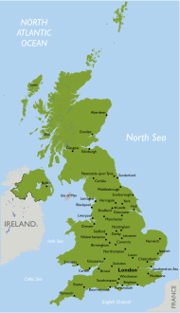
Knowledge
Knowledge
An Example of a UK Coastline
Location
Describe the location of the UK coastline you are studying.
Identify the location of the coastline on the map of the UK then complete a sketch map.
Geology
Describe the geology of the coastline and how it affects the formation of coastal landforms.
www.internetgeography.net/booklets/aqacoasts/

Slide 61


Dorset
Holderness
Major Landforms of Erosion
Give an overview of the major landforms of erosion in the area you have studied.
Major Landforms of Deposition
Give an overview of the major landforms of deposition in the area you have studied.
www.internetgeography.net/booklets/aqacoasts/

Slide 62
Retrieval
An Example of a UK Coastline
UK Coastline
Complete the questions below. Do not refer to your notes when you do this for the first time. Once complete refer to your notes and make improvements.
 | Identify the section of UK coastline you have studied.
 | Describe its location.
 | Describe its geology.
 | Give an overview of how its geology influences coastal landforms.
 | Identify the major landforms of coastal erosion.
 | Identify the major landforms of coastal deposition.
1
2
3
4
5
6
www.internetgeography.net/booklets/aqacoasts/

Slide 63
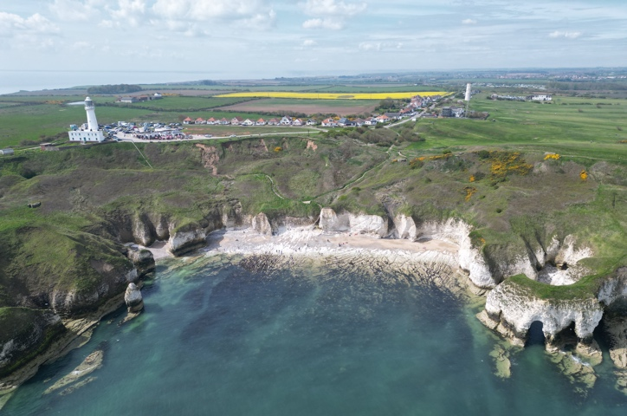
Application
An Example of a UK Coastline
The Holderness Coast
Study the photographs below. Identify the landforms of coastal erosion and deposition found along the section of UK coastline you have studied.
1
2
www.internetgeography.net/booklets/aqacoasts/

Slide 64
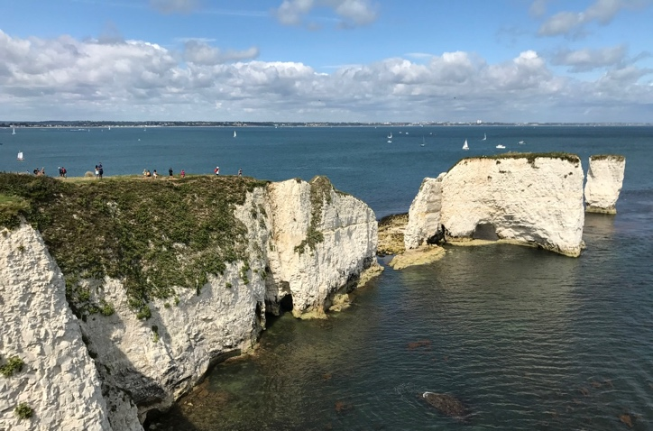
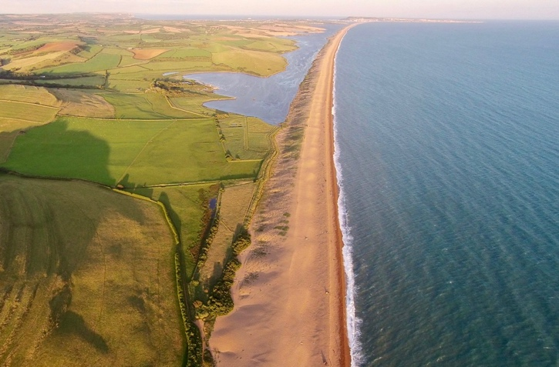
Application
An Example of a UK Coastline
The Dorset Coast
Study the photographs below. Identify the landforms of coastal erosion and deposition found along the section of UK coastline you have studied.
1
2
www.internetgeography.net/booklets/aqacoasts/

Slide 65
Exam Questions
An Example of a UK Coastline
Exam style question(s)
Which of the following landforms is not found along the Holderness Coast?
Arch
Stack
Spit
Bar
[1 mark]
2. Explain how geology affects the formation of coastal landforms
on the Holderness Coast.
[4 marks]
Extra space
www.internetgeography.net/booklets/aqacoasts/

Slide 66
Exam Questions
An Example of a UK Coastline
Exam style question(s)
Which of the following landforms is not found along the Dorset Coast?
Arch
Stack
Spit
Bar
[1 mark]
2. Explain how geology affects the formation of coastal landforms
on the Dorset Coast.
[4 marks]
Extra space
www.internetgeography.net/booklets/aqacoasts/

Slide 67
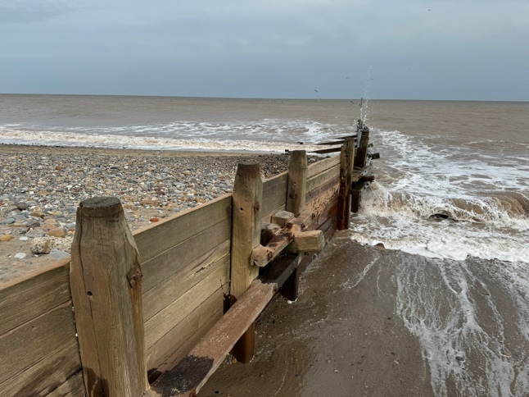
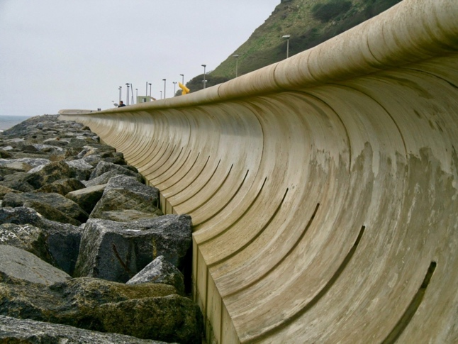
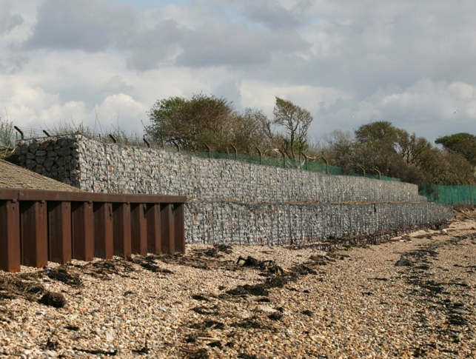
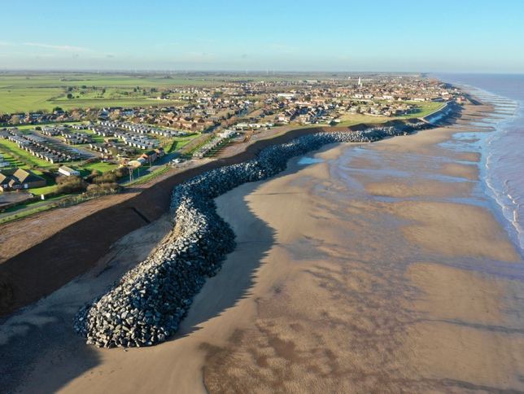
Knowledge
Knowledge
Hard Engineering Coastal Management
What is hard engineering coastal management?
Types of hard engineering
Identify the types of hard engineering strategies shown below.
www.internetgeography.net/booklets/aqacoasts/

Slide 68

Complete the table below.
Strategy | How does it work? | Advantages | Disadvantages
Sea wall
Rock armour
Gabions
Groynes
www.internetgeography.net/booklets/aqacoasts/

Slide 69

Retrieval
Hard Engineering Coastal Management
Hard engineering coastal management
True or false?
 |  | True | False
1. | Hard engineering coastal management involves using natural materials and processes to protect the coastline from erosion.
2. | A sea wall is a concrete or stone barrier built along the shore to absorb and reflect wave energy, thus protecting the coastline from erosion.
3. | A groyne is a structure built parallel to the coastline to prevent sand and sediment from being carried away by longshore drift.
4. | Rock armour consists of large boulders placed at the base of cliffs or along the shore to absorb wave energy and reduce erosion.
5. | Gabions are wire cages filled with sand used to absorb wave energy and prevent coastal erosion.
6. | Hard engineering solutions are typically less expensive and have a lower environmental impact than soft engineering solutions.
Find and Fix
A groyne is a structure built parallel to the coastline to prevent sand and sediment from being carried away by longshore drift.
Gabions are wire cages filled with sand used to absorb wave energy and prevent coastal erosion.
Hard engineering solutions are typically less expensive and have a lower environmental impact than soft engineering solutions.
Definitions
Hard engineering coastal management:
Groyne:
www.internetgeography.net/booklets/aqacoasts/

Slide 70
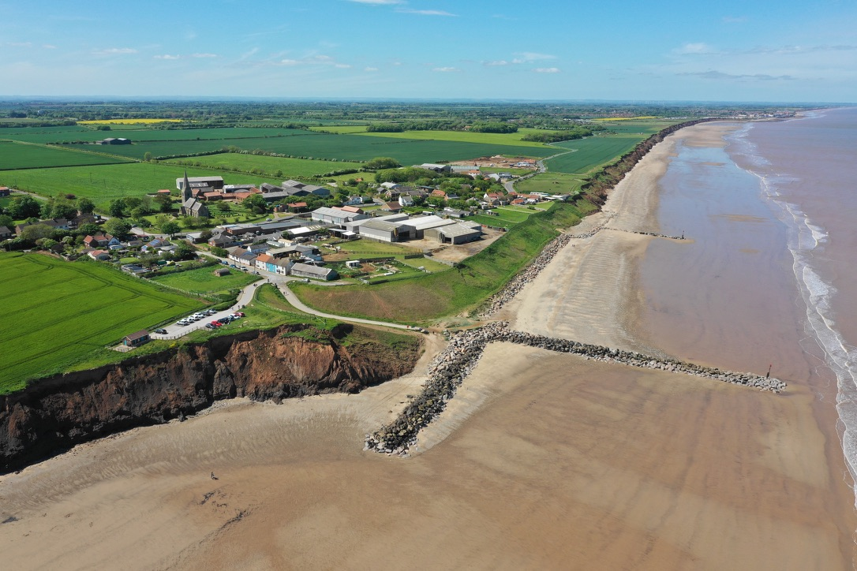
Application
Hard Engineering Coastal Management
Hard engineering strategies
Annotate the photograph below to show the positive and negative impacts of hard engineering coastal management at Mappleton on the Holderness Coast, East Yorkshire.
www.internetgeography.net/booklets/aqacoasts/

Slide 71
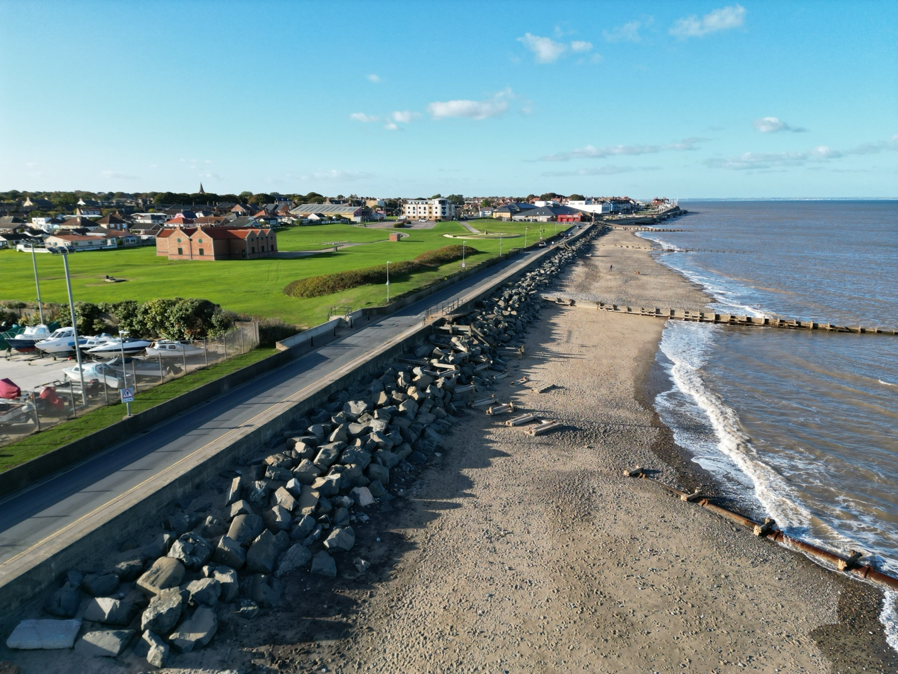
Exam Questions
Hard Engineering Coastal Management
Exam style question(s)
Which of the following is not an example of a hard engineering coastal management strategy?
Sea wall
Groyne
Gabion
Beach nourishment
[1 mark]
Study Figure 1, a photograph of coastal defences at Hornsea in eastern England.
Figure 1
www.internetgeography.net/booklets/aqacoasts/

Slide 72
Hard Engineering Coastal Management
Exam style question(s)
2. Discuss the costs and benefits of hard engineering strategies for coastal management. Use Figure 1 and your own understanding.
[6 marks]
Extra space
Coastal Landscapes in the UK www.internetgeography.net

Slide 73



Knowledge
Knowledge
Soft Engineering Coastal Management
What is soft engineering coastal management?
Types of Soft Engineering
Identify the soft engineering strategies shown below.
www.internetgeography.net/booklets/aqacoasts/

Slide 74

Complete the table below.
Strategy | How does it work? | Advantages | Disadvantages
Beach nourishment
Beach reprofiling
Dune Regeneration
www.internetgeography.net/booklets/aqacoasts/

Slide 75
Retrieval
Soft Engineering Coastal Management
Soft engineering coastal management
 |  | True | False
1. | Soft engineering coastal management uses natural processes and materials to protect the coastline from erosion.
2. | Beach nourishment involves removing sand from the beach to reduce erosion.
3. | Beach reprofiling is the process of reshaping the beach by adding sand to create a gentler slope.
4. | Dune regeneration is a hard engineering method that uses concrete structures to protect the coastline.
5. | Gabions are wire cages filled with sand used to absorb wave energy and prevent coastal erosion and are an example of soft engineering.
6. | Soft engineering methods are typically more expensive and less environmentally friendly than hard engineering methods.
True or false?
Find and Fix
Beach nourishment involves removing sand from the beach to reduce erosion.
Dune regeneration is a hard engineering method that uses concrete structures to protect the coastline.
Soft engineering methods are typically more expensive and less environmentally friendly than hard engineering methods.
Definitions
Soft engineering coastal management:
Beach nourishment:
Beach profiling:
Dune regeneration:
www.internetgeography.net/booklets/aqacoasts/

Slide 76


Application
Soft Engineering Coastal Management
Processes of coastal erosion
Study the photographs below. Identify the types of soft engineering coastal management techniques and explain how each is sustainable.
1
2
www.internetgeography.net/booklets/aqacoasts/

Slide 77


Exam Questions
Soft Engineering Coastal Management
Exam style question(s)
Which of the following is not an example of soft engineering coastal management?
Beach nourishment
Beach regeneration
Beach reprofiling
Beach groynes
[1 mark]
Study Figure 1, sandscaping at Bacton.
Figure 1
A £20 million sandscaping scheme which aims to protect a 6km stretch of the North Norfolk coast from Bacton to Walcott was completed in 2019.
www.internetgeography.net/booklets/aqacoasts/

Slide 78
Soft Engineering Coastal Management
Exam style question(s)
2. Discuss the costs and benefits of soft engineering strategies for coastal management. Use Figure 1 and your own understanding.
[6 marks]
Extra space
Coastal Landscapes in the UK www.internetgeography.net

Slide 79
Knowledge
Knowledge
Managed Retreat
Shore Management Plan
What is a shore management plan?
Approaches to managing the coast
Give a brief overview of the four approaches to coastal management.
Do nothing
Hold the line
Advance the line
Managed retreat
www.internetgeography.net/booklets/aqacoasts/

Slide 80

Knowledge
Managed Retreat
Managed Retreat
What is managed retreat?
Why is managed retreat considered a sustainable approach to managing coastlines?
www.internetgeography.net/booklets/aqacoasts/

Slide 81
Knowledge
Knowledge
Medmerry Case Study
Medmerry
Where is Medmerry?
Why was the Medmerry coastal realignment scheme needed?
Give an overview of the main features of the Medmerry coastal realignment scheme.
www.internetgeography.net/booklets/aqacoasts/

Slide 82


Annotate the image below to show the main features of the Medmerry coastal realignment scheme.
Complete the table to outline the benefits and issues caused by the Medmerry coastal realignment scheme.
 | Benefits | Issues
Social
Economic
Environmental
www.internetgeography.net/booklets/aqacoasts/

Slide 83
Retrieval
Managed Retreat
Managed retreat
True or false?
 |  | True | False
1. | A Shoreline Management Plan (SMP) is a strategy for managing flood and erosion risk for a particular stretch of coastline.
2. | The four approaches to managing the coast used in SMPs are hold the line, advance the line, managed retreat, and no active intervention.
3. | Managed retreat involves building new coastal defences closer to the sea.
4. | Managed retreat is considered sustainable because it works with natural processes and can create new habitats.
5. | An example of a managed retreat scheme in the UK is the Medmerry Managed Realignment Scheme.
6. | The Medmerry scheme was needed because the existing sea defences were adequate and did not require improvement.
7. | The main features of the Medmerry managed retreat scheme include new floodbanks, intertidal habitats, and improved public access.
8. | One benefit of the Medmerry scheme is the creation of new habitats for wildlife.
9. | Issues caused by the Medmerry scheme include increased risk of flooding and loss of agricultural land.
Find and Fix
Managed retreat involves building new coastal defences closer to the sea.
The Medmerry scheme was needed because the existing sea defences were adequate and did not require improvement.
Issues caused by the Medmerry scheme include increased risk of flooding and loss of agricultural land.
www.internetgeography.net/booklets/aqacoasts/

Slide 84

Exam Questions
Managed retreat
Exam style question(s)
Which of the following is not a characteristic of managed retreat?
A policy of allowing the sea to flood or erode an area of low-value land.
A form of soft engineering
Allows natural processes to take place.
It involves constructing groynes and sea walls.
[1 mark]
Study Figure 1, a photograph of the Medmerry coastal realignment scheme.
Figure 1
www.internetgeography.net/booklets/aqacoasts/

Slide 85
Managed Retreat
Exam style question(s)
2. Discuss the costs and benefits of managed retreat for coastal management. Use Figure 1 and your own understanding.
[6 marks]
Extra space
Coastal Landscapes in the UK www.internetgeography.net

Slide 86
Knowledge
Knowledge
A UK Coastal Management Scheme
Coastal Management Scheme in the UK
Identify a coastal management scheme in the UK
Outline the reasons for coastal management.
Produce a sketch map to show how the coastline has been managed.
www.internetgeography.net/booklets/aqacoasts/

Slide 87
Give an overview of the coastal management strategy.
Complete the table to outline the benefits and issues caused by the coastal management scheme.
 | Benefits | Issues (including conflicts)
Social
Economic
Environmental
www.internetgeography.net/booklets/aqacoasts/

Slide 88
Retrieval
A UK Coastal Management Scheme
Case Study Example
Complete the questions below. Do not refer to your notes when you do this for the first time. Once complete refer to your notes and make improvements.
 | Identify the example of coastal management you have studied.
 | Why was management needed?
 | What are the main features of the management strategy?
 | Outline the positive effects of the scheme.
 | Outline the negative effects of the scheme.
 | What conflicts have arisen due to the scheme?
1
2
3
4
5
6
www.internetgeography.net/booklets/aqacoasts/

Slide 89


Application
A UK Coastal Management Scheme
Coastal Management
Study the photographs below showing the impact of coastal erosion downdrift of management solutions. Using the images and your own knowledge explain how coastal management can have negative consequences elsewhere on a coastline.
1
2
www.internetgeography.net/booklets/aqacoasts/

Slide 90
Exam Questions
A UK Coastal Management Scheme
Exam style question(s)
‘Coastal management schemes are effective in protecting the coastline from physical processes’.
Do you agree?
Using an example, explain your answer.
[6 marks]
www.internetgeography.net/booklets/aqacoasts/

Slide 91

Knowledge
Knowledge
Coastal Environments and OS Maps
Landforms of erosion
Study the OS map extract below which shows a coastal environment. Label landforms of coastal erosion on the map.
44
43
42
65
66
67
True or false?
There is evidence of a wave cut platform in 6642.
Warren Point is a headland.
There is the potential for stacks and/or arches to exist in this area.
There are steep cliffs along the South West Coast Path.
www.internetgeography.net/booklets/aqacoasts/

Slide 92

Landforms of deposition
Study the OS map extract below which shows a coastal environment. Label landforms of coastal deposition on the map.
01
02
03
04
05
06
07
True or false?
Studland Heath is a bar.
Both sand dunes and salt marsh exist in the area.
Studland heath is a spit.
There is a beach at Studland.
The Foreland or Handfast point is a landform of coastal deposition.
www.internetgeography.net/booklets/aqacoasts/

Slide 93



Knowledge
Knowledge
Coastal Environments and OS Maps
Based on map evidence, what is the direction of the prevailing wind at Spurn Head?
Identify the landform shown on the map extract below.
Coastal Management
Study the OS map extract below. Using map evidence, identify how the coast is being managed in Withernsea.
28
27
34
35
www.internetgeography.net/booklets/aqacoasts/

Slide 94

Tourism
Study the map below.
28
29
30
31
32
33
34
35
36
Identify evidence to suggest the area is a tourist resort. Include 6 figure grid references in your answer.
www.internetgeography.net/booklets/aqacoasts/

Slide 95


Retrieval
Coastal Environments and OS Maps
Coastal Environments and OS Maps
Identify OS map features of coastal environments below.
Edit the map extract below to show what the coastline would look like if groynes were installed.
www.internetgeography.net/booklets/aqacoasts/

Slide 96

Application
Coastal Environments and OS Maps
Coastal Management
Study the OS map extract below showing Hornsea on the Holderness Coast. Annotate the extract to show the advantages and disadvantages of coastal defences in this area.
www.internetgeography.net/booklets/aqacoasts/

Slide 97

Exam Questions
Coastal Environments and OS Maps
Exam style question(s)
Study Figure 1, an OS Map extract showing Blakeney National Nature Reserve on the North Norfolk coast.
98
99
00
01
02
03
04
05
1. What type of coastal landform is Blakeney National Nature
Reserve?
[1 mark]
2. Describe one piece of evidence which suggests Blakeney is
popular with tourists.
[2 marks]
www.internetgeography.net/booklets/aqacoasts/

Slide 98
Online Quizzes
Take the quizzes below
Quiz
Use the webpage at the bottom of this page to access the quizzes. In the points available column, write the number of marks available in the quiz. This will be displayed once you have completed a quiz. Attempt each quiz at least 3 times. Leave time between each go.
 | Points available | Attempt 1 | Attempt 2 | Attempt 3
Waves
Weathering
Mass movement
Coastal erosion
Coastal transportation
Coastal deposition
Landforms of coastal erosion
Landforms of coastal deposition
An example of a UK coastline
Hard engineering
Soft engineering
Managed retreat
Managed retreat at Medmerry
A UK coastal management scheme
Coastal Environments and OS Maps
www.internetgeography.net/booklets/aqacoasts/

Slide 99

Glossary
Coastal Landscapes in the UK
Abrasion | Erosion caused by rocks and sediment carried by waves wears away cliff material. Also known as the sandpaper effect.
Arch | A natural rock formation where an arch has formed with a gap underneath.
Attrition | The process by which rocks and pebbles break into smaller pieces as they collide.
Backwash | The movement of water and sediment back down the beach after a wave breaks.
Bar | A ridge of sand or shingle across the mouth of a bay.
Bay | A broad, curved indentation in the coastline.
Beach | A deposit of sand or pebbles along the shore.
Beach nourishment | The process of adding sand or shingle to an eroding beach to build it up.
Beach reprofiling | The artificial reshaping of a beach using bulldozers.
Berm | A raised ridge of sand or shingle on a beach, typically parallel to the water.
Biological weathering | Weathering caused by the activities of plants, animals, or microorganisms.
Carbonation weathering | Weathering of limestone and other carbonate rocks by rainwater containing carbonic acid.
Cave | A large hollow in a cliff caused by wave action.
Chemical weathering | The breakdown of rock in situ through chemical reactions.
Cliff | A steep face of rock and earth
Coastal erosion | The wearing away of land by the sea.
Coastal management scheme | A plan or action to manage coastal erosion or flooding.
Constructive wave | A low, gentle wave that deposits material on the coast.
Deposition | The dropping of material that has been transported by wind, water, or ice.
Destructive wave | A high, powerful wave that removes material from the coast.
Differential erosion | Erosion occurring at different rates due to variations in rock resistance.
www.internetgeography.net/booklets/aqacoasts/

Slide 100
Glossary
Coastal Landscapes in the UK
Dune regeneration | The process of restoring or creating sand dunes.
Fetch | The distance over which the wind blows across open water.
Freeze-thaw weathering | Weathering caused by the freezing and thawing of water in cracks in rock.
Gabions | Cages filled with rocks used to stabilise the coastline.
Geological structure | The arrangement and relationship of rock layers.
Groynes | Wooden or stone barriers built at right angles to the beach to reduce longshore drift.
Hard engineering coastal management | The use of solid structures to resist coastal erosion.
Headland | A narrow piece of land that juts out into the sea.
Hydraulic action | Erosion caused by the force of water hitting the coastline.
Hydrolysis | The chemical breakdown of minerals by water.
Landform of deposition | A coastal feature created by the deposition of sediment.
Landform of erosion | A coastal feature created by the erosion of rock.
Longshore drift | The movement of sediment along the coast by wave action.
Managed retreat | Allowing controlled flooding of low-lying coastal areas.
Mass movement | The downslope movement of rock and soil under gravity.
Mechanical weathering | The breakdown of rock into smaller pieces without chemical change.
Oxidation | The reaction of rock minerals with oxygen.
Rock armour | Large boulders placed along the coast to absorb wave energy.
Rock type | The classification of rocks based on their characteristics.
Rockfall | The sudden fall of rock from a cliff face.
Sand dune | A ridge or mound of sand formed by the wind.
Salt weathering | Weathering caused by the growth of salt crystals in rock cracks.
Saltation | The bouncing movement of small particles along the seabed.
Sea wall | A solid wall built to prevent coastal erosion.
www.internetgeography.net/booklets/aqacoasts/

Slide 101
Glossary
Coastal Landscapes in the UK
Shore management plan | A plan to manage the coastline sustainably.
Sliding | The downward movement of rock or soil along a slope.
Slumping | The downward movement of saturated soil and weak rock along a curved surface.
Soft engineering coastal management | The use of natural systems to manage coastal erosion.
Solution | The transport of dissolved materials by water.
Spit | A narrow piece of land that extends into the sea, formed by deposition.
Stack | A vertical column of rock left standing after the collapse of an arch.
Suspension | The suspension of small particles in water or air.
Sustainable | Meeting present needs without compromising future generations.
Swash | The movement of water up the beach after a wave breaks.
Traction | The rolling movement of larger particles along the seabed.
Wave | An oscillation of the water surface caused by wind.
Wave cut platform | A flat, often rocky area found at the base of a cliff.
Wavelength | The horizontal distance between successive wave crests.
Weathering | The breakdown of rocks by physical, chemical, or biological processes.
www.internetgeography.net/booklets/aqacoasts/

Slide 102

Extra Pages
www.internetgeography.net/booklets/aqacoasts/

Slide 103
Extra Pages
www.internetgeography.net/booklets/aqacoasts/

Slide 104
Extra Pages
www.internetgeography.net/booklets/aqacoasts/

Slide 105
Extra Pages
www.internetgeography.net/booklets/aqacoasts/

Slide 106
Extra Pages
www.internetgeography.net/booklets/aqacoasts/

Slide 107
Extra Pages
www.internetgeography.net/booklets/aqacoasts/

Slide 108



Revision
5 Steps to Successful
Revision
Revision guide and
resources
PLC
Use a personal learning checklist (PLC) to revisit the specification, identify your strengths and areas for development, and ensure comprehensive revision. Download free PLCs for AQA GCSE Geography on Internet Geography (scan the QR code or use the link below).
2. Blank Page
Write down everything you remember about a revision topic on a blank piece of paper to actively recall and organise your knowledge.
3. Recap
Compare your blank page notes with your PLC to identify gaps in your knowledge, then read about or watch videos on the less confident areas.
4. Revision
Create active revision resources such as cards, mind maps, sketch notes, or revision clocks instead of copying or highlighting text. Refer to the Internet Geography guide for the most effective revision techniques.
5. Review
Test your knowledge with quizzes and past exam questions, then update your PLC. If gaps remain, continue revising to fill them.
DON’T LEAVE UNTIL THE LAST MINUTE!
www.internetgeography.net/booklets/aqacoasts/

