Slide 1

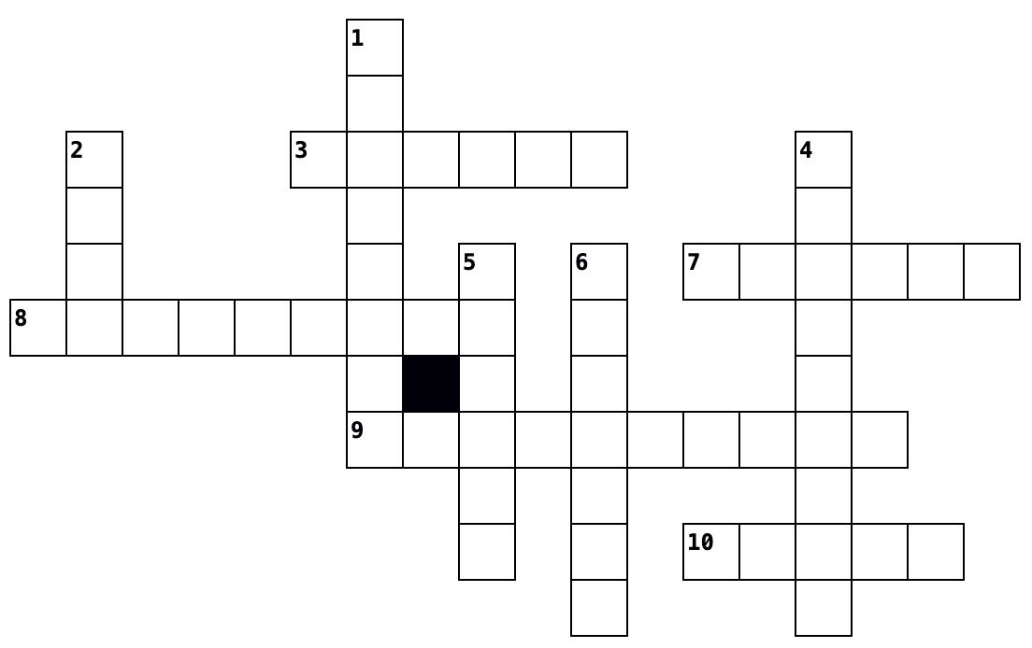
Recap – Nigeria: The Environmental Impact of Oil Extraction in Nigeria
Introduction to the environmental impact of oil extraction in Nigeria
Fill in the missing words below.
Oil extraction in the Niger _____________ has had a significant impact on the __________________________. _______ spills have destroyed aquatic ______________________ and burning gases associated with oil extraction has caused considerable _________ pollution, releasing ________________________ gases and causing respiratory problems for local ___________. ________ mining has caused soil ______________ and has polluted water supplies.
people environment Delta oil ecosystems air tin greenhouse soil
The environmental impact of oil extraction
Read the statements about the environmental impacts of oil extraction in Nigeria below and decide whether they are true or false.
Across
3. – What has destroyed aquatic ecosystems in the Niger Delta due to accidents in oil extraction?
7. – Besides oil extraction, which other activity has caused soil erosion and water pollution in Nigeria?
8. – Burning gases from oil extraction have caused severe air _______ in the Niger Delta.
9. – Oil _______ in the Niger Delta has caused significant environmental damage, including spills and air pollution.
10. – Which oil company was responsible for major oil spills in Bodo, Ogoniland?
 | T | F
Oil extraction in the Niger Delta has caused environmental damage, including oil spills and air pollution.
The oil company responsible for the Bodo oil spills in Ogoniland was British Petroleum (BP).
The 2008 Bodo oil spill was caused by a rupture in the Bodo-Bonny trans-Niger pipeline.
Oil spills in the Niger Delta have destroyed aquatic ecosystems and infiltrated farmland.
The oil spills in the Niger Delta were cleaned up immediately after the incident in 2008.
Compensation was paid to the Bodo community after the oil spill, but none was used for cleaning up the area.
The cost of cleaning up and restoring the Niger Delta after the spill is estimated to be over £100 million.
The investigation into the Bodo oil spills was conducted by the World Health Organisation.
Oil spills in the Niger Delta have led to significant destruction of mangrove swamps that lined the creeks and rivers.
20 square kilometres of creeks and inlets, relied upon by Bodo and around 30 other settlements, were destroyed by the oil spill, with no immediate cleanup efforts made at the time.
Down
1. – A rupture in the Bodo-Bonny trans-Niger _______ cause
2. – The 2008 oil spill occurred in which small region of the Niger Delta?
4. – What type of swamps lining the rivers and creeks were destroyed by the oil spill?
5. – Which international organisation led an investigation that initiated cleanup efforts in the Niger Delta? (First word only).
6. – The estimated cost of restoring the Niger Delta after the spill exceeds £100 million for the _______.
Environmental Impacts of Oil extraction - Define the keywords
Mangrove swamp:
Oil Spill:
Oil extraction:
Niger Delta:

