Slide 1







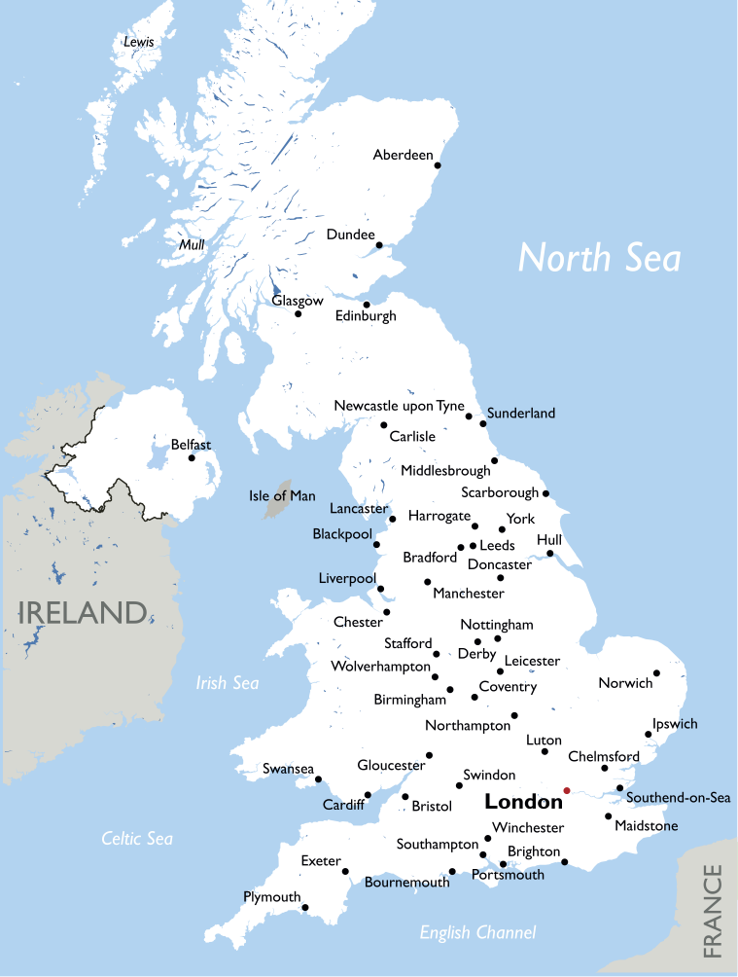



Urban Issues and Challenges
The Location and Importance of Bristol
read
quiz
The Big Picture
Key Terms
Urbanisation
Aerospace industry– Sector focused on the development and production of aircraft and space systems.
LIC/NEE case study
Economic World
European Green Capital Award – A prestigious environmental award recognising cities committed to sustainability.
Urban change in the UK*
Urban sustainability
The Location of Bristol
National Importance
Bristol is located in the southwest of England, approximately 120 miles west of London, at the confluence of the Rivers Frome and Avon.
Economic: Bristol is a hub for industries such as aerospace, defence, IT, and media, with major companies like Airbus and Rolls-Royce.
Educational: Home to the University of Bristol and the University of the West of England, attracting students and researchers globally.
Cultural: Renowned for its thriving arts scene, including Banksy’s street art and a rich history in music and film.
Transport: Excellent connections via its seaport, international airport, and strong road/rail links.
Established as a trading port in the Middle Ages, Bristol has grown
into one of the UK’s eleven ‘core cities.’
It is near the historic cities of Bath (southeast) and Gloucester (northeast).
International Importance
Economic:
Bristol’s aerospace industry contributes to global aviation, with Airbus designing wings for commercial aircraft.
A major hub for silicon chip manufacturing outside California.
The city imports 550,000 cars annually and has globally significant docks at Avonmouth and Royal Portbury.
Cultural:
Internationally recognised for music, Banksy’s art, and Wallace and Gromit animations.
The University of Bristol hosts students from over 150 countries.
Environmental:
Awarded the European Green Capital Award (2015) for sustainability efforts.
Historical:
Bristol’s transatlantic trade history shaped its global connections and cultural diversity, influencing its population and heritage.
Why did Bristol Grow?
Two key factors contributed to Bristol’s growth:
Maritime trade: Bristol developed as a major port during the Middle Ages, facilitating trade with Europe and beyond.
Triangular trade: In the 18th century, Bristol expanded through its role in the transatlantic slave trade, connecting West Africa and the West Indies. The wealth generated significantly fuelled the city’s growth.
Today, Bristol strives to acknowledge its complex history, as exemplified by renaming Colston Hall to Bristol Beacon.

