Slide 1
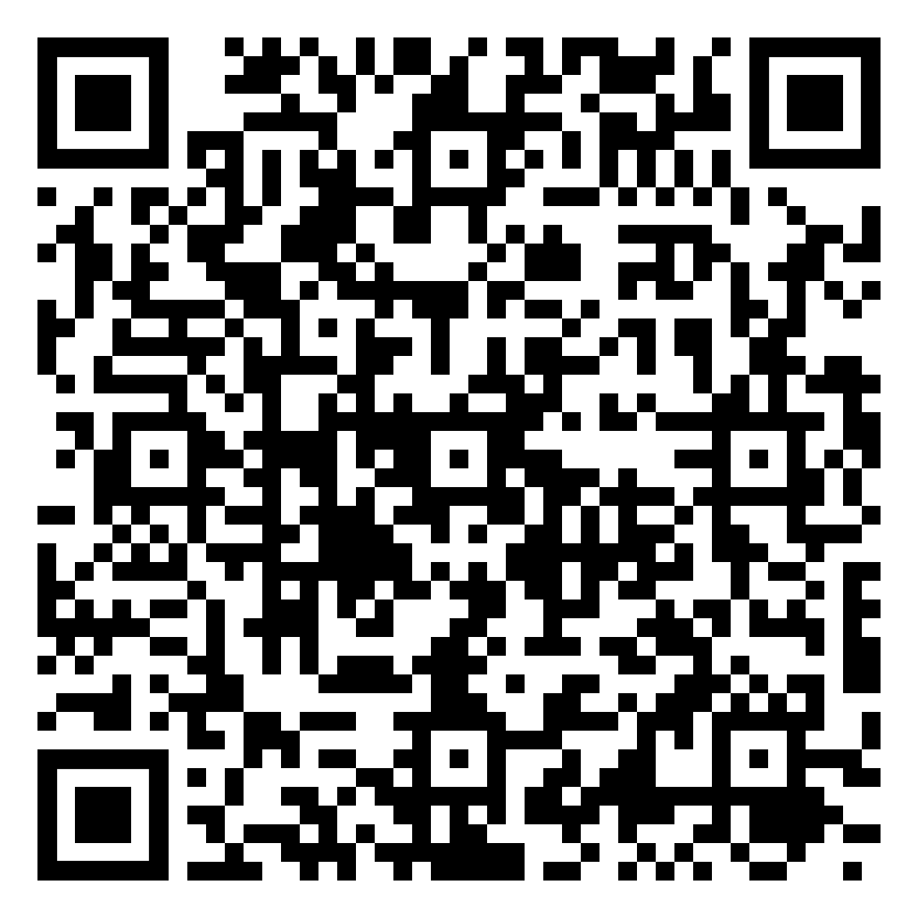
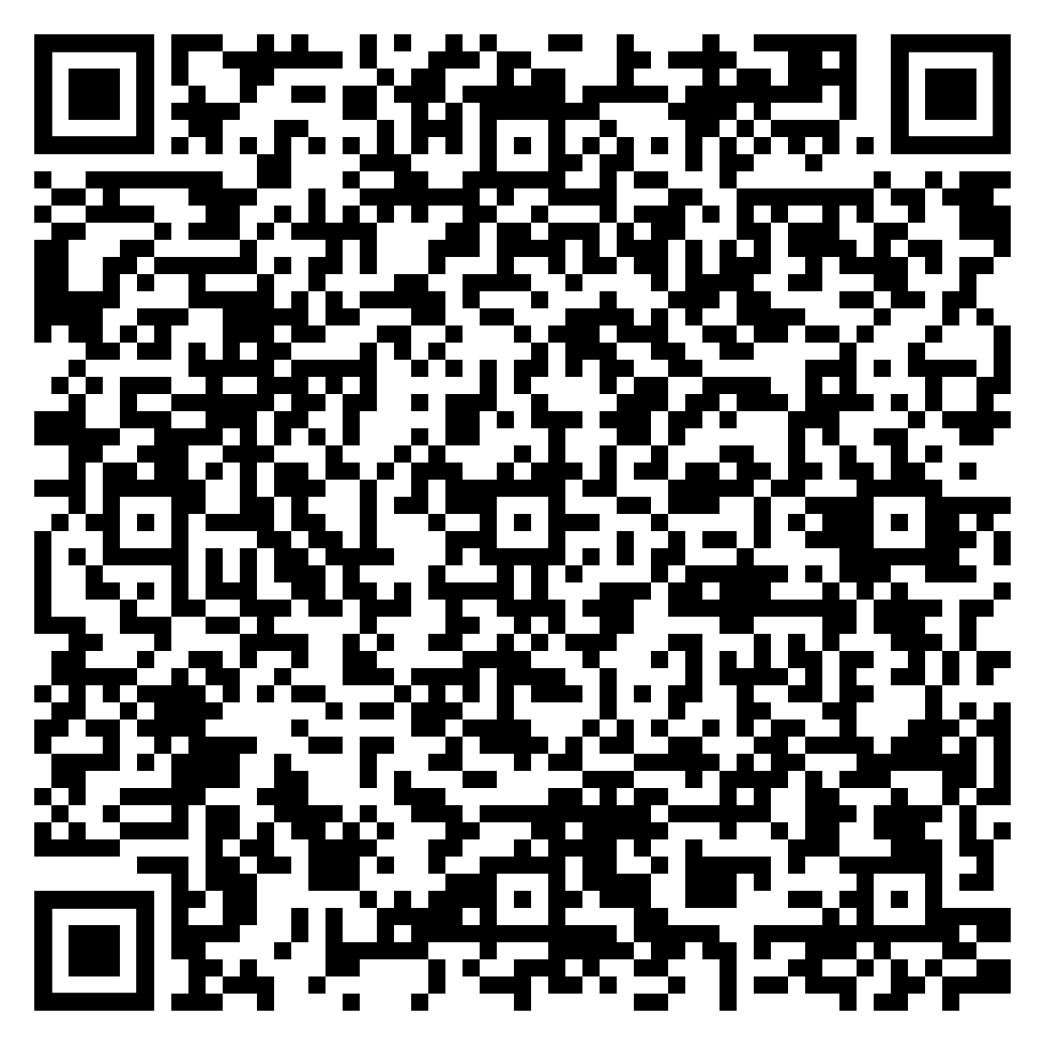










Urban Issues and Challenges
The Impact of Migration in Bristol
read
quiz
The Big Picture
Key Terms
Urbanisation
Multiculturalism – A society that includes people from diverse cultural, religious, and linguistic backgrounds.
LIC/NEE case study
Economic World
Urban Development – Expansion and modernisation of a city due to population growth.
Urban change in the UK*
Urban sustainability
Migration in Bristol
Between 1851 and 1891, Bristol’s population doubled as people migrated for employment.
Until 2015, around 50% of population growth was due to overseas migration, with 15% of the population born outside the UK.
By 2021, this figure rose to 18.8%, showcasing a continued trend of international migration.
Social Impact
Cultural Diversity: Migration has made Bristol a multicultural hub, with 91 languages spoken and a thriving arts and music scene. Events like St Paul’s Carnival attract 40,000 visitors, fostering community spirit.
Education: Schools adapt to multilingual and multicultural students, enriching educational experiences.
Pressure on Services: Migration increases demand for housing, healthcare, and education, causing shortages and longer waiting times.
Diversity in Bristol
45 religions, 180+ birth countries, 90+ languages spoken.
Many migrants come from EU countries, especially Poland and Spain, contributing to sectors like:
Hospitality
Retail
Construction
Manufacturing
Health
Transport
Compared to other regions in the UK, Bristol sees more migrants settling permanently, enriching the city’s socio-cultural landscape.
Environmental Impact
Urban Development: Population growth has led to more housing and infrastructure, increasing waste and resource use.
Transport: More people result in higher demand for public transport and more private vehicles, contributing to pollution.
Political Impact
Economic Impact
Policy Making: Migration influences housing, education, and social service policies in Bristol.
Social Cohesion: Policymakers aim to promote harmony and reduce tensions in Bristol’s diverse communities.
Labour Market: Migrants fill labour gaps, especially in healthcare, construction, and hospitality, providing a motivated workforce.
Economic Growth: Migrants contribute through taxes and spending, boosting the local economy.
Innovation: Many migrants start businesses, creating jobs and driving entrepreneurship in Bristol.
Migration has boosted Bristol’s economy, enriched its culture, and driven innovation. However, it also brings challenges, including pressure on public services and the environment. Policymakers work to balance these impacts for sustainable growth.

