Slide 1
Frayer model examples
Year 7

Slide 2
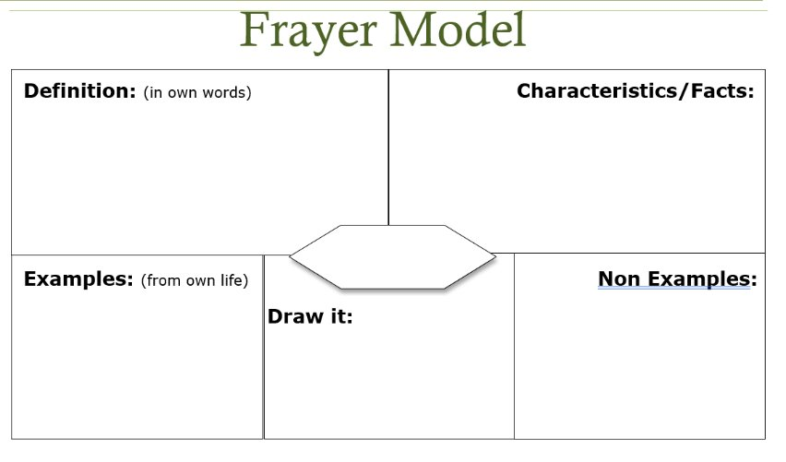

Slide 3
Biodiversity is the VARIETY of life on earth including the variety of species, genes and ecosystems

Slide 4
Biodiversity is the VARIETY of life on earth including the variety of species, genes and ecosystems
We have only discovered 19% of ALL life on earth but humans have destroyed 75% of this since 1970.

Slide 5
Biodiversity is the VARIETY of life on earth including the variety of species, genes and ecosystems
We have only discovered 19% of ALL life on earth but humans have destroyed 75% of this since 1970.
Bacteria
Fungi
Flowering plants
Ants
Beetles ….
There are LOADS more!

Slide 6
Biodiversity is the VARIETY of life on earth including the variety of species, genes and ecosystems
We have only discovered 19% of ALL life on earth but humans have destroyed 75% of this since 1970.
Bacteria
Fungi
Flowering plants
Ants
Beetles ….
There are LOADS more!
Abiotic factors
Monocrops
Carbon dioxide

Slide 7
Biodiversity is the VARIETY of life on earth including the variety of species, genes and ecosystems
We have only discovered 19% of ALL life on earth but humans have destroyed 75% of this since 1970.
Bacteria
Fungi
Flowering plants
Ants
Beetles ….
There are LOADS more!
Abiotic factors
Monocrops
Carbon dioxide

Slide 8

Vocabulary
Complete the table.
Define The wearing away of rocks |  | Use
the process by which the surface of something is gradually destroyed through the action of wind, rain, etc.
the process by which the surface of something is gradually destroyed through the action of wind, rain, etc.
Connect |  | Analyse
erosion

Slide 9
Vocabulary
Complete the table.
Define |  | Use
the measure of how steep a slope is
Connect |  | Analyse
gradient

Slide 10
Vocabulary
Complete the table.
Define |  | Use
the measure of how steep a slope is
Connect |  | Analyse
The hill had a gentle gradient
gradient

Slide 11
Vocabulary
Define |  | Use
the measure of how steep a slope is
Connect The word gradient can be used in Maths and Science |  | Analyse
Mathematics the degree of steepness of a graph at any point. Physics an increase or decrease in the magnitude of a property (e.g. temperature, pressure, or concentration) observed in passing from one point or moment to another. the rate of such a change. Mathematics the vector formed by the operator ∇ acting on a scalar function at a given point in a scalar field.
The hill had a gentle gradient
gradient

Slide 12
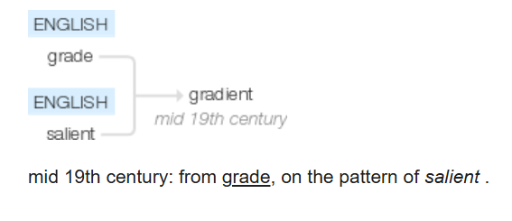
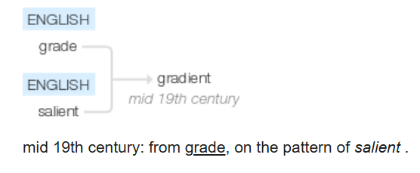
Vocabulary
Define |  | Use
the measure of how steep a slope is
Connect The word gradient can be used in Maths and Science |  | Analyse
Mathematics the degree of steepness of a graph at any point. Physics an increase or decrease in the magnitude of a property (e.g. temperature, pressure, or concentration) observed in passing from one point or moment to another. the rate of such a change. Mathematics the vector formed by the operator ∇ acting on a scalar function at a given point in a scalar field.
The hill had a gentle gradient
gradient

