Slide 1


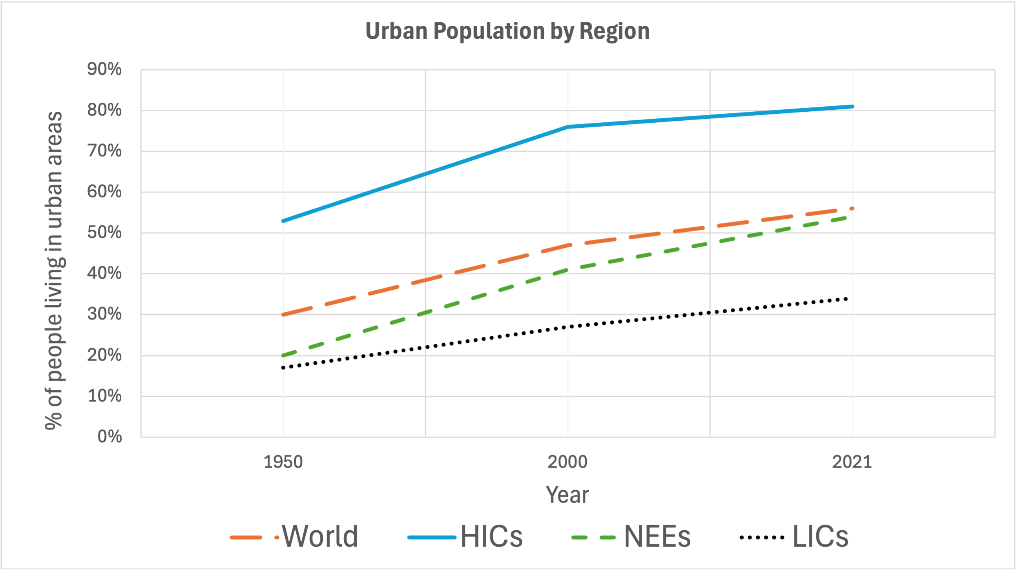


Urban Issues and Challenges
Geography Homework
Factors affecting the rate of urbanisation
1
Urbanisation is the growth in the proportion of people living in towns and c__________. It happens for two main reasons: m__________ from rural to urban areas and n__________ increase. M__________ is when people move from one place to another. P__________ factors cause people to leave the countryside, while p__________ factors attract them to towns. Natural increase is when b________ rates are higher than d________ rates.
2
Match each key term to its definition.
Push factor
Something that attracts people to move to a place.
Pull factor
When more people are born than die in a given area.
Natural
increase
A reason people want to leave a place.
Urbanisation
The increase in the proportion of people living in towns and cities.
3
Complete the key to the graph to show urban population by region. Choose from:
LIC
NEE
HIC
World
Coastal Landscapes in the UK
Key
Factors affecting the rate of urbanisation

Slide 2
Urban Issues and Challenges
Geography Homework
Factors affecting the rate of urbanisation
4
Before 1950, most urbanisation occurred in h______-i_________ countries (HICs), but since then, the fastest growth has been in l______-income countries (LICs) and newly e_____________ economies (NEEs), particularly in South A_________, Africa, and A________. According to the United N__________, 60% of the world’s p___________ is expected to live in u________ areas by 2030, continuing the trend of increasing u________________ globally.
5
Read each factor and tick whether it is a push or pull factor for migration.
Push
Pull
Lack of clean water and healthcare
Access to better-paid jobs
Risk of crop failure due to drought
Perception of a higher quality of life
Poor quality housing and overcrowding in rural areas
6
What are the main causes of urbanisation in LICs since 1950?
A. More shopping centres being built in rural villages
B. High birth rates and falling death rates (natural increase)
C. Fewer natural disasters in cities
D. Rural-to-urban migration due to population pressure
E. Government forcing people
to move to urban areas
F. People move in search of better jobs, healthcare, and education
www.internetgeography.net

Slide 3
Urban Issues and Challenges
Geography Homework
Factors affecting the rate of urbanisation
1
Urbanisation is the growth in the proportion of people living in towns and c__________. It happens for two main reasons: m__________ from rural to urban areas and n__________ increase. M__________ is when people move from one place to another. P__________ factors cause people to leave the countryside, while p__________ factors attract them to towns. Natural increase is when b________ rates are higher than d________ rates.
ities
igration
atural
igration
ush
ull
irth
eath
2
Match each key term to its definition.
Push factor
Something that attracts people to move to a place.
Pull factor
When more people are born than die in a given area.
Natural
increase
A reason people want to leave a place.
Urbanisation
The increase in the proportion of people living in towns and cities.
3
Complete the key to the graph to show urban population by region. Choose from:
LIC
NEE
HIC
World
Coastal Landscapes in the UK
Key
World
HICs
NEEs
LICs
Factors affecting the rate of urbanisation

Slide 4

Urban Issues and Challenges
Geography Homework
Factors affecting the rate of urbanisation
Before 1950, most urbanisation occurred in h______-i_________ countries (HICs), but since then, the fastest growth has been in l______-income countries (LICs) and newly e_____________ economies (NEEs), particularly in South A_________, Africa, and A________. According to the United N__________, 60% of the world’s p___________ is expected to live in u________ areas by 2030, continuing the trend of increasing u________________ globally.
4
igh
ncome
ow
merging
merica
sia
ations
opulation
rban
rbanisation
5
Read each factor and tick whether it is a push or pull factor for migration.
Push
Pull
Lack of clean water and healthcare
Access to better-paid jobs
Risk of crop failure due to drought
Perception of a higher quality of life
Poor quality housing and overcrowding in rural areas
6
What are the main causes of urbanisation in LICs since 1950?
A. More shopping centres being built in rural villages
B. High birth rates and falling death rates (natural increase)
C. Fewer natural disasters in cities
D. Rural-to-urban migration due to population pressure
E. Government forcing people
to move to urban areas
F. People move in search of better jobs, healthcare, and education
www.internetgeography.net

