Slide 1
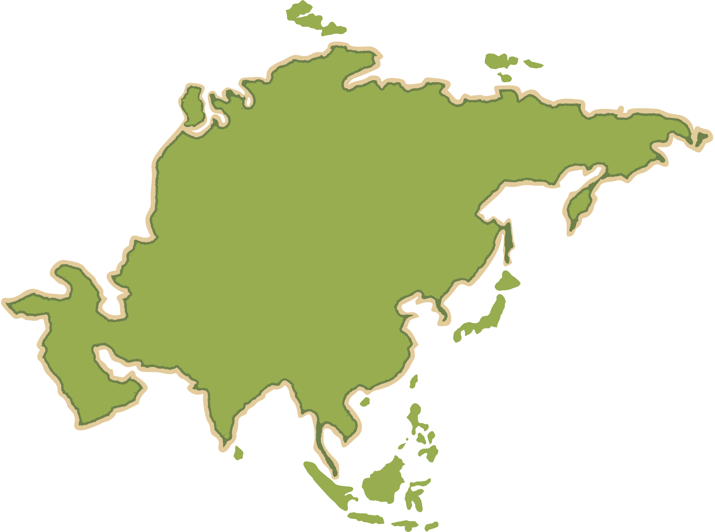
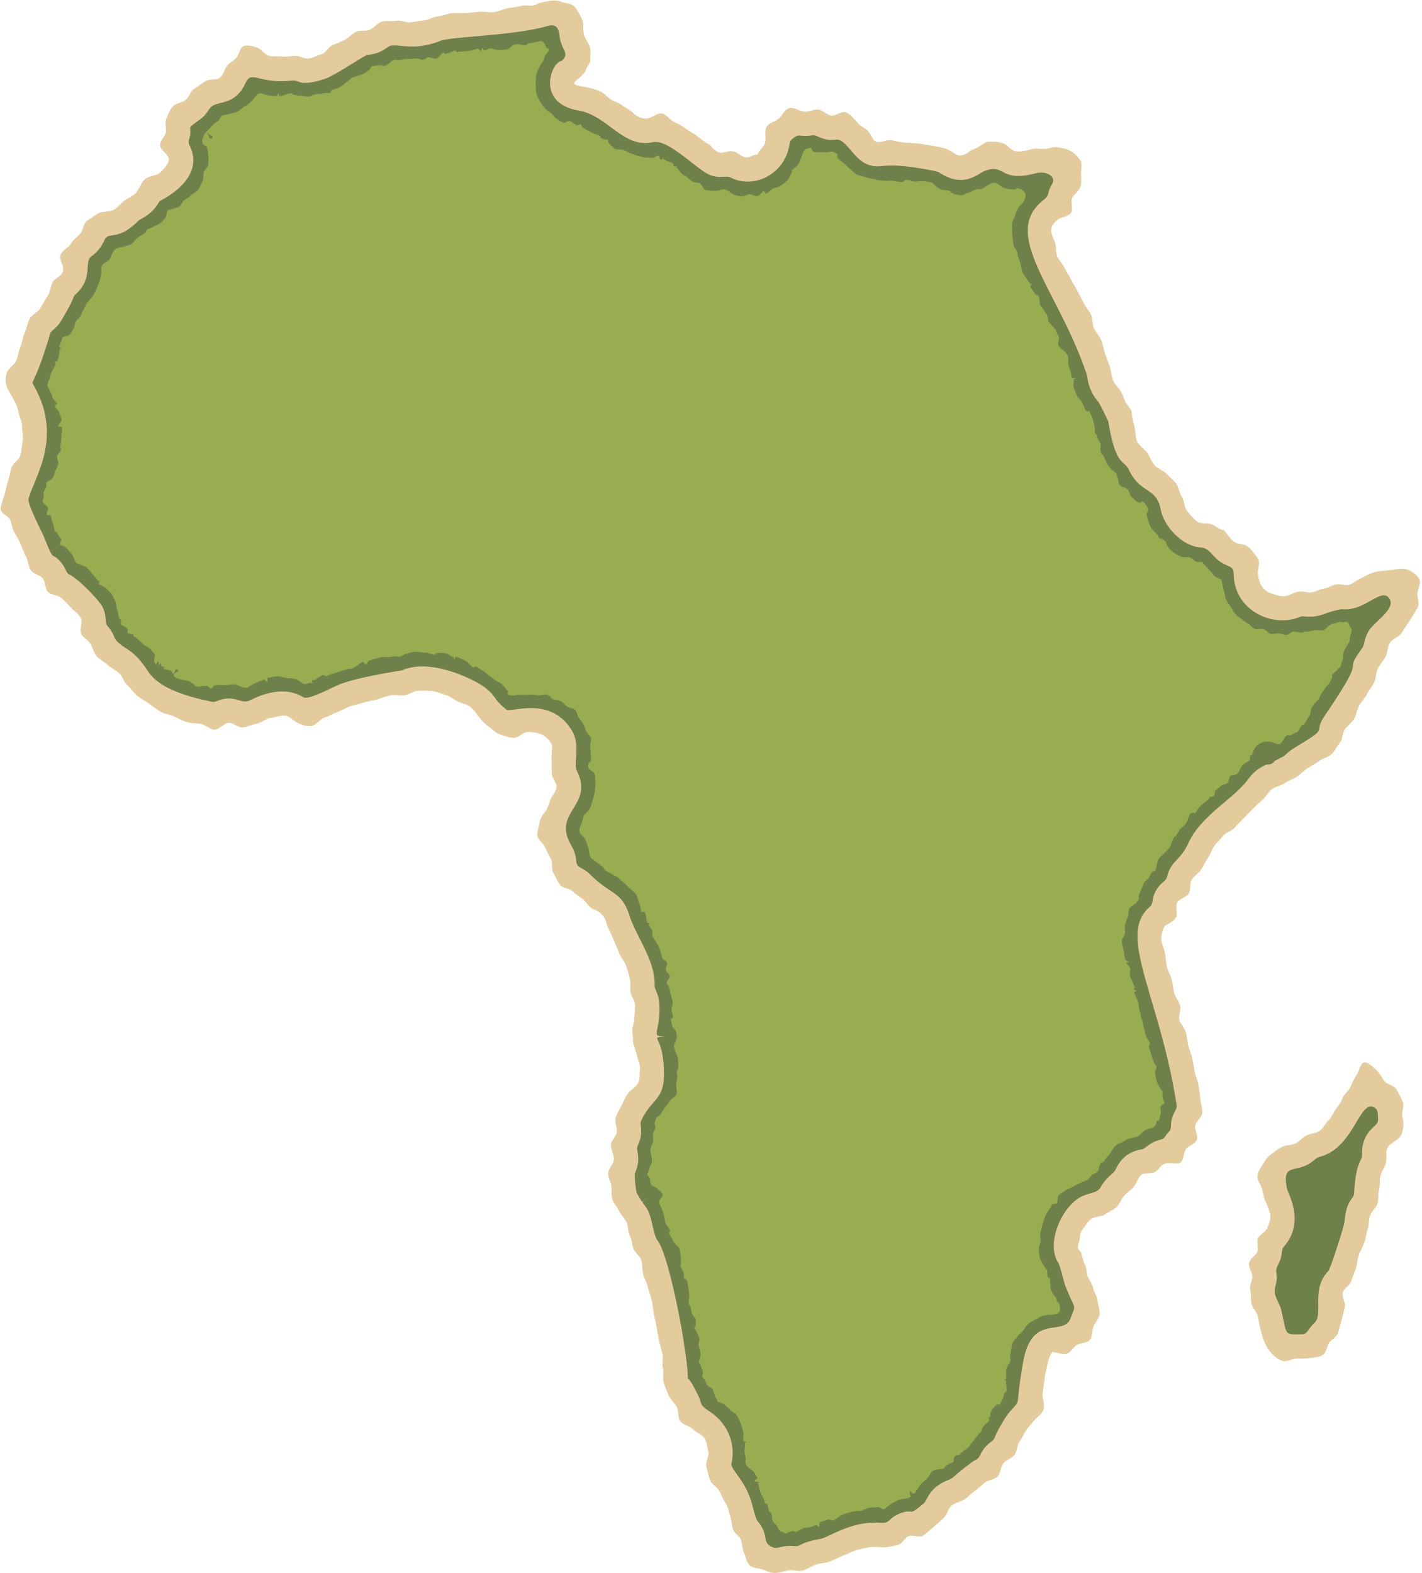


Hazardous Earth: Climate
Geography Homework
Atmospheric Circulation
1
The Earth’s atmosphere moves heat from areas of surplus (the E________) to areas of deficit (the p______). This movement of air is called g_______ a____________ circulation. It is split into three cells in each hemisphere: the H_______ cell, F_______ cell and P______ cell. At the Equator, warm air rises creating a belt of l____ pressure. At around 30°N and 30°S, air sinks creating h_____ pressure. Surface winds in the tropics are called t_____ winds.
2
True or false?
True
False
The Hadley cell is found closest to the poles.
Trade winds in the northern hemisphere blow from the south-east.
The Polar cell is the smallest of the three circulation cells.
Jet streams are fast-flowing air currents high in the atmosphere.
3
Match the Cells to their descriptions.
Hadley Cell
Found between 60° and the poles. Cold air sinks at the poles and moves towards lower latitudes.
Ferrel Cell
Found between the Equator and 30°. Warm air rises at the Equator, moves poleward, cools and sinks.
Polar Cell
Found between 30° and 60°. Air movement is complex, transferring warm air poleward and cold air equatorward.
Atmospheric Circulation

Slide 2
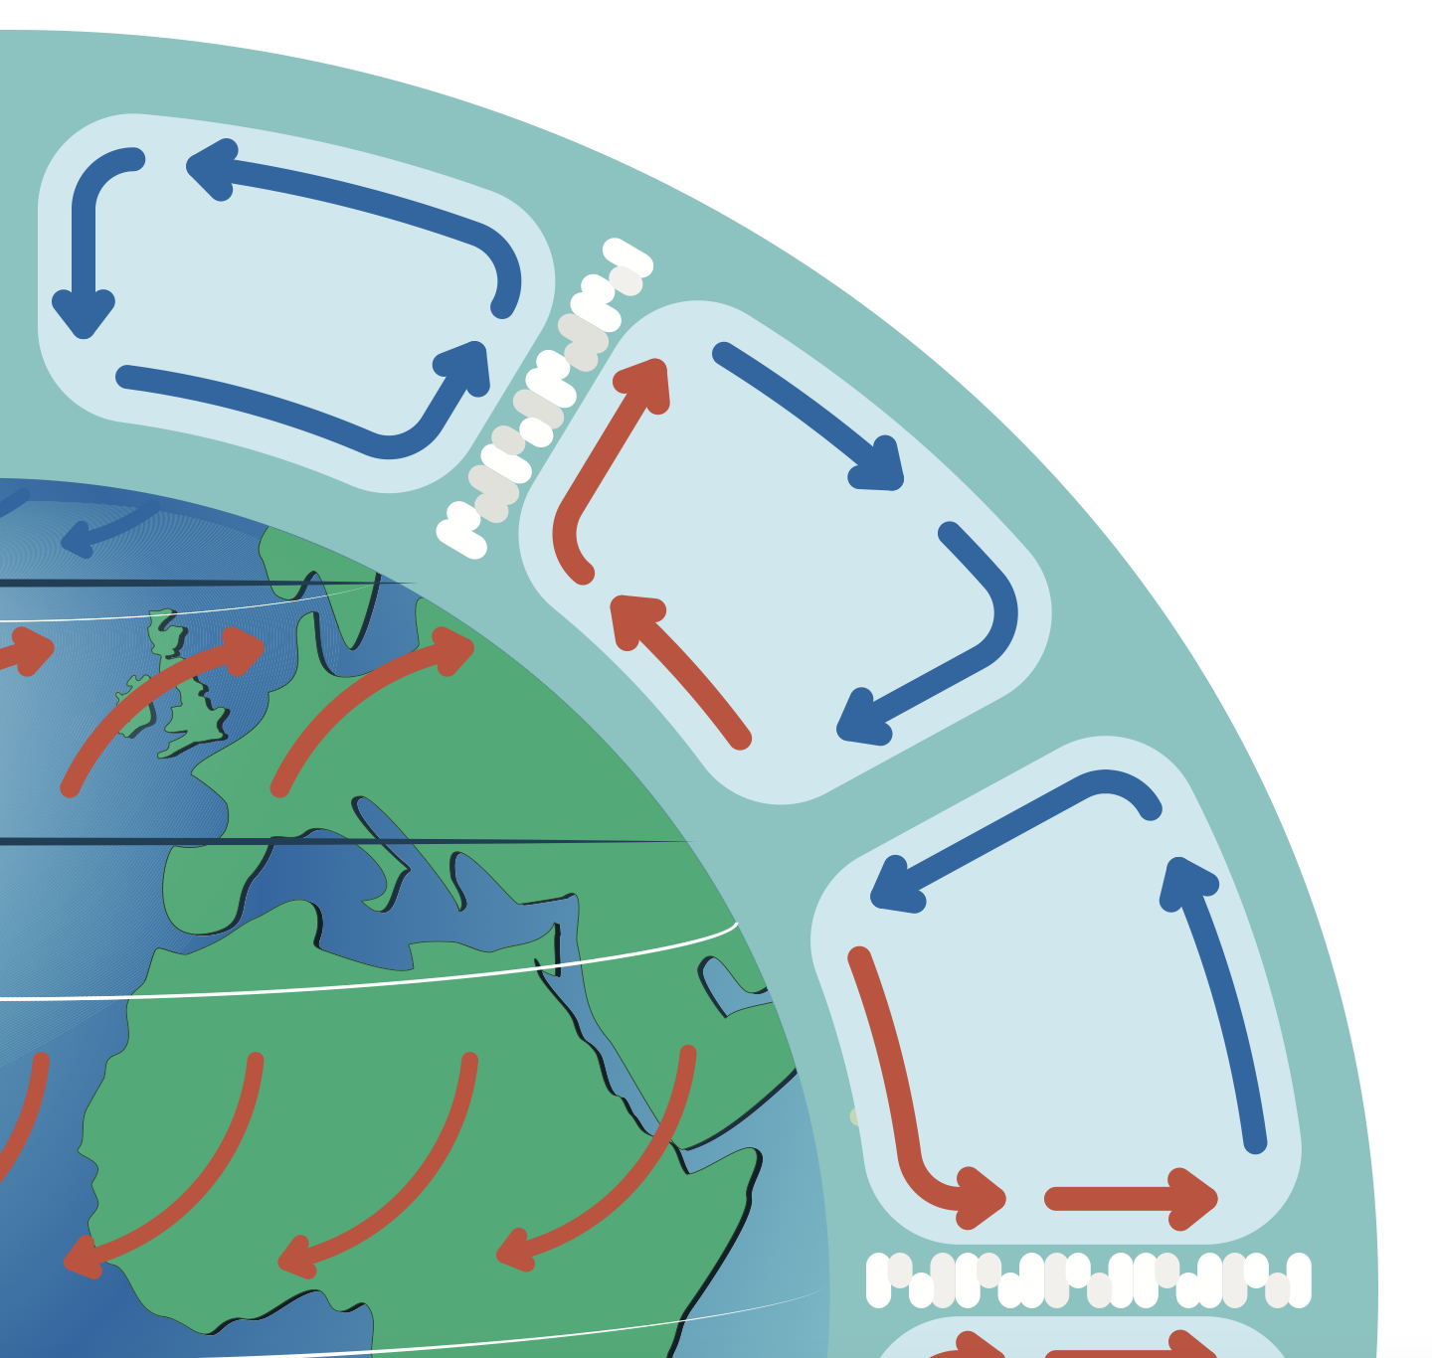
Hazardous Earth: Climate
Geography Homework
4
Draw and label one hemisphere's atmospheric circulation. Include:
Equator, 30°, 60°, Pole
Hadley, Ferrel, and Polar cells
5
At the Equator, rising air causes l___ pressure and h____ rainfall, which leads to tropical r__________. Around 30°, sinking air creates h___ pressure and d___ zones, such as deserts. Near 60°, warmer air rises at l___ pressure, leading to s_______ weather. The pattern of rising and sinking air and the resulting winds (trade, westerlies) influence the formation of t________ storms.
6
Complete the table to show what happens at each latitude.
9
Latitude
Pressure
Climate Characteristics
Equator
30º N/S
60º N/S
Poles
www.internetgeography.net

Slide 3

Hazardous Earth: Climate
Geography Homework
Atmospheric Circulation
1
The Earth’s atmosphere moves heat from areas of surplus (the Equator) to areas of deficit (the poles). This movement of air is called global atmospheric circulation. It is split into three cells in each hemisphere: the Hadley cell, Ferrel cell and Polar cell. At the Equator, warm air rises creating a belt of low pressure. At around 30°N and 30°S, air sinks creating high pressure. Surface winds in the tropics are called trade winds.
2
True or false?
True
False
The Hadley cell is found closest to the poles.
Trade winds in the northern hemisphere blow from the south-east.
The Polar cell is the smallest of the three circulation cells.
Jet streams are fast-flowing air currents high in the atmosphere.
3
Match the cells to their descriptions.
Hadley Cell
Found between 60° and the poles. Cold air sinks at the poles and moves towards lower latitudes.
Ferrel Cell
Found between the Equator and 30°. Warm air rises at the Equator, moves poleward, cools and sinks.
Polar Cell
Found between 30° and 60°. Air movement is complex, transferring warm air poleward and cold air equatorward.
Atmospheric Circulation

Slide 4
Hazardous Earth: Climate
Geography Homework
4
Draw and label one hemisphere's atmospheric circulation. Include:
Polar Cell
Pole
Ferrel Cell
60°
30°
Hadley Cell
Equator
5
At the Equator, rising air causes low pressure and high rainfall, which leads to tropical rainforest. Around 30°, sinking air creates high pressure and dry zones, such as deserts. Near 60°, warmer air rises at low pressure, leading to stormy weather. The pattern of rising and sinking air and the resulting winds (trade, westerlies) influence the formation of tropical storms.
6
Complete the table to show what happens at each latitude.
9
Latitude
Pressure
Climate Characteristics
Equator
Low
Intense solar heating, Intertropical Convergence Zone (ITCZ). High rainfall, tropical rainforests
30º N/S
High
Air sinks, becoming drier leading to desert formation and semi-arid regions. Little rainfall.
60º N/S
Low
Warm air from Ferrel Cell meets cold Polar air – high rainfall in temperate regions.
Poles
High
Cold air sinks, becoming drier leading to cold desert formation. Little rainfall.
www.internetgeography.net

