Slide 1
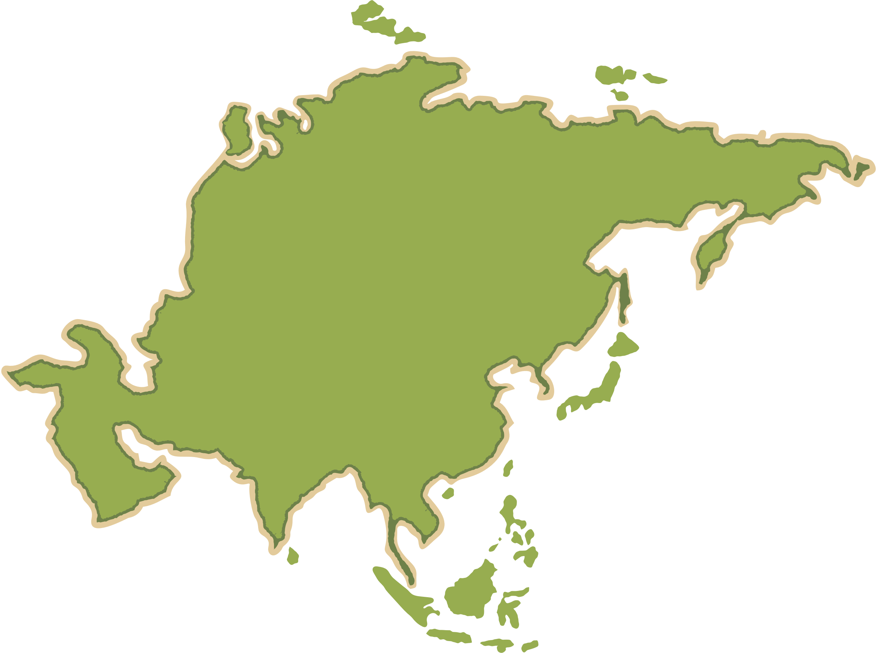
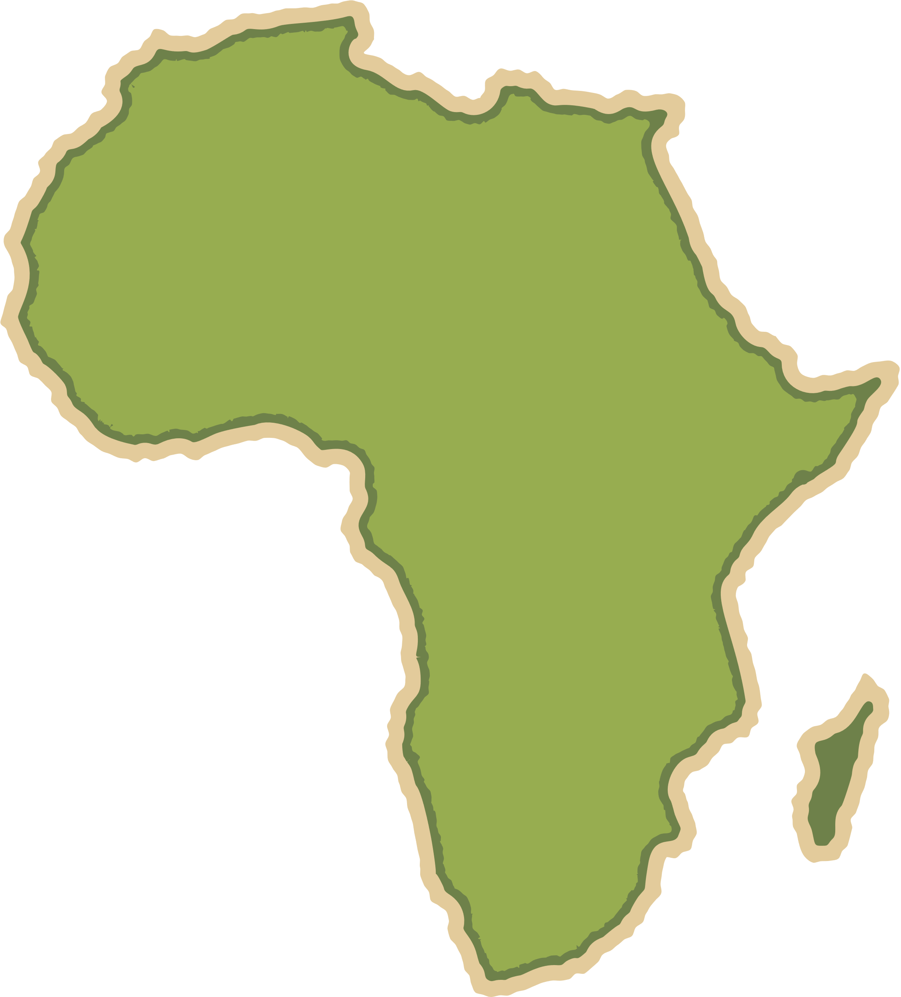


Coastal Change and Conflict
Geography Homework
Physical Processes and Upland and Lowland Landscapes in the UK
1
F__________ (mechanical) weathering dominates in uplands, breaking rocks a_____ when water f_______ and expands in cracks. Upland landscapes were further shaped by g_______ erosion, forming U-shaped valleys, corries, and arêtes, with deposits like m________ remaining. In lowland areas, landscapes are f________ and more fertile. Rivers in lowlands create features like m_________, o______ lakes, and f________, and rivers deposit alluvium which forms fertile s______.
2
True or false?
True
False
Upland areas are formed on hard, resistant rocks such as granite.
Freeze–thaw weathering is a chemical process common in lowlands.
U-shaped valleys in the Lake District were created by glacial erosion.
Lowland areas like East Anglia have waterlogged soils due to impermeable clay.
Alluvial deposits in floodplains reduce fertility due to poor drainage.
3
Match the key words to their definitions.
Chemical Weathering | The wearing away of rocks and soil by rivers, glaciers and waves.
Erosion | The dropping of material by rivers, waves or glaciers
Deposition | The decomposition of rock caused by chemical change within that rock.
Physical processes and upland and lowland landscapes in the UK

Slide 2
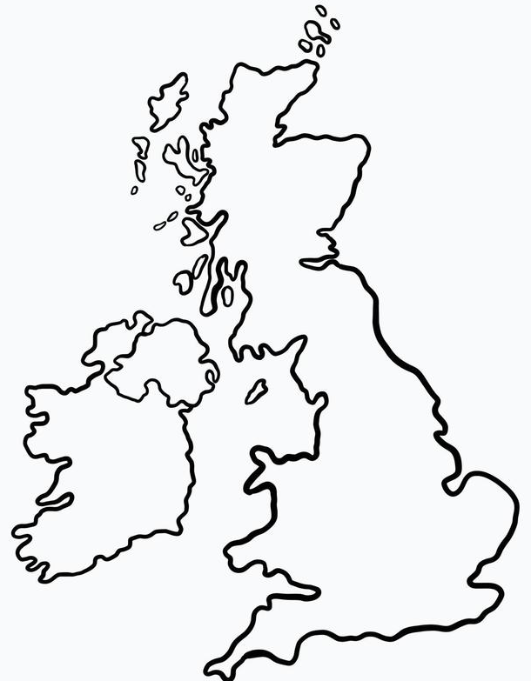
Coastal Change and Conflict
Geography Homework
4
Shade and Label the map with:
Upland regions (North & West—high resistant rock areas)
Lowland regions (South & East—soft sedimentary areas)
Glacial features: U-shaped valley, corrie, moraine
River landforms: meander, oxbow lake, floodplain
5
The imaginary Tees–Exe line divides ______-rock uplands in the _____ and west from ______ lowlands in the ______ and east. __________ rocks like chalk allow water to drain, forming dry ________, while ___________ rocks like clay and granite create ____________ soils and poor drainage.
6
Complete the table comparing area types.
Area Type | Physical Processes | Resulting Landscape Features
Upland
Lowland
Permeability
www.internetgeography.net

Slide 3

Coastal Change and Conflict
Geography Homework
Physical Processes and Upland and Lowland Landscapes in the UK
1
Freeze-thaw (mechanical) weathering dominates in uplands, breaking rocks apart when water freezes and expands in cracks. Upland landscapes were further shaped by glacial erosion, forming U-shaped valleys, corries, and arêtes, with deposits like moraines remaining. In lowland areas, landscapes are flatter and more fertile. Rivers in lowlands create features like meanders, oxbow lakes, and floodplains, and rivers deposit alluvium which forms fertile soils.
2
True or false?
True
False
Upland areas are formed on hard, resistant rocks such as granite.
Freeze–thaw weathering is a chemical process common in lowlands.
U-shaped valleys in the Lake District were created by glacial erosion.
Lowland areas like East Anglia have waterlogged soils due to impermeable clay.
Alluvial deposits in floodplains reduce fertility due to poor drainage.
3
Match the key words to their definitions.
Chemical Weathering | The wearing away of rocks and soil by rivers, glaciers and waves.
Erosion | The dropping of material by rivers, waves or glaciers
Deposition | The decomposition of rock caused by chemical change within that rock.
Physical processes and upland and lowland landscapes in the UK

Slide 4
Coastal Change and Conflict
Geography Homework
4
Shade and Label the map with:
Upland regions (North & West—high resistant rock areas)
Lowland regions (South & East—soft sedimentary areas)
Glacial features: U-shaped valley, corrie, moraine
River landforms: meander, oxbow lake, floodplain
U Shaped Valley, corries and moraines
Upland regions
High resistant rock
U Shaped Valley, corries and moraines
Upland regions
Lowland regions
Flood plains, Meanders and ox-bow lakes
Flood plains, Meanders and ox-bow lakes
Lowland regions
5
The imaginary Tees–Exe line divides hard-rock uplands in the north and west from softer lowlands in the south and east. Permeable rocks like chalk allow water to drain, forming dry valleys, while impermeable rocks like clay and granite create waterlogged soils and poor drainage.
6
Complete the table comparing area types.
Area Type | Physical Processes | Resulting Landscape Features
Upland | Freeze–thaw weathering; glacial erosion | U-shaped valleys, corries, rugged terrain
Lowland | River erosion/dep., gentle slope creep | Meanders, floodplains, fertile plains
Permeability | Chalk vs Clay | Dry valleys vs waterlogged areas
www.internetgeography.net

