Slide 1
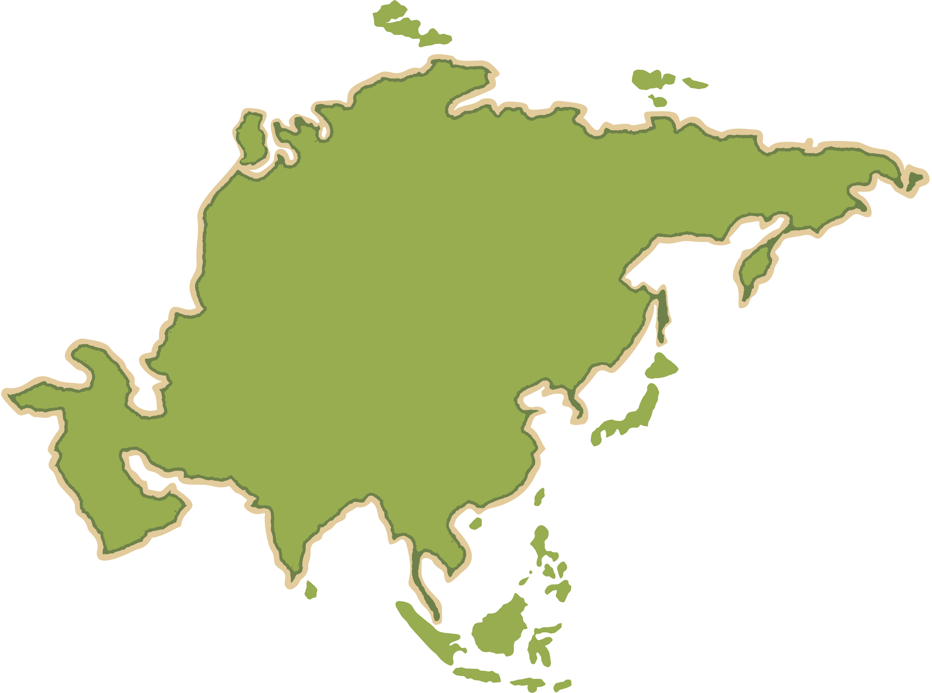
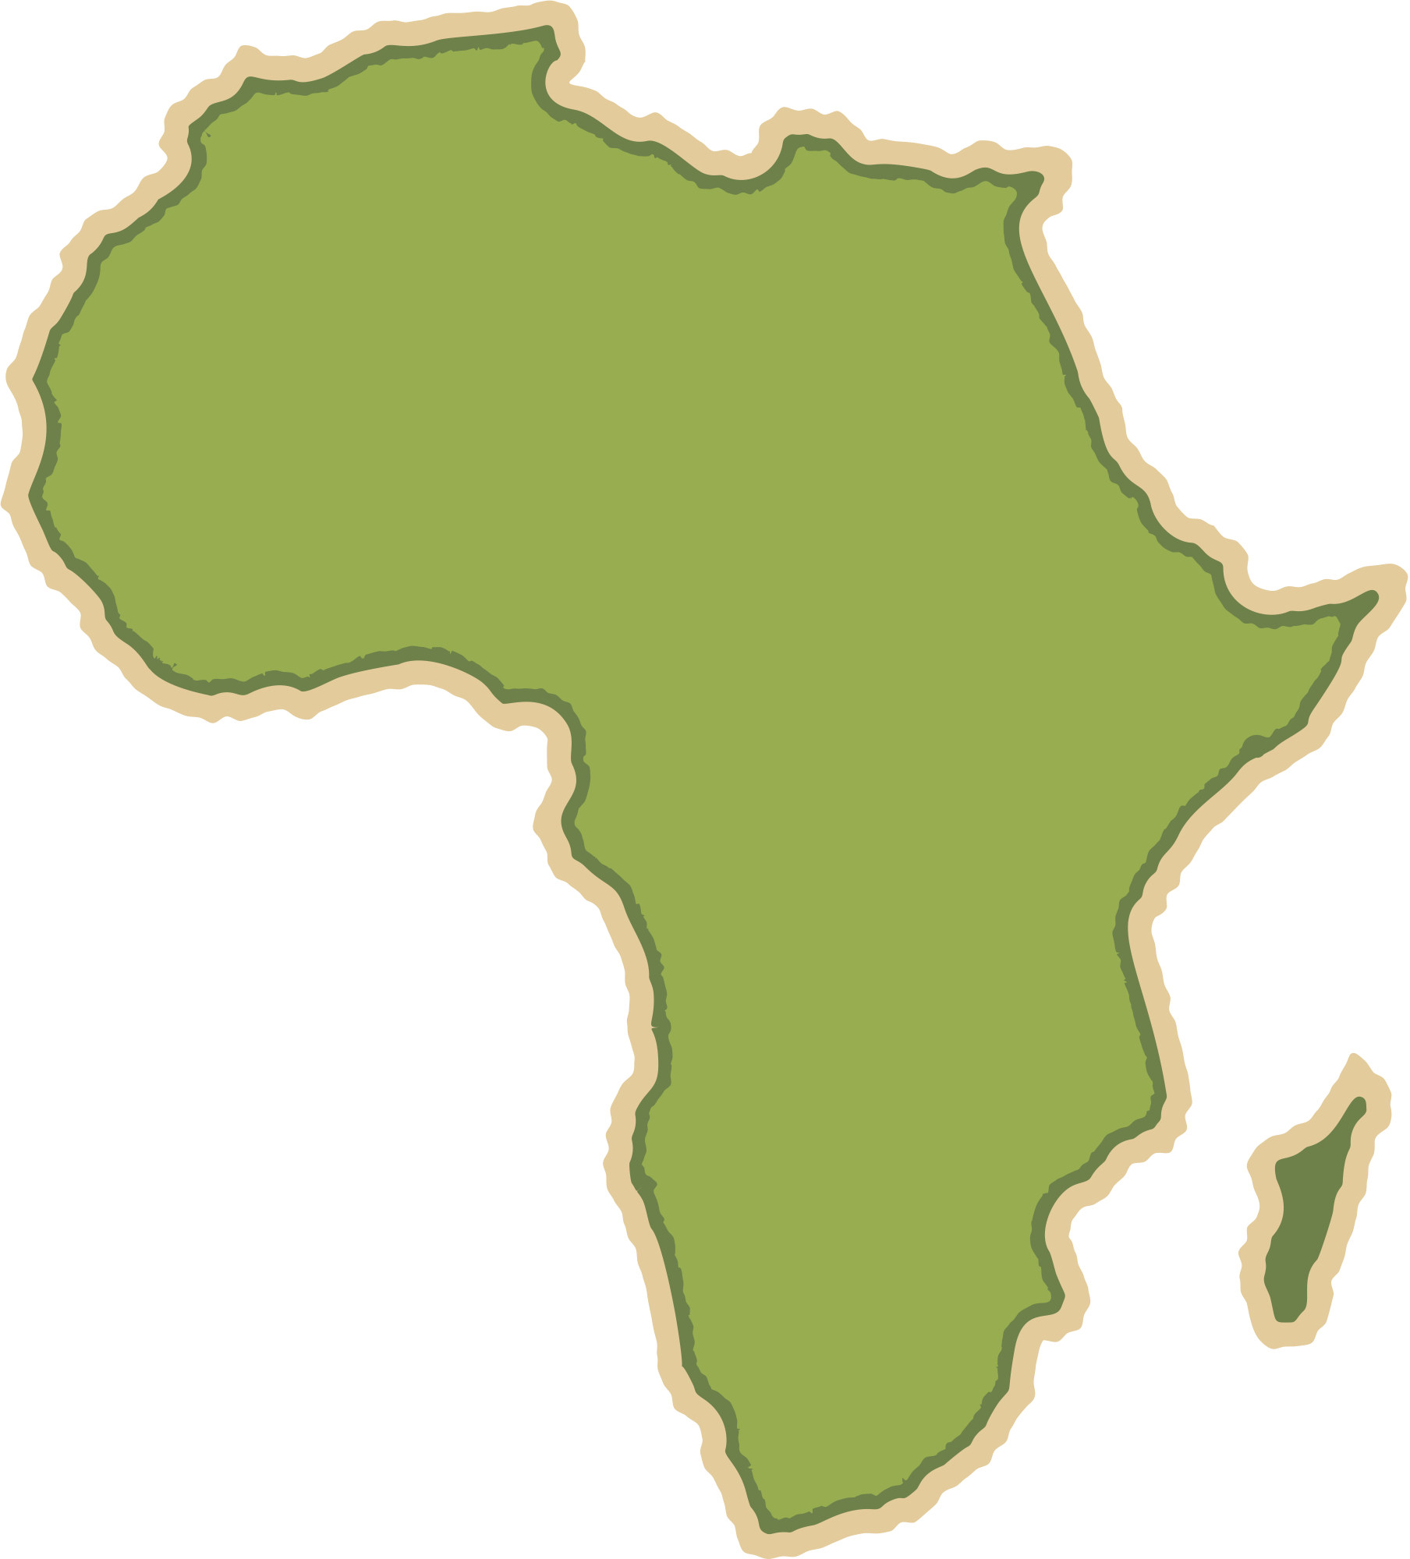


People and the Biosphere
Geography Homework
Explaining the distribution and characteristics of biomes
1
Fill in the blanks using: temperature, rainfall, winds, distribution, characteristics
Climate is a key factor affecting the ___________ of biomes. ____________ and _________ directly impact what grows in each biome. Annual and diurnal temperature range, seasonal variation in ________, and _________ also influence biomes. These factors affect both the ___________ and ___________ of each biome.
2
True or false?
True
False
Tropical rainforests occur at the equator due to rising warm air and heavy rainfall.
Tropical grasslands have a wet season all year, so trees dominate.
Hot deserts have high pressure, limited clouds, and extreme temperature differences between day and night.
Temperate forests have reduced sunlight in winter, and many trees shed their leaves.
Boreal forests are dominated by broadleaf deciduous trees.
Tundra regions have very limited plant growth due to cold temperatures and long winter darkness.
3
Match the key words to the definition
Inter-tropical convergence zone | The chemical process in plants where water, carbon dioxide & sunlight are used to produce glucose.
Photosynthesis | Where the northern hemisphere meets the atmospheric system of the southern hemisphere
Explaining the distribution and characteristics of biomes

Slide 2
People and the Biosphere
Geography Homework
4
Fill in the blanks using: mosses, grasslands, deserts, equator, deciduous
Tropical rainforests are found around the __________ where sunlight is direct all year. Tropical __________ have tall grasses that thrive in wet summers and die back in dry winters. Hot __________ are very dry, with plants and animals adapted to survive harsh conditions. Temperate forests are dominated by __________ trees that shed their leaves in autumn. Tundra vegetation is limited to small plants such as __________ and sedges.
5
Match the biome to the description
Tropical Rainforest | Long, cold winters with conifers adapted with waxy leaves and flexible branches.
Tropical Grassland (Savanna) | High rainfall and sunlight at the equator, causing lush dense vegetation.
Hot Desert | Seasonal wet and dry periods with tall grasses and scrub.
Temperate Forest | Extreme day–night temperature ranges, little rain, plants adapted to aridity.
Temperate Grassland | Harsh cold climate, very short growing season, mosses and sedges dominate.
Boreal Forest | Summers warm and wet, winters cold and dry, grasses thrive but few trees.
Tundra | Year-round rainfall, deciduous trees shedding leaves in autumn.
6
Answer the following questions in one or two sentences
Why do tropical rainforests experience high rainfall all year round?
____________________________________________________________________________________________________________________________________________
Give one reason why temperate grasslands have few trees.
____________________________________________________________________________________________________________________________________________
www.internetgeography.net

Slide 3

People and the Biosphere
Geography Homework
Explaining the distribution and characteristics of biomes
1
Fill in the blanks using: temperature, rainfall, winds, distribution, characteristics
Climate is a key factor affecting the distribution of biomes. Temperature and rainfall directly impact what grows in each biome. Annual and diurnal temperature range, seasonal variation in winds, and rainfall also influence biomes. These factors affect both the distribution and characteristics of each biome.
2
True or false?
True
False
Tropical rainforests occur at the equator due to rising warm air and heavy rainfall.
Tropical grasslands have a wet season all year, so trees dominate.
Hot deserts have high pressure, limited clouds, and extreme temperature differences between day and night.
Temperate forests have reduced sunlight in winter, and many trees shed their leaves.
Boreal forests are dominated by broadleaf deciduous trees.
Tundra regions have very limited plant growth due to cold temperatures and long winter darkness.
3
Match the key words to the definition
Inter-tropical convergence zone | The chemical process in plants where water, carbon dioxide & sunlight are used to produce glucose.
Photosynthesis | Where the northern hemisphere meets the atmospheric system of the southern hemisphere
Explaining the distribution and characteristics of biomes

Slide 4
People and the Biosphere
Geography Homework
4
Fill in the blanks using: mosses, grasslands, deserts, equator, deciduous
Tropical rainforests are found around the equator where sunlight is direct all year. Tropical grasslands have tall grasses that thrive in wet summers and die back in dry winters. Hot deserts are very dry, with plants and animals adapted to survive harsh conditions. Temperate forests are dominated by deciduous trees that shed their leaves in autumn. Tundra vegetation is limited to small plants such as mosses and sedges.
5
Match the biome to the description
Tropical Rainforest | Long, cold winters with conifers adapted with waxy leaves and flexible branches.
Tropical Grassland (Savanna) | High rainfall and sunlight at the equator, causing lush dense vegetation.
Hot Desert | Seasonal wet and dry periods with tall grasses and scrub.
Temperate Forest | Extreme day–night temperature ranges, little rain, plants adapted to aridity.
Temperate Grassland | Harsh cold climate, very short growing season, mosses and sedges dominate.
Boreal Forest | Summers warm and wet, winters cold and dry, grasses thrive but few trees.
Tundra | Year-round rainfall, deciduous trees shedding leaves in autumn.
6
Answer the following questions in one or two sentences
Why do tropical rainforests experience high rainfall all year round?
____________________________________________________________________________________________________________________________________________
Give one reason why temperate grasslands have few trees.
____________________________________________________________________________________________________________________________________________
Direct sunlight heats the air, which rises, cools, condenses, and forms
clouds, producing heavy rainfall.
Trees cannot survive the cold, dry winters.
www.internetgeography.net

