Slide 1
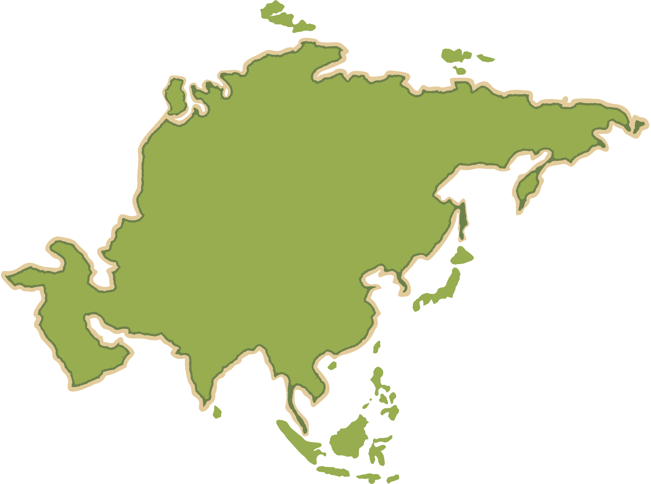
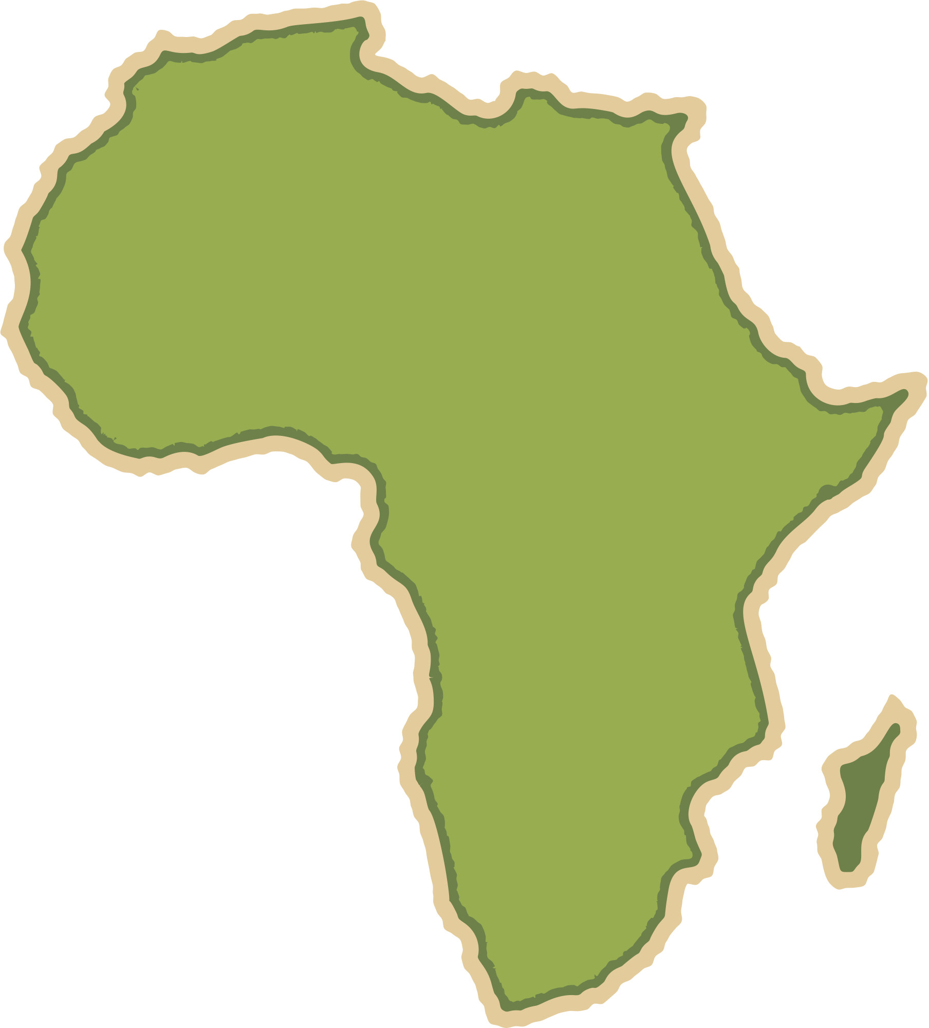


Forests under threat
Geography Homework
Characteristics of the tropical rainforest - 2
1
Fill in the blanks using:
climate, plants, biotic, abiotic, animals, soil, water
A tropical rainforest is a natural ecosystem where __________ and __________ components interact. The __________ parts include living things like __________ and __________, while the __________ parts include __________, __________ and air.
2
Which two of the following are abiotic components of the tropical rainforest ecosystem?
Monkeys
Rainfall
Soil
Trees
Frogs
Birds
3
Match the animal adaptation to the correct description
Poison dart frog | Strong legs and sharp talons used to catch prey from the canopy
Spider monkey | Bright skin secreting poison and warning predators
Eagle | Long prehensile tail and colour vision help with movement and finding fruit
4
Which three of the following are rainforest plant adaptations?
Drip tips on leaves
Deep tap roots
Thick bark to store water
Stratified layers
Buttress roots
Small leaves to conserve water
The characteristics of tropical rainforests

Slide 2
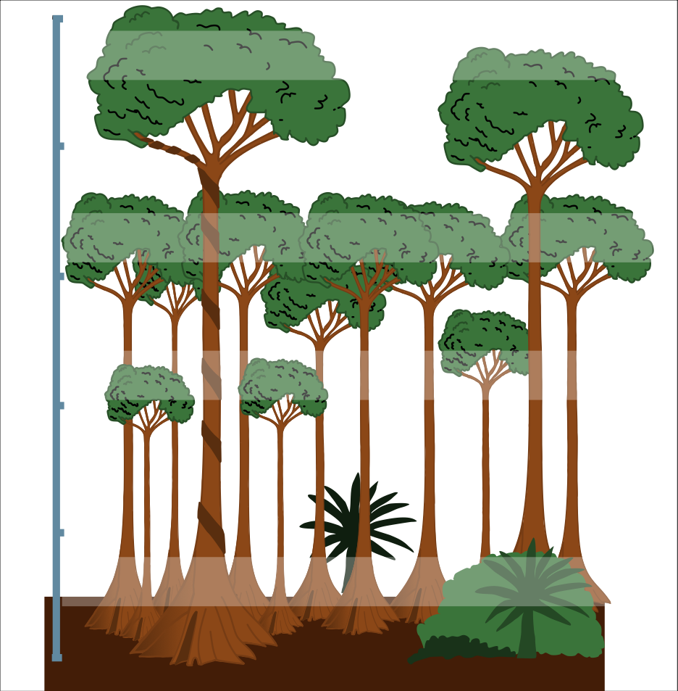
Forests under threat
Geography Homework
Characteristics of the tropical rainforest - 2
5
Fill in the blanks using:
heat, dead, quickly, soil, decomposers, rain
The combination of __________ and __________ encourages ____________ to break down __________ plants and animals very __________, releasing nutrients into the __________ for plants to absorb.
6
True or false?
True
False
Rainforests have low biodiversity.
Nutrients are quickly recycled in rainforest soils.
Rainforests have thin, nutrient-rich soils.
Decomposers act slowly in rainforest climates
Most nutrients are stored in the biomass.
7
Label the diagram below with:
Emergent
Canopy,
Under canopy
Shrub layer
Ground layer
Buttress roots
Drip-tip leaves
www.internetgeography.net

Slide 3

Forests under threat
Geography Homework
Characteristics of the tropical rainforest - 2
1
Fill in the blanks using:
climate, plants, biotic, abiotic, animals, soil, water
A tropical rainforest is a natural ecosystem where __________ and __________ components interact. The __________ parts include living things like __________ and __________, while the __________ parts include __________, __________ and air.
biotic
abiotic
biotic
plants
animals
abiotic
soil
water
2
Which two of the following are abiotic components of the tropical rainforest ecosystem?
Monkeys
Rainfall
Soil
Trees
Frogs
Birds
3
Match the animal adaptation to the correct description
Poison dart frog | Strong legs and sharp talons used to catch prey from the canopy
Spider monkey | Bright skin secreting poison and warning predators
Eagle | Long prehensile tail and colour vision help with movement and finding fruit
4
Which three of the following are rainforest plant adaptations?
Drip tips on leaves
Deep tap roots
Thick bark to store water
Stratified layers
Buttress roots
Small leaves to conserve water
The characteristics of tropical rainforests

Slide 4
Forests under threat
Geography Homework
Characteristics of the tropical rainforest - 2
5
Fill in the blanks using:
heat, dead, quickly, soil, decomposers, rain
The combination of __________ and __________ encourages ____________ to break down __________ plants and animals very __________, releasing nutrients into the __________ for plants to absorb.
rain
heat
decomposers
dead
quickly
soil
6
True or false?
True
False
Rainforests have low biodiversity.
Nutrients are quickly recycled in rainforest soils.
Rainforests have thin, nutrient-rich soils.
Decomposers act slowly in rainforest climates
Most nutrients are stored in the biomass.
7
Label the diagram below with:
Emergent
Canopy,
Under canopy
Shrub layer
Ground layer
Buttress roots
Drip-tip leaves
emergent
canopy
under canopy
shrub layer
drip- tip leaves
buttress roots
ground layer
www.internetgeography.net

