Slide 1






$25
Saturday,
April 21
per person / table of 8
including
welcome drink
at Borcelle's Place
Doors open at: 06:00pm
Game starts at: 07:00pm
QUESTION
A LESSON
Exam Practice
For registration & further Information
www.reallygreatsite.com
Urban Issues and Challenges

Slide 2
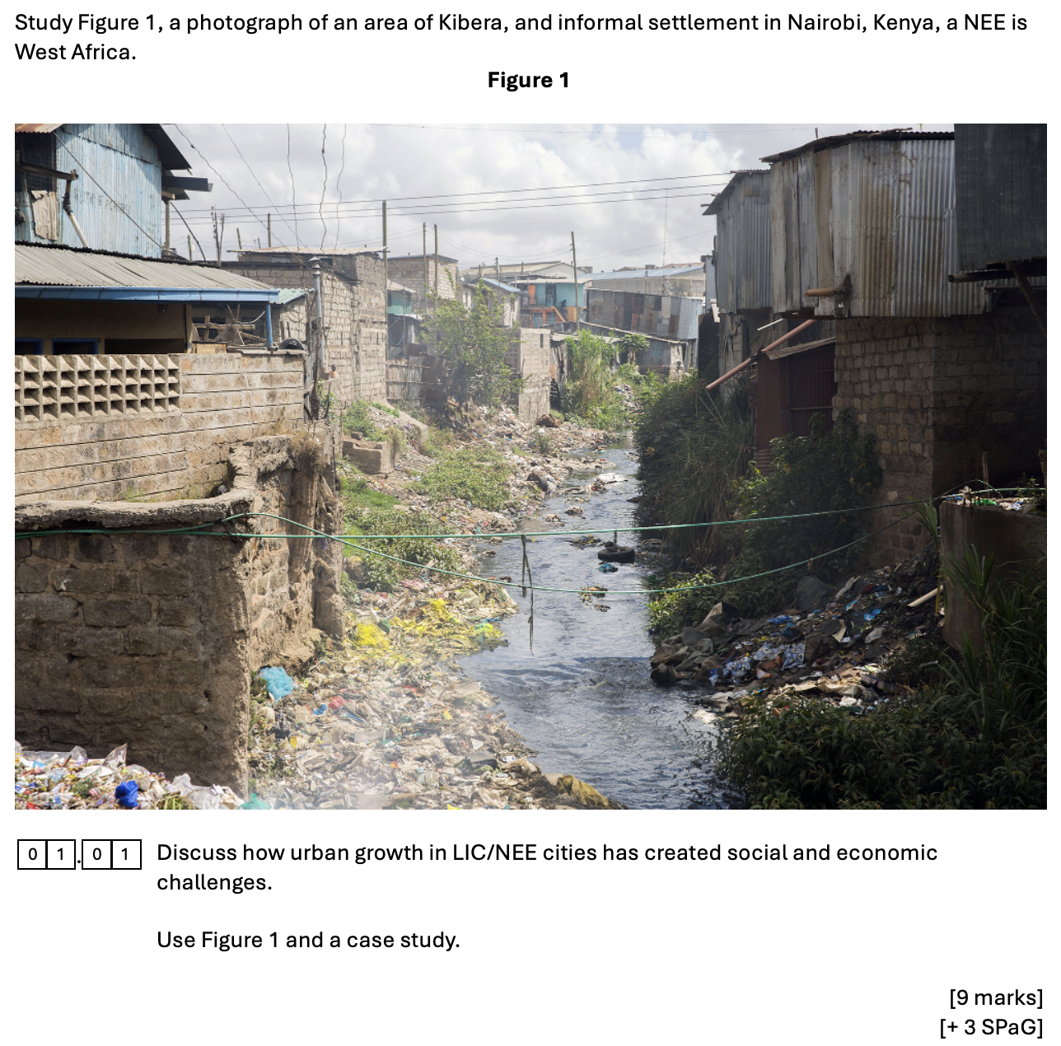



Urban Issues and
Challenges
Exam Question
Deconstruct the Q
Figure Analysis
Case Study
Review Answer - Lagos
Review Answer - Mumbai
Review Answer - Rio
Writing Guide
Writing Grid

Slide 3






Urban Issues and
Challenges
The increase in the population and physical size of a city.
The problems that affect people’s daily lives and wellbeing.
Present key points about different sides of an argument, issue or the strengths and weaknesses of an idea. !!! In this case you must discuss both social and economic challenges !!!
Exam Question
Reference to cities in low-income countries or newly emerging economies.
Deconstruct the Q
Figure Analysis
Case Study
Review Answer - Lagos
The problems linked to jobs, income, and the wider economy.
Review Answer - Mumbai
You must refer to Figure 1.
You must refer to the case study we have studied.
Review Answer - Rio
You will be assessed for spelling, punctuation, and grammar.
Writing Guide
Writing Grid

Slide 4
Urban Issues and
Challenges
Study Figure 1 – What social and economic challenges are evident?
What can we infer from the source?
Exam Question
Deconstruct the Q
Figure Analysis
Case Study
Review Answer - Lagos
Review Answer - Mumbai
Review Answer - Rio
Writing Guide
Writing Grid

Slide 5
Urban Issues and
Challenges
Study Figure 1 – What social and economic challenges are evident?
What can we infer from the source?
Building density?
Exam Question
Informal settlement?
Deconstruct the Q
Building quality?
Figure Analysis
Employment
Opportunities?
Case Study
Review Answer - Lagos
Sanitation?
Service provision?
Review Answer - Mumbai
Waste management?
Review Answer - Rio
Writing Guide
Writing Grid

Slide 6
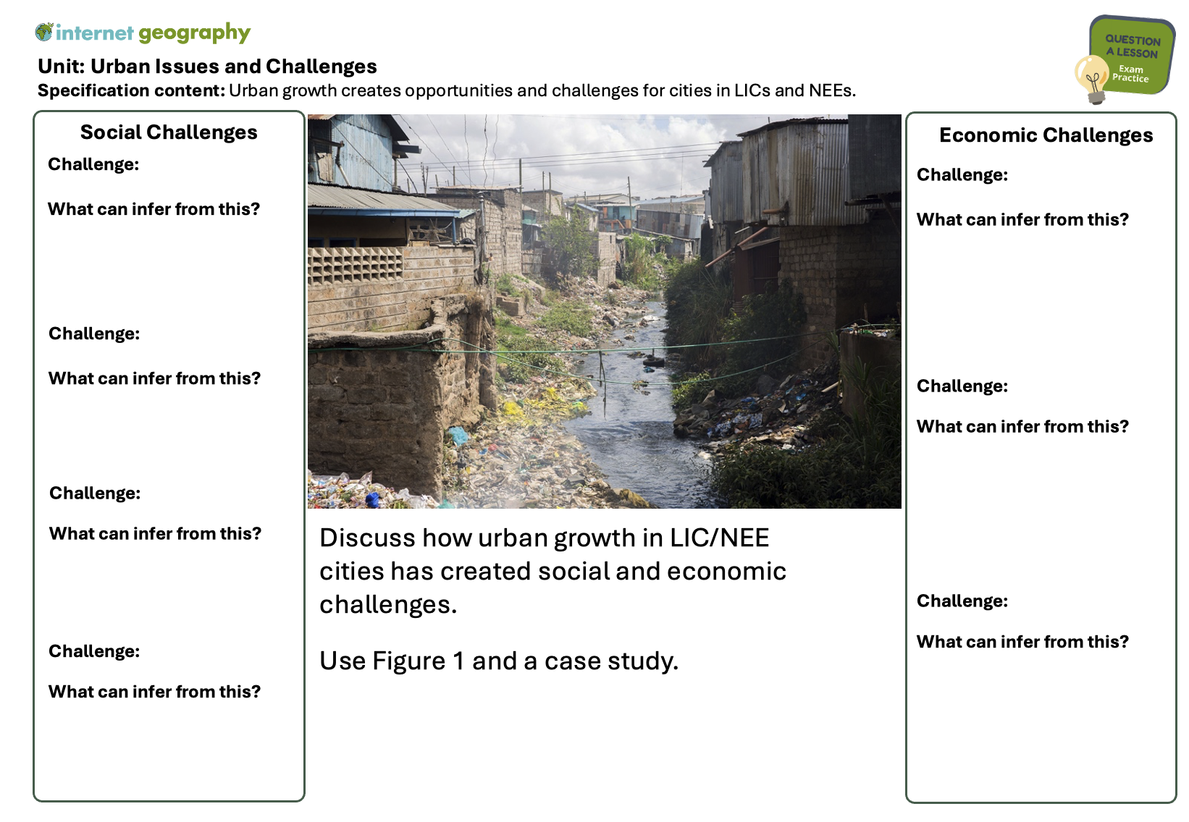
Urban Issues and
Challenges
Study Figure 1 – What social and economic challenges are evident?
What can we infer from the source?
Exam Question
Deconstruct the Q
Figure Analysis
Case Study
Review Answer - Lagos
Review Answer - Mumbai
Review Answer - Rio
Writing Guide
Writing Grid

Slide 7
Urban Issues and
Challenges
Study Figure 1 – What social and economic challenges are evident?
What can we infer from the source?
Exam Question
Deconstruct the Q
Figure Analysis
High building density
The houses are built very close together, showing a lack of space, overcrowding, and poor living conditions.
Case Study
Review Answer - Lagos
Review Answer - Mumbai
Poor quality housing
Review Answer - Rio
Many dwellings are made of corrugated iron sheets and wood, which are unsafe, offer little protection from weather, and increase the risk of fire spreading.
Writing Guide
Writing Grid

Slide 8
Urban Issues and
Challenges
What social and economic challenges have been created due to urban growth in our case study Mumbai / Rio / Lagos?
Exam Question
Social Challenges
Economic Challenges
Deconstruct the Q
Teacher to add examples – include data to support where possible. Or work with students to identify examples e.g. through questioning.
Teacher to add examples – include data to support where possible. Or work with students to identify examples e.g. through questioning.
Figure Analysis
Case Study
Review Answer - Lagos
Review Answer - Mumbai
Review Answer - Rio
Writing Guide
Writing Grid

Slide 9
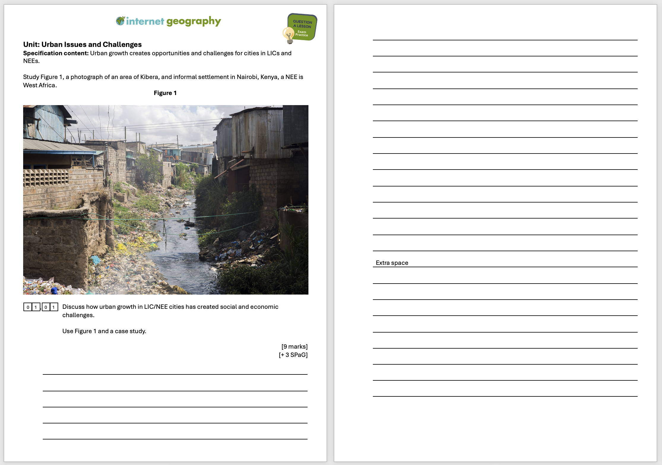
Urban Issues and
Challenges
Exam Question
Deconstruct the Q
Figure Analysis
Case Study
Review Answer - Lagos
Review Answer - Mumbai
Review Answer - Rio
Let’s review a student answer before we attempt the question.
Writing Guide
Writing Grid

Slide 10
Urban Issues and
Challenges
Student answer 1 - Lagos:
In Figure 1, which shows Kibera in Nairobi, we can see small houses that are close together. This shows a challenge of urban growth because people have to live in crowded areas with poor housing. There is also rubbish on the ground which means waste is not collected properly.
In Lagos, Nigeria, there are also challenges from urban growth. Many people live in areas like Makoko which are slums. These places do not have good sanitation so people can get diseases. Jobs in Lagos are often in the informal sector which are not paid well. Traffic congestion is also a big problem in the city.
In conclusion, Figure 1 and Lagos show that urban growth creates social challenges such as poor housing and sanitation, and economic challenges like low-paid jobs and traffic problems.
Exam Question
Deconstruct the Q
Figure Analysis
Case Study
Review Answer - Lagos
Review Answer - Mumbai
Review Answer - Rio
Using the mark scheme, what level would you give it?
Writing Guide
Writing Grid

Slide 11
Urban Issues and
Challenges
Student answer 1 - Lagos:
In Figure 1, which shows Kibera in Nairobi, we can see small houses that are close together. This shows a challenge of urban growth because people have to live in crowded areas with poor housing. There is also rubbish on the ground which means waste is not collected properly.
In Lagos, Nigeria, there are also challenges from urban growth. Many people live in areas like Makoko which are slums. These places do not have good sanitation so people can get diseases. Jobs in Lagos are often in the informal sector which are not paid well. Traffic congestion is also a big problem in the city.
In conclusion, Figure 1 and Lagos show that urban growth creates social challenges such as poor housing and sanitation, and economic challenges like low-paid jobs and traffic problems.
Exam Question
Deconstruct the Q
Figure Analysis
Case Study
An examiner would likely award a low level 2.
This is because it is quite generic but does include a basic case study and clear knowledge of urban process (AO1) which is linked to opportunities (AO2) and makes some reference to the photograph (AO3).
Review Answer - Lagos
Review Answer - Mumbai
Review Answer - Rio
Writing Guide
Writing Grid

Slide 12
Urban Issues and
Challenges
Exam Question
Deconstruct the Q
Figure Analysis
Case Study
Review Answer - Lagos
Review Answer - Mumbai
Review Answer - Rio
Let’s review a student answer before we attempt the question.
Writing Guide
Writing Grid

Slide 13
Urban Issues and
Challenges
Student answer 2 - Mumbai:
In Figure 1, which shows Kibera in Nairobi, Kenya, we can see overcrowded housing built from corrugated iron. This highlights one of the main social challenges of urban growth in LIC/NEE cities. Informal settlements like Kibera often lack clean water and toilets, which increases the spread of diseases such as cholera. The houses are built close together, creating fire risks, and piles of waste can also be seen, showing that the city struggles to manage rubbish collection. These conditions reduce people’s quality of life and limit life expectancy.
A case study of Mumbai, India, also shows how urban growth creates challenges. Dharavi, one of the largest slums in the world, is home to over 1 million people in just 2.1 km², creating very high population density. Although about 85% of residents are employed, most work in the informal sector in jobs like recycling or pottery, which are low paid and unregulated, leaving families trapped in poverty. Social services are under huge pressure – although literacy rates in Mumbai are around 90% compared to about 70% in rural India, schools and healthcare facilities are overcrowded, and many people cannot access them when needed. Air pollution and traffic congestion are also major problems, affecting people’s health and wellbeing.
In conclusion, Figure 1 and Mumbai show that rapid urban growth creates serious social challenges, such as poor housing, poor sanitation and pressure on services, as well as economic challenges including insecure employment and continuing poverty.
Exam Question
Deconstruct the Q
Figure Analysis
Case Study
Review Answer - Lagos
Review Answer - Mumbai
Review Answer - Rio
Writing Guide
Using the mark scheme, what level would you give it?
Writing Grid

Slide 14
Urban Issues and
Challenges
Student answer 2 - Mumbai:
In Figure 1, which shows Kibera in Nairobi, Kenya, we can see overcrowded housing built from corrugated iron. This highlights one of the main social challenges of urban growth in LIC/NEE cities. Informal settlements like Kibera often lack clean water and toilets, which increases the spread of diseases such as cholera. The houses are built close together, creating fire risks, and piles of waste can also be seen, showing that the city struggles to manage rubbish collection. These conditions reduce people’s quality of life and limit life expectancy.
A case study of Mumbai, India, also shows how urban growth creates challenges. Dharavi, one of the largest slums in the world, is home to over 1 million people in just 2.1 km², creating very high population density. Although about 85% of residents are employed, most work in the informal sector in jobs like recycling or pottery, which are low paid and unregulated, leaving families trapped in poverty. Social services are under huge pressure – although literacy rates in Mumbai are around 90% compared to about 70% in rural India, schools and healthcare facilities are overcrowded, and many people cannot access them when needed. Air pollution and traffic congestion are also major problems, affecting people’s health and wellbeing.
In conclusion, Figure 1 and Mumbai show that rapid urban growth creates serious social challenges, such as poor housing, poor sanitation and pressure on services, as well as economic challenges including insecure employment and continuing poverty.
Exam Question
Deconstruct the Q
Figure Analysis
Case Study
Review Answer - Lagos
An examiner would likely award a high level 3. This is because the student responds with real detail and thoroughness in engaging with the photograph (AO3), using this information to show excellent understanding of urban challenges (AO2). It shows real grasp of urban processes through a well-used case study (AO1) which is discussed critically (e.g. there are comments about how significant the challenges are). Real facts about the case study were included. This answer is a very thorough GCSE-level response whose overall level of understanding warranted full marks.
Review Answer - Mumbai
Review Answer - Rio
Writing Guide
Writing Grid

Slide 15
Urban Issues and
Challenges
Exam Question
Deconstruct the Q
Figure Analysis
Case Study
Review Answer - Lagos
Review Answer - Mumbai
Review Answer - Rio
Let’s review a student answer before we attempt the question.
Writing Guide
Writing Grid

Slide 16
Urban Issues and
Challenges
Student answer 2 - Rio:
In Figure 1, which shows Kibera in Nairobi, Kenya, we can see overcrowded housing built from corrugated iron. This highlights one of the main social challenges of urban growth in LIC/NEE cities. Informal settlements like Kibera often lack clean water and toilets, which increases the spread of diseases such as cholera. The houses are built close together, creating fire risks, and piles of waste can also be seen, showing that the city struggles to manage rubbish collection. These conditions reduce people’s quality of life and limit life expectancy.
A case study of Rio de Janeiro, Brazil, shows similar challenges. Over 20% of Rio’s population live in favelas such as Rocinha. Houses here are often built illegally on steep hillsides, making them vulnerable to landslides during heavy rain. Many homes lack access to clean water and proper sanitation, with around 30% of Rio’s population without access to a mains sewage connection. This creates major health problems such as the spread of diseases like cholera. Economically, many residents work in the informal sector in low-paid jobs such as street vending. Although this provides some income, it is insecure and unregulated, trapping families in poverty. Crime is also a serious issue, with high levels of drug-related violence in favelas reducing safety for residents. Traffic congestion and air pollution also affect the city as it continues to grow.
In conclusion, Figure 1 and Rio show that urban growth in LIC/NEE cities creates serious social challenges such as poor housing, sanitation, and health risks, as well as economic challenges including insecure employment, crime, and poor infrastructure.
Exam Question
Deconstruct the Q
Figure Analysis
Case Study
Review Answer - Lagos
Review Answer - Mumbai
Review Answer - Rio
Writing Guide
Using the mark scheme, what level would you give it?
Writing Grid

Slide 17
Urban Issues and
Challenges
Student answer 2 - Rio:
In Figure 1, which shows Kibera in Nairobi, Kenya, we can see overcrowded housing built from corrugated iron. This highlights one of the main social challenges of urban growth in LIC/NEE cities. Informal settlements like Kibera often lack clean water and toilets, which increases the spread of diseases such as cholera. The houses are built close together, creating fire risks, and piles of waste can also be seen, showing that the city struggles to manage rubbish collection. These conditions reduce people’s quality of life and limit life expectancy.
A case study of Rio de Janeiro, Brazil, shows similar challenges. Over 20% of Rio’s population live in favelas such as Rocinha. Houses here are often built illegally on steep hillsides, making them vulnerable to landslides during heavy rain. Many homes lack access to clean water and proper sanitation, with around 30% of Rio’s population without access to a mains sewage connection. This creates major health problems such as the spread of diseases like cholera. Economically, many residents work in the informal sector in low-paid jobs such as street vending. Although this provides some income, it is insecure and unregulated, trapping families in poverty. Crime is also a serious issue, with high levels of drug-related violence in favelas reducing safety for residents. Traffic congestion and air pollution also affect the city as it continues to grow.
In conclusion, Figure 1 and Rio show that urban growth in LIC/NEE cities creates serious social challenges such as poor housing, sanitation, and health risks, as well as economic challenges including insecure employment, crime, and poor infrastructure.
Exam Question
Deconstruct the Q
Figure Analysis
Case Study
Review Answer - Lagos
An examiner would likely award a high level 3. This is because the student responds with real detail and thoroughness in engaging with the photograph (AO3), using this information to show excellent understanding of urban challenges (AO2). It shows real grasp of urban processes through a well-used case study (AO1) which is discussed critically (e.g. there are comments about how significant the challenges are). Real facts about the case study were included. This answer is a very thorough GCSE-level response whose overall level of understanding warranted full marks.
Review Answer - Mumbai
Review Answer - Rio
Writing Guide
Writing Grid

Slide 18
Urban Issues and
Challenges
Your turn
Intro sentence
Urban growth in LIC/NEE cities has created many social and economic challenges because populations grow faster than services and housing can cope.
Paragraph 1 – Figure 1 (AO3)
In Figure 1, which shows [location], we can see … (describe what is visible, e.g. overcrowded housing, waste, poor-quality materials).
This shows a social/economic challenge because … (explain why it causes problems for people/the city).
Paragraph 2 – Case study: Social challenges (AO1 + AO2)
In [city case study], a main social challenge is … (e.g. poor housing in slums, lack of clean water, pressure on schools/hospitals).
For example … (add data/statistic/detail).
This means … (explain the impact on people’s quality of life).
Paragraph 3 – Case study: Economic challenges (AO1 + AO2)
Urban growth has also created economic challenges such as … (e.g. informal sector jobs, unemployment, traffic congestion, waste).
For example … (add data/statistic/detail).
This leads to … (explain the impact on jobs, income, economy).
Conclusion
In conclusion, Figure 1 and [city case study] show that urban growth creates both social challenges (housing, sanitation, services) and economic challenges (insecure jobs, poverty, traffic), which make life very difficult for many people in LIC/NEE cities.
Exam Question
Deconstruct the Q
Figure Analysis
Case Study
Review Answer - Lagos
Review Answer - Mumbai
Review Answer - Rio
Writing Guide
Writing Grid

Slide 19
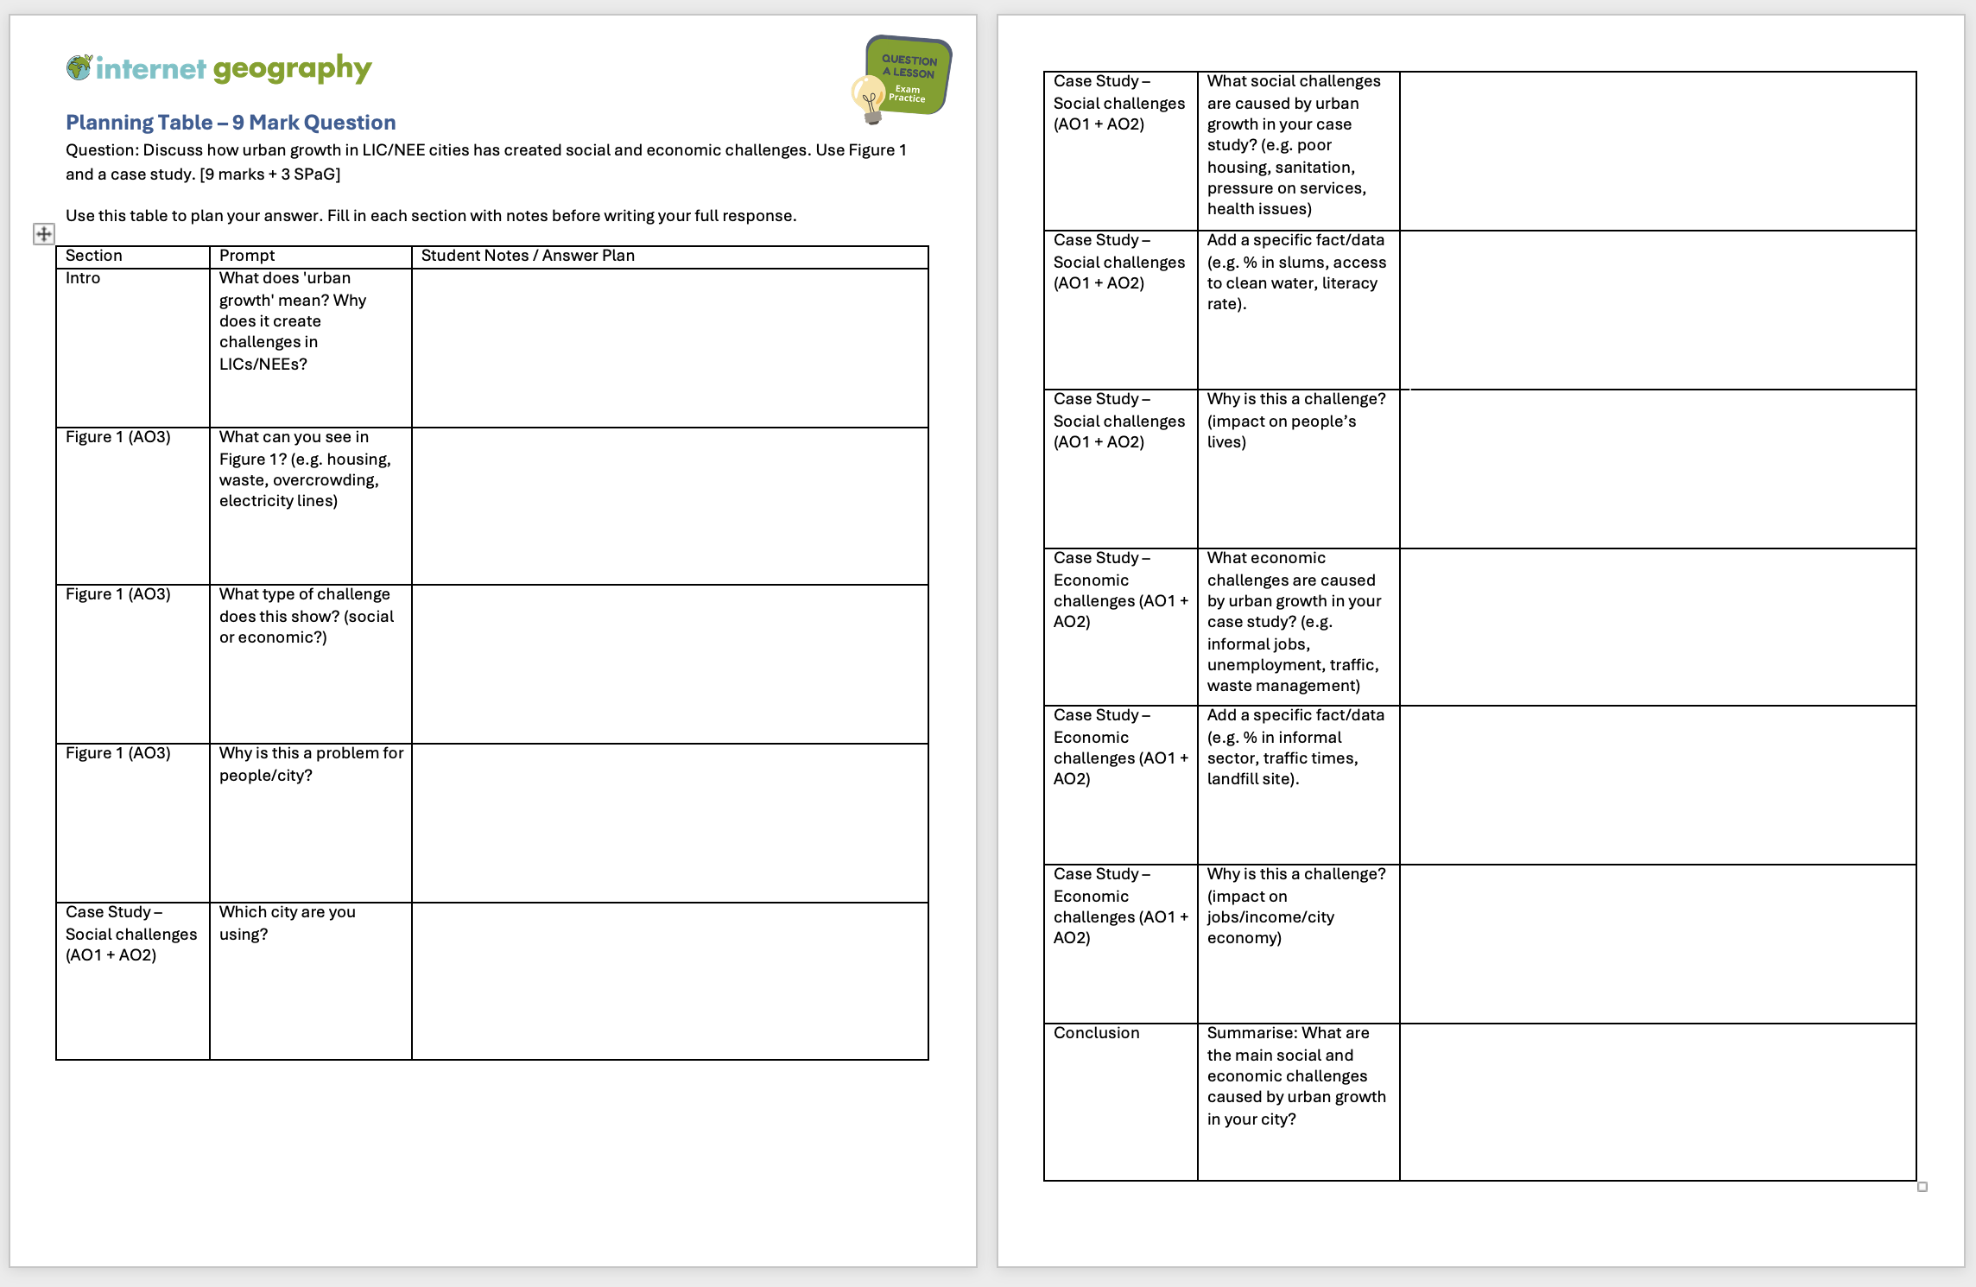
Urban Issues and
Challenges
Your turn
Use the template to answer the question.
Exam Question
Deconstruct the Q
Figure Analysis
Case Study
Review Answer - Lagos
Review Answer - Mumbai
Review Answer - Rio
Writing Guide
Writing Grid

