Slide 1

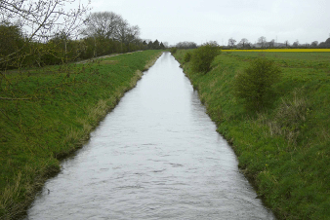
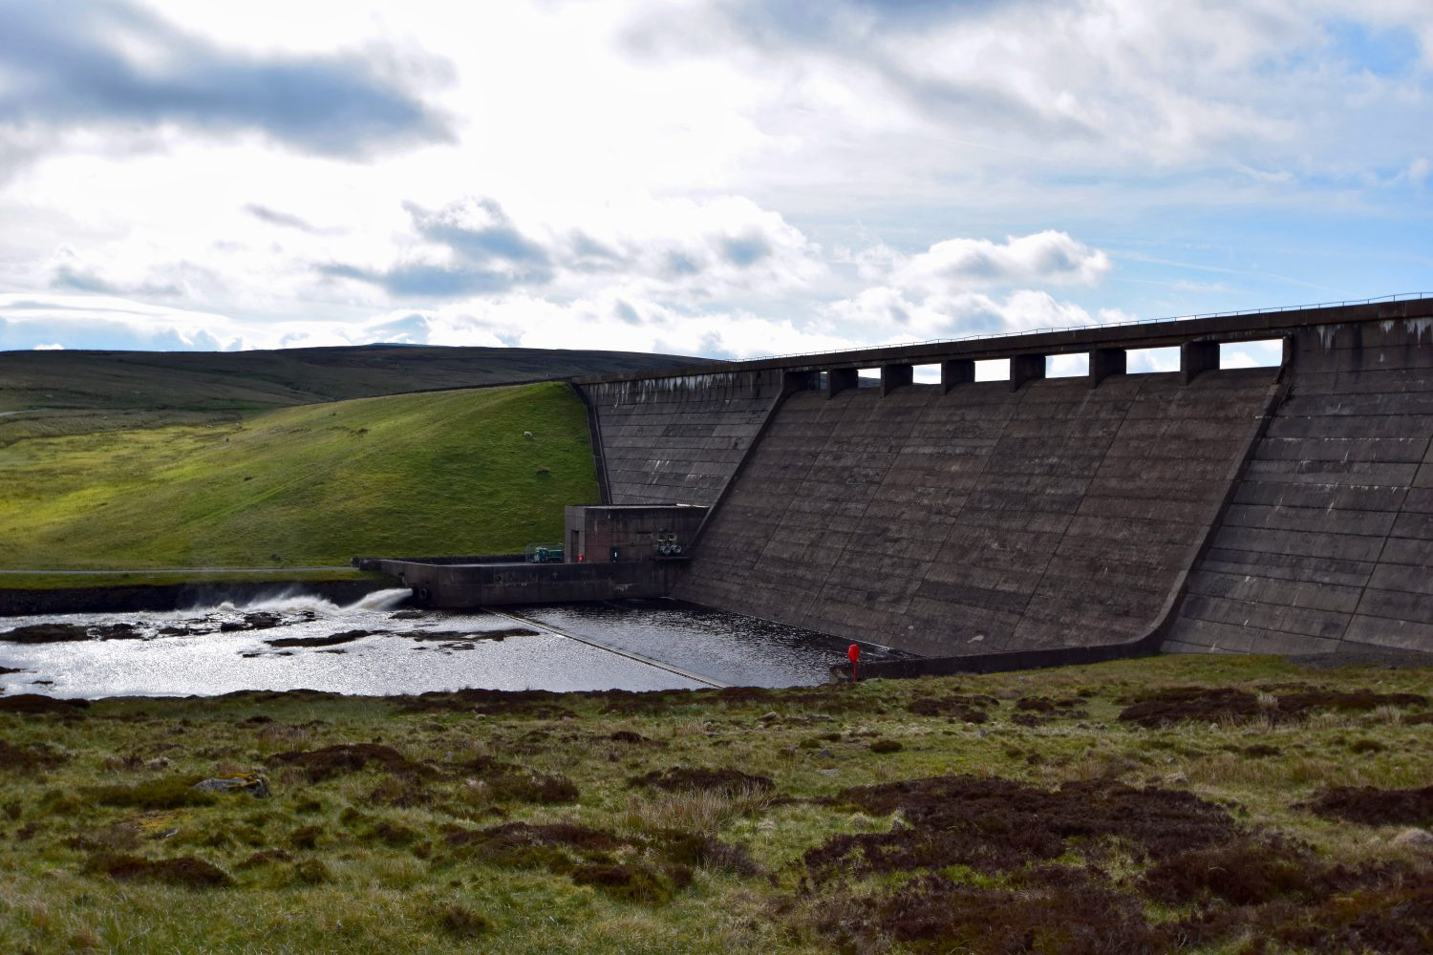
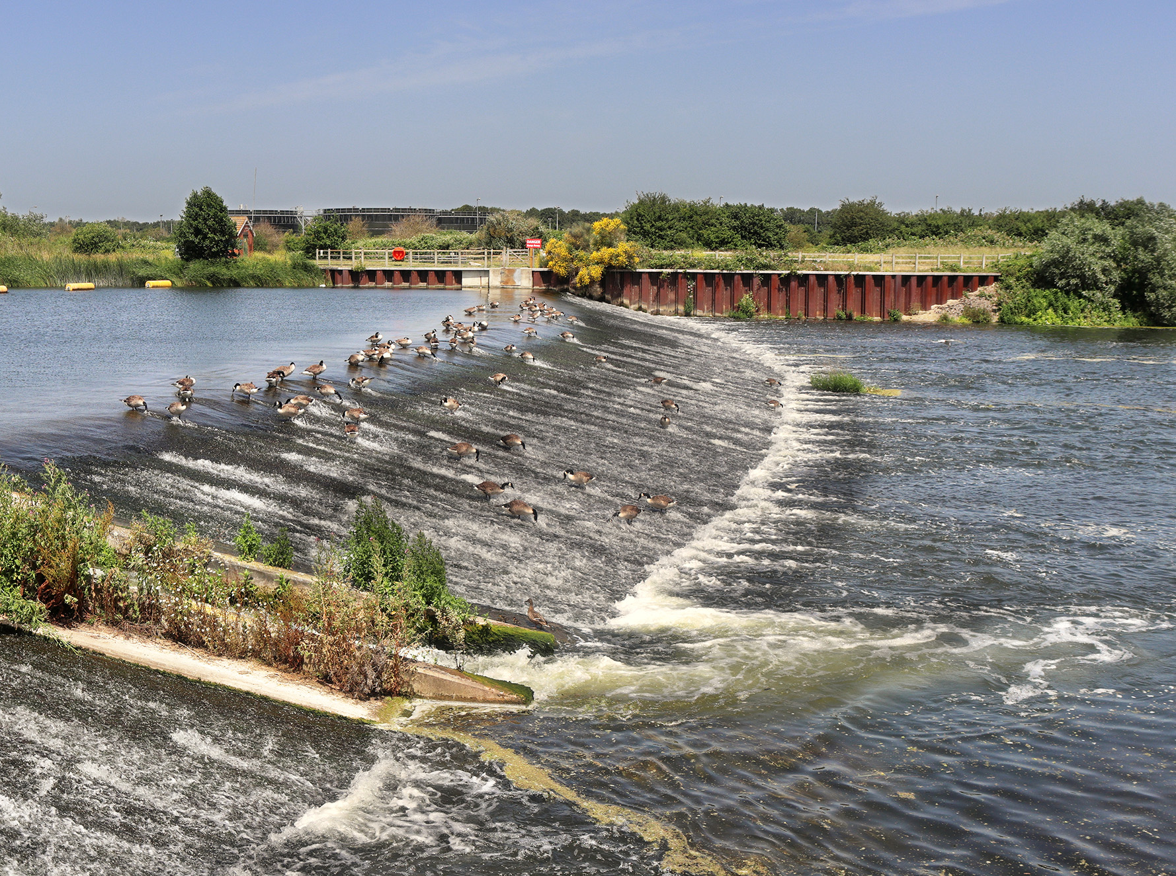
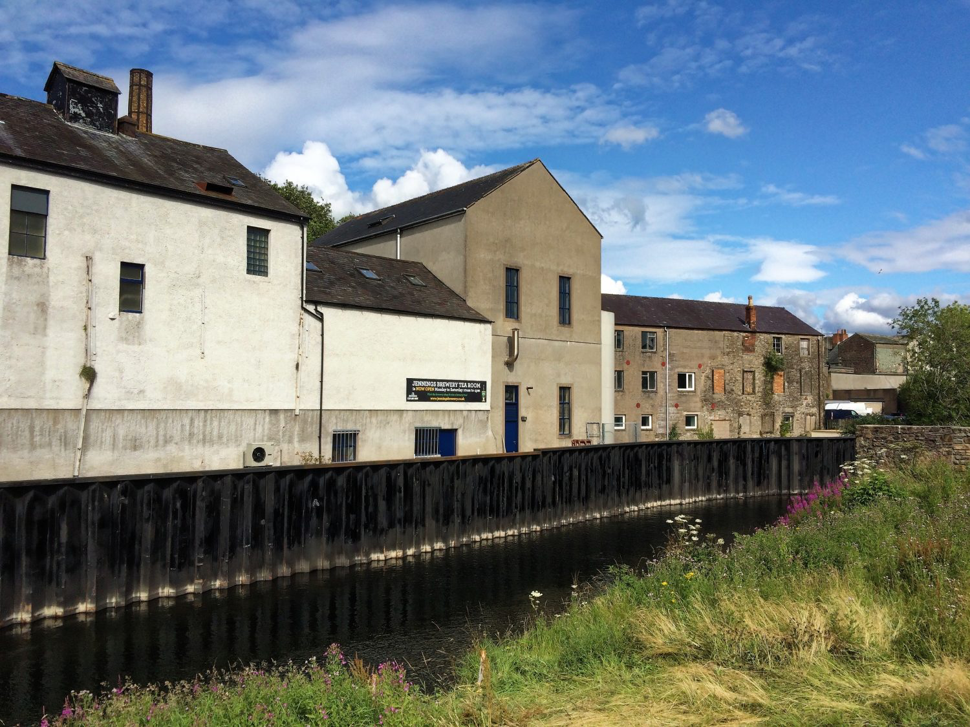
R9
Learning Review - 9
Hard Engineering River Management
3. Match the keywords below to their correct definitions.
Keyword | Definition
Dams and reservoirs | Artificial channels created to divert water around or from important locations if a river is at risk of flooding.
Embankments | A large wall is built across a river, usually in the upper stages. The land behind the dam is then flooded.
Straightening | Building up the banks of the river. This could be by creating levees or building walls.
Flood relief channels | Changing the course of the river by cutting out meanders.
1. What is hard engineering river management?
/ 1
2. Identify the hard engineering river management techniques shown in the images below.
1
2
/ 4
4. Suggest how the strategy shown in Figure 1 helps to manage the river.
Figure 1
3
4
Dams and reservoirs
Embankments
Straightening
Flood relief channels
/ 4
/ 1

Slide 2
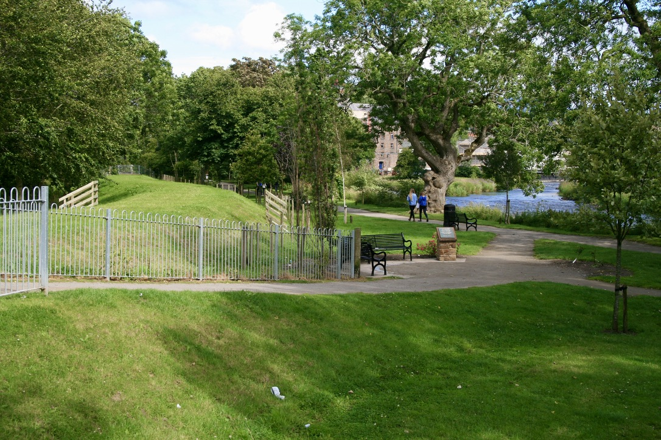
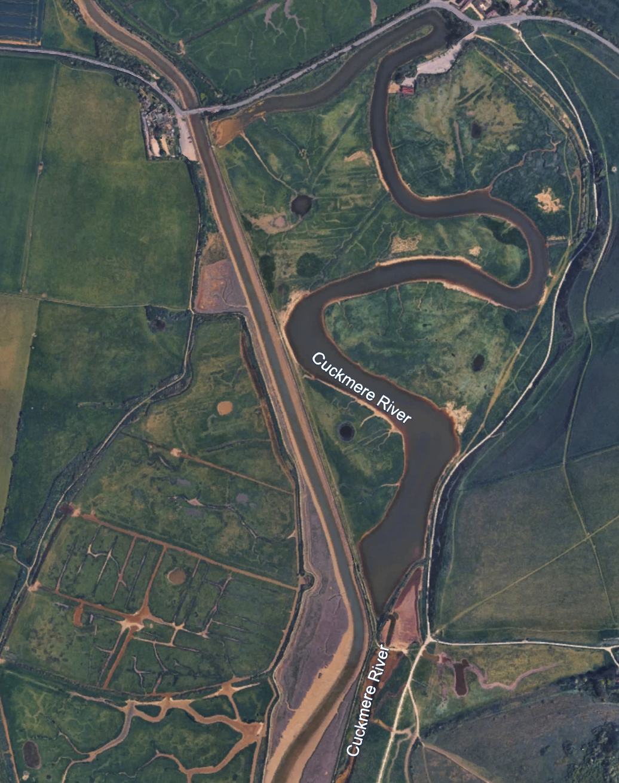
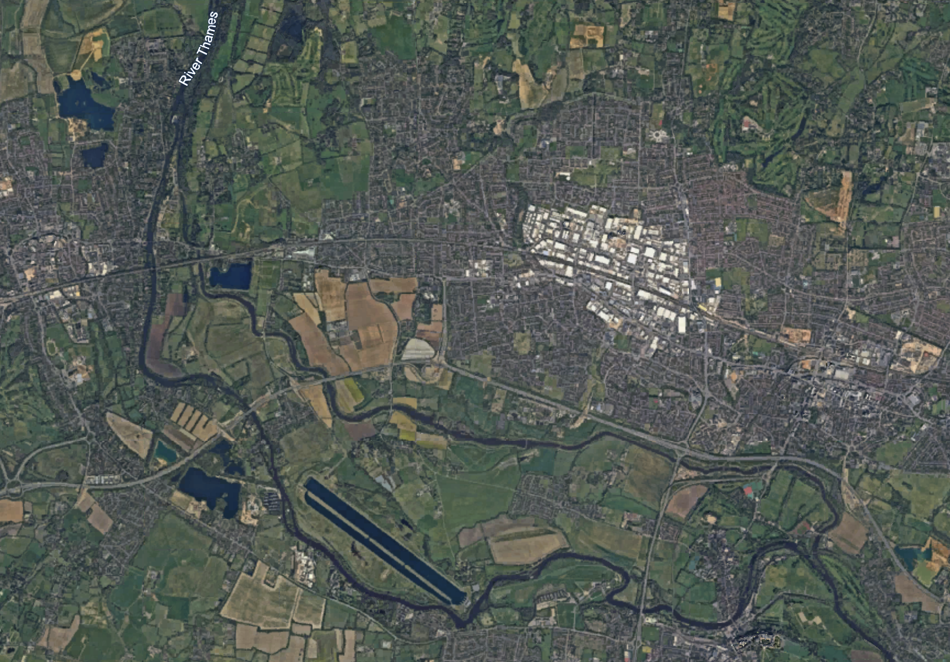
R9
Learning Review - 9
Hard Engineering River Management
6. Suggest how the strategy shown in Figure 3 helps to manage the river.
Figure 3
5. Suggest how the strategy shown in Figure 2 helps to manage the river.
Figure 2
/ 1
7. Suggest how the strategy shown in Figure 4 helps to manage the river.
Figure 4
Jubilee River (flood relief channel)
River Thames
/ 1
/ 1

Slide 3
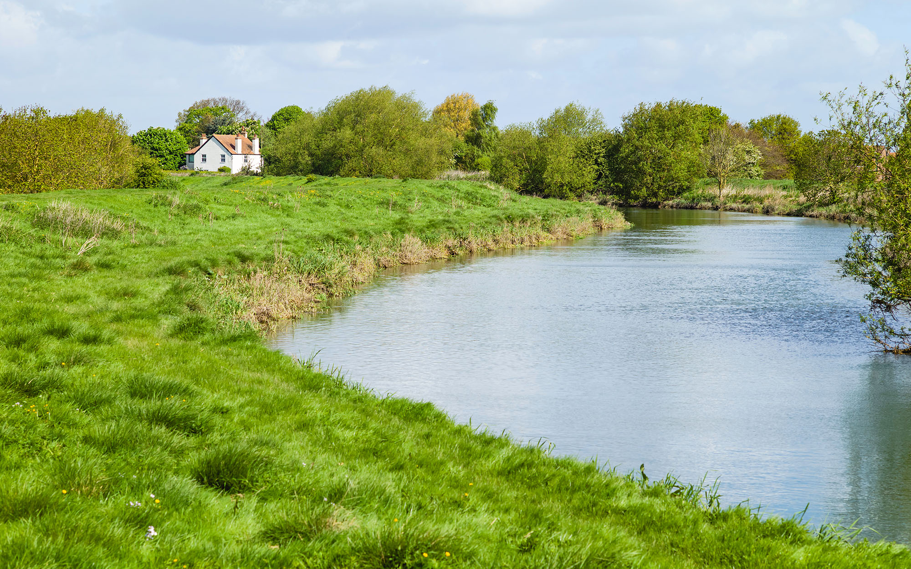
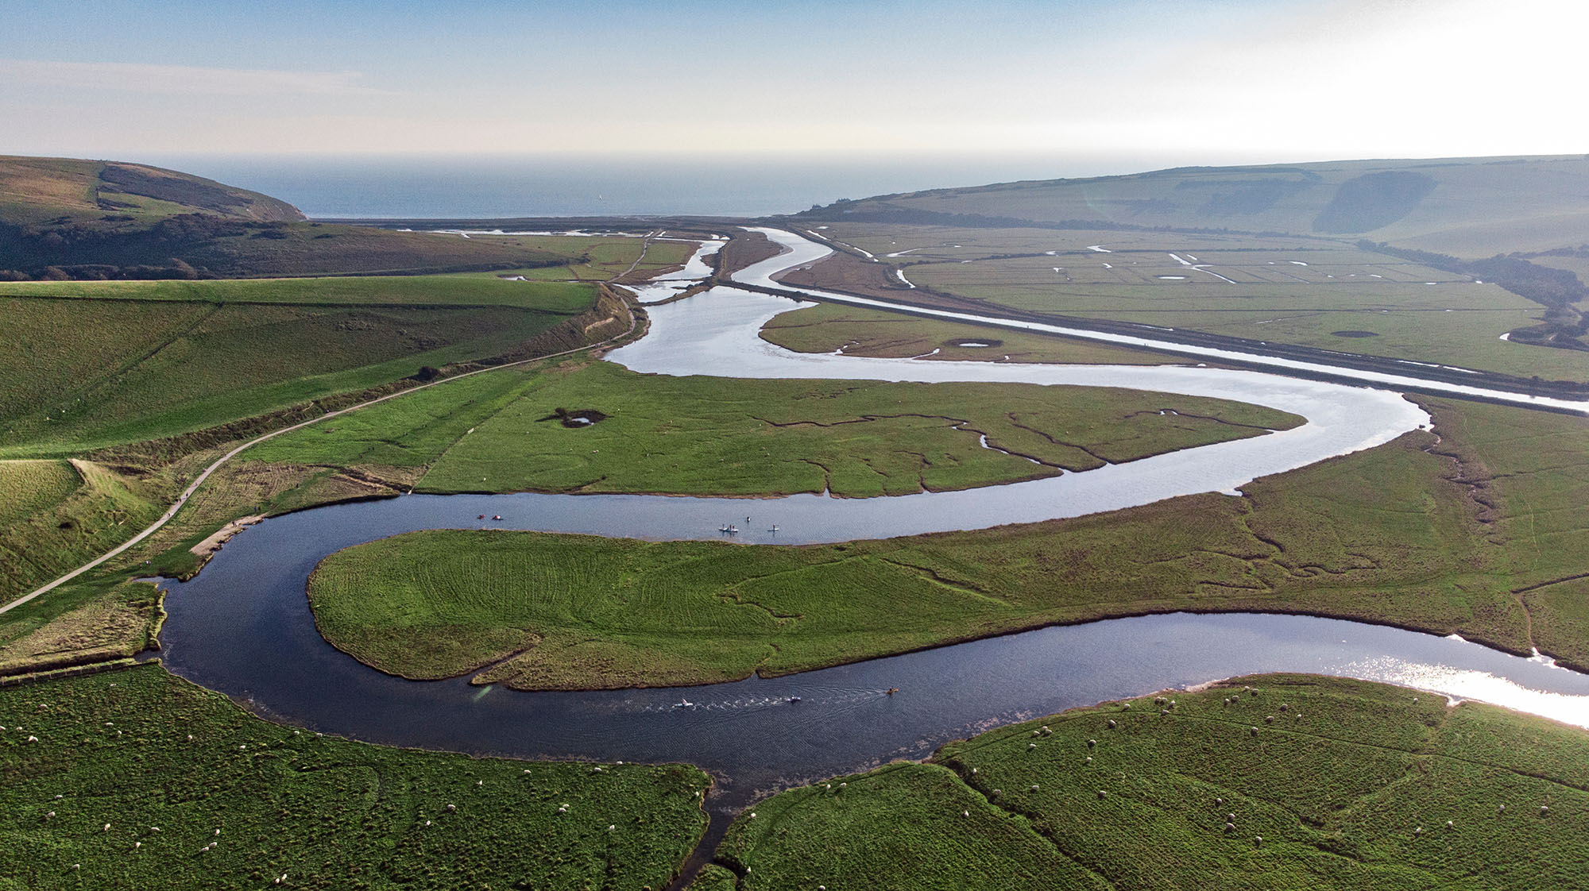
R9
Learning Review - 9
Hard Engineering River Management
Study Figure 5 and Figure 6, photographs showing hard engineering strategies.
Figure 5
Figure 6
8. Put a ✓ if the statement is a positive (advantage) and applies. Put an ✗ if the statement is a negative (disadvantage) and applies to that strategy
Statement | Dams and Reservoirs | Channel Straightening | Embankments | Flood relief channels
Reduces flooding in built-up areas
Can cause increased flood risk downstream
Very expensive to build
Long-lasting protection
Can damage river habitats
Helps water move through the area more quickly
May fail suddenly if overtopped
Can displace people or destroy land upstream
Requires regular maintenance
Effective at protecting high-value land uses
Transfers flood risk elsewhere
Increases channel capacity
9. Discuss the costs and benefits of hard engineering strategies in managing rivers.
Use Figure 5 and 6 and your own understanding.
/ 6

Slide 4
R9
Learning Review - 9
Hard Engineering River Management
Extra space

Slide 5
R9
Learning Review - 9
Hard Engineering River Management
3. Match the keywords below to their correct definitions.
Keyword | Definition
Dams and reservoirs | Artificial channels created to divert water around or from important locations if a river is at risk of flooding.
Embankments | A large wall is built across a river, usually in the upper stages. The land behind the dam is then flooded.
Straightening | Building up the banks of the river. This could be by creating levees or building walls.
Flood relief channels | Changing the course of the river by cutting out meanders.
1. What is hard engineering river management?
The construction of artificial structures using materials such as rock,
concrete and steel to reduce, disrupt or stop the impact of river processes.
/ 1
2. Identify the hard engineering river management techniques shown in the images below.
1
2
/ 4
4. Suggest how the strategy shown in Figure 1 helps to manage the river.
Figure 1
3
4
Storing water in the reservoir, reducing the risk of flooding downstream. (1)
Controlling the flow of water, releasing it slowly to prevent sudden increases in discharge. (1)
Regulating river levels during periods of heavy rainfall. (1)
2
Dams and reservoirs
4
Embankments
1
Straightening
3
Flood relief channels
/ 4
/ 1

Slide 6
Learning Review - 9
Hard Engineering River Management
6. Suggest how the strategy shown in Figure 3 helps to manage the river.
Figure 3
5. Suggest how the strategy shown in Figure 1 helps to manage the river.
Figure 2
Raises the riverbank to keep water in the channel during high flow (1)
Reduces flood risk by containing water within the channel (1)
Prevents water spilling onto surrounding land (1)
Increases channel capacity so more water can be carried safely (1)
Protects nearby paths/parkland from flooding (1)
/ 1
7. Suggest how the strategy shown in Figure 4 helps to manage the river.
Figure 4
Jubilee River (flood relief channel)
The straightened channel helps to manage the river. (1)
By straightening the river, the water can flow more quickly and directly, reducing the chance of flooding. (1)
A straighter course moves water out of the area faster, as there is less friction with the banks. (1)
The faster flow prevents sediment from building up in the channel. (1)
River Thames
/ 1
Raises the riverbank to keep water in the channel during high flow (1)
Reduces flood risk by containing water within the channel (1)
Prevents water spilling onto surrounding land (1)
Increases channel capacity so more water can be carried safely (1)
Protects nearby paths/parkland from flooding (1)
/ 1

Slide 7
R9
Learning Review - 9
Hard Engineering River Management
Study Figure 5 and Figure 6, photographs showing hard engineering strategies.
Figure 5
Figure 6
8. Put a ✓ if the statement is a positive (advantage) and applies. Put an ✗ if the statement is a negative (disadvantage) and applies to that strategy
Statement | Dams and Reservoirs | Channel Straightening | Embankments | Flood relief channels
Reduces flooding in built-up areas | ✓ | ✓ | ✓ | ✓
Can cause increased flood risk downstream |  | ✗ | ✗ | ✗
Very expensive to build | ✗ | ✗ | ✗ | ✗
Long-lasting protection | ✓ | ✓ | ✓ | ✓
Can damage river habitats | ✗ | ✗ | ✗ | ✗
Helps water move through the area more quickly |  | ✓ |  | ✓
May fail suddenly if overtopped | ✗ |  | ✗
Can displace people or destroy land upstream | ✗
Requires regular maintenance | ✗ |  | ✗
Effective at protecting high-value land uses | ✓ | ✓ | ✓ | ✓
Transfers flood risk elsewhere | ✗ | ✗ | ✗ | ✗
Increases channel capacity |  |  | ✓ | ✓
Hard engineering strategies can bring significant benefits in managing river flooding, especially in urban areas where the consequences of flooding are severe. Figure 5 shows an embankment, which raises the height of the riverbank and increases the channel’s capacity. This helps to keep more water within the channel during storms and protects nearby paths, green spaces and properties. Embankments can therefore reduce the frequency of flooding and offer long-term protection for high-value land uses.
Figure 6 shows channel straightening, which speeds up the flow of water by removing meanders. This can move floodwater away from vulnerable areas more quickly, reducing the duration of high river levels. For towns close to the river, this can be an effective way of preventing water from building up and causing damage.
However, these strategies also have considerable costs. Embankments can be expensive to maintain and may fail suddenly if water overtops them, leading to more dangerous flooding. Channel straightening increases the speed of the river, which can raise flood risk downstream and cause greater erosion of the riverbanks and bed. Both strategies can damage habitats and disrupt natural river processes.
Overall, hard engineering can be very effective at protecting specific areas, especially built-up locations, but it is not always sustainable. It often transfers problems elsewhere and involves high financial and environmental costs. Therefore, while beneficial in some locations, hard engineering should be used carefully and alongside other approaches.
9. Discuss the costs and benefits of hard engineering strategies in managing rivers.
Use Figure 5 and 6 and your own understanding.
/ 6

Slide 8
R9
Learning Review - 9
Hard Engineering River Management
• Level 3 (detailed)
Will be developed responses clearly discussing both costs AND benefits of named hard engineering strategies. Appropriate geographical terminology will be used.
• Level 2 (clear)
Responses are likely to show understanding of hard engineering strategy(ies) and their costs and/or benefits. Some discussion and some geographical terminology may be evident.
• Level 1 (basic)
Responses will be simple statements with limited understanding or development. May consist of listed points or random statements about general river management strategy(ies).
• Max Level 1 for soft engineering strategy(ies).
• Max Level 2 for an answer that does not refer to Figure(s).
Indicative content
Credit different hard engineering strategies. Embankments and channel straightening are listed in the specification.
Embankments (Figure 5)
Benefits:
Increase the capacity of the channel by raising the riverbank.
Help to contain floodwater, protecting nearby paths, green space and property visible in Figure 5.
Can be less visually intrusive than concrete walls when built from earth.
Offer long-term protection where the consequences of flooding are severe.
Q8 Mark Scheme
Level | Marks | Description
3 | 5-6 | AO2 Shows thorough geographical understanding of the costs and benefits of hard engineering strategies. AO3 Demonstrates thorough application of knowledge and understanding by making reasoned analysis of hard engineering strategies.
2 | 3-4 | AO2 Shows some geographical understanding of the costs and/or benefits of hard engineering strategy(ies). AO3 Demonstrates reasonable application of knowledge and understanding by making clear analysis of hard engineering strategy(ies).
1 | 1-2 | AO2 Shows limited geographical understanding of the costs and/or benefits of hard engineering strategy(ies). AO3 Demonstrates limited application of knowledge and understanding by making basic analysis of hard engineering strategy(ies).
 | 0 | No relevant content.

Slide 9
R9
Learning Review - 9
Hard Engineering River Management
Benefits:
Provide reliable, predictable protection for high-value locations (housing, industry, infrastructure).
Can significantly reduce flood frequency and severity in managed areas.
Costs:
Expensive to build and maintain.
Can transfer problems to other places (especially downstream impacts).
Often reduce natural river functioning and damage ecosystems.
Overall assessment
Hard engineering strategies can be very effective at protecting high-risk urban areas and can provide long-term, predictable flood protection. However, they are often expensive, can cause negative environmental impacts, and may simply shift flood problems elsewhere. Their success usually depends on regular maintenance and the scale of the flood event. While they can protect valuable land uses, they may not always be sustainable and can disrupt natural river processes.
Costs:
Can fail suddenly if overtopped, causing rapid and dangerous flooding.
Require ongoing maintenance, as they can erode or weaken.
Confine the river, potentially worsening downstream flooding.
May encourage development on the floodplain, increasing long-term risk.
Channel straightening (Figure 6)
Benefits:
Shortens the river’s course, allowing water to move through the area more quickly.
Reduces the duration of flooding in built-up areas shown in Figure 6.
Helps protect settlements and transport routes from water backing up.
Costs:
Can increase flood risk downstream, as water is transferred more rapidly.
Greater flow velocities cause erosion, bank collapse and habitat loss.
Removes natural meanders, reducing biodiversity and altering river processes.
Expensive and disruptive to construct.
General hard-engineering considerations

