Slide 1
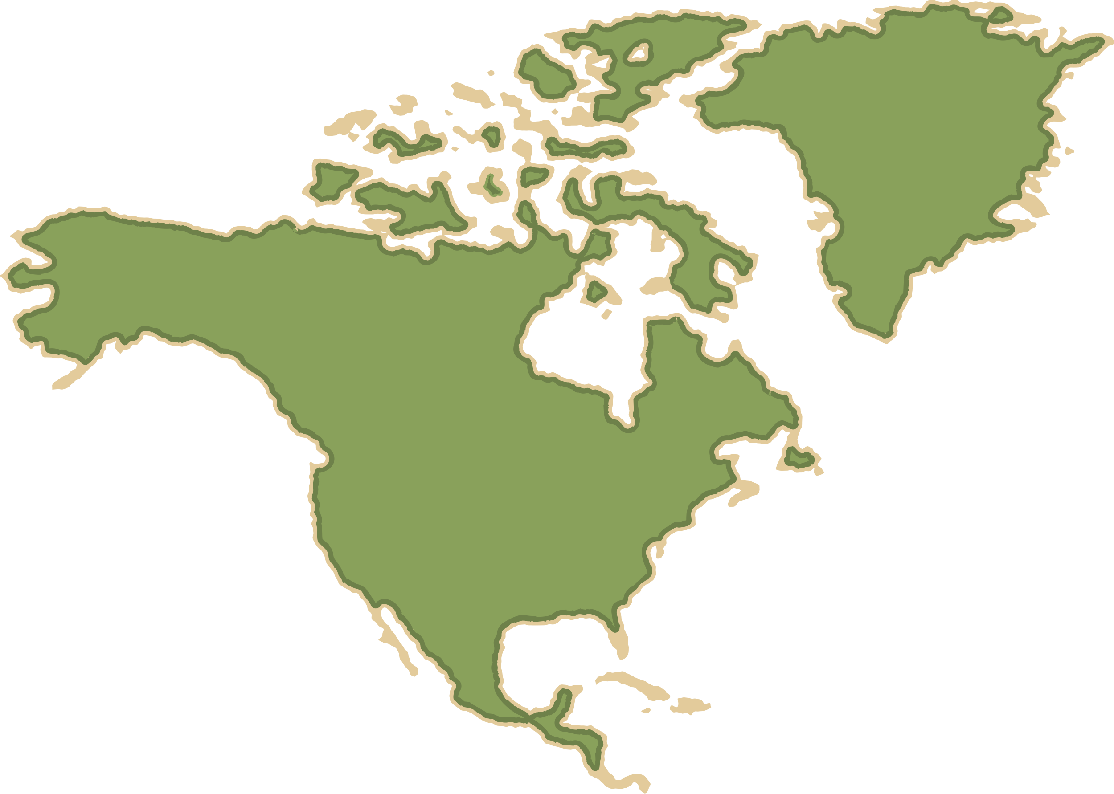
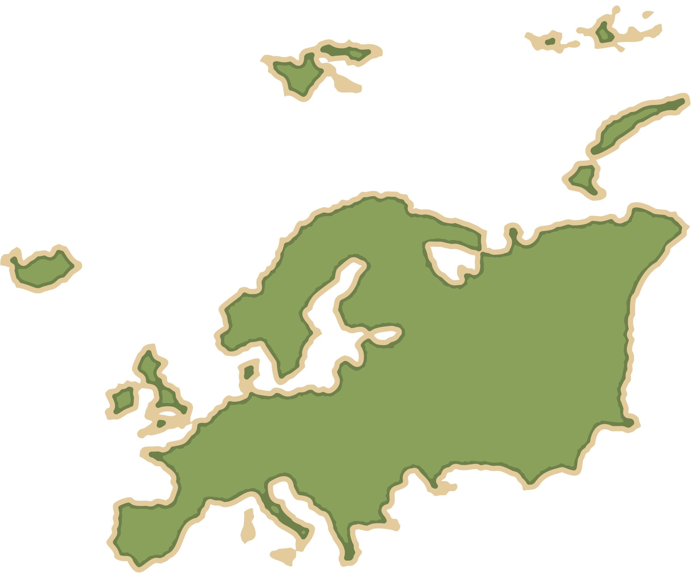
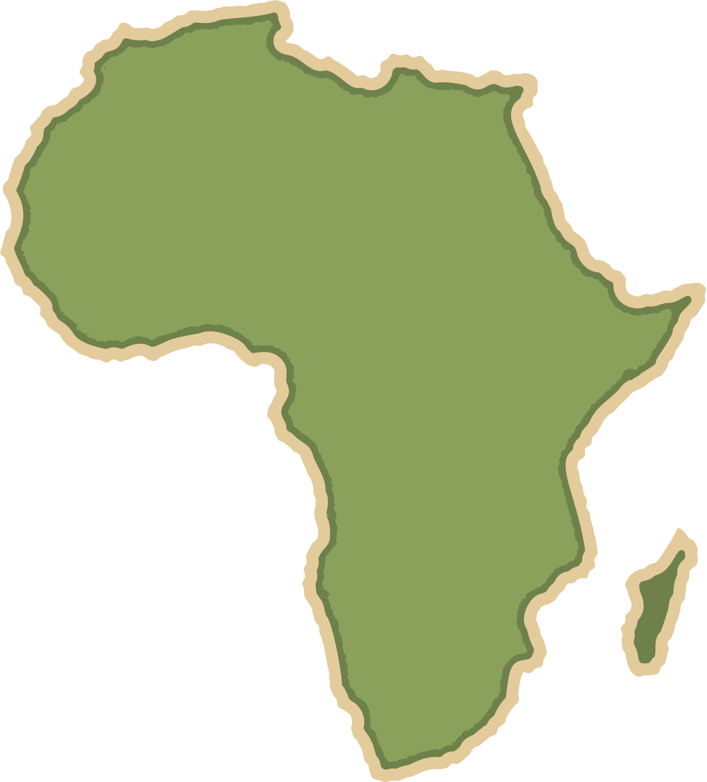
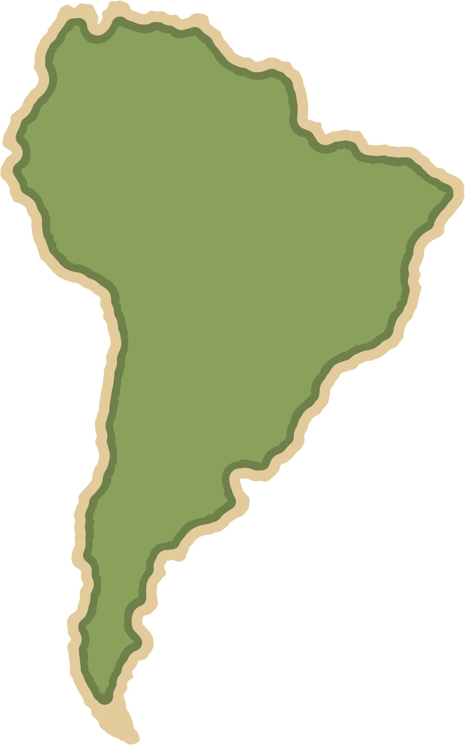
The Living World
Geography
Homework
Name:
Class:

Slide 2
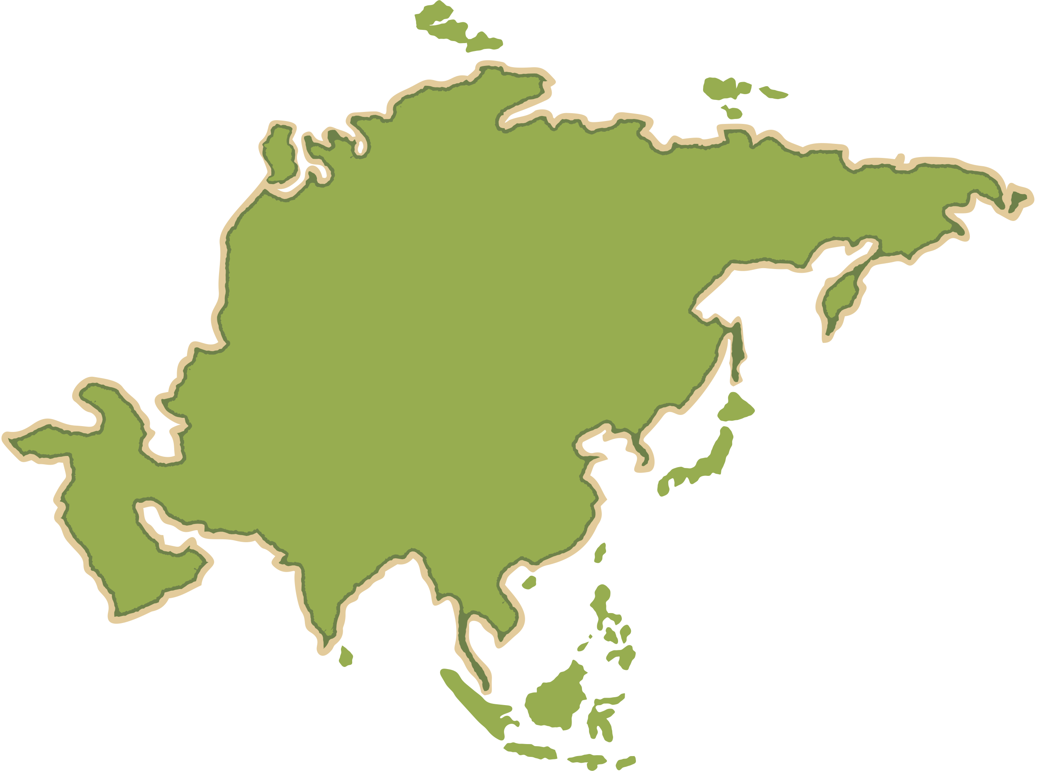






The Living World
Geography Homework
Introduction to Ecosystems
1
An ecosystem is a community of l_________ o_________ (plants and animals) that interact with each other and with their n________________ e________________ (like air, water and soil).
2
Match the key terms to their definitions
Producer
An animal that eats plants or other animals to get energy.
Consumer
A plant that makes its own food using sunlight.
Decomposer
An organism that breaks down dead plants and animals.
3
Tick one example of each.
Producer:
cow
oak tree
fox
Consumer:
grass
human
mushroom
Decomposer:
earthworm
squirrel
rose bush
4
A food c__________ shows how different plants and a________ are linked by what they e_____. It shows connections between different o___________ that rely on one another as their source of f_______ (energy).
Coastal Landscapes in the UK
5
Identify the:
Primary consumer
Producer
Secondary consumer
A simple food chain
Ecosystems

Slide 3
The Living World
Geography Homework
Introduction to Ecosystems
6
What is a food web?
A single line showing what eats what in an ecosystem
A map showing where animals migrate
A complex network of connected food chains in an ecosystem
A list of endangered species in an ecosystem
7
The n___________ cycle is the way nutrients are moved through an e_____________. Nutrients are transferred between the s_______, a_______, and l________ o________ in an ecosystem. D_______________ help release nutrients back into the soil when plants and a_________ die.
8
Label the diagram below to show the main stores and flows in the nutrient cycle.
9
True or false?
Producers get their energy from eating consumers.
True
False
Decomposers play a key role in nutrient cycling.
True
False
A food chain shows many connections between plants and animals.
True
False
www.internetgeography.net

Slide 4

The Living World
Geography Homework
Global Ecosystems
1
A global ecosystem is also called a b__________. It is a large area of the world with a particular c__________, vegetation, and wildlife. Each biome contains similar types of p__________ and a__________ that are adapted to its environment. The d__________ of biomes is linked to global patterns of c__________.
2
True or false?
True
False
Deserts are found where rainfall is high all year round.
Tropical rainforests are located near the Equator.
The tundra biome has very low temperatures and short growing seasons.
Temperate deciduous forests lose their leaves in winter to survive cold conditions.
3
Match the biome to its location.
Tropical rainforest
Found at high latitudes in North America, Europe, and Asia – very cold.
Coastal Landscapes in the UK
Desert
Found near the Equator – hot and wet all year.
Tundra
Found around 30° north and south – very dry, extreme temperatures.
Temperate
Deciduous forest
Found in mid-latitude areas with mild summers, cool winters, and year-round rainfall.
Global ecosystems

Slide 5
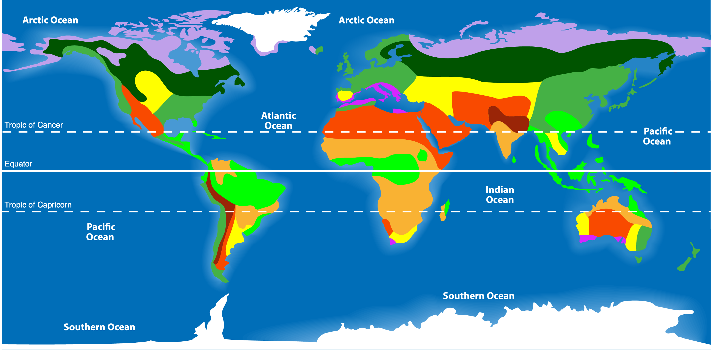
The Living World
Geography Homework
Global Ecosystems
4
Identify the location of the biomes below:
Tropical
rainforest
1.
2.
Desert
4.
6.
Tundra
3.
Temperate deciduous forest
5.
Savanna
Polar
5
Tropical rainforests are found near the E__________ and have h__________ temperatures all year. They have high r____________ and very high b______________ – more species of plants and animals than any other biome. Tall trees form a continuous c__________ layer.
6
Underline the odd one out. Explain your choice.
a) Tropical rainforest | Desert | Savanna | Tundra
b) Temperate deciduous forest | Tundra | Taiga (coniferous forest) | Tropical rainforest
7
Identify the characteristics of temperate deciduous forests.
Four distinct seasons
Trees lose leaves in winter
Found near the Equator
Mild, wet climate
Evergreen coniferous trees
Found between
40°N and 60°N
www.internetgeography.net

Slide 6



The Living World
Geography Homework
The physical characteristics
of a tropical rainforest
1
Tropical rainforests are located near the E__________, where the s______ rays are strongest. They experience d__________ rainfall all year, often over __________ mm annually.
Temperatures are consistently h________, averaging about ____°C. Rainfall is caused by c_____________ rainfall due to intense heat. The climate is h_____ and w_____, ideal for plant growth.
2
Match the descriptions to the rainforest layer.
Canopy
Shorter trees with fewer leaves, growing in limited sunlight.
Under canopy
Dark and damp layer with ferns and small plants.
Emergents
The tallest trees that rise above the canopy, exposed to strong winds
Shrub layer
Dense layer that blocks sunlight and captures most rainfall
4
Rainforest soils – true or false?
True
False
Rainforest soils are called latosols.
Coastal Landscapes in the UK
Most nutrients are stored in the soil.
Nutrients are leached quickly due to heavy rainfall.
Rainforest soils are very fertile and deep.
Vegetation
Climate
Nutrient cycle

Slide 7
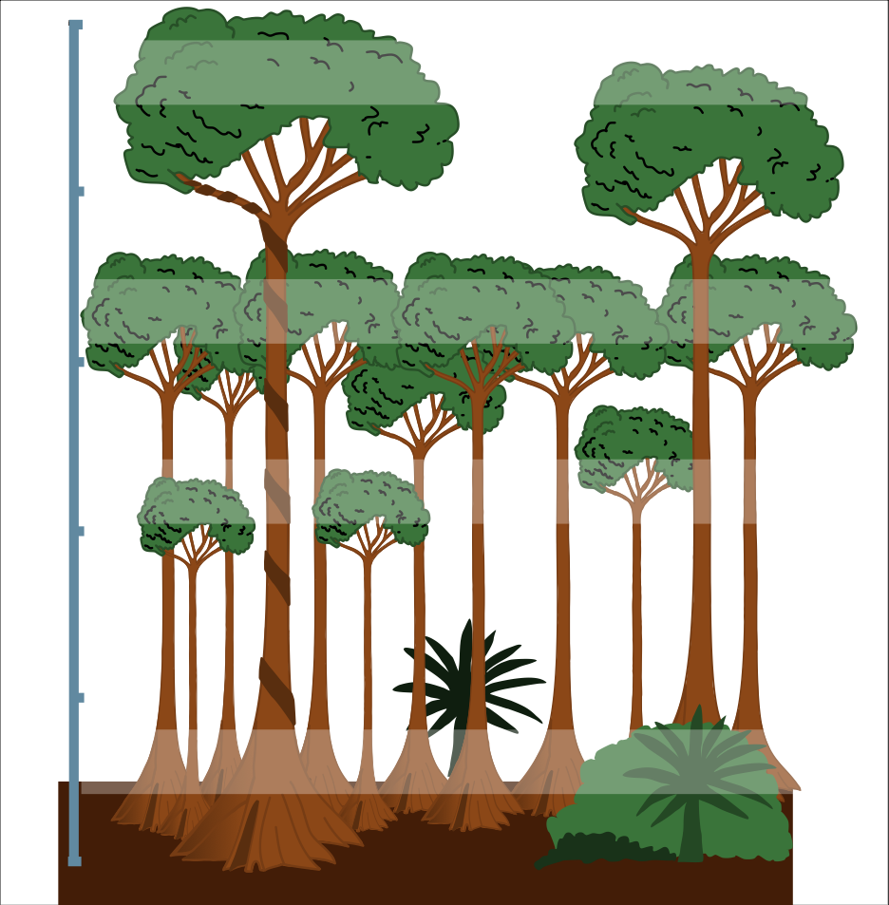
The Living World
Geography Homework
The physical characteristics
of a tropical rainforest
5
Tropical rainforests have a very fast n__________ cycle. The hot, wet climate encourages rapid d_______________ of dead material. Most nutrients are stored in the b__________, not in the s_______. High rainfall causes l__________, which washes nutrients out of the soil.
6
Complete the diagram to show the main features of the nutrient cycle.
7
Label the diagram below with:
Emergent
Canopy,
Under canopy
Shrub layer
Ground layer
Buttress roots
Drip-tip leaves
www.internetgeography.net

Slide 8

The Living World
Geography Homework
Interdependence in the Tropical Rainforest
1
Fill in the gaps using the words below:
climate plants soil water humus animals
people nutrients decompose knock-on
Tropical rainforests are highly ______________ ecosystems. This means that all the different parts depend on one another, and a change to one part of the ecosystem can have __________ effects on the others. The hot, wet ________ causes dead organic matter, such as leaves, to __________ quickly. This releases __________ into the _____, forming a layer of rich ________. These nutrients are rapidly absorbed by ______, which grow densely in the ideal conditions. The lush vegetation provides food and shelter for many ________, some of which are specially adapted to survive in very specific conditions. Local _______ rely on the rainforest for food, fuel, medicine, and building materials.
2
Climate and Interdependence: Which of the following are TRUE? Tick two correct answers.
True
False
A. Trees lose their leaves in the dry season
B. Animals help plants reproduce by dispersing
seeds
C. Soils are deep and rich in nutrients
D. Rainforest trees help maintain the water cycle
E. The rainforest is cold and dry all year round
F. People have no effect on ecosystems
Interdependence in the tropical rainforest

Slide 9
The Living World
Geography Homework
The physical characteristics
of a tropical rainforest
3
Which of the following are true about the rainforest climate and interdependence? (Tick TWO correct answers)
A. It slows down decomposition,
preserving nutrients.
D. It helps organic matter
decompose quickly, releasing
nutrients.
B. It supports rapid plant growth
through heat and moisture.
E. It removes nutrients from the
soil permanently.
C. It causes trees to grow deep
roots for more nutrients.
4
Complete the table showing how rainforest elements are interdependent.
Element | What is depends on | Why
Plants
Animals
People
Decomposers
5
Define interdependence in the tropical rainforest.
www.internetgeography.net

Slide 10


The Living World
Geography Homework
Rainforest Plant and Animal Adaptations
1
Fill in the blanks: adaptations, survive, climate, features, rainforest, resources
Plants and animals in the tropical ___________ have special __________ that help them to ________ in this challenging ________. These ________ are called ____________, and they include ways of finding food, staying safe, and dealing with heavy rainfall and intense heat.
2
Complete the table by matching each adaptation to the correct benefit.
Adaptation |  | Benefit
Buttress roots |  | Prevent fungus and bacteria from growing on leaves
Tree Frog |  | Allow trees to grow very tall and remain stable
Flexible leaf stems |  | Repel rainwater and shed it quickly
Thin, smooth bark |  | Maximise sunlight capture during the day
Toucan |  | Reduce the risk of epiphytes attaching to the tree
Sloth |  | Camouflaged fur and slow movement to avoid predators
Waxy leaves with drip tips |  | Suction pads to grip leaves and branches
Anteater |  | Large bill for reaching and eating fruit
Leaves in the under-canopy are large |  | Long, sticky tongue for catching insects
Plant Adaptations
Animal Adaptations

Slide 11
The Living World
Geography Homework
3
Fill in the blanks: diet, camouflage, climb, nocturnal, swim, limbs
Tropical rainforest animals have special adaptations. Some animals use ____________ to blend into their surroundings, helping them hide from predators. Many are __________, meaning they are active at night when it is cooler. Animals like monkeys have strong __________ to help them swing and __________ trees. Some rainforest animals can __________ through rivers, and others have a specialised __________ so they can eat only one type of plant or insect.
4
True or false?
True
False
Trees in the rainforest have thick bark to protect them from the cold.
Animals like sloths move slowly to avoid being spotted by predators.
All rainforest plants grow deep roots to reach underground water.
Epiphytes grow in soil to absorb nutrients more easily.
The rainforest climate encourages adaptations that manage heat and rainfall.
5
Which adaptation helps rainforest trees support their great height and cope with nutrient-poor soils?
A. Deep taproots reaching mineral layers deep underground
C. Thick, rough bark to anchor to sloped ground
B. Buttress roots spreading
wide near the surface
D. Very narrow root systems to avoid competition
6
What adaptation do the leaves of many rainforest shrubs have to cope with high rainfall?
A. Thick, waxy leaves with drip tips
C. Leaves oriented horizontally to catch water
B. Very small, needle-like leaves
D. Leaf surfaces covered in sticky hairs
www.internetgeography.net

Slide 12
The Living World
Geography Homework
Issues relating to biodiversity in the tropical rainforest
1
What is Biodiversity? - Complete the paragraph using the words below:
species ecosystem diverse extinction habitats interdependence
Biodiversity is the variety of all living things in an __________. Tropical rainforests are some of the most __________ places on Earth, home to more than half of all known __________. Each plant and animal plays a role, with high levels of _______________ between organisms. When one species is lost, it can affect many others. Deforestation can lead to the loss of __________ and may even cause the __________ of species.
2
Draw lines or label the correct definitions.
Deforestation |  | Benefit
Biodiversity |  | Damage to the natural home of organisms.
Endangered species |  | Protecting and managing natural environments.
Conservation |  | The variety of plant and animal life in a particular habitat.
Habitat destruction |  | A species that is at risk of extinction.
Deforestation |  | The cutting down and removal of trees.
3
Why is biodiversity important in tropical rainforests?
A. It provides fewer opportunities for species to survive
C. It supports food chains, medicine, and future scientific discoveries
B. It helps create deserts
D. It only affects animals, not humans
Plant Adaptations
Animal Adaptations

Slide 13
The Living World
Geography Homework
4
Tick ✓ the statements that correctly describe causes of biodiversity loss in tropical rainforests.
Trees are cut down for timber and to clear land for farming.
Afforestation projects are affecting biodiversity levels.
Forests are burned to make space for cattle ranching.
Mining removes vegetation and pollutes rivers.
Conservation areas are expanding.
5
True or false?
True
False
Deforestation helps protect biodiversity.
Biodiversity loss can lead to fewer medical discoveries.
Rainforests can survive well without animal species.
6
Outline why biodiversity loss matters globally:
oxygen carbon climate species future medicine
Rainforests play a global role in regulating the __________ by absorbing __________. They also produce __________ and store thousands of undiscovered __________. Many of today’s important __________ have come from rainforest plants. Protecting biodiversity helps ensure the health of the planet and the well-being of __________ generations.
7
Identify the actions that can reduce rainforest biodiversity loss
Encourages conservation by bringing money from holiday makers into local communities.
Involves planting trees in deforested areas to restore habitats.
www.internetgeography.net

Slide 14

The Living World
Geography Homework
Changing Rates of rainforest deforestation
1
Introduction to Deforestation Rates - Complete the paragraph using the words below:
Amazon increase climate change decrease 1990s cleared agriculture
Tropical rainforest deforestation has changed over time. Since the early ________, large areas of forest have been ________ for activities such as logging and ___________. In some areas, rates of deforestation have started to ________, while in others they continue to ________. The ________ rainforest has experienced especially high rates of deforestation, contributing to global ________ ________.
2
True or false?
True
False
The Amazon rainforest has one of the lowest deforestation rates in the world.
Cattle ranching is a major cause of deforestation in the Amazon.
Deforestation only happens for logging.
Replanting efforts have helped reduce net deforestation rates in some areas.
Deforestation has no impact on biodiversity.
3
Tick the main causes of rainforest deforestation.
A. Urban regeneration
D. Ecotourism
B. Subsistence farming
E. Commercial agriculture
C. Logging
F. Mining
Changing rates of deforestation

Slide 15
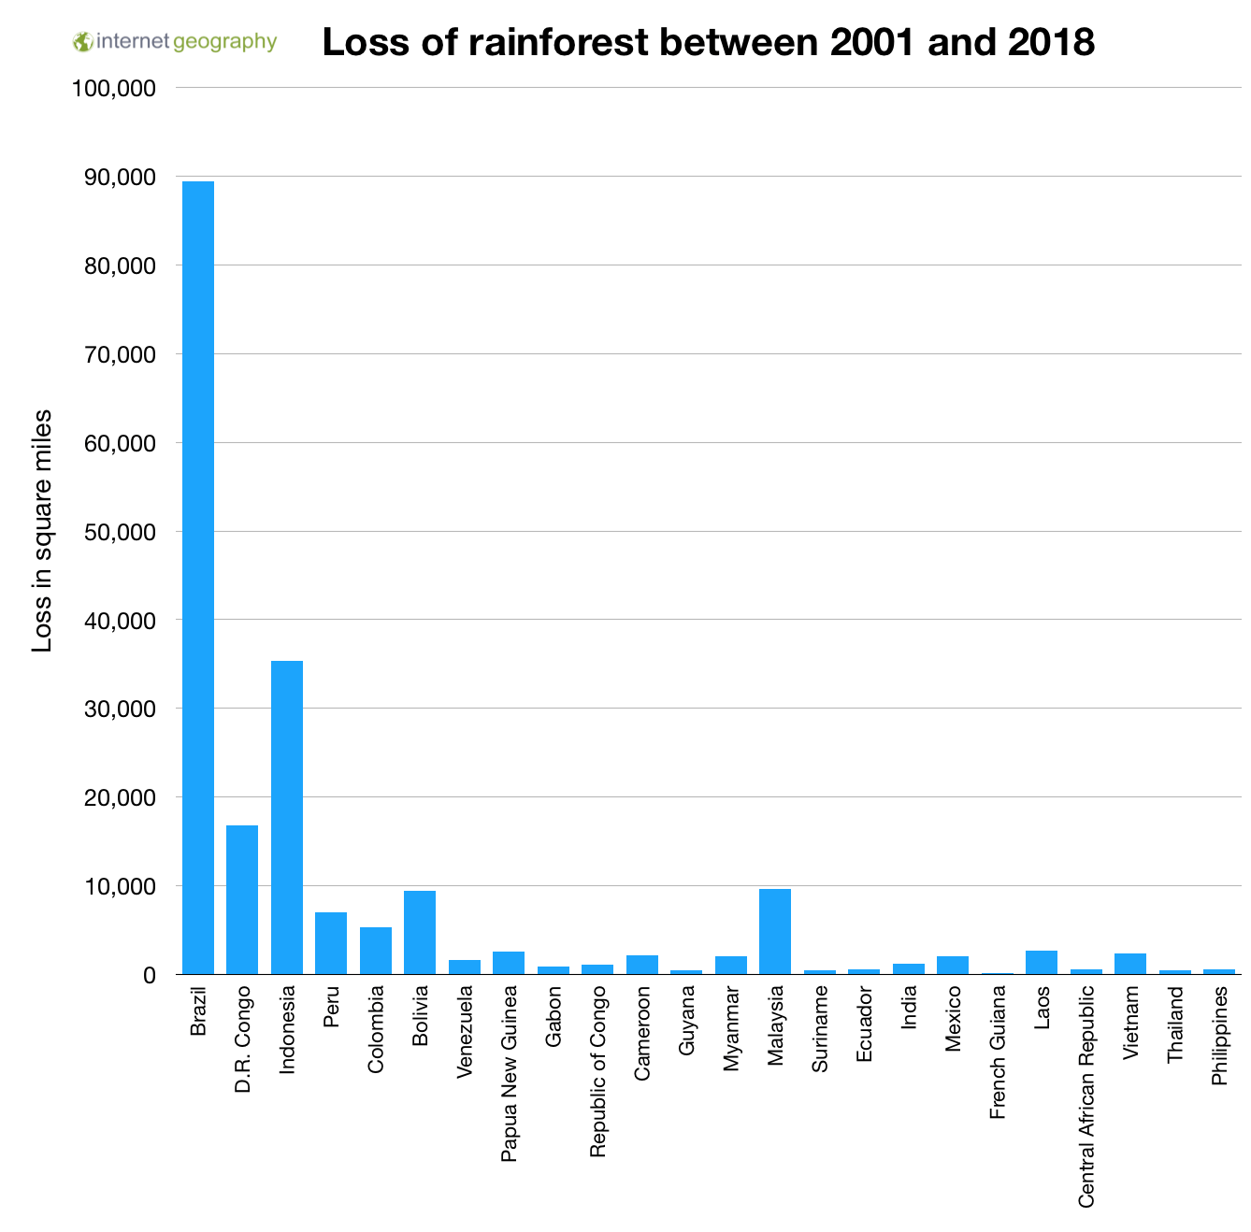
The Living World
Geography Homework
4
Number the steps to show how deforestation contributes to climate change.
Less carbon dioxide is absorbed from the atmosphere.
Carbon dioxide is released when trees are burned or decompose.
Trees are cut down in large numbers.
Global temperatures rise due to the enhanced greenhouse effect.
5
Rank the countries in order according to rainforest loss between 2001 and 2018.
Rank
DR Congo
Indonesia
Brazil
Malaysia
Bolivia
Number of countries
in the top 5
6
Which three continents contain the top 5 countries for rainforest deforestation between 2001 and 2018?
Asia
South America
Africa
www.internetgeography.net

Slide 16
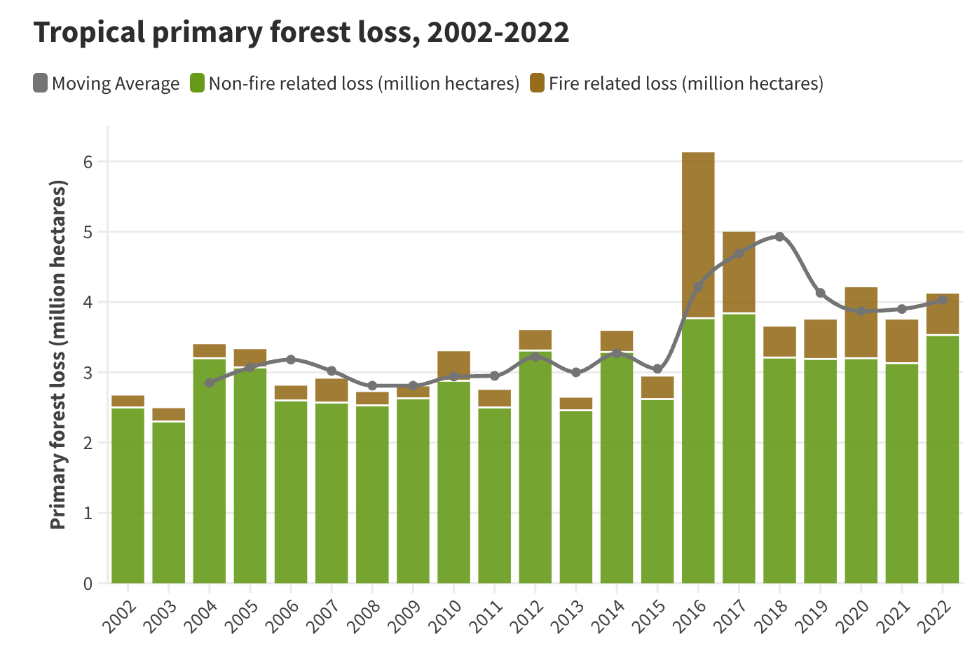
The Living World
Geography Homework
Study the graph below showing the global loss of primary tropical rainforest loss.
7
True or false?
True
False
Overall, the trend in forest loss has increased since 2002, with noticeable peaks after 2015.
The year with the highest total tropical primary forest loss was 2016.
From 2002 to 2010, annual forest loss remained mostly below 3 million hectares.
Fire-related forest loss was significantly higher in 2016 and 2017 compared to other years.
The moving average of forest loss decreased continuously between 2016 and 2022.
The moving average peaked in 2018 and then started to decline.
www.internetgeography.net

Slide 17

The Living World
Geography Homework
Causes of deforestation in the Amazon Rainforest
1
Introduction to the Amazon Rainforest
Complete the paragraph using the following words:
Brazil biodiversity largest equator South America climate
The Amazon Rainforest is the world’s ________ tropical rainforest. It is located in _______________, mainly in ________. The rainforest is home to a rich variety of ____________ and plays a crucial role in regulating the global ________. It lies close to the ________.
2
Draw lines to match each cause of deforestation with its description:
Causes |  | Benefit
Logging |  | Constructing highways like the Trans-Amazonian Highway for transport.
Road building |  | Building hydroelectric dams, flooding forest areas e.g. Belo Monte Dam in Brazil.
Mineral extraction |  | Land cleared by small-scale farmers to grow food for their families, e.g. indigenous groups like the Kayapo.
Subsistence farming |  | Forest cleared to build new towns or housing e.g. around Manaus.
Commercial farming |  | Large areas cleared to access valuable timber like mahogany and teak.
Energy development |  | Forest cleared for cattle ranching or soya plantations e.g. in States such as Mato Grosso and Rondônia.
Settlement |  | Increasing demand for land due to rising population e.g. close to Manaus.
Population growth |  | Digging for gold, bauxite and other resources using open-cast methods, such as at Carajas Mine.
Causes of deforestation in the Amazon

Slide 18
The Living World
Geography Homework
3
Tick whether each cause is economic or social:
Economic
Social
Subsistence farming
Logging
Road building
Population growth
Commercial farming
4
What type of logging causes the most damage to the rainforest?
A. Selective logging
C. Sustainable forestry
B. Clear felling
D. Urban logging
5
True or false? – Causes of deforestation
True
False
The Trans-Amazonian Highway is an example of road building.
Subsistence farmers sell crops on a global scale.
Energy development in the Amazon Rainforest includes hydroelectric power.
Cattle ranching is a form of subsistence farming.
Mining for gold in the Carajas Mine has no environmental impact.
6
Commercial Farming in the Amazon - Use the following words:
beef exports global clearance Brazil deforestation
One of the main causes of _____________ in the Amazon is commercial farming, particularly for ________. Large areas of rainforest are cleared to raise ________. Much of the ________ is for export, especially from ________, which is a leading ________ beef producer.
www.internetgeography.net

Slide 19
The Living World
Geography Homework
Effects of deforestation in the Amazon Rainforest
1
Introduction to Impacts of Deforestation
Complete the paragraph using the following words:
biodiversity rainforest jobs climate carbon dioxide resources
The Amazon __________ is often cleared to access natural __________, creating ________ in industries such as logging and mining. However, removing trees affects the local ___________ and increases the amount of _______________ in the atmosphere. Deforestation also threatens ___________ as habitats are destroyed.
2
Tick whether the impact is local or global.
Local
Global
Loss of biodiversity
Increased carbon dioxide levels
Disruption of the water cycle
Indigenous people forced from homes
Mercury pollution in rivers
3
What is one economic benefit of deforestation in the Amazon?
A. It reduces soil erosion
C. It creates jobs in mining and logging
B. It increases biodiversity
D. It helps local people conserve forests
4
True or false? Hydro electric power schemes such as Belo Monte, destroy biodiversity in the tropical rainforest
A. True
B. False
Causes of deforestation in the Amazon

Slide 20
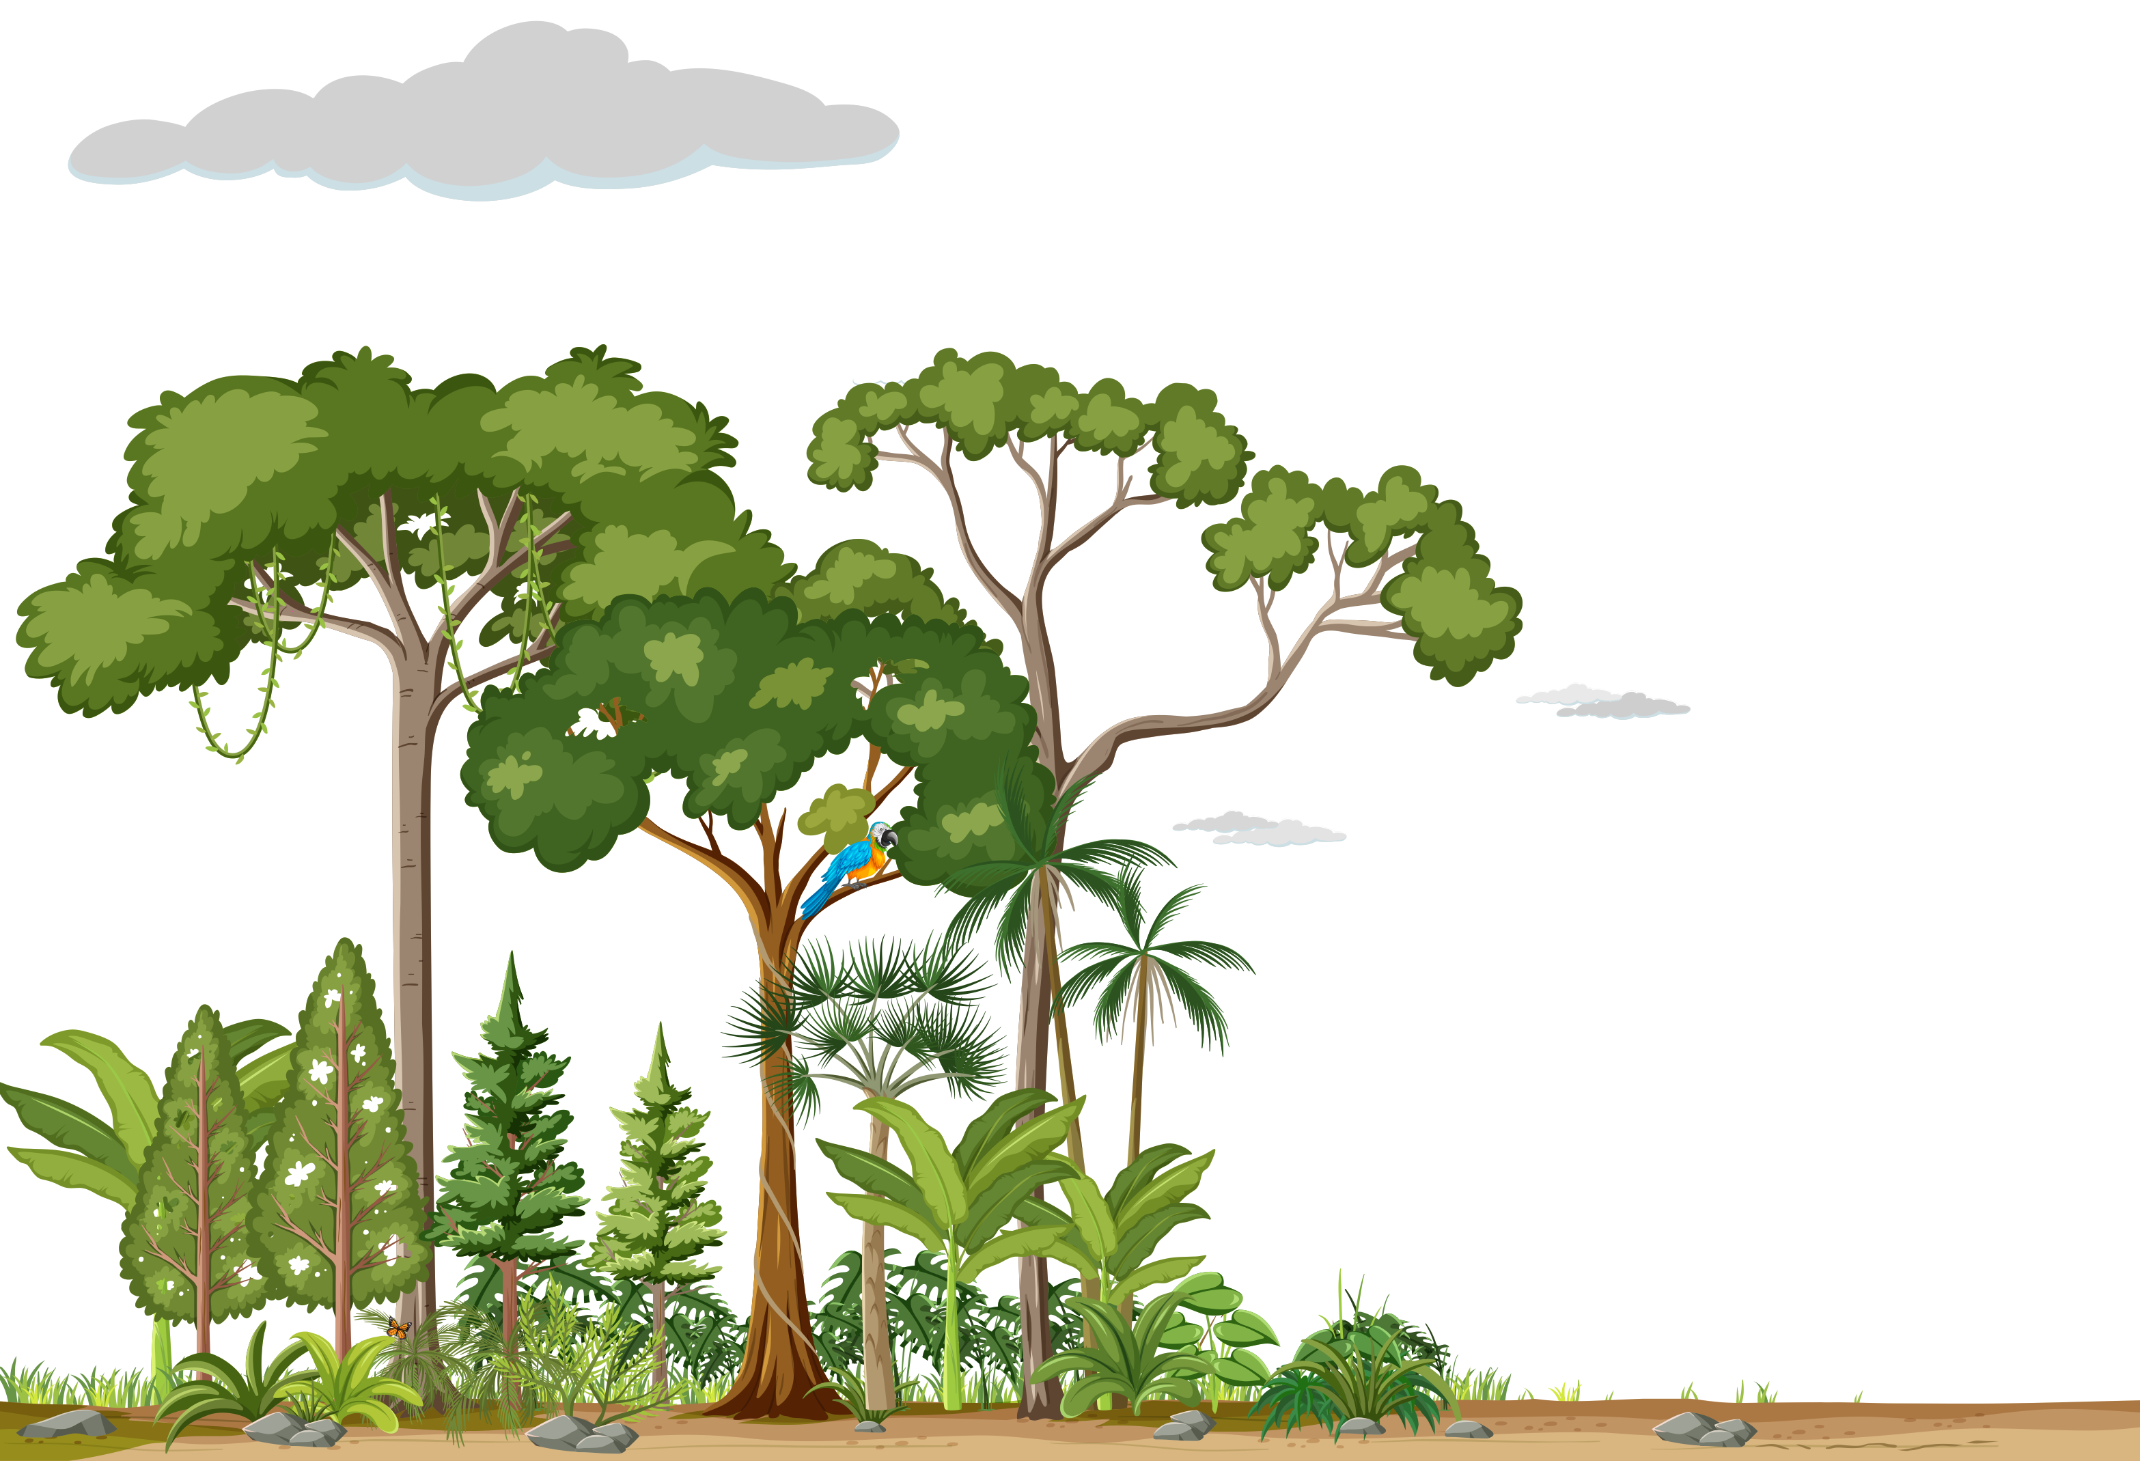

The Living World
Geography Homework
5
Climate Change and Soil – True or false?
True
False
Deforestation helps regulate carbon dioxide levels.
Using fire to clear forest increases greenhouse gas emissions.
Soil becomes more fertile after deforestation.
Fewer trees mean less evapotranspiration and rainfall.
6
Label the diagram below to show the impact of rainforest deforestation on the water cycle and the nutrient cycle.
Pre-deforestation:
High rates of rainfall interception by the canopy.
Water is returned to the atmosphere by evapotranspiration.
Moist air rises, cools and condenses to form rainclouds.
Heavy frequent convectional rainfall.
Nutrient rich topsoil.
Litter decomposes quickly recycling nutrients.
Dense vegetation absorbs nutrients through shallow roots.
Post-deforestation
Less vegetation means reduced interception leading to more water reaching the surface.
Increased surface run-off, causing soil erosion.
Leaching means nutrients are washed away within the soil.
No vegetation, means reduced leaf litter, and fewer nutrients recycled. Soil become infertile.
www.internetgeography.net

Slide 21

The Living World
Geography Homework
What is the value of the tropical rainforest?
1
Complete the paragraph using the following words:
medicines, oxygen, habitats, climate, resources
Tropical rainforests provide a wide range of important benefits.
They are home to over half of the world’s plant and animal __________. They act as a global __________ regulator by absorbing carbon dioxide. Rainforests produce around 20% of the world’s __________. Many modern __________ are derived from rainforest plants. Rainforests also provide natural __________ such as timber and food.
2
What role do rainforests play in the global climate system?
A. They increase air pollution
C. They absorb carbon
dioxide
B. They reduce oxygen levels
D. They cause acid rain
3
What happens to biodiversity when rainforests are protected?
A. It is preserved
C. It decreases
B. It becomes extinct
D. It damages the
ecosystem
4
What is one way rainforests help prevent soil erosion?
A. Tree roots hold the soil in place
C. They extract nutrients
B. Tree roots grow very deep, securing the soil.
D. The increase the
frequency of landslides
The value of the tropical rainforest

Slide 22
The Living World
Geography Homework
5
Why are tropical rainforests important for the water cycle?
A. They increase the
likelihood of drought
C. They reduce rainfall
B. They increase temperatures
D. They return moisture to the atmosphere through transpiration
6
True or false?
False
True
Rainforest trees release water into the atmosphere.
Rainforests provide no economic value to people.
Rainforests support biodiversity.
All rainforest products are non-renewable.
6
Sort the following into either benefits to people and/or to the environment.
People
Environment
Produces oxygen
Timber and food supplies
Global carbon sink
Medical resources
Prevents soil erosion
Habitat for species
7
Tick the correct boxes for how tropical rainforests benefit each group:
Economic
Environment
Indigenous people
Pharmaceutical companies
Conservation groups
Logging companies
www.internetgeography.net

Slide 23

The Living World
Geography Homework
Sustainable management of the tropical rainforest
1
Complete the paragraph using the following words:
future, resources, needs, environment, balance
Sustainable management means using rainforest __________ in a way that meets people’s __________ without damaging the _____________. It aims to strike a __________ between economic development and protecting the rainforest for the __________.
2
Match each strategy to the correct description.
Strategy |  | Description
Selective logging |  | Tourism that is low-impact and raises money for conservation.
Ecotourism |  | Countries agree not to import endangered hardwoods like mahogany.
International agreements |  | Only certain trees are cut down, reducing damage to the rainforest.
Conservation and education |  | Richer countries cancel debt if rainforests are protected.
Debt reduction |  | Teaching people about the importance of the rainforest and protecting it.
3
True or false?
True
False
Ecotourism involves destroying parts of the rainforest.
Conservation schemes often include national parks.
Debt reduction means poorer countries can develop by logging more.
Educating local communities helps them protect the forest.
Sustainable management of the tropical rainforest

Slide 24
The Living World
Geography Homework
4
Complete the paragraph using the following words:
biodiversity, future, resources, climate, income
Sustainable management of the rainforest helps protect ____________, ensuring that rare plants and animals are not lost.
It also supports the global __________ by absorbing carbon dioxide.
Local communities can earn __________ through methods like ecotourism. Sustainable use of rainforest __________ ensures they are available for __________ generations.
5
Tick whether each group benefits from each strategy.
Conservation & education
Debt reduction
Group
Ecotourism
Local communities
Logging companies
Tourists
Global environment
6
Match each rainforest management strategy to its benefit.
Strategy |  | Description
Selective logging and replanting |  | Helps local people earn money while protecting the rainforest.
Ecotourism |  | Replaces cut-down trees and avoids large-scale deforestation.
International agreements |  | Raises awareness and supports long-term rainforest protection.
Conservation and education |  | Encourages responsible logging and protects ecosystems.
Debt reduction |  | Allows LICs to preserve rainforests rather than exploit them.
www.internetgeography.net

Slide 25

Geography
Revision
How do I revise GCSE Geography
Practical tips on how to revise GCSE Geography effectively.
https://tinyurl.com/IGREVTIPS
Interactive Revision
Online quizzes and flashcards to support you revising AQA GCSE Geography.
https://tinyurl.com/IGINTREV
Reference Notes
Reference notes covering every AQA GCSE Geography unit for paper 1 and paper 2.
https://tinyurl.com/IGAQANOTES

