Slide 1
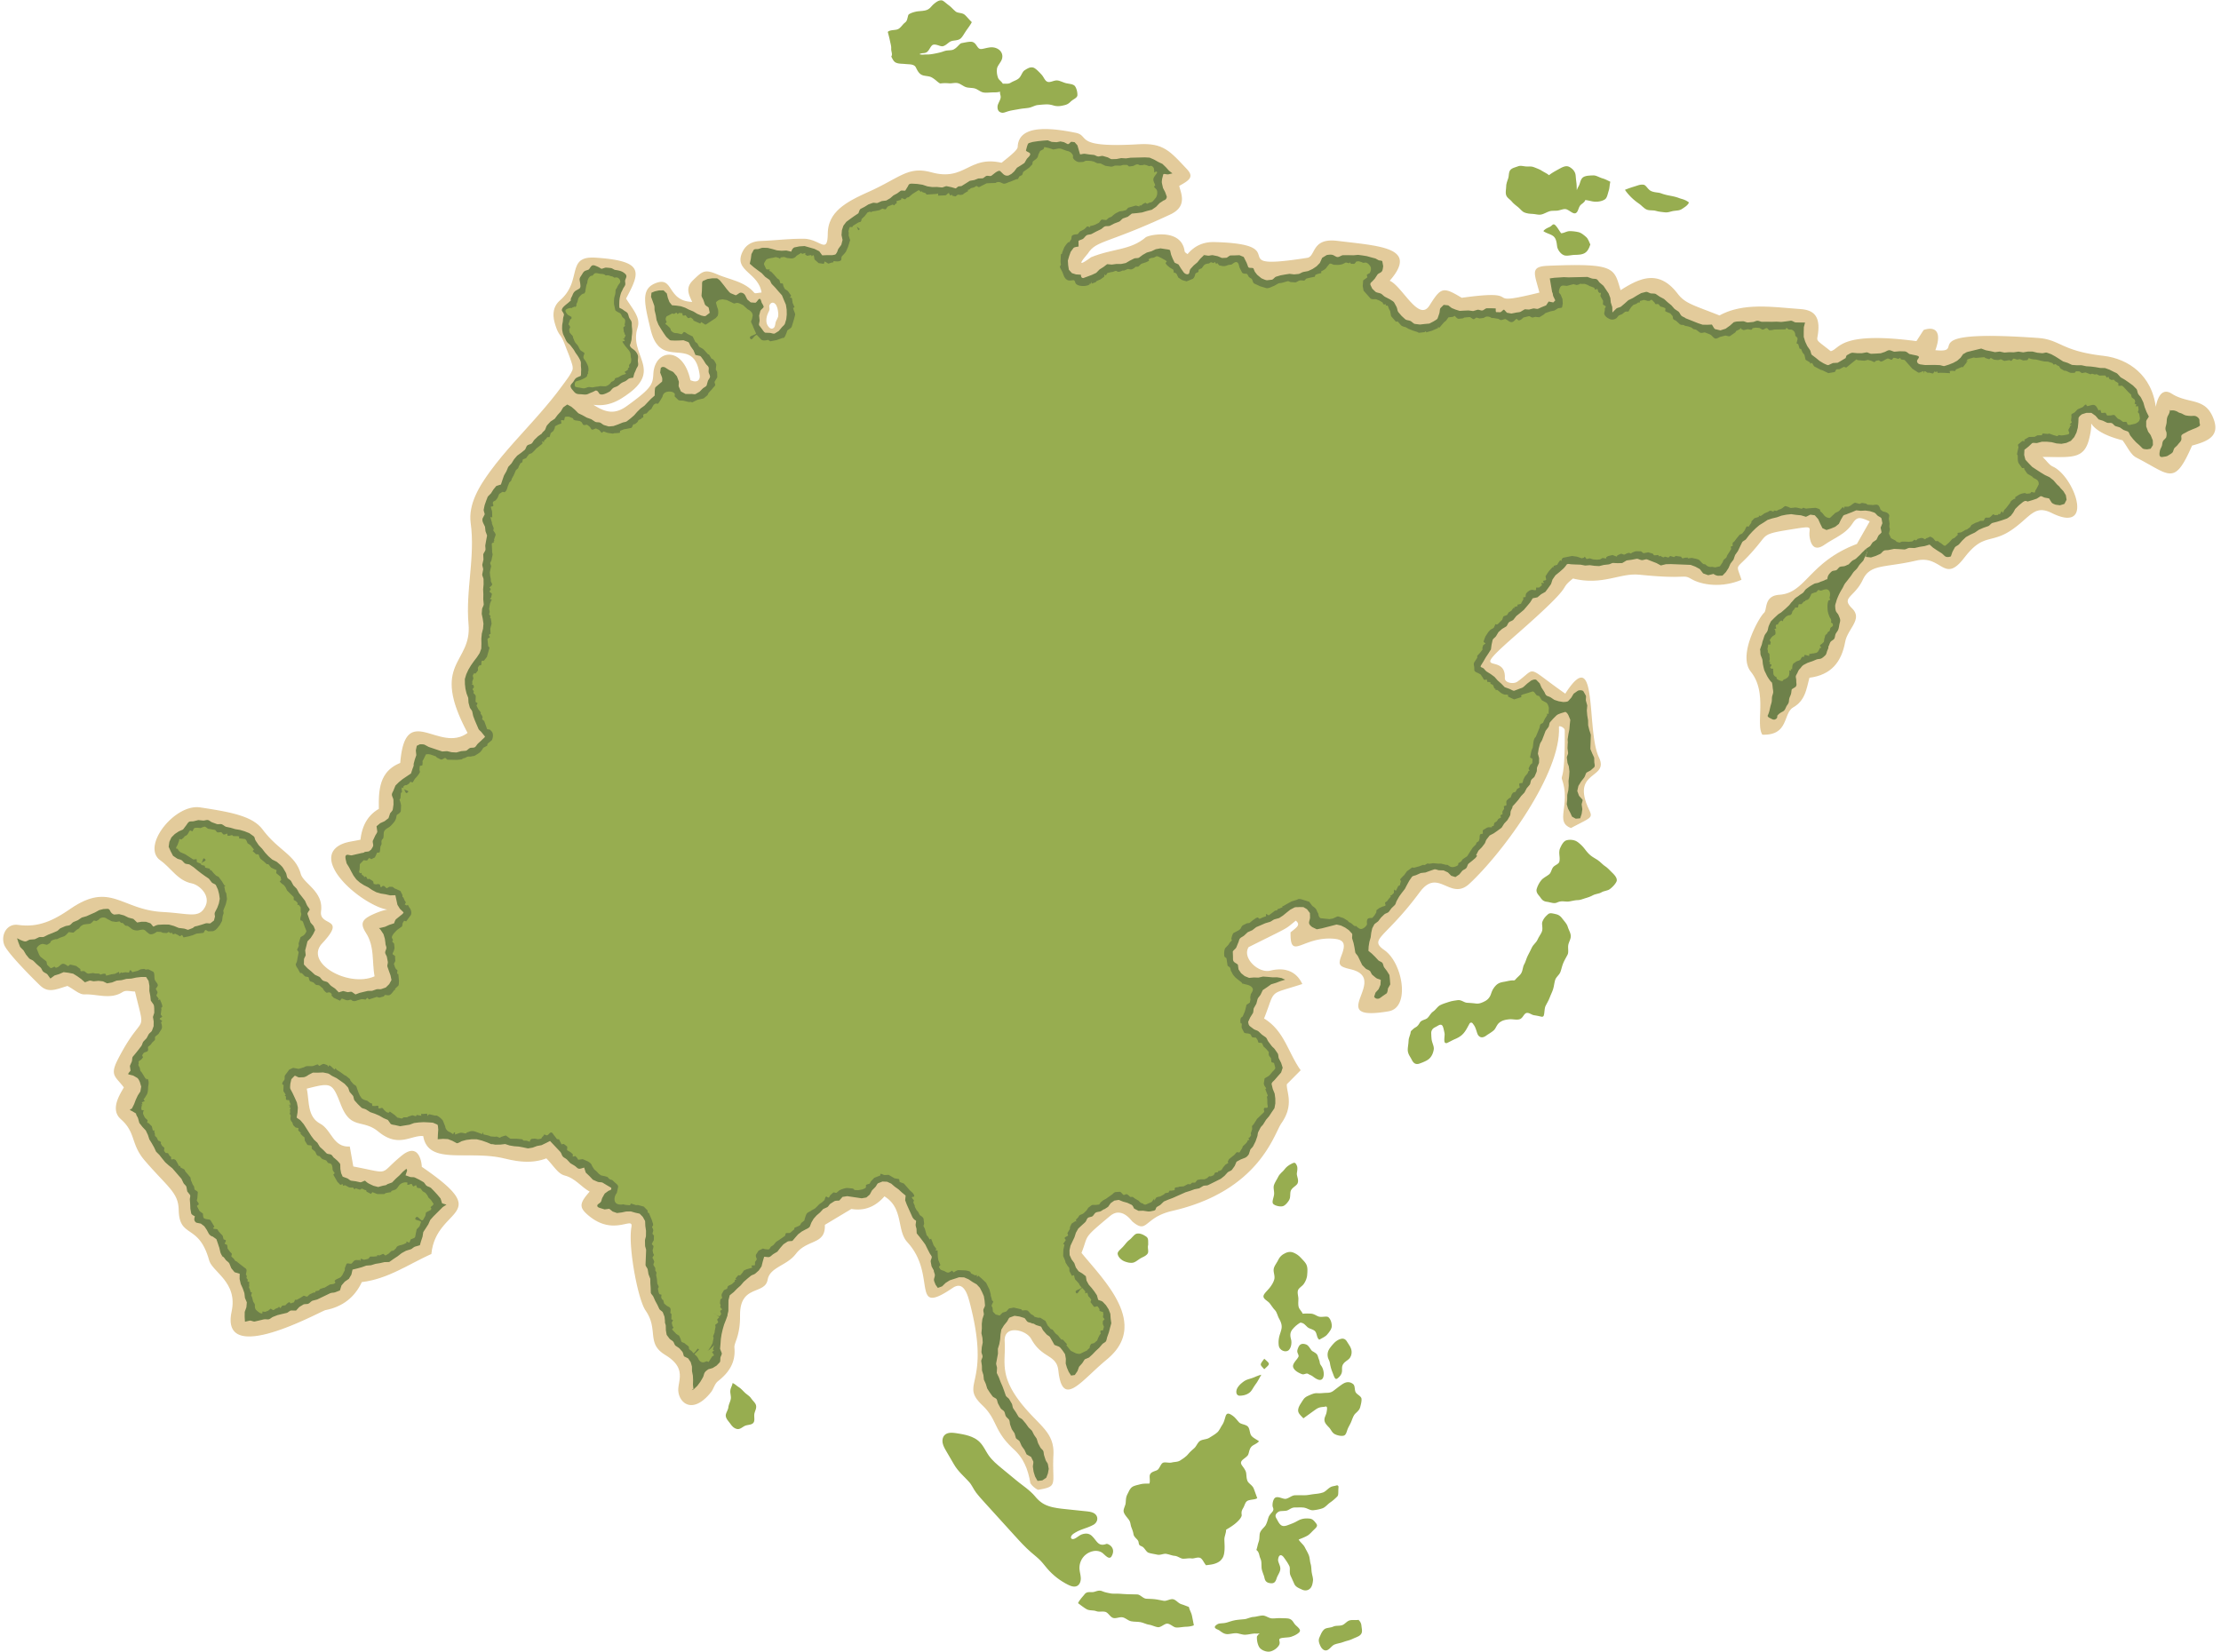




The Challenge of Resource Management
Geography Homework
The Significance of Food, Water and Energy
1
Food, water and energy are essential resources for human life and w_____-b_______. Without access to enough f______, people suffer from hunger and poor h__________. Clean water is vital for hygiene and s__________. Access to reliable e__________ supports economic activity, including manufacturing and t__________. Lack of these resources can lead to c__________ and prevent a country from d_________.
ell
eing
ood
ealth
anitation
nergy
ransport
onflict
eveloping
2
Match the resource to its impact on well-being.
Classification
Letter
Descriptions
A. Powers hospitals, homes, and industry
B. Provides essential nutrients and calories for growth and development
C. Needed for drinking, farming, sanitation and hygiene
Food
B
Water
C
A
Energy
3
4
Which of these is not a cause of water stress?
What is food insecurity?
A. Too much food is produced
A. Pollution
B. People do not have access to
enough nutritious food
B. Climate change
C. Shops run out of food during
storms
Coastal Landscapes in the UK
C. Improved irrigation
D. Farming is restricted
D. Over-abstraction
5
Why is energy vital for development?
A. To reduce life expectancy
C. To combat malaria.
B. It is only used in developed
countries
D. To fuel transport and
industry
The Significance of Food, Water and Energy

Slide 2
The Challenge of Resource Management
Geography Homework
The Significance of Food, Water and Energy
True
6
False
True or false?
Access to clean water reduces the spread of disease.
Countries with plenty of natural resources always have high development.
Lack of energy can limit the development of industries.
Most countries have equal access to food and water.
7
True or false?
A resource is a stock or supply of something with a value or a purpose. The three most crucial resources are food, energy, and water, which are vital for countries to develop.
True
False
8
Give two reasons why some countries have more access to food, water or energy than others. Try to use full sentences and specific terms.
“Wealthier countries can afford to import resources or invest in infrastructure.” ✔
“Some countries have more natural resources (e.g. oil, rivers) than others.” ✔
“Climate and geography affect water and food supply.” ✔
“Political stability or conflict can affect access to resources.” ✔
1.
Examples
2.
9
Underline the correct word in each set of brackets to complete the sentences.
The (lowest / highest) levels of resource consumption are found in HICs. This is because HICs can afford to (import / ration / ban) large amounts of food, water and energy.
In LICs, many people cannot access enough resources because they are too (cheap / remote / expensive) or unavailable. As NEEs develop, their demand for resources is likely to (decrease / stay the same / increase).
www.internetgeography.net

Slide 3

The Challenge of Resource Management
Geography Homework
global inequalities in the supply and consumption of resources
1
Draw lines to match the term to its correct description.
HIC
When people don’t have enough access to food, water or energy
LIC
Country with low resource consumption per person
Resource scarcity
Country with high resource consumption and wealth
The consumption of r______________ across the world varies significantly. H__________ typically consume more than L________. The main challenge is insufficient resources, but the existing resources are u_______________ distributed. As a LIC develops, so too does its d____________ for resources. This growth in demand, along with p______________ growth, leads to a s______________ of resources.
2
esources
ICs
ICs
nevenly
emand
opulation
hortage
3
Complete the table.
One reason supply may be high
One reason consumption may be high
Coastal Landscapes in the UK
Has money and technology to import/exploit
More industry, technology and affluence (wealth)
HIC
May have a large supply natural resources
Rapid population growth, urbanisation
LIC
Global inequalities in the supply and consumption of resources

Slide 4
The Challenge of Resource Management
Geography Homework
global inequalities in the supply and consumption of resources
4
5
Which of the following explains why LICs consume fewer resources?
Which country is most likely to have high resource consumption?
A. Ethiopia
A. Stronger economies
B. Bangladesh
B. Less access and affordability
C. United States of America
C. Higher urbanisation
D. Nepal
D. More exports
6
A region experiencing resource insecurity is likely to face:
A. Rapid economic growth
C. High food surplus
B. Good infrastructure
D. Conflict and poor living
standards
7
urope
Much of E________, Asia, and North and South America have a food s____________, thanks to fertile s______, moderate climate, and advanced t___________. Most people in these regions meet their daily f_____ requirements. In Africa, challenging p___________ conditions, low technological development, and p___________ instability contribute to unreliable food production. Consequently, many individuals face u_______________________ due to a lack of food.
urplus
oils
echnology
ood
hyscial
olitical
ndernourishment
8
limate
Due to variations in c_____________, freshwater distribution worldwide is limited and u_____________ distributed. Water scarcity and d_________ are common challenges, particularly in A_________ and parts of the Middle E______. This situation forces people to dedicate considerable time to w_______ collection, significantly affecting e___________ growth and quality of l______.
nevenly
rought
frica
ast
ater
conomic
ife
ossil
9
The distribution of energy resources, especially f_______ fuels, varies globally. Coal historically bolstered E________ early economic growth. As with water and f______, there are considerable differences in e_______ consumption.
urope’s
ood
nergy
www.internetgeography.net

Slide 5

The Challenge of Resource Management
Geography Homework
The Demand for food in the UK
1
Draw lines to match the term to its correct description.
High value goods
Food grown without chemicals or artificial fertilisers.
Organic
produce
Expensive foods, often imported from LICs.
Seasonal
food
Food only naturally available at certain times of year.
2
3
What is one impact of organic farming on the environment?
Why is the UK importing more food from LICs?
A. To reduce prices for farmers
A. Increases chemical use
B. To support UK farming
B. Reduces pollution and
chemical runoff
C. To meet growing demand
for exotic/high-value foods
C. Uses more fertilisers
D. Because it’s cheaper to
grow all food in the UK
D. Increases energy production
4
Which of the following is a reason for buying seasonal food locally?
A. It supports global
supermarkets
C. It lowers carbon emissions
B. It reduces food miles
D. It encourages pesticide
use
Coastal Landscapes in the UK
oods
5
In the UK, there is growing demand for high-value f______ like exotic fruits and v____________. Many of these are imported from L__________. These foods are often flown in, which increases their airmiles and c__________ footprints. UK s_____________ now stock a wide variety of international produce all y______ round. While this trade brings income to farmers, many still earn low w__________.
egetables
ICs
arbon
upermarkets
ear
ages
The demand for food in the UK

Slide 6
The Challenge of Resource Management
Geography Homework
The Demand for food in the UK
6
Complete the table to show one advantage and one disadvantage of each factor.
Advantage
Disadvantage
Wider variety of food all year round.
High food miles increase carbon emissions
Importing
food
Buying local produce
Supports local farmers and economy.
May be more expensive or limited in variety.
7
8
Tick three reasons why demand for seasonal and exotic food has increased in the UK:
What do we mean by “food miles”?
A. The distance people
travel to buy food
B. The price of food at
different distances
A. People want to eat food
they tried overseas
C. How many meals people
eat per day
B. UK farmers have stopped
growing traditional crops
D. The distance food travels
from producer to consumer
C. Supermarkets import food
providing year-round choice
Organic produce is…
D. British food is no longer
available in winter
9
E. Rising incomes = people can
afford a wider range of food
food grown using environmentally and animal-friendly methods without artificial fertilisers, pesticides,
or synthetic additives.
F. UK law bans out-of-season
food
There has been a growing demand for o_________ produce in the UK. This is because many c_________ are concerned about the use of c_________ in food production. Organic food is often more e_________, but people are willing to pay more for fewer additives and lower e______________ impact.
10
rganic
onsumers
hemicals
xpensive
nvironmental
www.internetgeography.net

Slide 7

The Challenge of Resource Management
Geography Homework
Carbon Footprints, Food Miles and the move towards local sourcing of food
1
Draw lines to match the term to its correct description.
Carbon Footprint
The distance food travels from where it is grown to where it is eaten.
Food miles
Buying food produced close to where it is consumed.
Local sourcing
The total greenhouse gases released by an activity, product or country.
2
3
Which is a disadvantage of local sourcing?
Why are food miles considered a problem?
A. They reduce variety of food available
A. Food is fresher
B. They increase greenhouse gas emissions from transport
B. It lowers carbon emissions
C. They always make food cheaper
C. Fewer chemicals are used
D. They support local farmers
D. Seasonal variety is reduced
4
What percentage of UK greenhouse gas emissions is thought to come from the food industry?
A. 1%
C. 25%
B. 10%
D. 50%
5
The UK imports large amounts of food, which increases food miles and therefore carbon dioxide e__________. This adds to people’s overall c__________ footprint. Many c__________ are now choosing to buy food from l_________ sources instead. Although locally sourced food can sometimes be more e__________, it reduces reliance on food that has been i__________ from other countries.
missions
arbon
onsumers
ocal
xpensive
mported
Carbon Footprints & Food Miles

Slide 8
The Challenge of Resource Management
Geography Homework
Carbon Footprints, Food Miles and the move towards local sourcing of food
6
True or false?
True
False
Food miles only measure the distance food travels by plane.
Buying local produce helps support nearby farmers.
Carbon footprints include emissions from farming, processing, and transporting food.
All locally sourced food is cheaper than imported food.
7
Which of these is an example of reducing food miles?
8
Put the following stages in order of their contribution to the carbon footprint of food (1 = smallest, 3 = largest).
A. Eating strawberries imported from Spain in December
B. Buying apples from a UK orchard in autumn
2
A. Transport and distribution
C. Importing bananas from South America
3
B. Farming and production
D. Eating mangoes all year round
1
C. Storage and processing
9
Tick the correct column(s) for each statement: does it describe a Benefit of local sourcing, a Disadvantage of local sourcing, or both?
Benefit
Disadvantage
Both
a) Reduces food miles and carbon footprint
b) Often more expensive for consumers
c) Supports UK farmers and local economy
d) Less variety of foods year-round
e) Fresher food with fewer preservatives
www.internetgeography.net

Slide 9

The Challenge of Resource Management
Geography Homework
The Trend Towards Agribusiness
1
What is the term used to describe farms run like large industrial businesses?
A. Organic farming
B. Pastoral farming
C. Agribusiness
D. Urban living
2
Complete the sentences using the words from the box below.
[mechanisation, fertilisers, hedgerows, combine, factories]
Many agribusinesses use high levels of ______________ to reduce the need for manual labour. __________ are often removed to create larger fields. Chemical __________ and pesticides are commonly used to increase crop yields. Small family farms are sometimes forced to __________ to compete. Some agribusinesses also own __________ for processing and selling food.
mechanisation
Hedgerows
fertilisers
combine
factories
3
True or false?
True
False
Agribusiness farms are typically small, family-owned plots.
The use of modern machinery has reduced the need for farm workers.
Agribusiness improves biodiversity by protecting natural habitats.
Supermarkets often buy crops after they have been harvested.
Agribusiness contributes to food security by increasing food production.
The trend towards agribusiness

Slide 10
The Challenge of Resource Management
Geography Homework
The Trend Towards Agribusiness
4
Draw lines to match the term to its correct description.
Larger field sizes
Fewer jobs in farming
Use of pesticides and fertilisers
Jobs for skilled workers
Mechanisation
Potential environmental damage
Research into agricultural technology
More efficient use of machinery
5
Complete the sentences using the words from the box below.
[boundaries unskilled mechanisation chemicals food]
The trend towards agribusiness in the UK has changed how food is produced. Farms have become larger, often by removing ____________ and combining smaller farms. The use of __________ and ______________ has made _______ production more efficient, but it can harm the environment. While this method increases food security and creates jobs for skilled workers, it also means fewer jobs for __________ workers.
boundaries
chemicals
mechanisation
food
unskilled
6
True or false?
True
False
Agribusiness farms tend to be smaller than traditional farms.
Agribusiness uses modern technology and fertilisers to increase productivity.
Agribusiness involves producing food only for the farmer’s family.
www.internetgeography.net

Slide 11

The Challenge of Resource Management
Geography Homework
The Changing Demand for Water in the UK
1
Fill in the blanks using these words: leisure, population, appliances, greenhouses, hygiene, industrial, car
The demand for water in the UK has increased due to several reasons. More people own household ___________ such as washing machines and dishwashers. There has also been a rise in personal ________ habits, with more frequent showers and baths. In agriculture, farmers use water to grow plants in ____________. The __________ sector uses large amounts of water for production and cooling. More people own a ________, which needs water for washing. Increases in ________ activities, like swimming pools and golf courses, also raise demand. Lastly, the growing __________ adds more pressure on water resources.
appliances
hygiene
greenhouses
industrial
car
leisure
population
2
True or false?
True
False
Water usage in the UK has decreased over the past 50 years.
More frequent car washing increases domestic water use.
The agricultural sector uses more water than homes in the UK.
Water is used in many industrial processes.
3
Match the strategy on the left to the correct cost or benefit on the right.
More appliances |  | People wash more often, increasing water usage.
More cars |  | More greenhouses and irrigation require more water.
Increased hygiene awareness |  | More cars mean more water used for washing.
Agricultural change |  | Factories and power stations use large quantities of water.
Industrial needs |  | Dishwashers and washing machines increase water use in homes.
The Changing Demand for Water in the UK

Slide 12
The Challenge of Resource Management
Geography Homework
The Changing Demand for Water in the UK
4
What percentage of household water is used in the bathroom?
5
How many litres of water does the average person in the UK use daily?
A. 30%
C. 70%
A. 100
C. 149
B. 50%
D. 90%
B. 120
D. 180
6
Which country uses more water per person than the UK?
7
What percentage of water in the UK is used in homes?
A. 25%
C. 60%
A. USA
C. India
B. France
B. 50%
D. 75%
D. Spain
8
Rank the following from most to least in terms of how much water they use in the UK (1 = most, 4 = least):
a) Homes
1
c) Industry
2
b) Agriculture
3
d) Public services (e.g. hospitals schools etc)
4
9
Tick all the reasons that contribute to increasing water demand in the UK.
More homes have dishwashers and washing. machines
Decrease in UK population.
Increased agricultural use of greenhouses.
More people taking fewer showers.
Increased car ownership.
Factories needing water for production.
www.internetgeography.net

Slide 13

The Challenge of Resource Management
Geography Homework
Water Quality and Pollution Management in the UK
1
Fill in the blanks using these words: cleanliness, rivers, lakes, human, activities, control, reduce, pollution
Water quality refers to the level of __________ of water in __________, __________, and other water bodies.
Pollution management involves __________ __________ taken to __________ and __________ water __________.
pollution
rivers
lakes
human
activities
control
reduce
pollution
2
True or false?
True
False
Polluted water reduces the amount of clean water available for use.
Most surface water bodies in the UK currently achieve high or good ecological status.
Rivers and lakes generally have better water quality than coastal waters.
3
Which statement best describes the recent trend in the quality of surface water bodies in the UK?
a) Water quality has improved
rapidly every year
c) Water quality has declined
sharply since 2009
b) Water quality has remained
broadly stable with little
recent improvement
d) All surface water bodies
are now in good condition
4
Match the pollution sources on the left to their correct description.
Agricultural pollution |  | Untreated waste released during heavy rainfall.
Urban run-off |  | Chemicals entering water from factories.
Sewage pollution |  | Nutrients washed from fertilisers into rivers during rainfall.
Industrial pollution |  | Heavy metals from old mines and industrial sites.
Historical pollution |  | Oils and metals washed from roads into drains.
Water quality and pollution management in the UK

Slide 14
The Challenge of Resource Management
Geography Homework
Water Quality and Pollution Management in the UK
5
Sort each impact of water pollution into Environmental or Social / Economic.
Environmental
Economic / social
Fish deaths due to lack of oxygen
Unsafe drinking water supplies
Spread of disease-causing bacteria
Decline in fishing and tourism
Damage to aquatic plants and animals
6
Fill in the gaps to outline how water quality is managed in the UK.
Word bank: regulations, treatment, sewer, education, wetlands, drainage
_____________ limit the number of fertilisers, pesticides, and industrial waste released into water.
Wastewater __________ plants remove harmful substances before water is returned to rivers.
Investment in the __________ network helps reduce leaks and storm overflows.
Improved __________ systems slow rainwater flow, reducing pollution entering rivers.
Pollution traps such as reed beds and __________ naturally filter pollutants.
Public __________ campaigns encourage correct waste disposal.
Regulations
treatment
sewer
drainage
wetlands
education
7
True or false?
True
False
Sustainable drainage systems (SuDS) increase surface run-off.
Groundwater is never affected by pollution in the UK.
Progress in improving surface water quality has slowed in recent years.
www.internetgeography.net

Slide 15

The Challenge of Resource Management
Geography Homework
Matching supply and demand
– areas of deficit and surplus
1
Fill in the blanks using these words: supply, demand, exceeds, shortage, people, deficit.
A water surplus occurs when water __________ __________ demand.
A water __________ occurs when there is a __________ of water to meet the needs of __________ and industry.
supply
exceeds
deficit
shortage
people
2
Match each area to the correct description.
Area |  | Description
East Anglia |  | The wettest region in the UK, with very high annual rainfall and low population density, leading to a large water surplus.
Lake District |  | Low rainfall combined with very high population and industrial demand, leading to water deficit.
Western Scotland |  | Flat, low-lying area with low rainfall and high agricultural demand, increasing the risk of water deficit.
South-east England |  | An upland national park where relief rainfall creates a local water surplus, but on a much smaller scale.
3
Sort each statement into Water Surplus or Water Deficit.
Surplus
Deficit
High rainfall from Atlantic weather systems.
Large population requiring water for homes and industry.
Upland relief causing relief rainfall.
Low rainfall in the south-east.
Low population density, high rainfall.
Matching supply and demand – areas of deficit and surplus

Slide 16
The Challenge of Resource Management
Geography Homework
Matching supply and demand
– areas of deficit and surplus
4
True or False – Water availability across the UK
True
False
Water availability is evenly distributed across the UK.
Some areas receive high rainfall but have low population density.
High population density always occurs in the wettest parts of the UK.
5
Fill in the blanks using these words: Atlantic, cool, relief, rise, prevailing, upland
The north and west of the UK are wetter because they are mainly __________ areas. Moist air arrives from the __________ Ocean on __________ winds.
As air is forced to __________ over high land, it __________ and condenses.
This type of rainfall is known as __________ rainfall.
upland
Atlantic
prevailing
rise
cools
relief
6
True or False – Water Stress and Future Pressure
True
False
Water stress occurs when water supply cannot meet demand or when water quality limits use.
Climate change and population growth are increasing pressure on water supplies in the UK.
Water deficits are most likely to occur in northern and western upland areas.
7
Tick whether each region experiences serious or not serious water stress. Scan the QR code on the previous page if you are not sure.
Serious
Not serious
South-east England
East Anglia
North-west England
South-west England
www.internetgeography.net

Slide 17
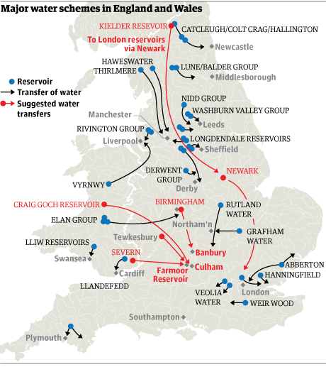

The Challenge of Resource Management
Geography Homework
Water Transfer in the UK
1
Fill in the blanks using these words: surplus, deficit, supply, demand, transfer, pipes
Water transfer involves the __________ of water from areas of __________ to areas of __________. Water is usually moved through a network of __________ to balance __________ and __________.
transfer
surplus
deficit
pipes
supply
demand
2
True or False – Why is water transfer needed?
True
False
Some areas of the UK have high rainfall but low population density.
Water deficits are most common in the north and west of the UK.
Water transfer is one method used to overcome water shortages.
The southeast of England experiences a water deficit.
3
UK Water Transfer Examples – Match each water source to the area it supplies.
Water source |  | Supplies water to:
Elan Valley reservoirs (Mid Wales) |  | Manchester
Thirlmere Reservoir (Lake District) |  | Newcastle
Kielder Reservoir (Northumberland) |  | Birmingham and the West Midlands
Water transfer in the UK

Slide 18
The Challenge of Resource Management
Geography Homework
Water Transfer in the UK
4
Advantages and disadvantages of water transfer
Advantages
Disadvantages
Helps areas affected by water scarcity avoid restrictions
Expensive to build dams, aqueducts and pipelines
Creates jobs during construction
Disrupts fish migration
Provides new recreational opportunities
Increases energy use and carbon emissions
5
Fill in the blanks using these words: environmental, cost, energy, habitats, climate change
Large-scale water transfer schemes have a high __________ and require large amounts of __________. Building dams can flood natural __________, damaging ecosystems. There may be _______________ impacts on river flow and wildlife downstream. ___________ ____________could make some schemes less effective if rainfall patterns change.
cost
energy
habitats
environmental
climate
change
6
True or false? Water transfer in the UK
True
False
Around 5% of water supplied in the UK is transferred from outside the immediate area.
A national water grid has already been built across the UK.
Water transfer schemes can lead to disagreements between regions.
www.internetgeography.net

Slide 19

The Challenge of Resource Management
Geography Homework
The UK’s Changing Energy mix
1
Fill in the blanks using these words: geological past, range, fossil fuels, sources, renewable, nuclear
The energy mix is the __________ of energy __________ used by a region or country, including __________ energy that is not diminished when it is used, __________ formed in the _______________ from the remains of living organisms, and __________ energy produced using uranium.
range
sources
renewable
fossil fuels
geological past
nuclear
2
True or False? Fossil fuels
True
False
Fossil fuels were historically the main source of electricity generation in the UK.
Coal remains a major source of electricity generation in the UK today.
Natural gas is still the largest fossil fuel used for electricity generation.
3
Match each energy source its characteristic.
Energy source |  | Characteristic
Coal |  | Renewable energy source that depends on sunlight
Gas |  | Fossil fuel that has been almost completely phased out in the UK
Nuclear |  | Low-carbon energy source using uranium
Wind |  | Renewable energy source with higher output in winter
Solar |  | Fossil fuel still widely used for electricity and heating
The UK’s changing energy mix

Slide 20
The Challenge of Resource Management
Geography Homework
The UK’s Changing Energy mix
4
Which statement best describes how the UK’s energy mix is changing?
A. The UK is becoming more
reliant on coal
C. Renewable energy is becoming more significant while reliance on fossil fuels is decreasing
B. Fossil fuels are increasing as renewable energy declines
D. The energy mix has remained the same since 1990
5
Fill in the blanks using these words: offshore, policy, emissions, climate change, technology
Concerns about _______________ have reduced reliance on fossil fuels. Advances in ____________ have improved renewable energy efficiency. Government __________ has encouraged investment in low-carbon energy. __________ wind farms have increased renewable electricity generation. Lower carbon __________ are a key advantage of renewable energy.
climate change
technology
policy
Offshore
emissions
6
True or false? Renewables in the UK
True
False
Renewable energy now makes up a larger share of the UK energy mix than in the past.
Renewable energy generation is completely unaffected by weather conditions.
The UK energy mix is becoming cleaner over time.
7
Sort each statement into Fossil Fuels (FF) or Renewable Energy (RE).
FF
RE
Produces carbon dioxide when burned.
Uses natural processes to generate energy.
Will eventually run out.
Has increased rapidly in the UK in recent decades.
Produces low-carbon energy.
www.internetgeography.net

Slide 21

The Challenge of Resource Management
Geography Homework
Economic & Environmental Issues of Energy Production
1
Fill in the blanks using these words: multiplier effect, radioactive waste, external costs, jobs, greenhouse gases
The _______________ refers to additional economic activity in an area created by a major employer such as an energy plant. Energy production from fossil fuels and renewables creates __________ in extraction, generation and support industries. Burning fossil fuels releases _________________, which contribute to climate change. Nuclear power produces _________________ which is difficult to dispose of safely. _______________ are indirect costs of energy production, such as health impacts from air pollution.
multiplier effect
jobs
greenhouse gases
radioactive waste
External costs
2
Identify whether the economic opportunities below relate to fossil fuels (FF), nuclear (N), or renewable energy production (R). You can select more than one!
FF
N
R
Jobs are created in supporting industries providing equipment. This brings jobs and money into the area and is known as the multiplier effect.
Creates a considerable number of jobs in research and development.
Creates a considerable number of jobs in manufacturing.
3
Identify whether the economic challenges below relate to fossil fuels (FF), nuclear (N), or renewable energy production (R).
FF
N
R
The remaining coal is mostly deep underground and expensive to extract. The environmental impact of extraction is expensive to clean.
The cost of construction is huge. Storing and disposing of nuclear waste is very expensive.
Set up costs are very expensive. Reduced profitability when the weather conditions are not right.
What are the economic and environmental issues of energy production?

Slide 22
The Challenge of Resource Management
Geography Homework
Economic & Environmental Issues of Energy Production
4
Identify whether the environmental opportunities below relate to fossil fuels (FF), nuclear (N), or renewable energy production (R). You can select more than one.
FF
N
R
They are generally considered stable which means they pose little risk to the environment when stored.
Carbon emissions are very low compared to coal and oil.
Cleaner than fossil fuels.
5
Identify whether the environmental challenges below relate to fossil fuels (FF), nuclear (N), or renewable energy production (R).
FF
N
R
Waste must be stored safely for between 1,000 and 10,000 years to avoid contamination. The release of radiation in an accident can have a devastating environmental impacts.
Remote, formally untouched environments can be impacted by construction. Migrating bird patters can be affected.
The use of this energy source contributes to the enhanced greenhouse effect, leading to climate change.
6
True or False? Renewable energy issues
True
False
Renewable energy always has zero environmental impact.
Wind turbines can affect bird populations and local landscapes.
Renewable energy sources do not provide any economic benefits.
7
Which statement best summarises the economic and environmental issues linked to the exploitation of energy sources?
A. Energy exploitation only causes environmental damage and provides few economic benefits.
C. Energy exploitation creates economic benefits such as jobs but can also cause environmental damage
B. Renewable energy has no environmental impacts and no economic benefits.
D. Fossil fuels are environmentally sustainable and cheap to exploit everywhere.
www.internetgeography.net

