Slide 1

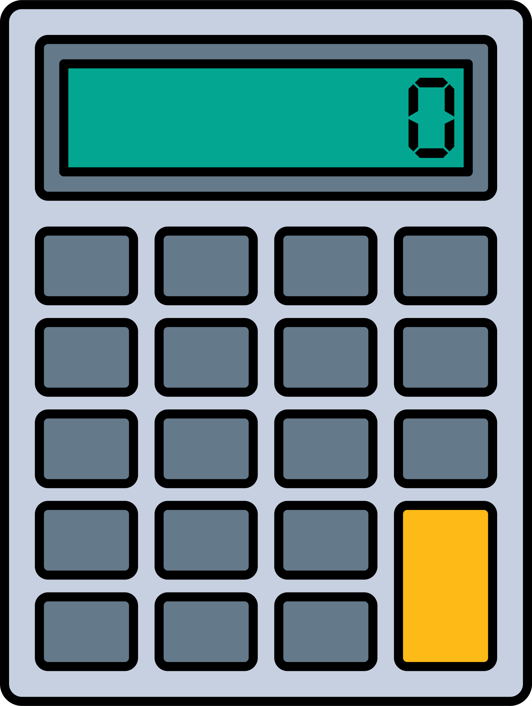


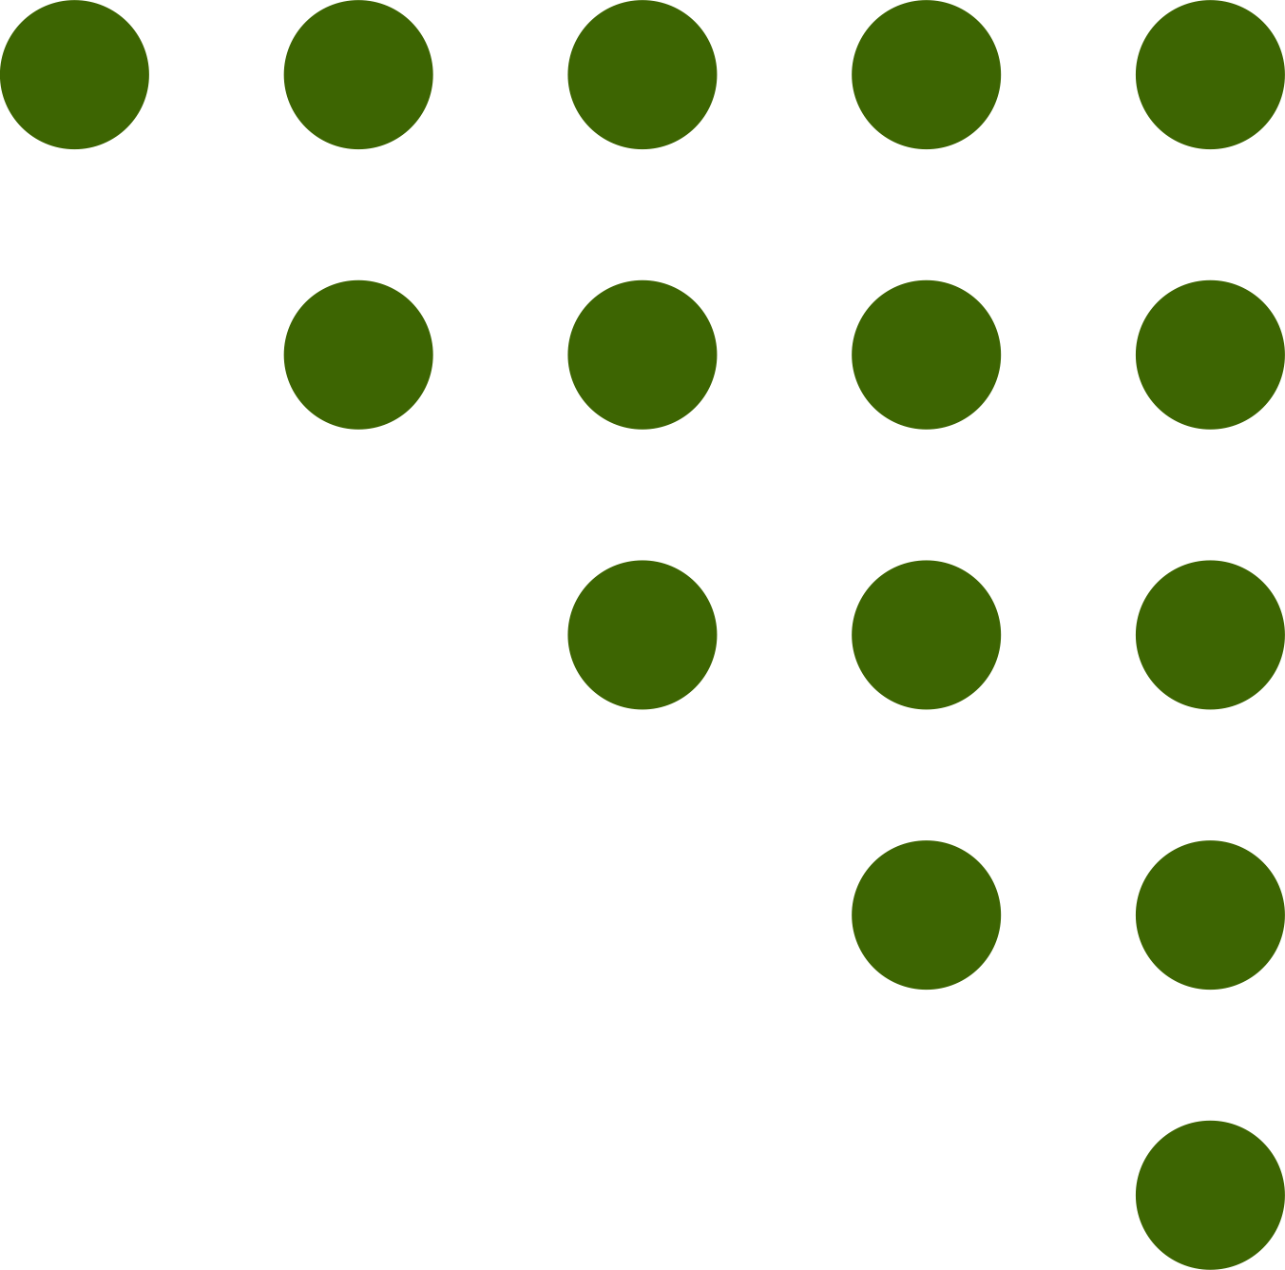
SKILLS
FOCUS
Statistical Skills
percentages
mean
range
median
percentage change
interquartile range
mode and modal class

Slide 2

SKILLS FOCUS
Median
Question 1 – The Challenge of Natural Hazards
Mark scheme
1 mark for ordering the data correctly (or clear evidence of correct ordering)
1 mark for the correct median value – if students have not shown working and the answer is correct 2 marks can be awarded (as AQA exam advice)
Worked answer
Deaths (ordered):
1 629, 1 833, 2 782, 3 859, 4 234, 5 960, 6 200, 11 400, 14 200, 15 000, 138 366, 138 866, 171 000, 300 000
There are 14 values, so the median is the mean of the 7th and 8th values:
(6 200 + 11 400) ÷ 2 = 8800
(6200+11400)÷2=8800
Median = 8 800 deaths
Question 2 – The Living World
Mark scheme
1 mark for the correct median value
Worked answer
Ordered values:
6, 9, 12, 18, 34, 41, 52
Middle value = 18
Median = 18 species
Question 3 – River Landscapes in the UK
Mark scheme
1 mark for the correct median value
Worked answer
Channel widths (ordered):
18, 20, 21, 22, 24, 25, 28
There are 7 values, so the median is the middle (4th) value:
Median = 22 m

Slide 3
SKILLS FOCUS
Median
Question 4 – Coastal Landscapes in the UK
Mark scheme
1 mark for ordering the data correctly (or clear evidence of correct ordering)
1 mark for the correct median value
If students have not shown working and the answer is correct, 2 marks can be awarded (as per AQA exam advice).
Worked answer
Cliff heights (ordered):
19, 22, 24, 28, 31, 37, 42, 55
There are 8 values, so the median is the mean of the 4th and 5th values:
(28 + 31) ÷ 2 = 29.5
Median = 29.5 m
Question 5 – Glacial Landscapes in the UK
Mark scheme
1 mark for ordering the data correctly (or clear evidence of correct ordering)
1 mark for the correct median value
If students have not shown working and the answer is correct, 2 marks can be awarded (as per AQA exam advice).
Worked answer
Tarn altitudes (ordered):
480, 480, 488, 500, 538, 538, 600, 718
There are 8 values, so the median is the mean of the 4th and 5th values:
(500 + 538) ÷ 2 = 519
Median = 519 m

Slide 4
SKILLS FOCUS
Median
Question 6 – Urban Issues and Challenges
Mark scheme
1 mark for ordering the data correctly (or clear evidence of correct ordering)
1 mark for the correct median value
If students have not shown working and the answer is correct, 2 marks can be awarded (as per AQA exam advice).
Worked answer
Life expectancy values (ordered):
78.9, 79.1, 79.4, 79.8, 80.2, 80.5, 81.6
There are 7 values, so the median is the middle (4th) value:
Median = 79.8 years
Question 7 – The Changing Economic World
Mark scheme
1 mark for ordering the data correctly (or clear evidence of correct ordering)
1 mark for the correct median value
If students have not shown working and the answer is correct, 2 marks can be awarded (as per AQA exam advice).
Worked answer
Manufacturing employment (millions) (ordered):
5, 6, 8, 8, 9, 11, 14, 18
There are 8 values, so the median is the mean of the 4th and 5th values:
(8+9) ÷ 2 = 8.5
Median = 8.5 million

Slide 5
SKILLS FOCUS
Median
Question 8 – The Changing Economic World
Mark scheme
1 mark for ordering the data correctly (or clear evidence of correct ordering)
1 mark for the correct median value
If students have not shown working and the answer is correct, 2 marks can be awarded (as per AQA exam advice).
Worked answer
Birth rates (ordered):
7, 7, 9, 13, 14, 17, 37, 45
There are 8 values, so the median is the mean of the 4th and 5th values:
(13 + 14) ÷ 2 = 13.5
Median = 13.5 births per 1 000 people
Question 9 – The Challenge of Resource Management
Mark scheme
1 mark for ordering the data correctly (or clear evidence of correct ordering)
1 mark for the correct median value
If students have not shown working and the answer is correct, 2 marks can be awarded (as per AQA exam advice).
Worked answer
CO₂ per person values (ordered):
5.6, 6.2, 6.8, 7.0, 7.1, 7.5, 8.9
There are 7 values, so the median is the middle (4th) value:
Median = 7.0 tonnes per person

Slide 6





ONLINE
SUPPORT
Free-to-access resources for you
Statistical Skills
Graphical Skills
Online guides to support you in a range of statistical skills including mean, median, mode, range, interquartile range, calculating percentages, and percentage change.
Which data presentation technique should you use and why? Find out about bar charts, pie charts, population pyramids, line graphs, choropleth maps, and more.
OS Maps
Field sketches
A guide to interpreting OS maps including scale, compass directions, four and six figure grid references, and height on a map.
Struggling with field sketches? Take a look at our step-by-step to creating an effective field sketch.
Grid References
Interactive Revision
Need support in using four and six figure grid references? Our guide takes you through the steps involved in interpreting maps using grid references.
Check your knowledge and understanding using our online quizzes. These self-marking quizzes are ideal to support your revision journey.

