Slide 1
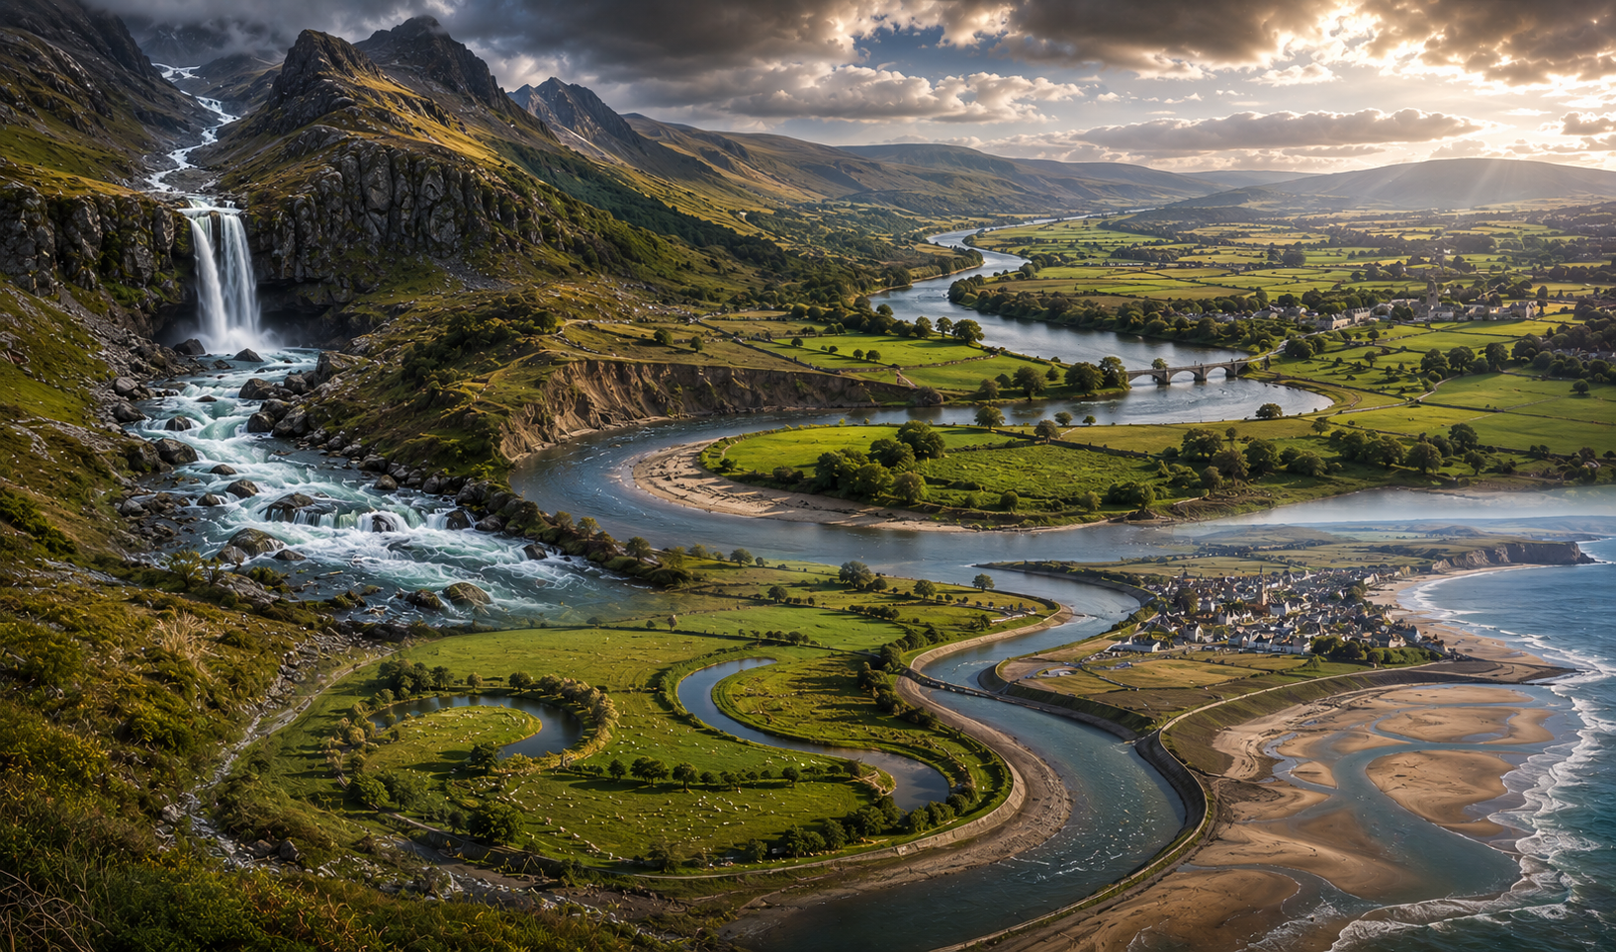

Coastal Landscapes in the UK
AQA GCSE Geography
Revision and Practice Book
Mark Scheme
Coming soon!
Revision Notes
Retrieval
Practice
Case
Studies
Exam-style
Questions
internetgeography.net
Designed for GCSE Success

