Slide 1
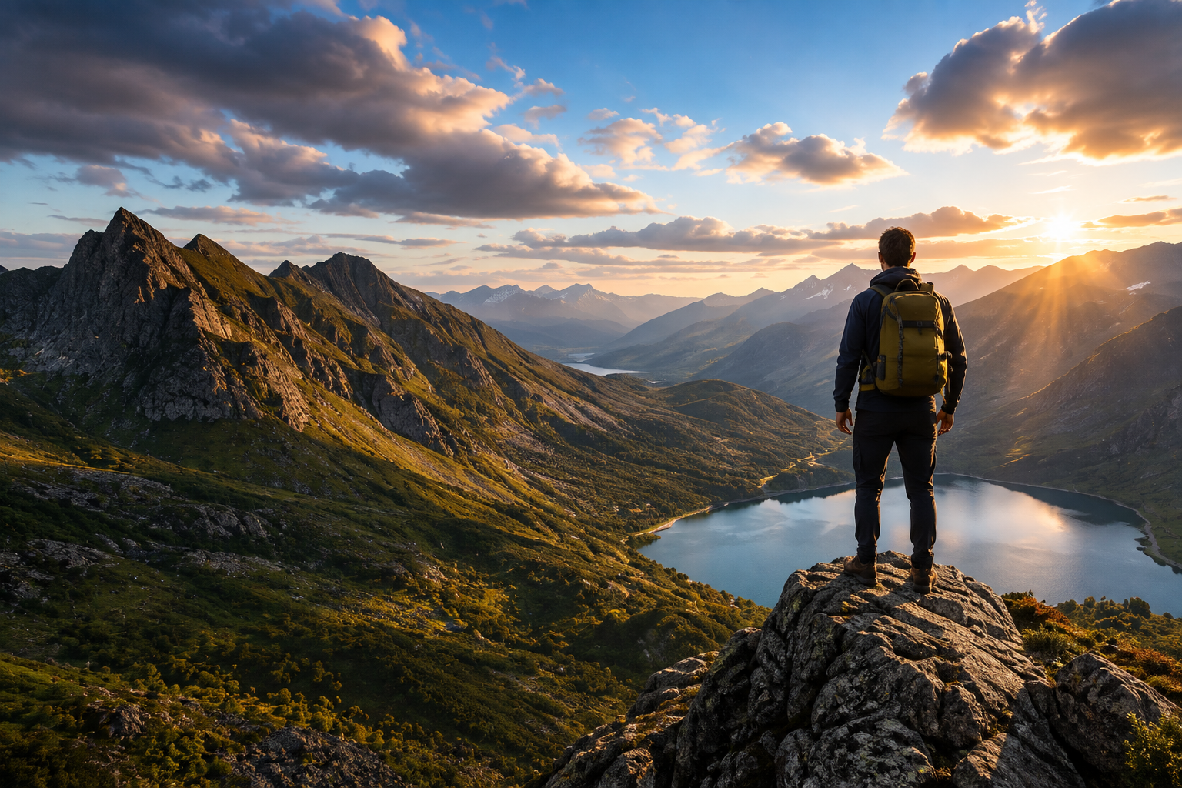

Welcome to
GCSE Geography

Slide 2
AQA GCSE Geography The Big Picture
PAPER 1
Living with the Physical Environment
PAPER 2
Challenges in the Human Environment
PAPER 3
Geographical Applications
The Challenge of Natural Hazards
The Living World
Physical Landscapes in the UK (coasts, rivers, and glaciation)
Urban Issues and Challenges
The Changing Economic World
The Challenge of Resource Management (water, energy, food)
Issue Evaluation (pre-release)
Unfamiliar Fieldwork
Familiar Fieldwork
35%
35%
30%

Slide 3
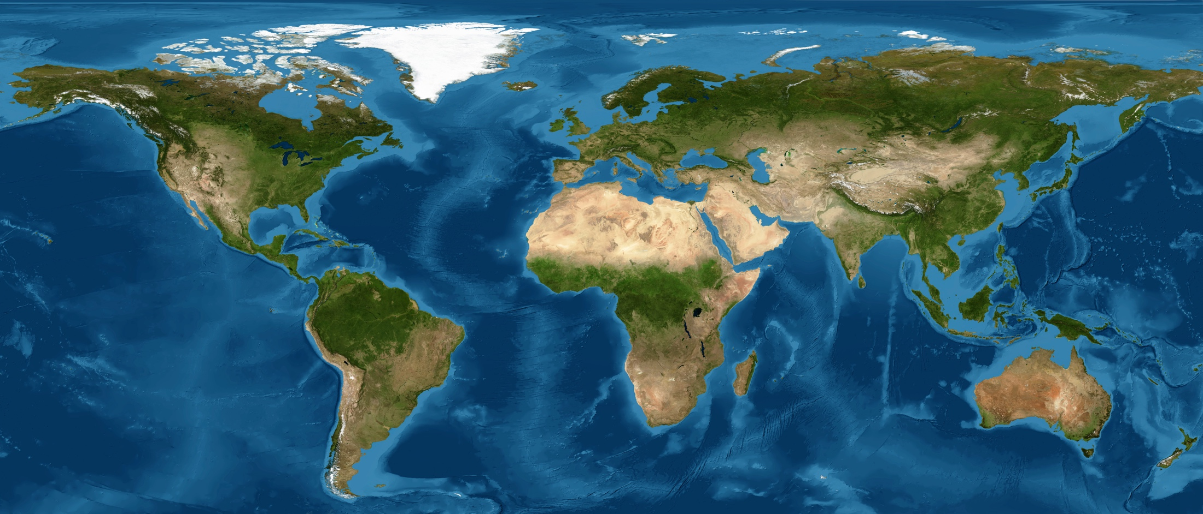
A Summer of Geography in the News
Lagos, Nigeria
UK
Sunderland
Nepal
Makoko demolitions
Heatwave & drought
Nissan
Glacial collapse
Amazon Rainforest
Holderness
Indonesia
Falling deforestation rates
Erosion
Earthquake
Notes:
The stories:
Lagos – Makoko demolitions
Homes and other buildings have been demolished in Makoko, a large informal waterfront settlement in Lagos. Authorities have raised concerns about safety and living conditions, while residents argue that demolitions have destroyed homes and livelihoods. Plans have been proposed to relocate residents to new low-cost housing in Agbowa, but some residents do not want to leave the community where their families have lived and worked for generations. The controversy highlights the challenges of managing housing, inequality and rapid urban growth in Lagos.
https://www.icirnigeria.org/were-not-leaving-inside-lagos-controversial-makoko-relocation-plan/
UK – heatwaves and drought
The UK experienced an exceptionally hot and dry summer in 2026, with four major heatwaves contributing to rapidly worsening drought conditions. Temperatures reached 38.1°C at Kew Gardens on 13 August, while July was the driest on record for England. By mid-August, around 71% of England was in drought, with low river flows, falling reservoir levels, water-use restrictions, reduced crop yields and increased wildfire risk. The combination of very low rainfall and high temperatures resulted in rapidly developing drought conditions across much of England.
https://www.gov.uk/government/news/more-areas-in-england-declared-in-drought-after-record-dry-july
Sunderland – Nissan and the changing UK economy
Nissan is considering producing vehicles for Chinese manufacturer Chery at its Sunderland factory, demonstrating how globalisation is changing UK manufacturing. If the agreement goes ahead, production could begin in 2027 and help secure jobs at a factory employing around 6,000 workers. The plant already produces electric vehicles but is operating below its maximum capacity, highlighting the challenges facing Britain's changing car industry as it responds to international competition, new technology and the transition towards electric vehicles.
https://www.theguardian.com/business/2026/jun/03/nissan-chery-car-building-deal-sunderland-factory
Nepal – catastrophic Himalayan glacier collapse
A deadly flash flood struck Nepal close to the border with Tibet on 26 August 2026. Satellite evidence suggested that part of a glacier may have broken away and fallen hundreds of metres onto the valley floor, releasing a destructive surge of water, ice, rock and debris downstream. Settlements, roads, bridges and other infrastructure were damaged. The disaster demonstrates how changes within high-mountain environments can create serious hazards for communities living many kilometres downstream.
https://www.internazionale.it/ultime-notizie-reuters/2026/08/26/glacier-collapse-may-have-triggered-deadly-nepal-flash-flood-experts-say
Amazon rainforest – deforestation falls
Deforestation in the Brazilian Amazon fell to its lowest level for ten years during the first half of 2026. Around 1,295 km² of forest was lost between January and June, 38% less than during the same period in 2025. The decline suggests that government action can reduce forest clearance, although illegal mining, fires and drought continue to threaten the rainforest and its biodiversity.
https://news.mongabay.com/short-article/2026/07/amazon-deforestation-falls-to-10-year-low-in-first-half-of-2026/
Holderness Coast – new homes for people threatened by coastal erosion
A new £3.1 million affordable housing development near Skipsea is being built for people who have lost, or are at risk of losing, their homes to coastal erosion. Nine new homes are being constructed around one mile inland, with affected residents given priority. Parts of the East Yorkshire coastline are retreating by up to 4.5 metres per year, so the scheme demonstrates an alternative to attempting to defend every threatened property from the sea.
https://www.eastriding.gov.uk/news/article/?entry=affordable_housing_project_underway_for_east_riding_residents_affected_by_coastal_erosion
Indonesia – magnitude 7.7 earthquake
A powerful magnitude 7.7 earthquake struck the Flores region of eastern Indonesia on 15 August 2026. The shallow earthquake caused deaths, damaged homes and displaced thousands of people. Landslides blocked roads and made it difficult for rescuers to reach some affected communities. The disaster demonstrates the significant tectonic risks faced by people living along Indonesia's active plate boundaries.
https://www.aljazeera.com/news/2026/8/16/indonesias-magnitude-7-7-quake-kills-at-least-51-displaces-thousands

Slide 4
Match the stories to the AQA GCSE Geography unit
Lagos: Makoko demolition
The Challenge of Natural Hazards
UK: Heatwave and drought
The Living World
Sunderland: Nissan car factory
Physical Landscapes in the UK
Nepal: Glacial collapse
Urban Issues and Challenges
Amazon rainforest: Falling deforestation
The Changing Economic World
Indonesia: Earthquake
The Challenge of Resource Management
Holderness: Erosion

Slide 5
 | The Challenge of Natural Hazards | The Living World | Physical Landscapes in the UK | Urban Issues and Challenges | The Changing Economic World | The Challenge of Resource Management
Lagos: Makoko demolition
UK: Heatwave and drought
Sunderland: Nissan car factory
Nepal: Glacial collapse
Amazon rainforest: Falling deforestation
Indonesia: Earthquake
Holderness: Erosion

Slide 6

Everything is connected…
Cocoa grows in hot, wet climates (Living World)
Processed and made in factories (Changing Economic World)
Grown and harvested by people, often in LICs (Changing Economic World)
Increased urbanisation as people move from rural to urban areas to work in factories (Urban)
Living standards improve e.g. through fair trade, increased tax supports development
Needs land, water, and labour (The Challenge of Resource Management)
Geography explores how people and places are connected

Slide 7
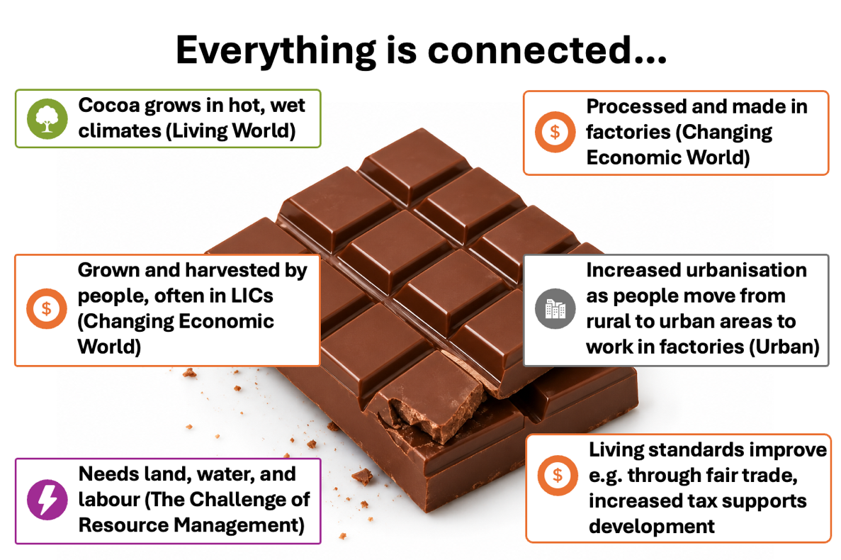
V1
Synoptic links
Challenge
In pairs, choose one Geography in the News event (can be one we’ve explored here or something else you have studied). Identify as many links to the AQA GCSE Geography units we will study as you can.
Geography explores how people and places are connected

Slide 8
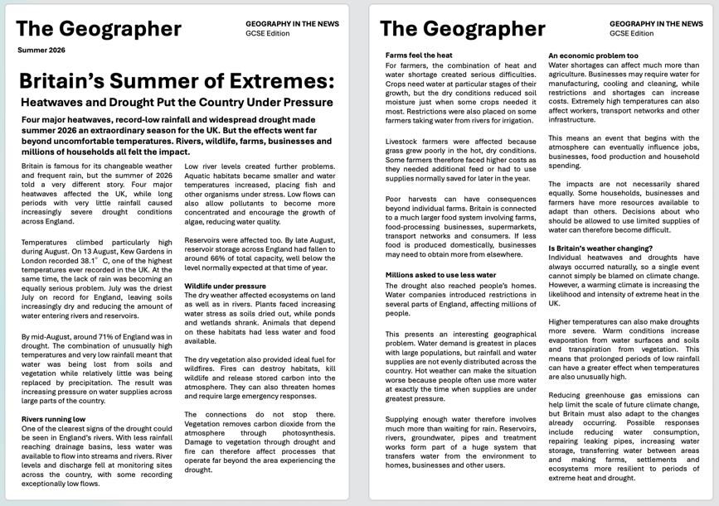
V2
Synoptic links
Challenge
In pairs, read the Geography in the News article you have been given. Identify as many links to the AQA GCSE Geography units we will study as you can.
Geography explores how people and places are connected
Notes:
PowerPoint teacher notes – Synoptic Links activity
Purpose of the activity
This activity introduces students to synoptic thinking – recognising that geographical events do not fit neatly into individual topics. Students use the Britain’s Summer of Extremes article to identify connections between the heatwaves and drought and the different areas of the AQA GCSE Geography course.
Before students begin the challenge – literacy and comprehension
Allow students time to read and understand the article before asking them to make connections. Possible approaches include:
First read – gist: Students read the article independently. Ask: What is this article mainly about? They should be able to summarise it in one or two sentences.
Second read – annotate: Ask students to underline or highlight information about causes, effects and responses using different colours or symbols.
Identify unfamiliar vocabulary: Students circle geographical or unfamiliar terms. Useful terms to check include heatwave, drought, precipitation, discharge, drainage basin, reservoir, aquatic habitat, irrigation, groundwater, evaporation, transpiration, infrastructure, adaptation and greenhouse gas emissions.
Check understanding: Rather than simply giving definitions, ask pairs to explain selected terms to one another in their own words. Encourage them to use the context of the article to help work out meanings.
Find the evidence: Give students several quick retrieval prompts before moving to the synoptic task, e.g. How hot did it get? What percentage of England was in drought? How were rivers affected? How were farmers affected? How were people affected?
Completing the synoptic activity
In pairs, students identify as many connections as possible between the article and the AQA GCSE Geography units shown earlier in the lesson.
Encourage students to go beyond simply naming a unit. Each connection should include evidence or an explanation:
Article evidence → geographical connection → explanation
For example, rather than writing “Living World – wildlife”, expect something closer to “Low river levels reduced aquatic habitats and placed fish under stress, showing how changes in water availability can affect ecosystems.”
Students could record their ideas as a spider diagram around UK Heatwaves and Drought, using a different branch for each area of the course.
Support: Give students the six unit titles from the earlier slide and ask them to find at least one connection to each. Alternatively, allocate different sections of the article to pairs before bringing their ideas together.
Challenge: Ask students to identify connections between their connections. For example, how could low rainfall affect rivers, which then affects ecosystems, farming, food production and ultimately people? Which consequences are social, economic and environmental?
Discussion / reveal
Take feedback one unit at a time. Ask students to justify each suggestion with evidence from the article. Some links will be stronger than others – this is useful discussion rather than something to avoid.
Finish by returning to the chocolate example and the statement:
“Geography explores how people and places are connected.”
Emphasise that the specification divides Geography into units to make it manageable to study, but real geographical events cross those boundaries. This ability to draw together knowledge from different parts of the course is what we mean by synoptic thinking.

Slide 9
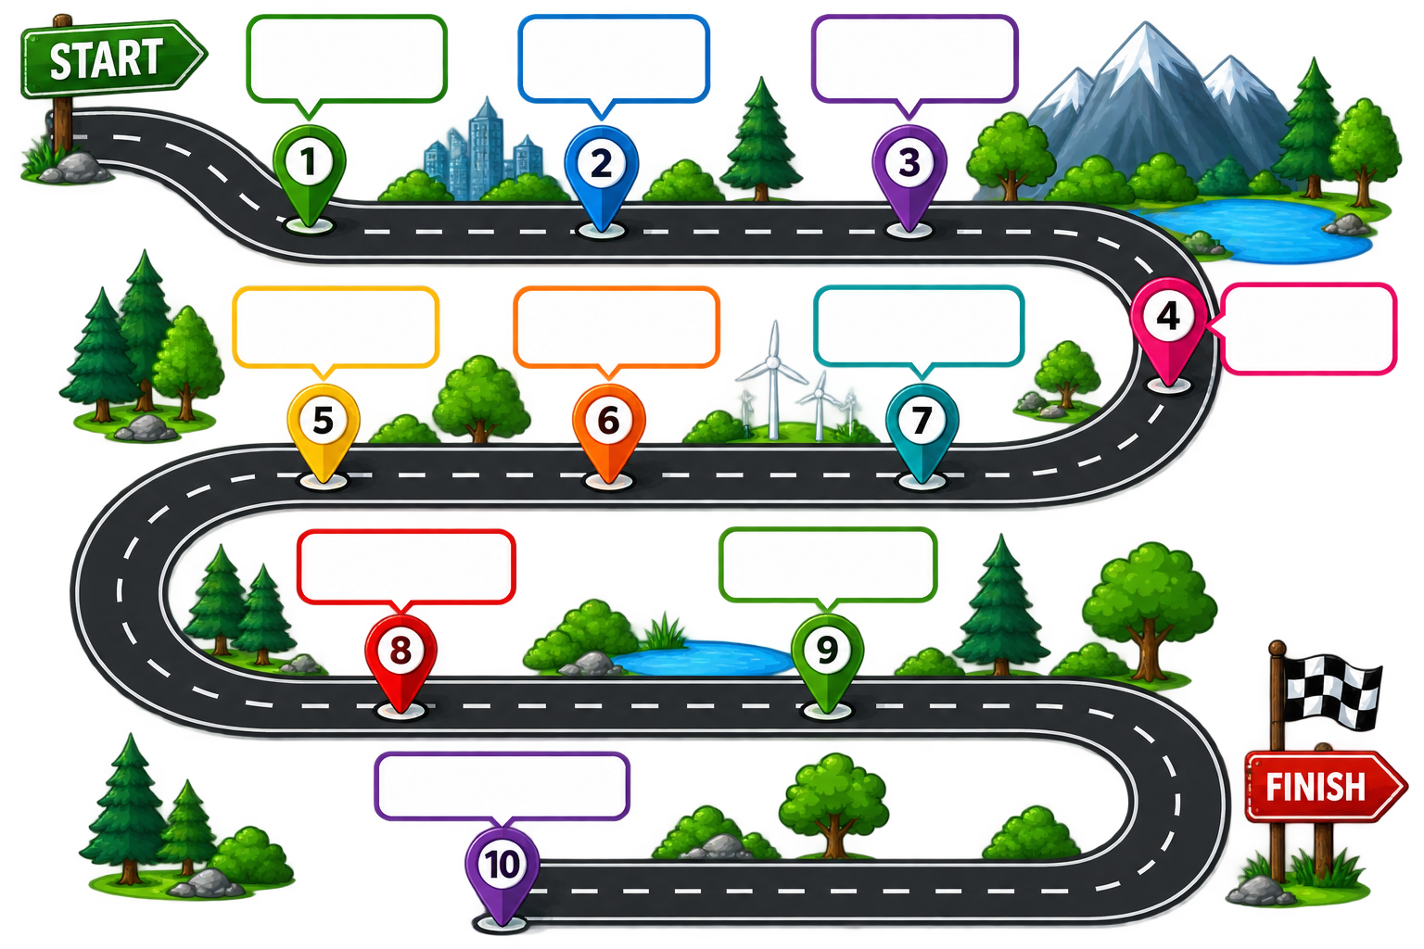
Our Journey
The Challenge of Natural Hazards
The Living
World
Coastal Landscapes
Resource Management
The Changing Economic World
Urban Issues and Challenges
River
Landscapes
Physical Fieldwork
Human
Fieldwork
Issue
Evaluation

Slide 10
What skills will you develop?
Data analysis
Research skills
Interpreting maps, graphs and statistics to draw conclusions.
Collecting real data in the field and using it to answer questions.
These skills will help you succeed in Geography and in many other areas of life.
Problem solving
Map skills
Applying your knowledge to unfamiliar situations and real-world issues.
Reading, interpreting and creating maps at different scales.
Critical thinking
Communication
Evaluating evidence, considering different viewpoints and making judgements.
Explaining your ideas clearly using accurate geographical vocabulary.

Slide 11
Exit Reflection
What have you discovered about GCSE Geography that you didn't know at the start of the lesson?
What will we study?
How are the topics connected?
Why might Geography help us make sense of the world and shape the future?

