Slide 1
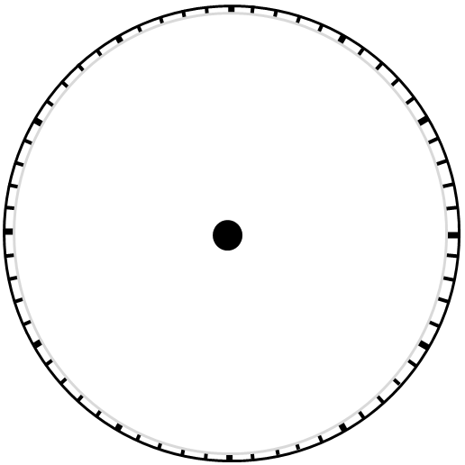
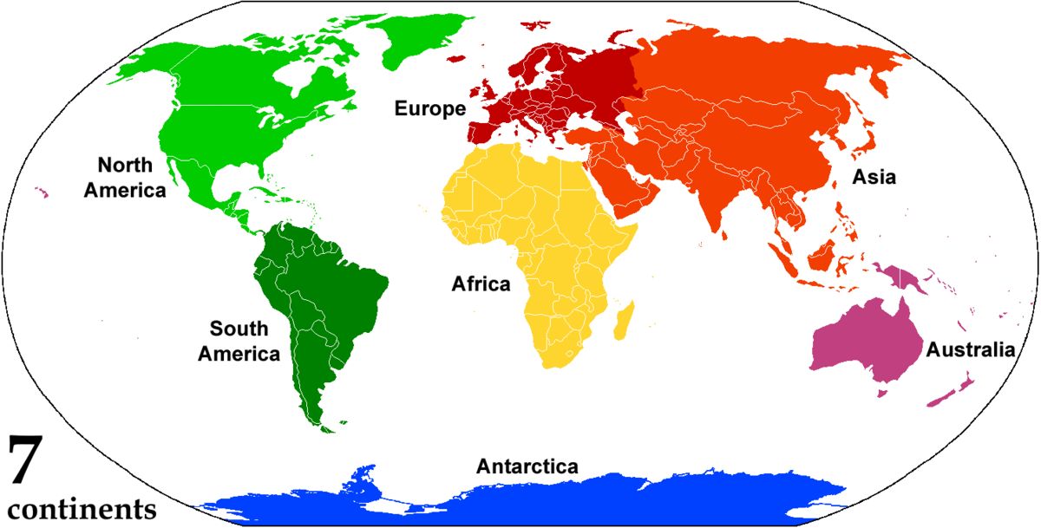
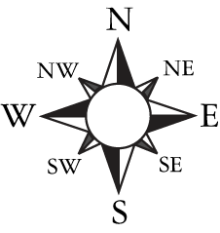
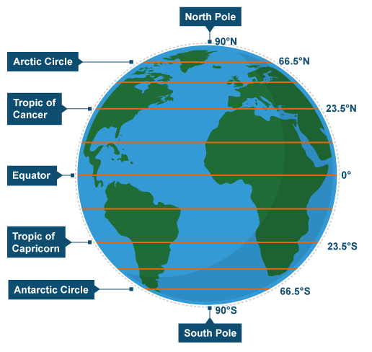
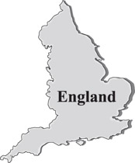
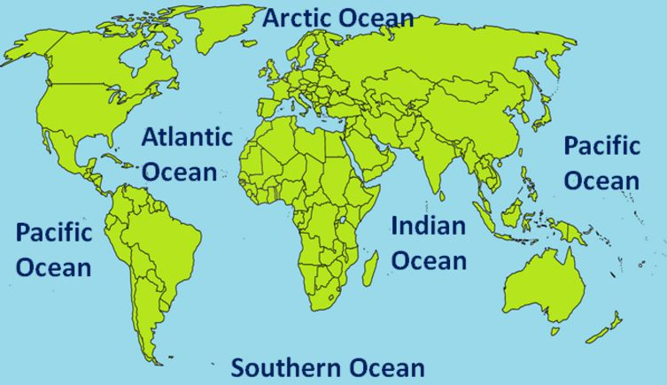
C.L.O.C.C your
description
Continent
Compass Rose
Lines of latitude
Country
Oceans & Seas

Slide 2
Describe the distribution of polar regions. (3 marks)
Continent
Antarctica, North America, Europe, Asia
Compass Rose
Lines of latitude
Northern Canada, South of the Antarctic Circle, North of the Arctic Circle
Arctic Circle, Antarctic Circle, extreme northern latitudes
Country
Oceans & Seas
Canada, Russia, Greenland
Southern Ocean, Arctic Ocean

Slide 3
Thought stems to improve your writing
Sentence starter: Polar regions are located…
Include compass rose points throughout instead of saying next to/under etc.
You could start be mentioning continents and countries found within polar regions.
Describe the distribution of polar regions (3 marks).
Assume that you are giving the reader directions to find the location on a map! Be specific.
Include compass rose points instead of saying next to/under etc.

Slide 4
C.L.O.C.C your description
Continent
Lines of latitude
Oceans/seas
Country
Compass Rose

