Slide 1
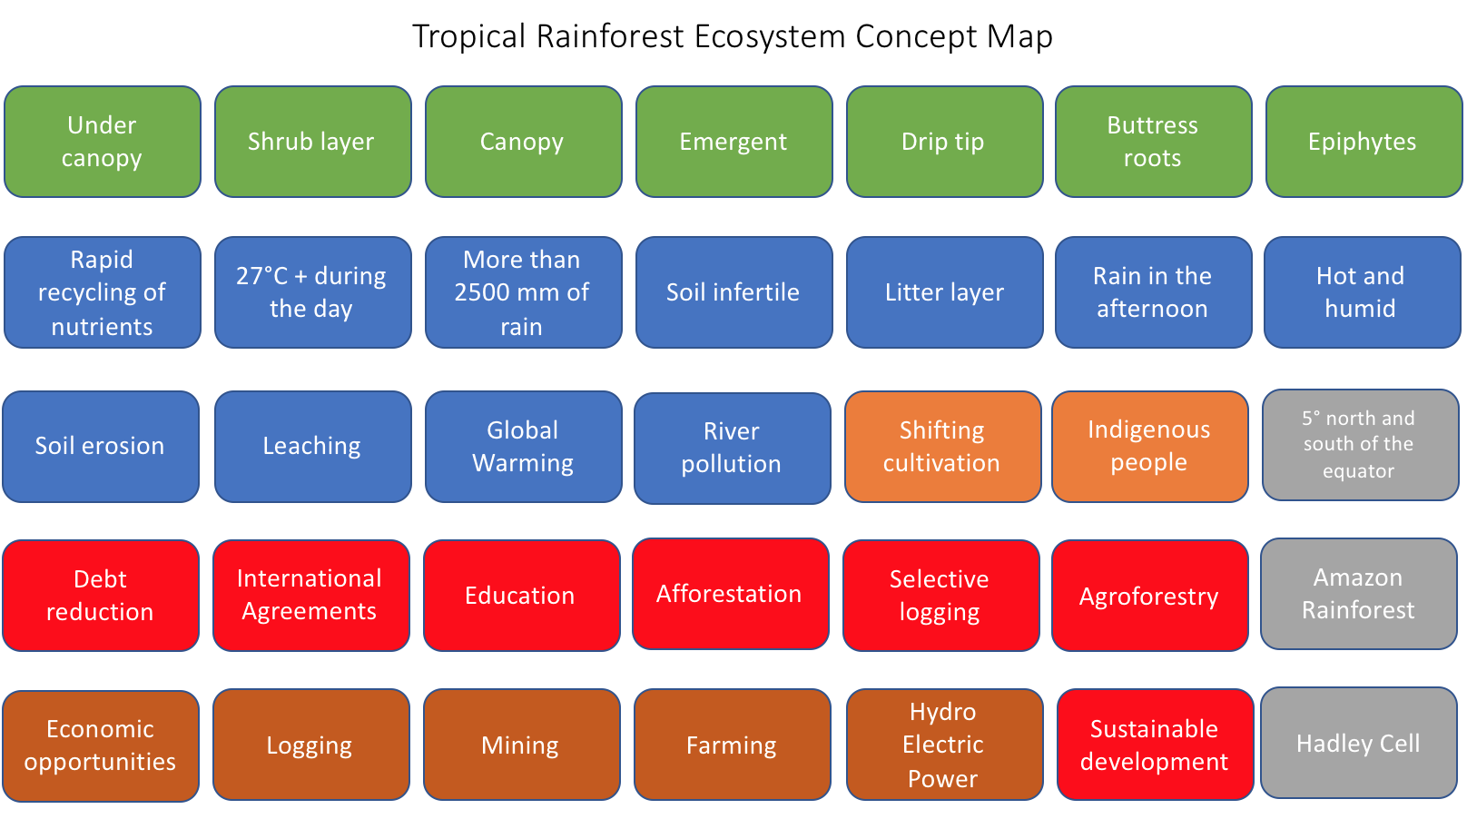
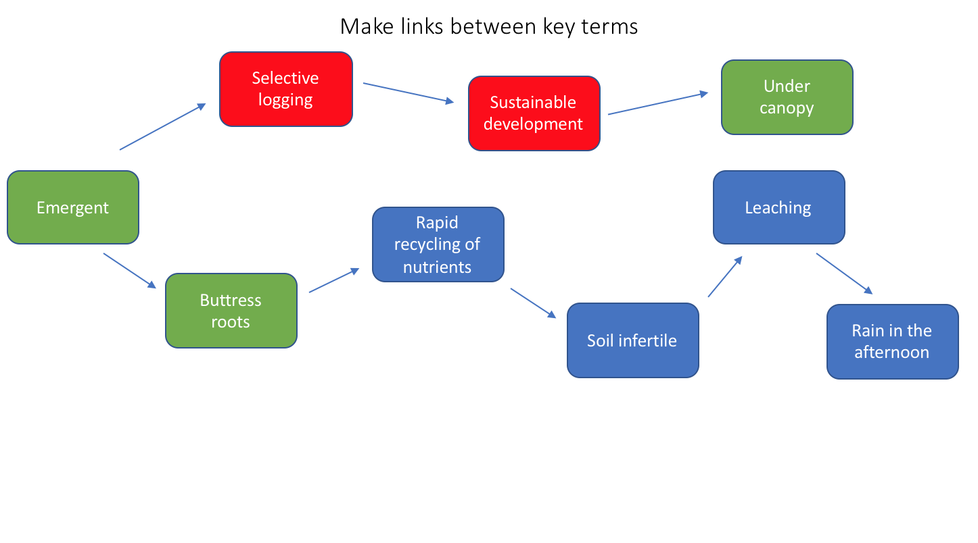
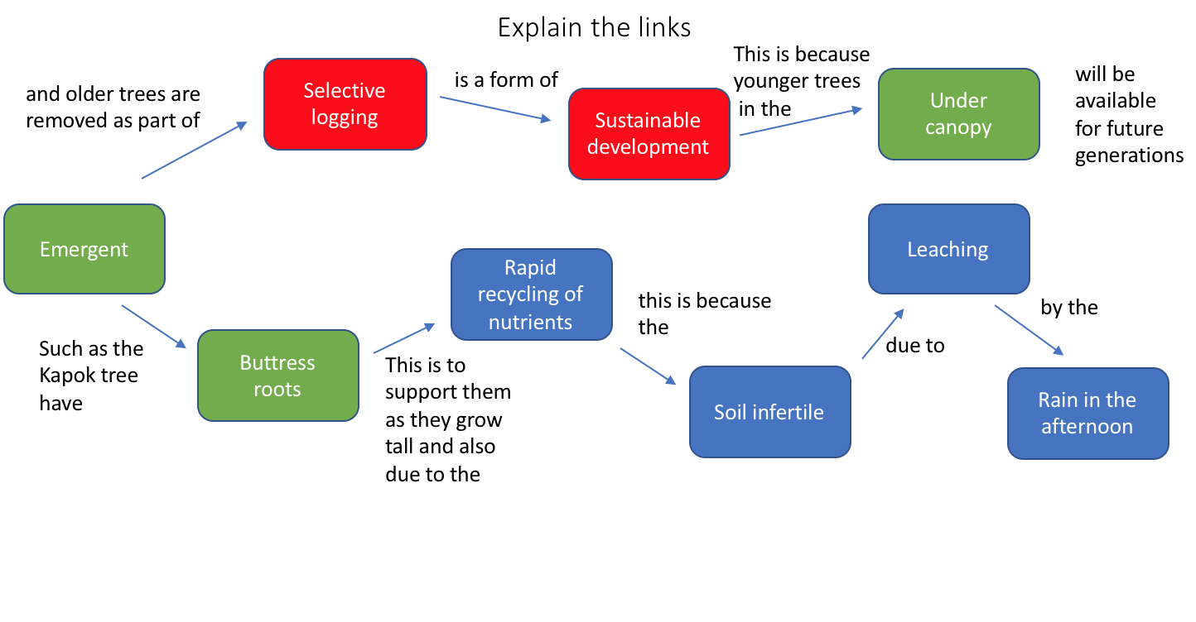
1.
2.
3.

Slide 2
Tropical Rainforest Ecosystem Concept Map
Under canopy
Shrub layer
Canopy
Emergent
Drip tip
Buttress roots
Epiphytes
Rapid recycling of nutrients
27°C + during the day
More than 2500 mm of rain
Soil infertile
Litter layer
Rain in the afternoon
Hot and humid
Soil erosion
Leaching
Global Warming
River pollution
Shifting cultivation
Indigenous people
5° north and south of the equator
Debt reduction
International Agreements
Education
Afforestation
Selective logging
Agroforestry
Amazon Rainforest
Economic opportunities
Logging
Mining
Farming
Hydro Electric Power
Sustainable development
Hadley Cell

Slide 3
Make links between key terms
Selective logging
Under canopy
Sustainable development
Emergent
Leaching
Rapid recycling of nutrients
Buttress roots
Soil infertile
Rain in the afternoon

Slide 4
Explain the links
This is because
younger trees
in the
Selective logging
is a form of
will be available
for future generations
and older trees are removed as part of
Under canopy
Sustainable development
Emergent
Leaching
Rapid recycling of nutrients
this is because the
by the
Such as the Kapok tree have
Buttress roots
due to
This is to support them as they grow tall and also due to the
Soil infertile
Rain in the afternoon

