Slide 1
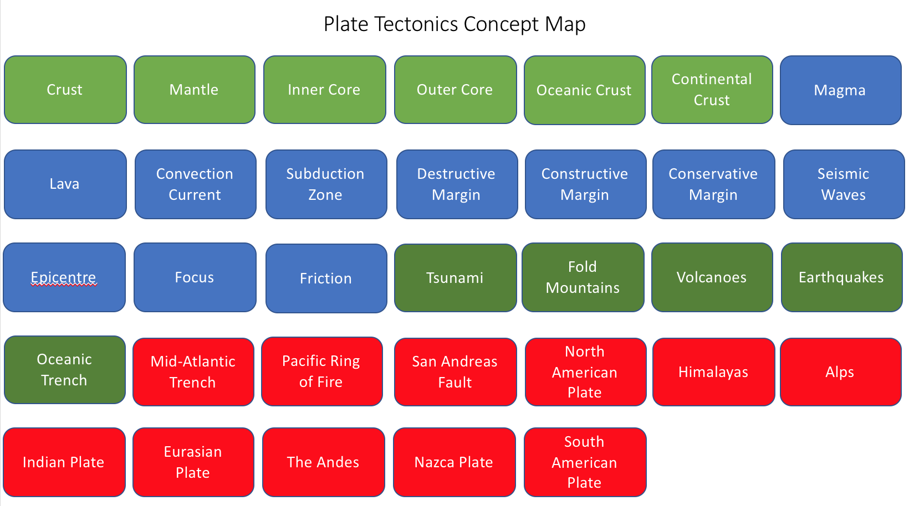
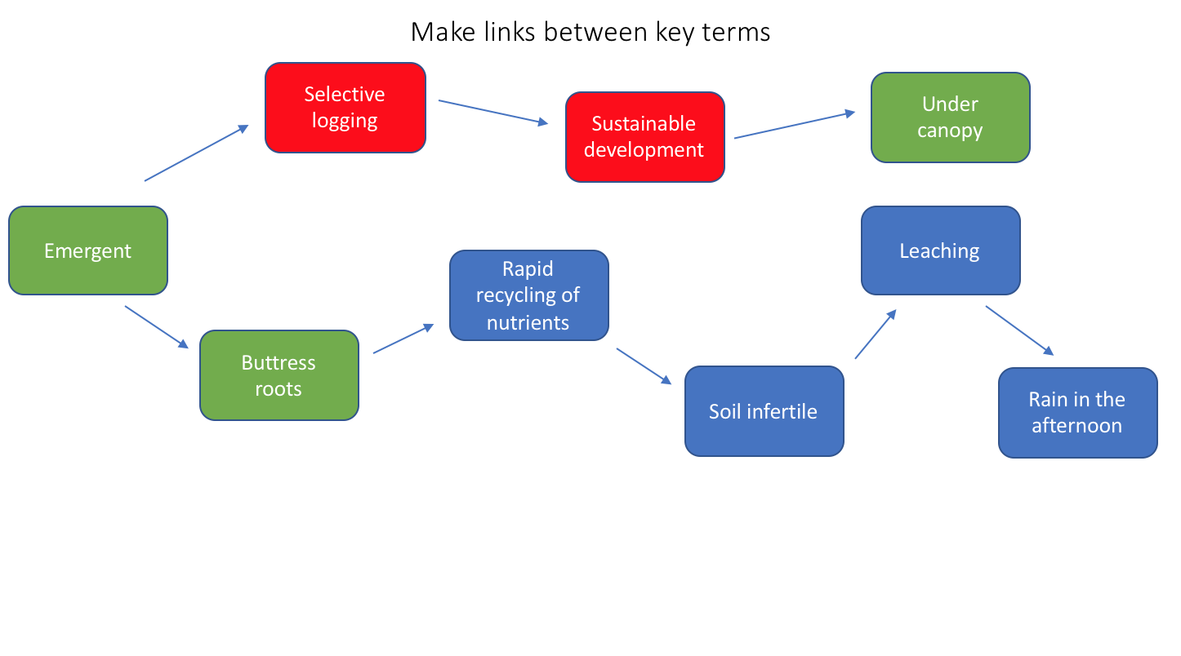
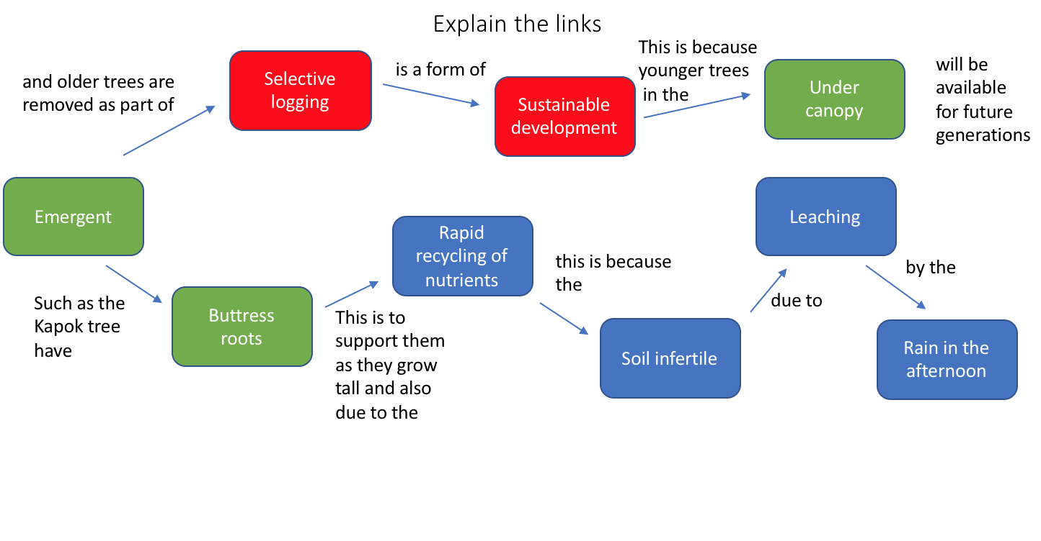
1.
2.
3.

Slide 2
Plate Tectonics Concept Map
Crust
Mantle
Inner Core
Outer Core
Oceanic Crust
Continental Crust
Magma
Lava
Convection Current
Subduction Zone
Destructive Margin
Constructive Margin
Conservative Margin
Seismic Waves
Epicentre
Focus
Friction
Tsunami
Fold Mountains
Volcanoes
Earthquakes
Oceanic Trench
Mid-Atlantic Trench
Pacific Ring of Fire
San Andreas Fault
North American Plate
Himalayas
Alps
Indian Plate
Eurasian Plate
The Andes
Nazca Plate
South American Plate

