Slide 1
Coastal Processes & Management Concept Map
groynes
gabions
Rock armour
Off shore reefs
Beach nourishment
Sea wall
Old Harry
bay
cove
beaches
spits
headland
geology
Sedimentary rock
concordant
discordant
Managed retreat
Hold the line
Retreat the line
Advance the line
3
undercutting
Long shore drift
swash
backwash
deposition
erosion
transportation
weathering
4
Human activity
Climate change
Sea level rise
Soft engineering
Hard engineering

Slide 2
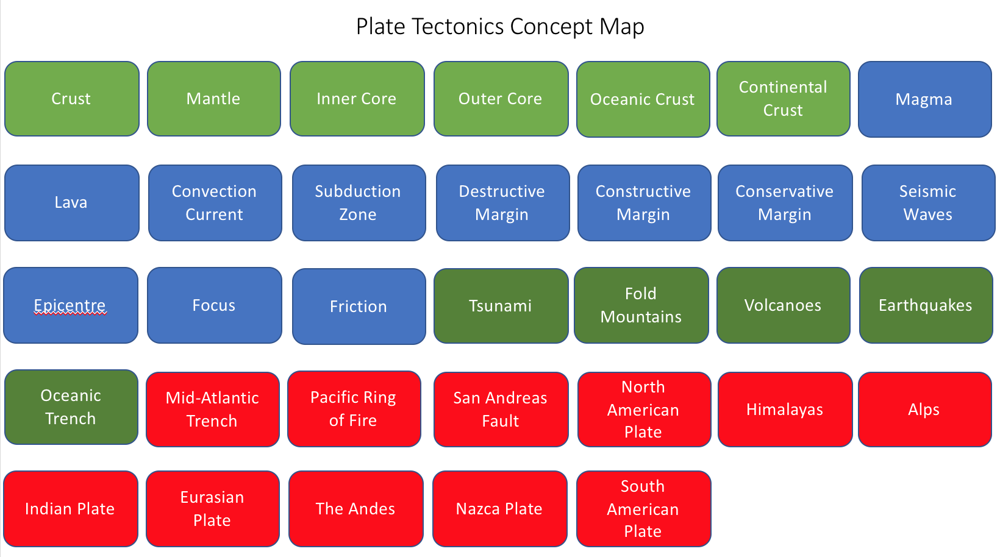
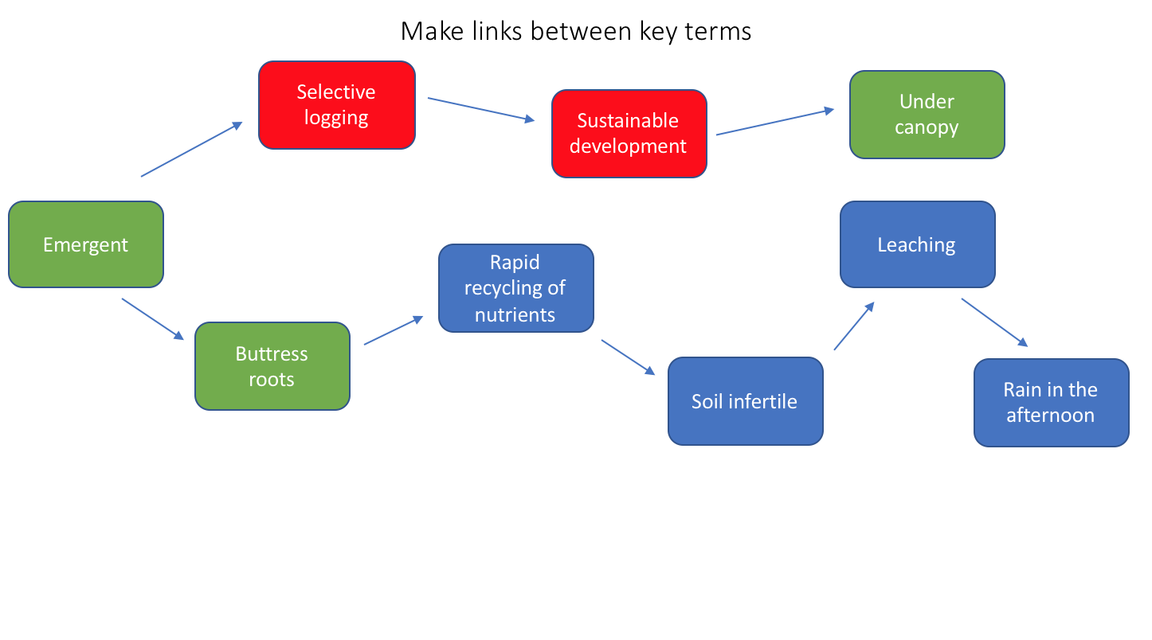
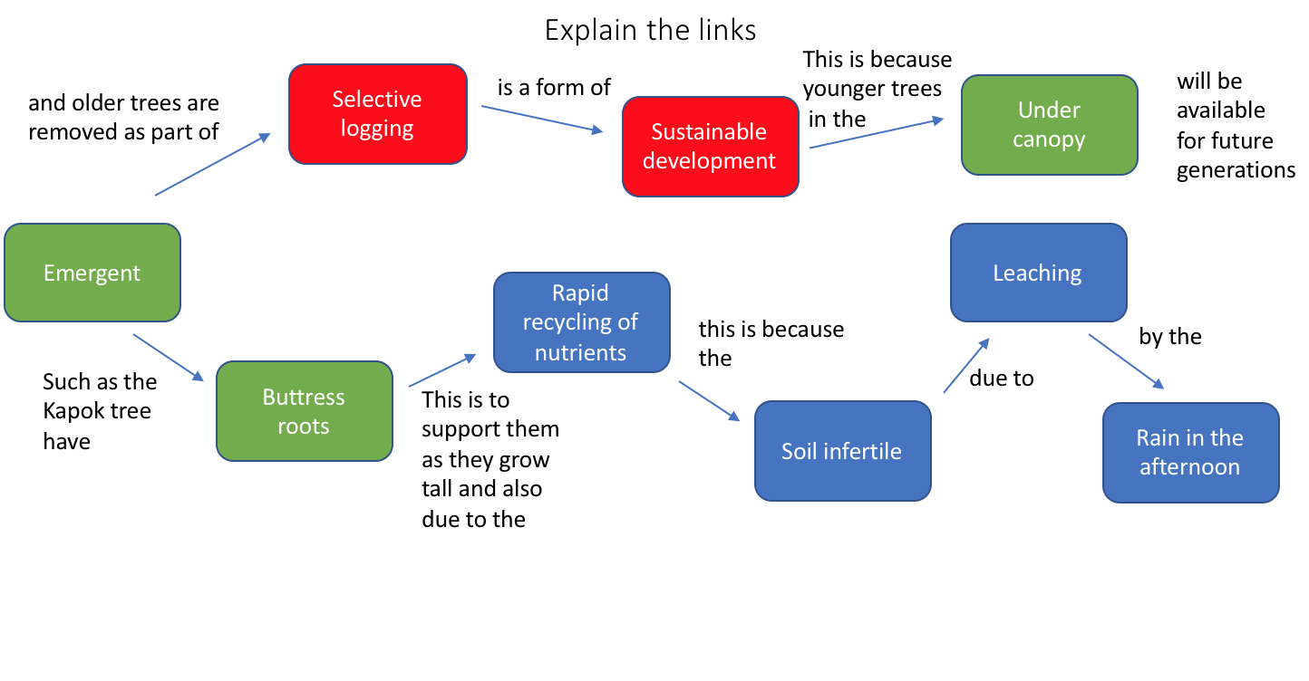
1.
2.
3.

